Slide 1
Exchange-correlation functionals and corrections in QE
제 7회 전자구조계산 여름학교
Intro to Tutorial

Slide 2
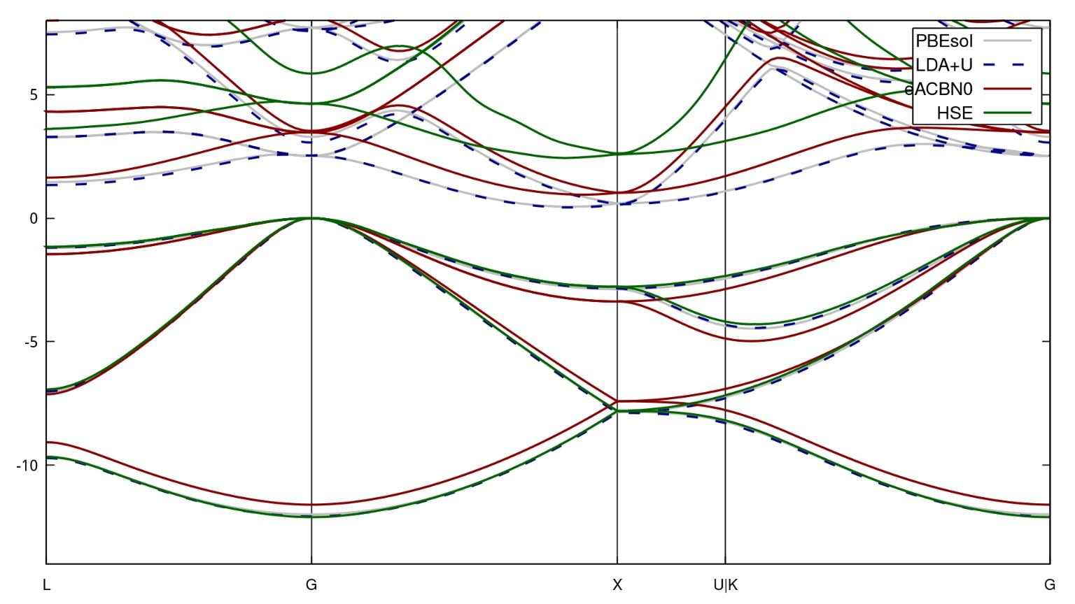
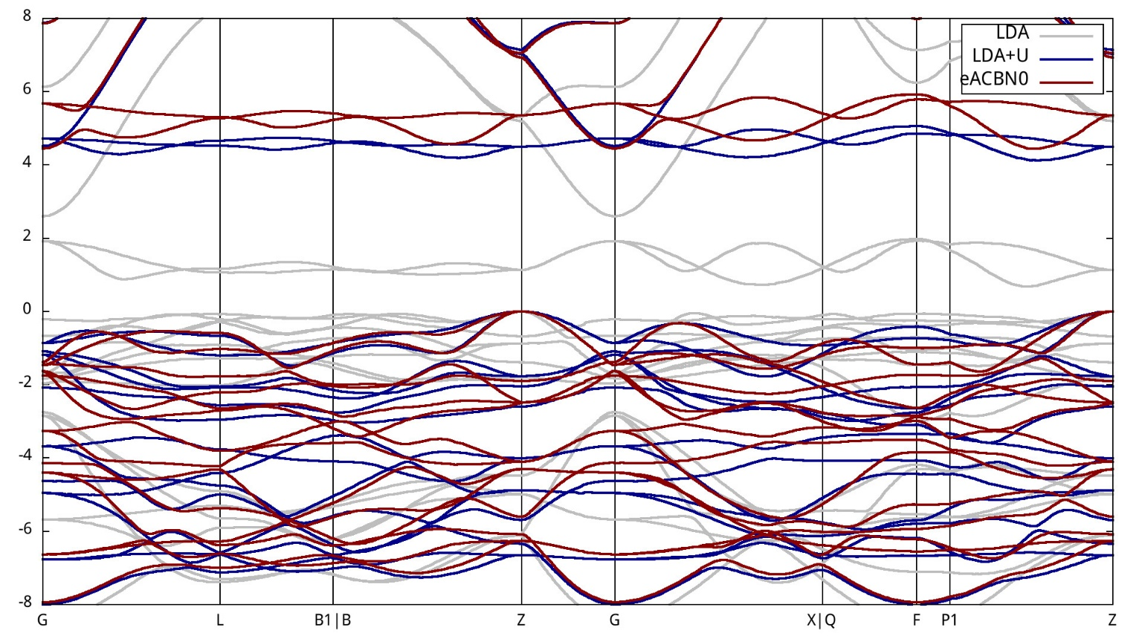
Goal
2
Explore different XC functionals (LDA/GGA)
and advanced corrections (DFT+U and Hybrid functionals).
Silicon
NiO

Slide 3
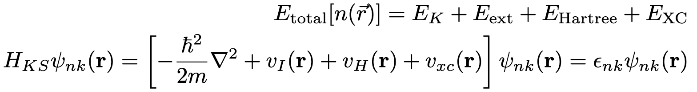
Recap: Inaccuracy of Density functional theory
3
Total energy:
Exact form is unknown.
A single particle Kohn-Sham equations:
Approximate functionals for XC such as LDA or GGA are fast but makes self-interaction error.
[1] P. Hoenberg, et al., Phys. Rev. 136, B864 (1964)
[2] W. Kohn, et al., Phys. Rev. 140, A1133 (1965)
Notes:
DFT has proven its effectiveness in diverse area. However, since the exact from of exchange-correlation functional is unknown, approximate functionals like LDA or GGA can introduce self-interaction error.

Slide 4
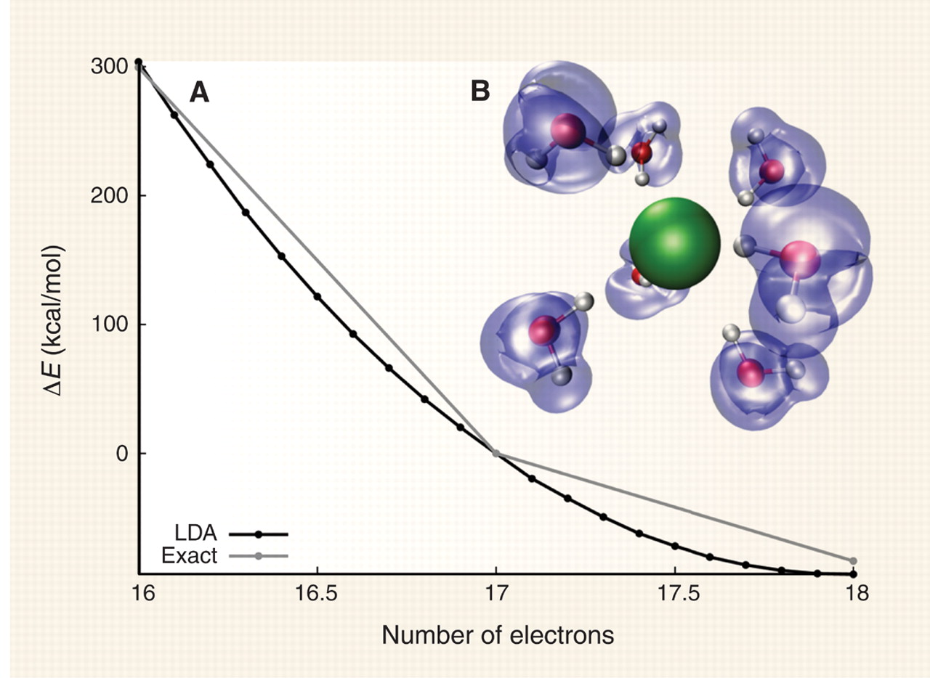
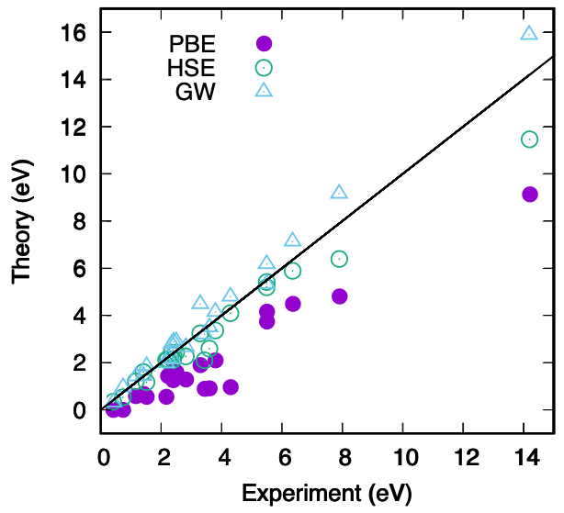
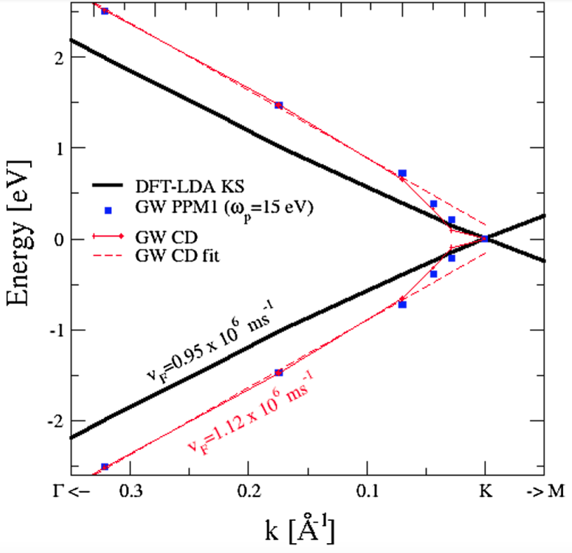
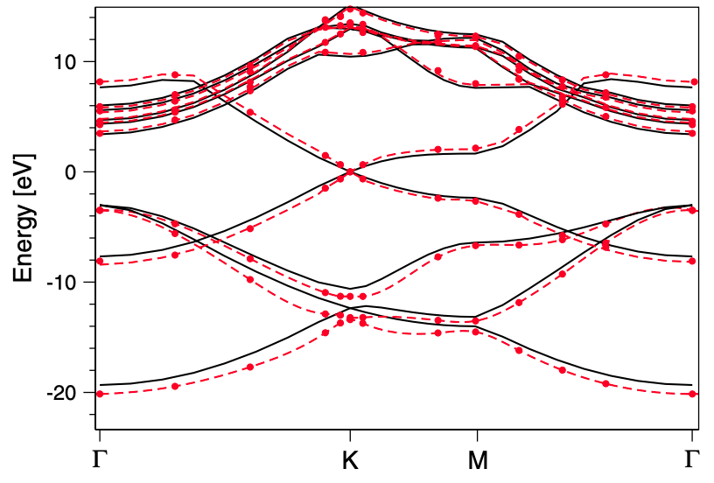
Recap: Quantitative errors in DFT-LDA and DFT-GGA
4
Chlorine atom
Monolayer graphene
PBE
HSE
GW
PBE
HSE
GW
Delocalization error
Bandgap underestimation
Inaccurate Fermi velocity
[1] A. J. Cohen, et al., Science 321, 792 (2008)
[2] S.-H. Lee, et al., Phys. Rev. Research 2, 043410 (2020)
[3] P. E. Trevisanutto, et al., Phys. Rev. Lett. 101, 226405 (2008)
Notes:
In terms of quantitiative errors, it is linked to delocalization issues, bandgap underestimation, and inaccuracies in Fermi velocity.

Slide 5
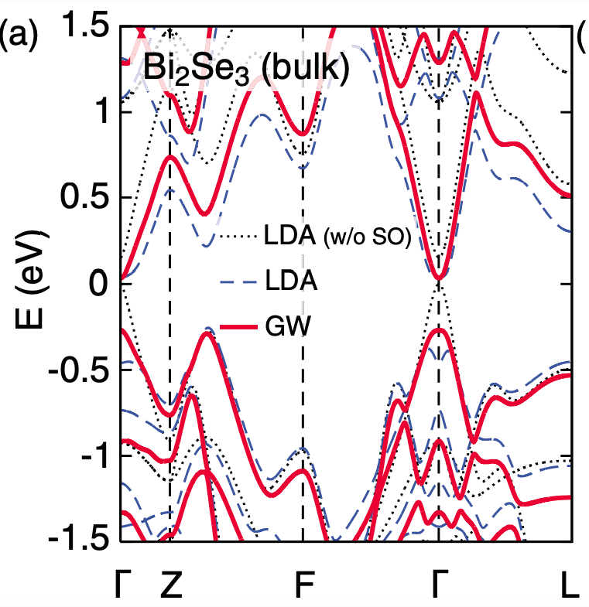
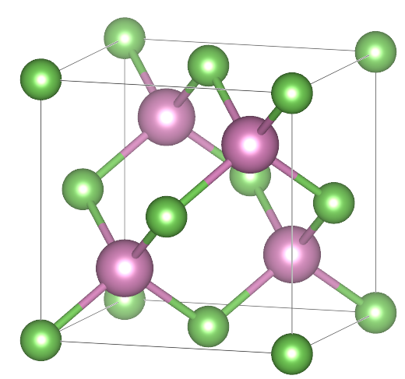
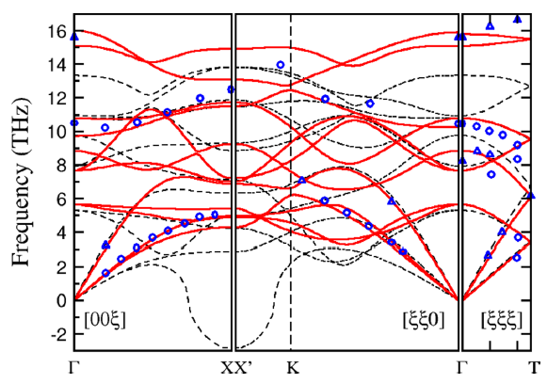
Recap: Qualitative errors in DFT-LDA and DFT-GGA
5
Indium arsenide
Cobalt oxide
Bismuth selenide
GGA
DFT+U
As
In
GGA: topological insulator
Expt.: normal insulator
Dynamically unstable in GGA
LDA: indirect band gap
GW: direct band gap
[1] J. Vidal, et al., Phys. Rev. B 84, 041109 (2011)
[2] A, Floris, et al., Phys. Rev. B 101, 064305 (2020)
[3] O. V. Yazyev, et al., Phys. Rev. B 85, 161101(R) (2012)
Notes:
In terms of qualitative errors, it can lead to misclassifying topological phases, inaccurately predicting dynamical unstability, and distorting band gap shape.

Slide 6
Various method for correction
6
Approximate functionals for XC such as LDA or GGA are fast but makes self-interaction error.
Self-energy correction through GW approximation
Dynamical mean-field theory + DFT
Hybrid functional
Local self-interaction error correction through DFT+U
and many others…
Notes:
Already, there are many methods to overcome this issue. Like self-energy correction through GW approximation, Dynamical mean-field theory+DFT, Hybrid functional or Local self-interaction error correction through DFT+U and many others.

Slide 7
Various method for correction
6
Approximate functionals for XC such as LDA or GGA are fast but makes self-interaction error.
Self-energy correction through GW approximation
Beyond the one-body treatment
Dynamical mean-field theory + DFT
Hybrid functional
Today’s scope.
Local self-interaction error correction through DFT+U
and many others…
Notes:
Already, there are many methods to overcome this issue. Like self-energy correction through GW approximation, Dynamical mean-field theory+DFT, Hybrid functional or Local self-interaction error correction through DFT+U and many others.

Slide 8
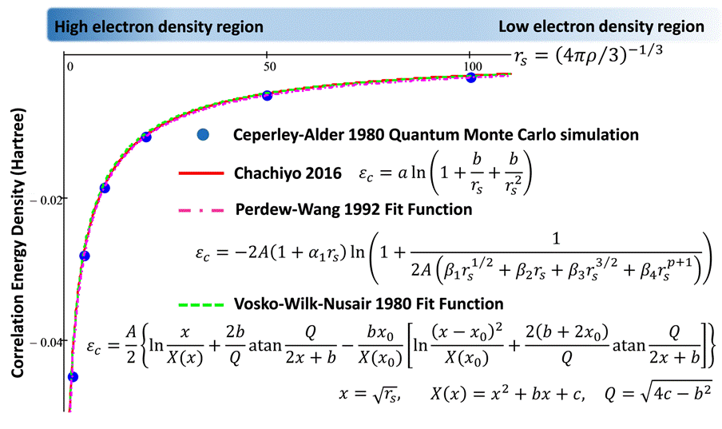
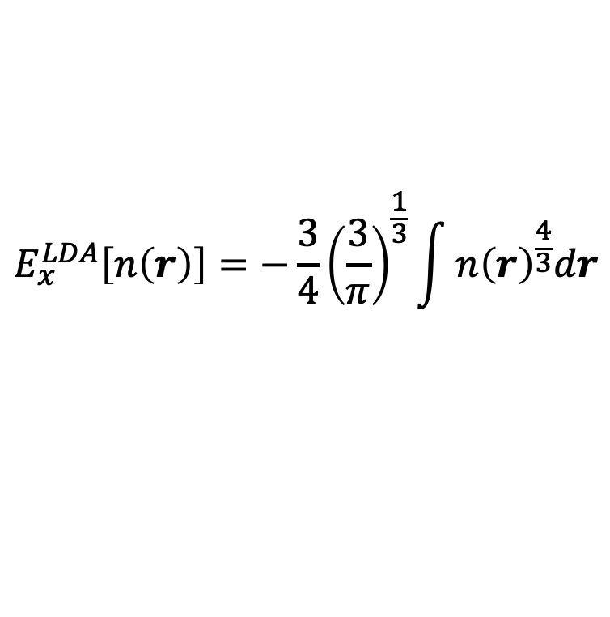
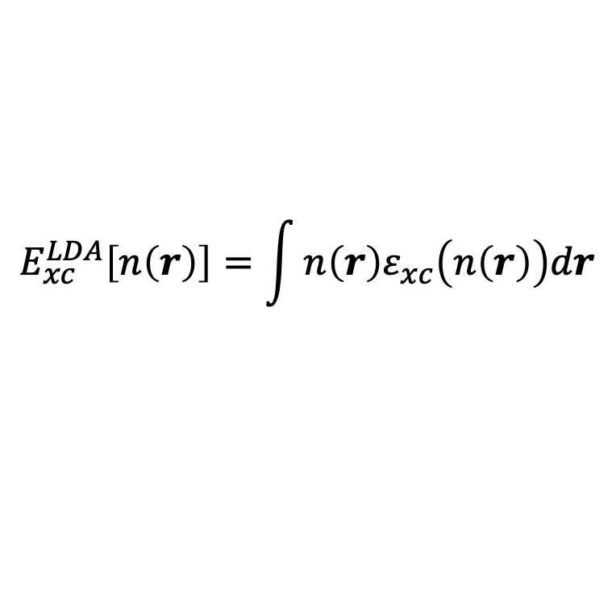
Local Density Approximation (LDA)
7
Derived from the homogeneous electron gas (HEG) model.
The XC energy is calculated purely based on the local density $n(r)$ at each point.
$$E_{xc}^{LDA}\left[n\left(r\right)\right]=\int{n\left(r\right)ε_{xc}\left(n\left(r\right)\right)dr}$$
$$E_{x}^{LDA}\left[n\left(r\right)\right]=−\frac{3}{4}{\left(\frac{3}{π}\right)}^{\frac{1}{3}}\int{n{\left(r\right)}^{\frac{4}{3}}dr}$$

Slide 9
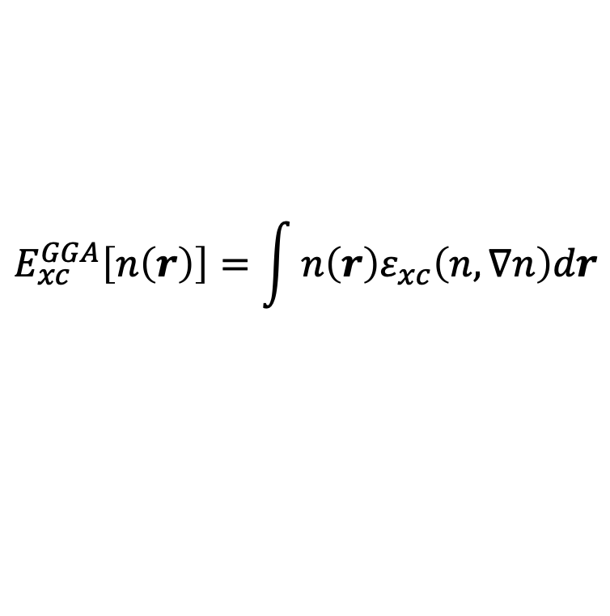
Generalized Grandient Approximation (GGA)
8
An improvement over LDA. Considering $n(r)$ and its gradient $∇n(r)$. (Semi-local)
$$E_{xc}^{GGA}\left[n\left(r\right)\right]=\int{n\left(r\right)ε_{xc}\left(n,∇n\right)dr}$$

Slide 10
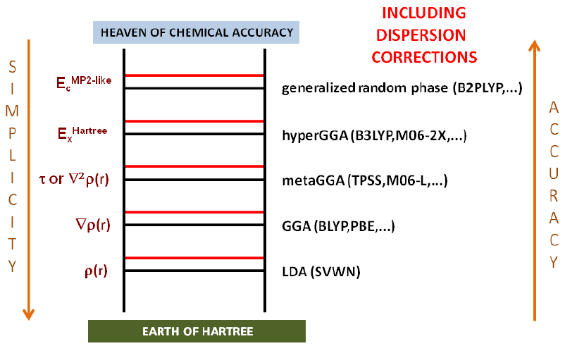
Generalized Grandient Approximation (GGA)
8
An improvement over LDA. Considering $n(r)$ and its gradient $∇n(r)$. (Semi-local)
$$E_{xc}^{GGA}\left[n\left(r\right)\right]=\int{n\left(r\right)ε_{xc}\left(n,∇n\right)dr}$$
Beyond the GGA

Slide 11
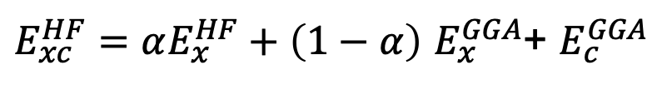

Hybrid functional
9
The exchange component consists of a mixing of GGA and Hartree-Fock exchange:
Unscreened hybrid functionals
$E_{xc}^{HF}=αE_{x}^{HF}+\left(1−α\right)$ $E_{x}^{GGA}$+ $E_{c}^{GGA}$
Range-separated hybrid functionals
$E_{xc}^{HF}=αE_{x}^{HF,SR}(μ)+\left(1−α\right)$ $E_{x}^{GGA,SR}(μ)$+$E_{x}^{GGA,LR}(μ)+E_{c}^{GGA}$
$E_{xc}^{HSE}=\frac{1}{4}E_{x}^{HF,SR}(μ)+\frac{3}{4}E_{x}^{PBE,SR}(μ)$+$E_{x}^{PBE,LR}(μ)+E_{c}^{PBE}$
HSE06: $μ=0.2 Å^{−1}$

Slide 12
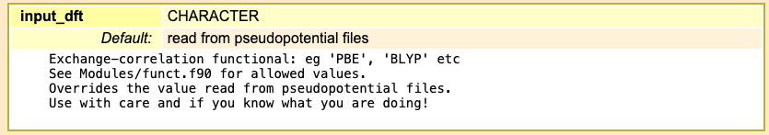
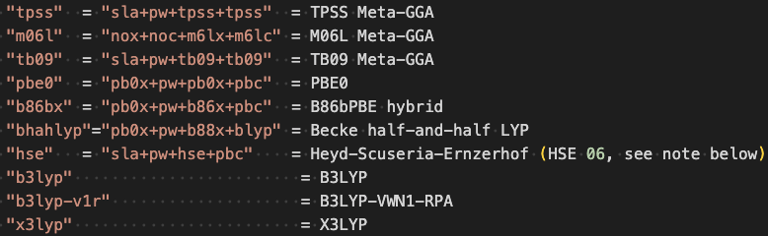
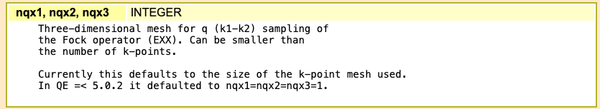
Hybrid functional related input variables
10

Slide 13
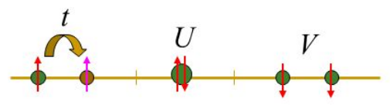
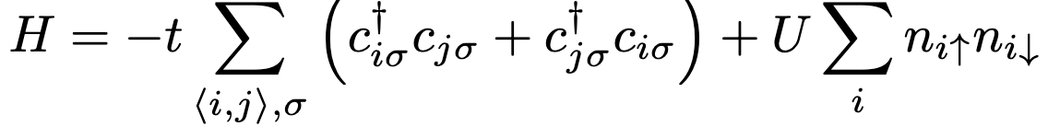
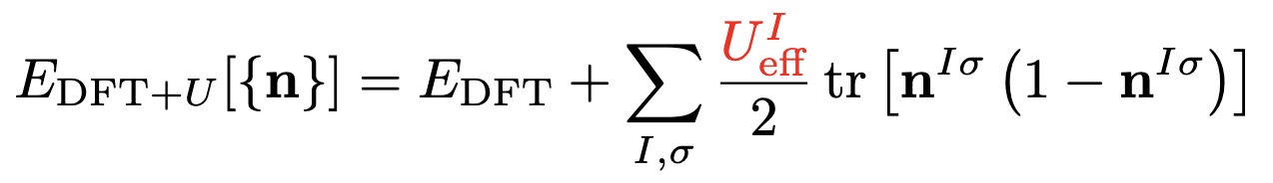
DFT+U
11
Original Hubbard Hamiltonian:
On-site U correction:
Empirical to fit experiments
Linear response theory [M. Cococcioni, et al., Phys Rev B 71, 035105 (2005)]
Constraint random phase approximation [F. Aryasetiawan, et al., Phys Rev B 70, 195104 (2004)]
Hartree-Fock-based formalism [L. A. Agapito, et al., Phys. Rev. X 5, 011006 (2015)]
Notes:
DFT+U corrections are originally motivated by Hubbard Hamiltonian and the correction magntidue depends on the Hubbard paramter, U.
However, choosing a proper U value for each calculation poses a challenge.
Historically, empirical value were used to match experimental data, but more recently, several self-consistent schemes have been proposed such as linear response theory, c-RPA, and direct Hartree-Fock-based methods and so on.
In this talk, we focus on a self-consistently determined Hubbard correction using Hartree-Fock-based formalism that includs inter-site interactions and achieves hybrid functional or near GW-level accuracy at a significantly lower computational cost.

Slide 14
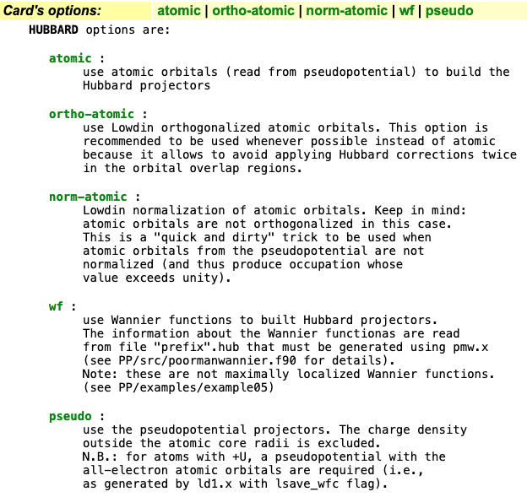
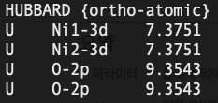
DFT+U related input variables in official QE
12
Within input file,
Parameter value
Atom species-Manifold

Slide 15
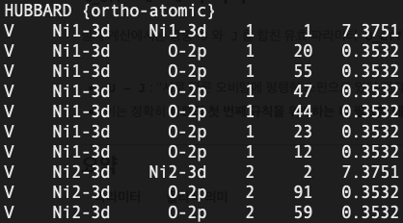
DFT+U(+V) related input variables in official QE
12
Within input file,
Parameter value
Atom species-Manifold

Slide 16
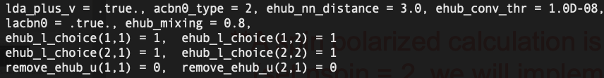
DFT+U(+V) related input variables for eACBN0
13
1. lda_plus_v = .true. (default: .false.)
Specify ‘lda_plus_v = .true.’ to enable DFT+U+V calculaitons
2. acbn0_type = 2 (default: 1)
1: original ACBN0 (for U only), 2: extended ACBN0 (for U and V)
3. ehub_nn_distance = 2.4 (default: 3.0 angstrom)
Specify a cut-off inter-atomic disance d_{IJ} defined in our paper.
(S. Lee and Y-W. Son, Phys. Rev. Res. 2, 043410 (2020))
4. ehub_conv_thr = 1.0D-8 (default: 1.0D-8)
Convergence threshold on Hubbard energy U & V (a.u) for ACBN0 calculation.

Slide 17
DFT+U(+V) related input variables for eACBN0
14
5.lacbn0 = .true. (default: .false.)
Specify ‘lacbn0 = .true.’ to calculate eACBN0 energy for self-consistent Hubbard parameters.
6. ehub_mixing = 0.8 (default: 0.7)
We use a simple linear mixing. [U_{new} = (1 – ehub_mixing)*ΔU + U_{old}]
7. ehub_l_choice(a,b) = 1 (default: 0)
a: a type of atom in atomic species card
b: orbital index (1: s orbital, 2: p orbital, 3: d orbital, f-orbital is not available yet.)
Set “ehub_l_choice(a,b) = 1”: DFT+U+V calculation for the b orbital of and atom with type a.
8. remove_ehub_u(a,b) = 0, (default: 1)
Set “remove_ehub_u(a,b) = 0” : U for the b orbital of an atom with type a is forced to 0.

Slide 18
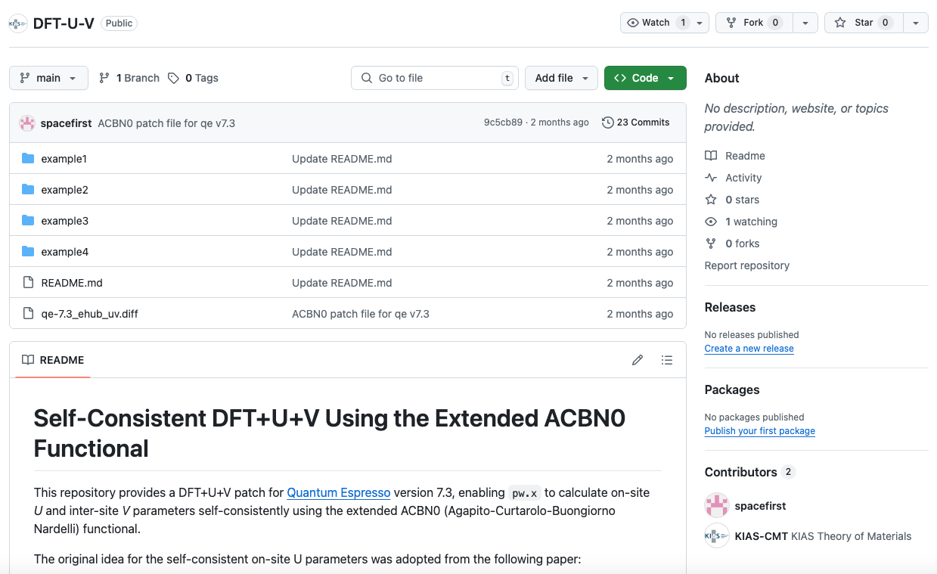

Code availability for eACBN0
Patch file is accessible via github (https://github.com/KIAS-CMT/DFT-U-V).
QR Code

