Slide 1

Prediction crime
<2021 Business Analytics Team project>
Team 6

Slide 2
Table
Data source
Merge and data preprocessing
Select Variable
Hypothesis
Make Model and Evaluation

Slide 3
Data source

Slide 4
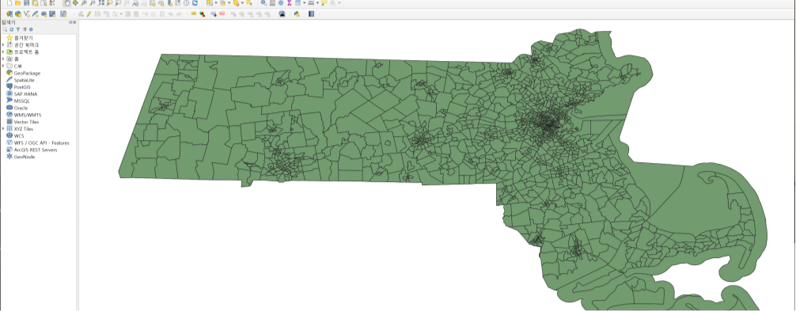
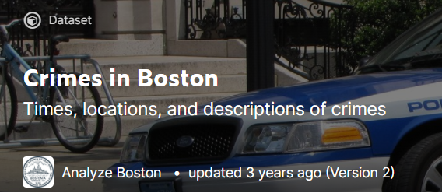

Data source
Crime data (crime data in Boston) from Kaggle
Shooting data (shooting crime data in Boston) from Official Boston Dataset site
Weather data (weather data in Boston) from Kaggle
BFD data (firearm recovery count in Boston) from Kaggle
Census data (USA District population data) using QGIS program with official census site
> QSIS program
> Dataset from Kaggle
> Official Boston dataset site

Slide 5
2. Merge and data preprocessing

Slide 6
2. Merge and data preprocessing
Merge all data
Weather data
Merge with
Date column
Shooting data
Crime data
BFD data
Merge with
Date column
Merge with
Date column
Merge with
GEOID code
Using QGIS program and shapely
Census data

Slide 7
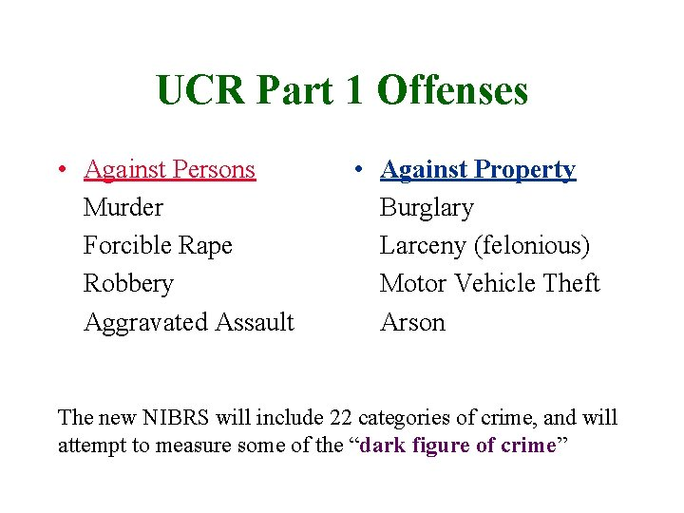
2. Merge and data preprocessing
Data Preprocessing
Delete all unnecessary column and remove Nan data
Unnecessary column : ID, regional data(we only use GEOID), crime description(we only use UCR_PART)
Make target column
We predict UCR_PART1 crime in Boston
We add target column ‘final count’ that count in same GEOID and in same date.

Slide 8

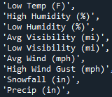

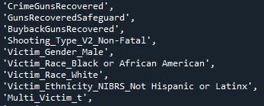
2. Merge and data preprocessing
Merged dataset
Time column
Weather column
Census column
BPD column
Shooting crime data
Target data
Each column means population according to race(Color, White, Hispanic …)

Slide 9
2. Merge and data preprocessing
Data preprocessing
P0020005 : white race
Color_race column : make new crime column by summing all color
-> our hypothesis is comparing crime rate between color people and white.
Therefore we make new column

Slide 10
3. Select Variable

Slide 11
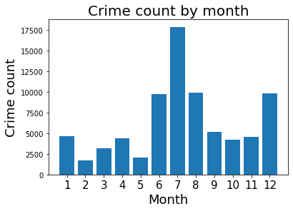
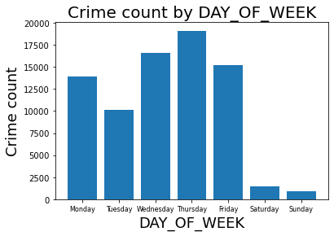
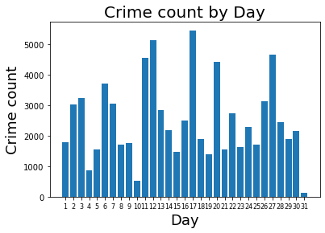
3. Select Variable
Time column
We delete ‘YEAR’ column because there are only 3 attribute 2016,2017 and 2018. Therefore, it is not meaningful that making dummy
You can see that there is more crime in summer and there is less crime in Saturday and Sunday
In Day column, It is difficult to find any pattern, so I will not use Day

Slide 12
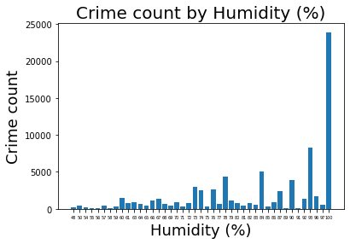
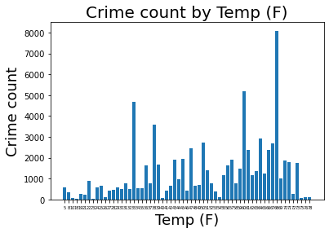
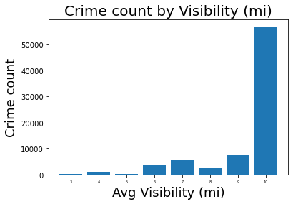
3. Select Variable
Weather column
If Humidity is high, crime count is increasing
Overall trend of temperature is that if high, more crime occur
Visibility is also important to crime occur

Slide 13
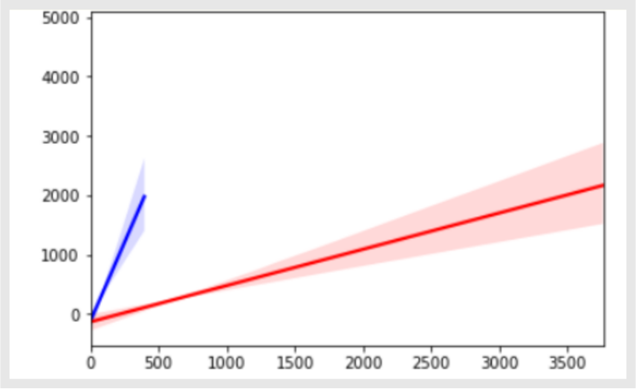
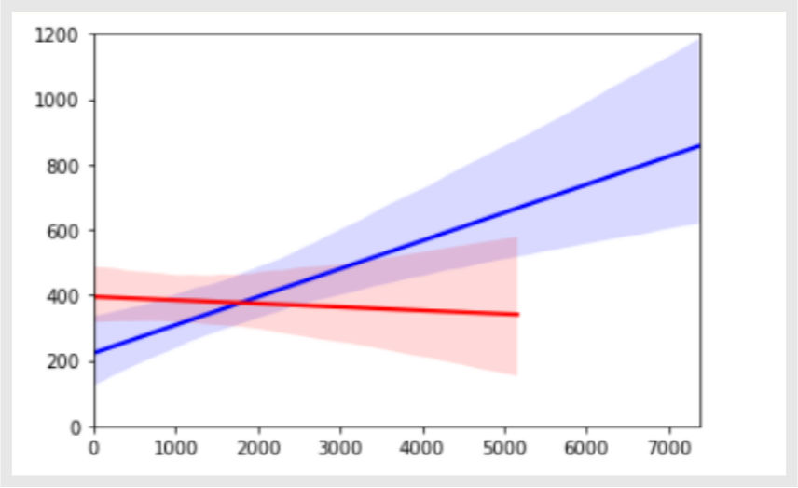
3. Select Variable
Census column
X-axis is number of victim, Y-axis is count part_1 blue line represent white people, red line represent color people.
The more victim of color occurred the more crime occurred. And white is same trend but the victim is much smaller than color
X-axis is number of people, Y-axis is count part_1, blue line represent white, red line represent color.
As we can see the more color people the more crime occurred, in contrast the more white people the less crime occurred.

Slide 14

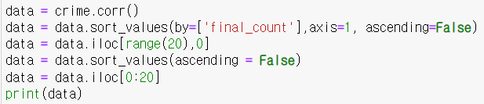
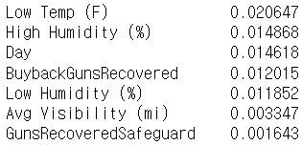
3. Select Variable
Correlation
…
The Shooting column is having most correlation with our target column

Slide 15
4. Hypothesis

Slide 16
4. Hypothesis
Since there is some racism in the United States, there will be many violent crimes against people of color.
Also according to EDA, Crime rates occur a lot in the summer season when the temperature is high and humidity is high.

Slide 17
5. Make Model and Evaluation

Slide 18
5. Make Model and Evaluation
Train set
VS
Test set
<The year before 2017>
<The year after 2017>
<2017
2017<
trainX
trainY
testX
testY
[‘final_count']
[‘final_count']

Slide 19



Model result
Decision tree
Random forest
KNN

Slide 20
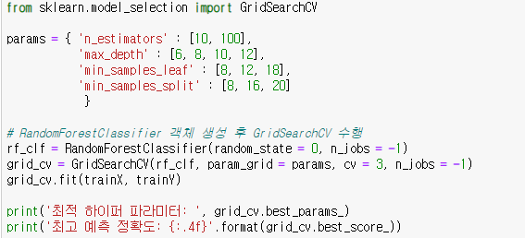
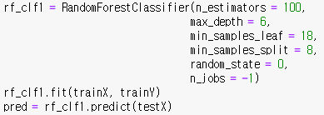
Set Random forest hyperparameter
Increasing accuracy
Using GridSearchCV, we can find best hyperparameter to use RandomForestClassifier

Slide 21
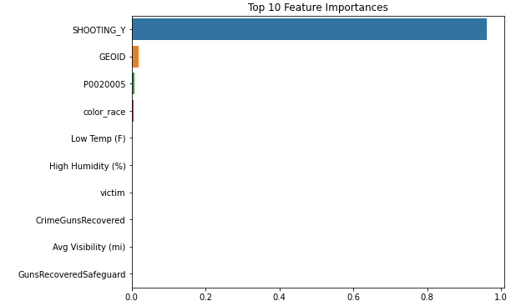
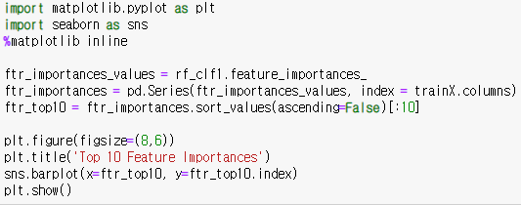
Feature importance
You can see that Shooting is the important features in model

Slide 22
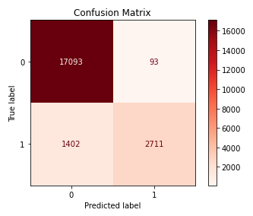
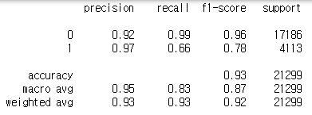
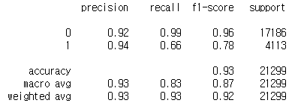
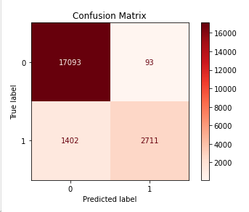
Precision, recall, f1-score, confusion Matrix
Decision tree
Random forest
The result of decision tree and random forest is same

Slide 23
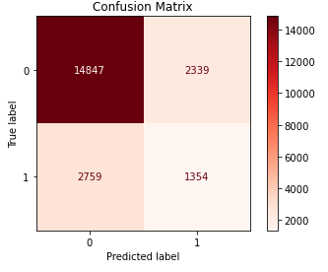
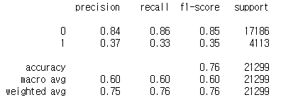
Precision, recall, f1-score, confusion Matrix
KNN
For predicting crime, using decision tree is more better than KNN

Slide 24
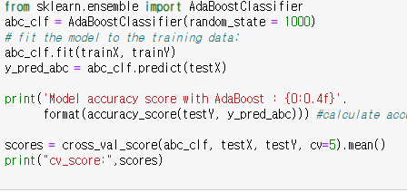
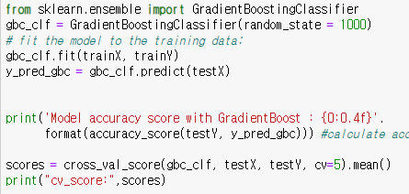


Upgrade performance
AdaBoost, Gradient Boosting
There can be data imbalancing. Therefore we use AdaBoost to make best sampling
Also we use Gradient boosting to make better decision tree model
We can find that there is not dramatic increasing of performance

Slide 25
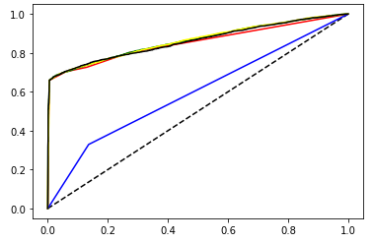

Roc_curve, roc_auc_score
Roc_curve, roc_auc_score
KNN roc_auc_score is blue.
In predicting crime, all model related to decision tree show good performance
Among them, the AdaBoost shows best performance in roc_curve

Slide 26
Thank you for listening!

