Slide 2
k1
k2
k3
k4
k5
..
param1
param2
param3
param4
param5
..
1.Log Key Anomaly Detection model
Anomaly?
no
Web log file
yes
t1 : log entry1
t2 : log entry2
t3 : log entry3
t4 : log entry4
t5 : log entry5
t6 : log entry6
…..
Log
Parser
Person
2.Log Parameter Anomaly Detection model
yes
Anomaly?
Log key
Request
(Encoding)
Log Parameter
time difference
between the current log
and previous log
no
Robot

Slide 3
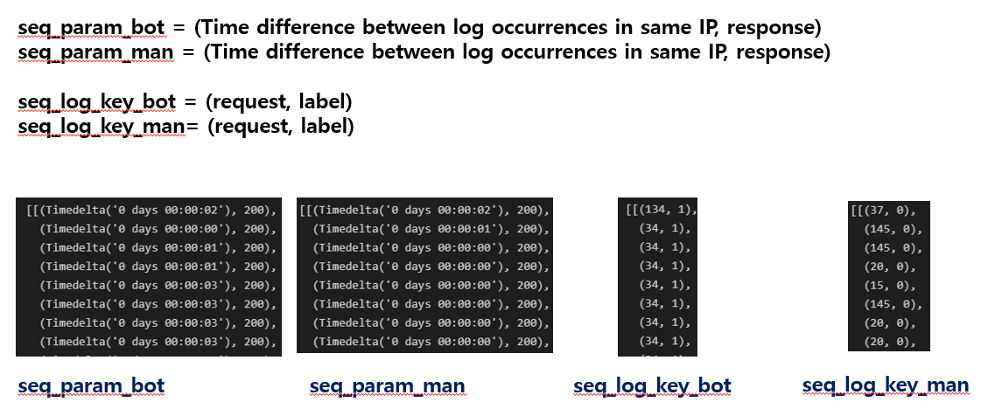
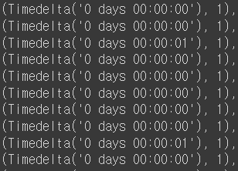
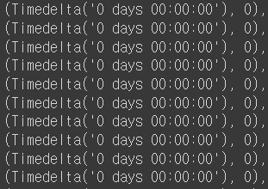
(Time difference between log occurrences in same IP, label)
(Time difference between log occurrences in same IP, label)

Slide 4
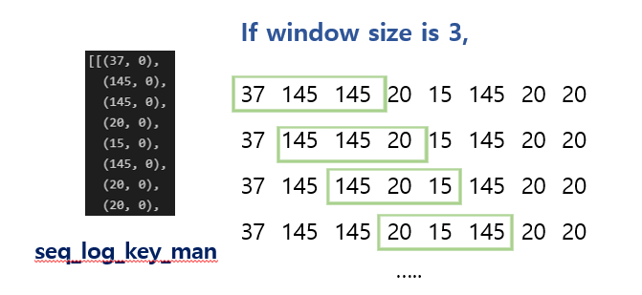
If window size is 3, next log is predicted

Slide 5
Bot IP
Parameters
0.8 : train
0.2 : test
66.249.34457
t1, t2, t3
t(n-2), t(n-3)
0.8 : train
0.2 : test
202.180.35500
t1, t2, t3
t(n-2), t(n-3)
0.8 : train
0.2 : test
87.202.48402
t1, t2, t3
t(n-2), t(n-3)
0.8 : train
0.2 : test
123.8473.12342
t1, t2, t3
t(n-2), t(n-3)

Slide 6
Soft-max result (Parameter – time difference between logs)
Class | Class1 | Class2 | Class3 | Class4 | class5
Value of Soft-max | 0.1 | 0.16 | 0.14 | 0.2 | 0.4
For example,
Class1 : (0~9 seconds)
Class2 : (10~19 seconds)
Class3 : (20~29 seconds)
Class4 : (30~39 seconds)
Class5 : (40~49 seconds)
If candidate is 3,
The top3 value of soft-max classes are candidate
(class5, class4, class2)
If next prediction is in candidates, ‘Correct’ += 1
If next prediction is not in candidates, ‘Human_count’ += 1

Slide 7
Soft-max result (Key – request)
1.Log Key Anomaly Detection model
Class | Class1 | Class2 | Class3 | Class4 | class5
Value of Soft-max | 0.1 | 0.16 | 0.14 | 0.2 | 0.4
Soft-max result (Parameter – time difference between logs)
2.Log Parameter Anomaly Detection model
Class | Class1 | Class2 | Class3 | Class4 | class5
Value of Soft-max | 0.1 | 0.16 | 0.14 | 0.2 | 0.4

Slide 8
Windows size = 3, candidate = 3
input
output
66.249.34457
key
34, 27, 1, 3 …. 5, 3, 19
parameter
t1, t2, t3, t4, …. t5, t6, t7
Class = unique number of request
1
With softmax result and candidate number, access whether it is bot or human
Class | Class1(34) | Class2(27) | Class3(27) | Class4(3) | …
Value of Soft-max | 0.1 | 0.16 | 0.14 | 0.2 | …
Human_count += 1
If output class is not in candidate class
(It is human)
If output class is in candidate class
(recheck whether it is bot or not)
Class = 30(300 seconds/ 10 seconds)
2
With softmax result and candidate number, access whether it is bot or human
Class | Class1(0-9) | Class2(10-19) | Class3(20-29) | Class4(21-30) | …
Value of Soft-max | 0.1 | 0.16 | 0.14 | 0.2 | …
Human_count += 1
If output class is in candidate class (it is bot)
If output class is not in candidate class
(It is human)
Correct += 1

