Slide 1
Image Classification Web Application
By: Yee Hang
Objective : User should learn about Convolutional Neural Networks by interacting with the UI

Slide 2
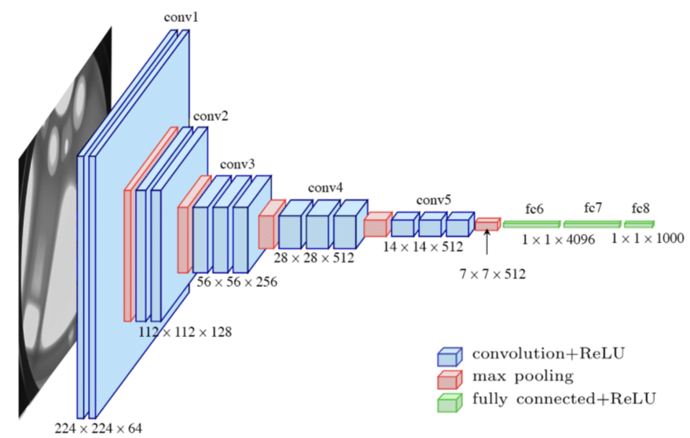
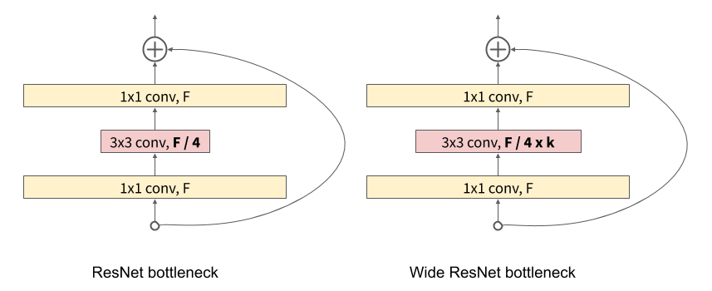
Model Info
Modified VGG:
A scaled down version of VGG with only 8 Convolutional layers with max pooling and dropout in between them, so that inference is faster, especially when hosted in cloud.
Wide ResNet:
Contains skip connection in Wide ResNet blocks with larger architecture
Contains 28 convolution layers,and 10 times number of filters as default ResNet
Generally more accurate but slower inference times
Wide ResNet
VGG

Slide 3
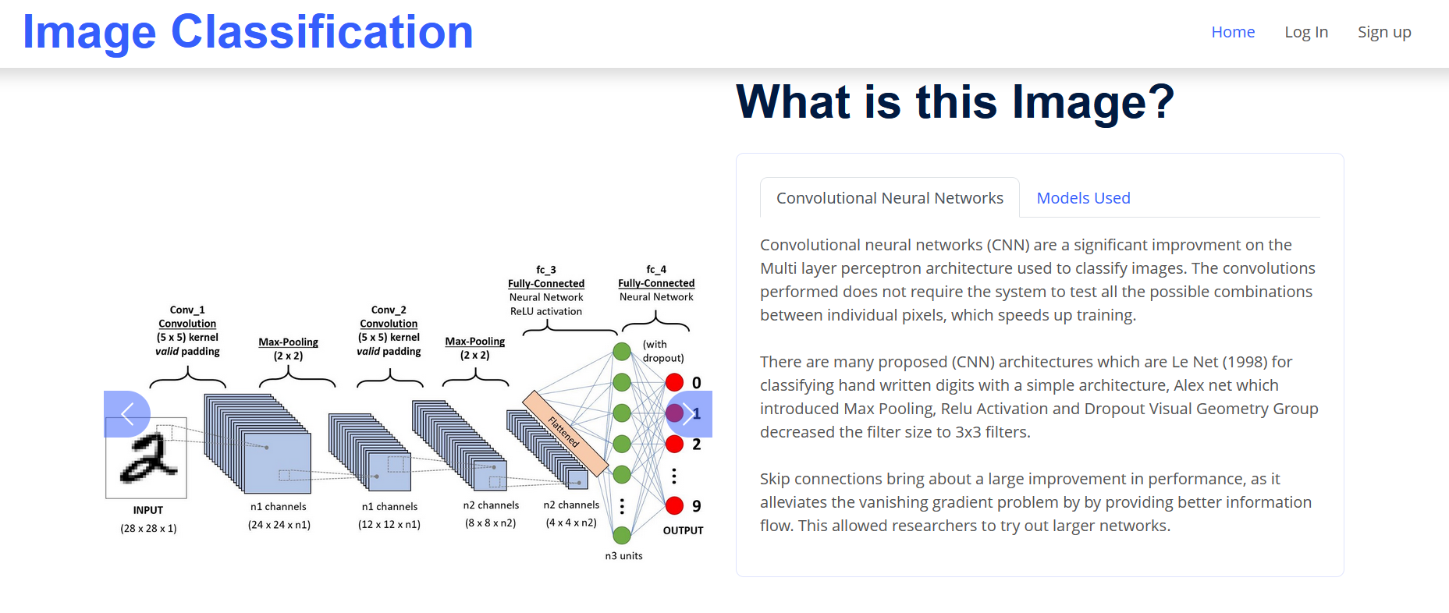
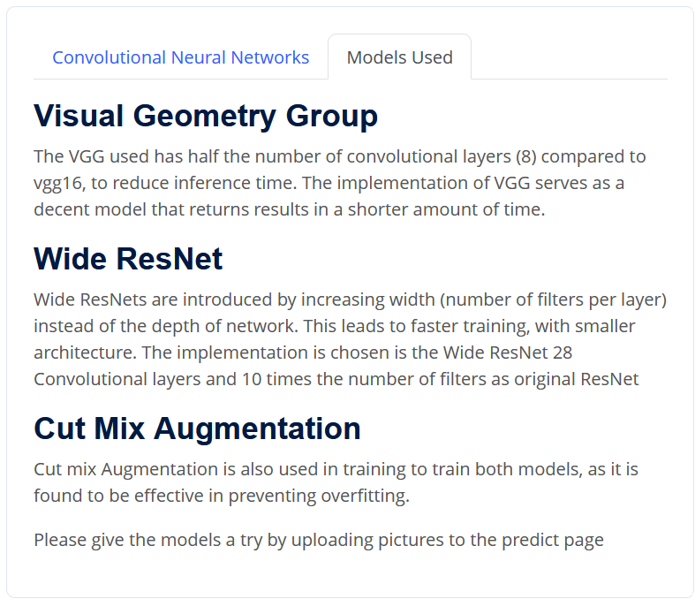
Application – Front end - Homepage
Give the users some background into image classification with convolutional neural networks
This page explains how the networks work and how they produce a classification
Notes:
PCA generates new features that are orthogonal to each other , and not correlated with each other

Slide 4
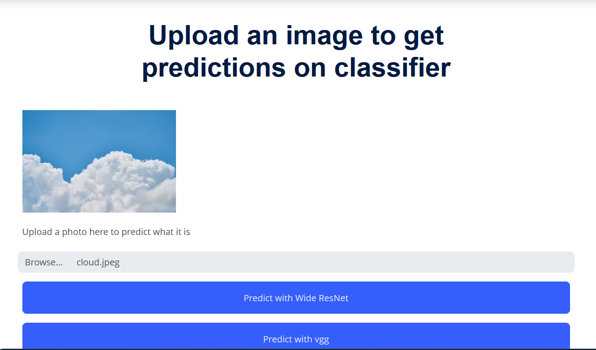
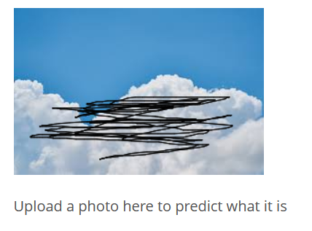
Application – Prediction Page
Allow user to upload a photo and display the photo to the user as html canvas
Allow user to corrupt the picture by adding black lines to obstruct the picture and compare the results of predictions with and without augmentation
Augmenting Pictures
Notes:
PCA generates new features that are orthogonal to each other , and not correlated with each other

Slide 5
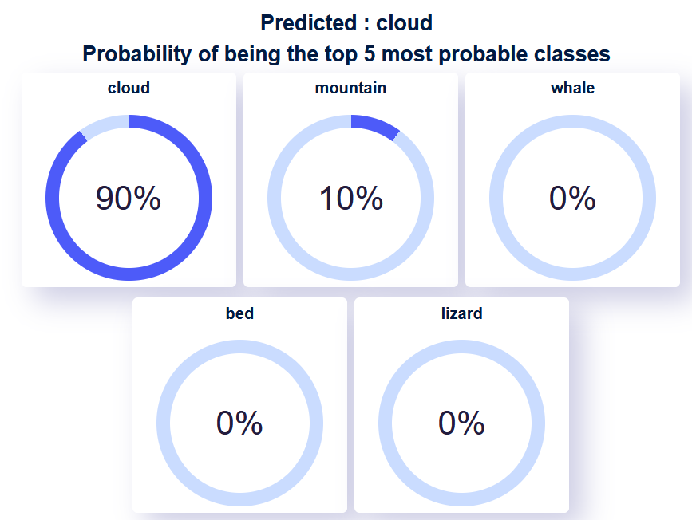
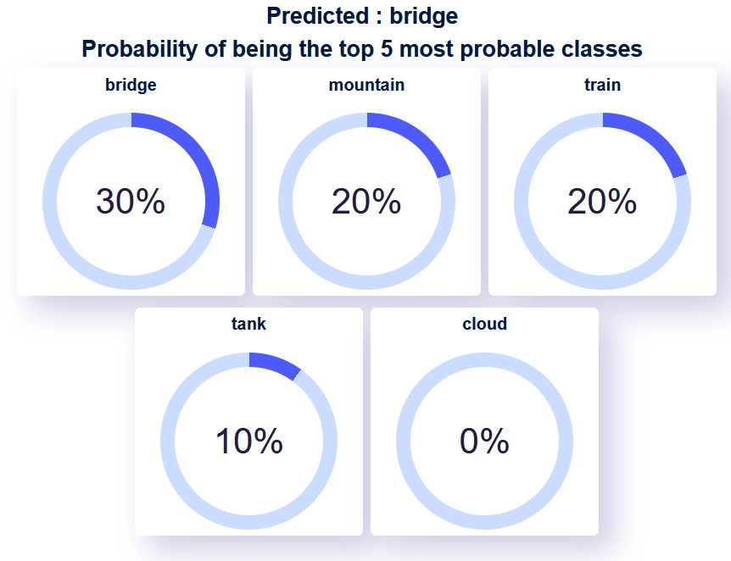
Application – Prediction Results Page
The prediction results will appear below the page, once result returned from server
Prediction probabilities of the top 5 most probable classes are also returned , so the user know how “confident” the model is about the classification
Prediction of an image with corruption makes the model less confident about its predictions
Non corrupted data is 90% confident and gives correct prediction, the corrupted data gives 30% and the wrong class (bridge)
Prediction without augmentation
Prediction with augmentation
Notes:
PCA generates new features that are orthogonal to each other , and not correlated with each other

Slide 6
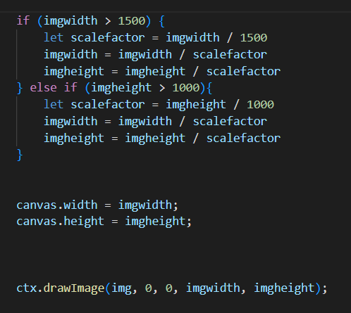

Application – Prediction Image downsampling
In the front end, Images with width larger than 1500 pixels or height larger then 1000 pixels, is rescaled to 1500 pixel width or 1000 pixel height, (To decrease image size and speed up post request to server)
Algorithm retains aspect ratio and prevent distorting
Compress the image with image quality argument of ‘canvas.toDataURL’ with 0.6
Image is not resized directly to 32 x 32 as the resizing algorithm depends on the browser and might lead to inconsistent predictions on different browsers
Decrease the dimension of image in Javascript
Compress the image with image quality argument of
Notes:
PCA generates new features that are orthogonal to each other , and not correlated with each other

Slide 7
Application – Prediction Image downsampling
The image are downsampled to 32x32 size using the resize method of PIL.Image.
It is then sharped using the ImageEnhance.Sharpness function
Image is HTTP POSTED to the tensorflow serving for classification
Image is read in and sharpened, using Pil.ImageEnchance.Sharpness
Notes:
PCA generates new features that are orthogonal to each other , and not correlated with each other

Slide 8
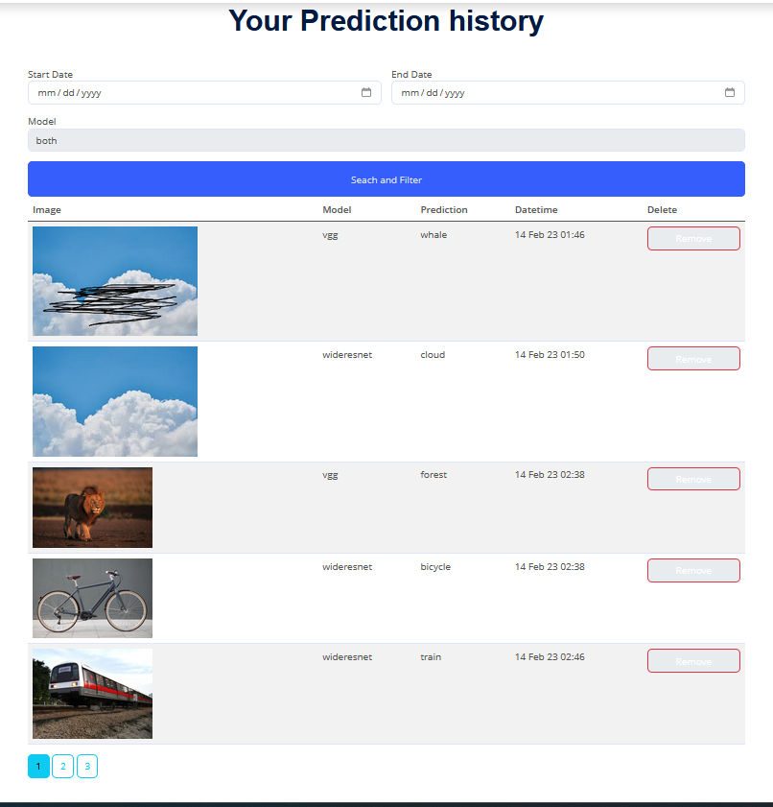
Application – Prediction History Page
Provide the image, model used, the predicted class and the date and time the prediction is done on
Pagination added for easier navigation, prevent excessive scrolling
Option to filter by start date ,end date and by model
Notes:
PCA generates new features that are orthogonal to each other , and not correlated with each other

Slide 9
Application – Testing
Expected fail test, test inserting invalid input
Consistency testing, whether model return same result every time same images given
Validity testing – test validity of data
Range testing, different ranges of inputs are given
Notes:
PCA generates new features that are orthogonal to each other , and not correlated with each other

Slide 10
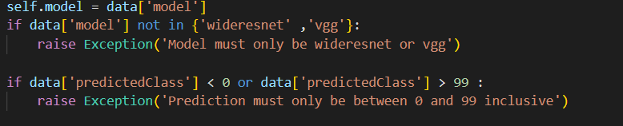
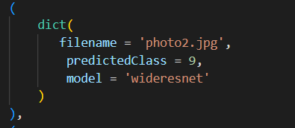
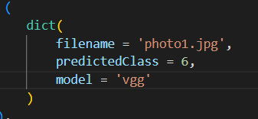
Application – Validity Testing
To test the validity of the inputs and ensure only string ‘vgg’ and ‘wideresnet’ inserted into the model column of database
Ensure no values less than 0 or larger than 99 inserted for predicted class as there are 100 classes in dataset.
Check the range of the data before data inserted into database
Expected Pass Cases, all values are valid
Notes:
I used validity testing to test the allowed range of values of values of the previous to be inputted
The test cases on the right shows the correct values which are expected pass cases, with all the values within the acceptable range

Slide 11
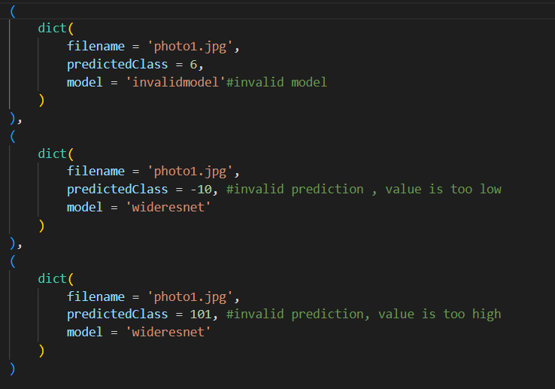
Application – Expected Failure Testing – invalid data
Expected fail cases
Where the model name is invalid or the classes inserted are invalid
Notes:
Expected fail cases where these variables given by user, is larger than the maximum allowed value,

Slide 12
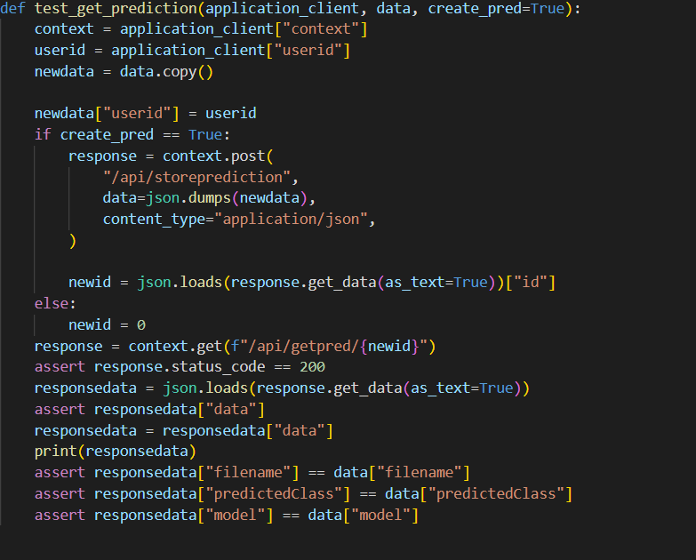
Application – validity testing- insert data and retrieving the data
Insert a prediction into database and retrieving the results back (expected pass)
Not inserting anything in database and attempt to retrieve results back (expected fail)
When create_pred is True, data is inserted,
When create_pred is False, data is not inserted before retrieving
Notes:
Expected fail cases where these variables given by user, is larger than the maximum allowed value,

Slide 13
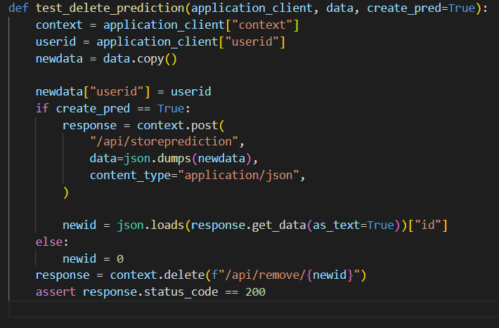
Application – validity testing – inserting data and deleting the data
Insert a prediction into database and deleting the row data (expected pass)
Not inserting anything in database and attempt to delete the data (expected fail)
When create_pred is True, data is inserted,
When create_pred is False, data is not inserted before retrieving
Notes:
Expected fail cases where these variables given by user, is larger than the maximum allowed value,

Slide 14
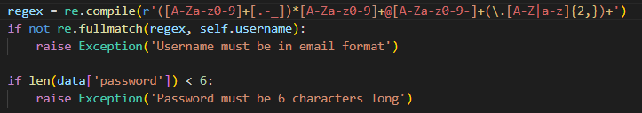
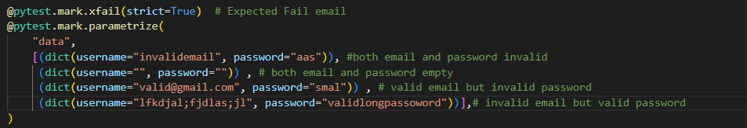
Application – User Validation - Expected fail test
Application checks for the correct username and password format
test inserting into database invalid email format when users sign up for new account
Either invalid email or invalid password should be rejected
Notes:
I used an expected fail test to test the codes that perform user validation when the user tries to signup but input wrong invalid emails with the wrong format, or the password that is less than 6 characters long,
These invalid emails or passwords are rejected

Slide 15
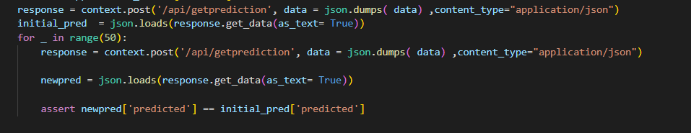
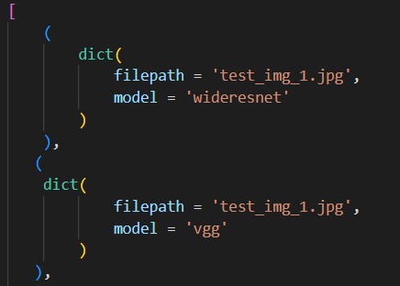
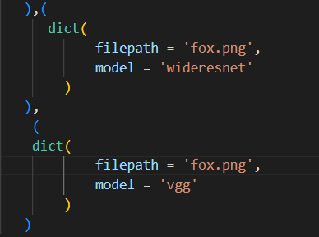
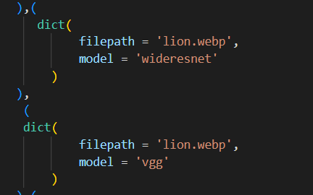
Application – Consistency Testing
Important for model to output the same predicted class, every time the same inputs are given
Test if the model is consistent on different image types (png , jpg and webm) and for both models
Notes:
It is Important for model to output the same predicted premium price, every time the same inputs are given
Test if model returns the same result every time same set of inputs are given
I test this by getting the predictions ten times in a loop and use assert to test whether each time the predictions inputs are the same

Slide 16

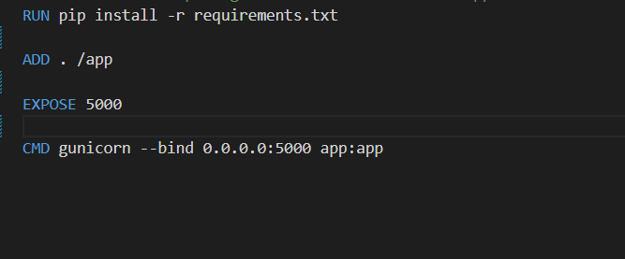
Application – Deployment - CI/CD
Feature branches are merged with main quickly.
Get all the versions of all package/module/library by doing pip freeze > requirements.txt
All pytest unit tests are run before each deployment ‘pytest –v’ , if there are failing cases, don’t push and fix the bugs first.
To Prepare the docker file, used for build the image by installing all dependencies in requirement.txt , exposing the port 5000 and the gunicorn server listens on that port.
Committing and pushing to the main branch will cause render to automatically deploy.
Notes:
PCA generates new features that are orthogonal to each other , and not correlated with each other

Slide 17
Thank You

