Slide 1
CIFAR100 IMAGE CLASSIFICATION
By: Yee Hang

Slide 2
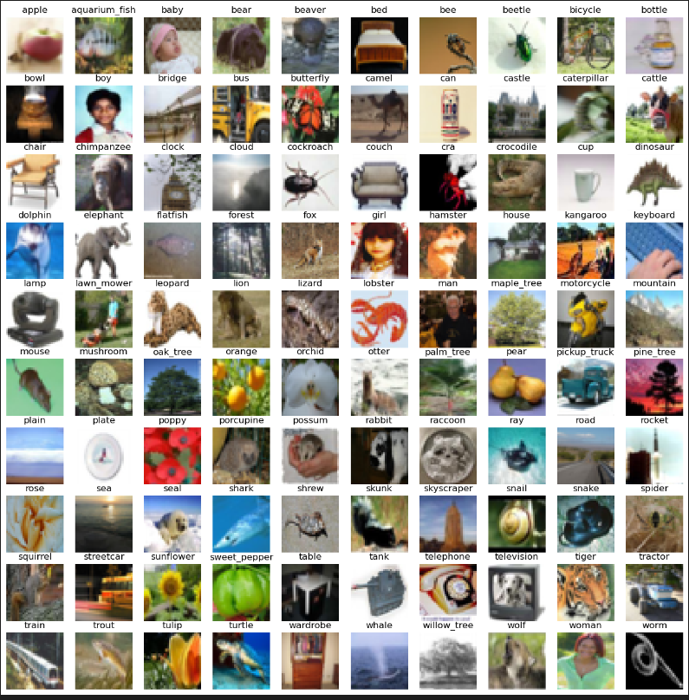
Dataset Info, Looking at the images
- This is a dataset of 50000 training images and 10,000 test images
- Each image is 32x32x3 (LxWxH)
- Exists in both 100 classes and 20 classes of normal day objects such as apple, bed, bicycle etc
#### Problem : Image resolution
- The image resolution is very blurry, which will impede the model predictive performance
- For Example, I cant tell what is in some of the images, for example, the beaver in the picture

Slide 3
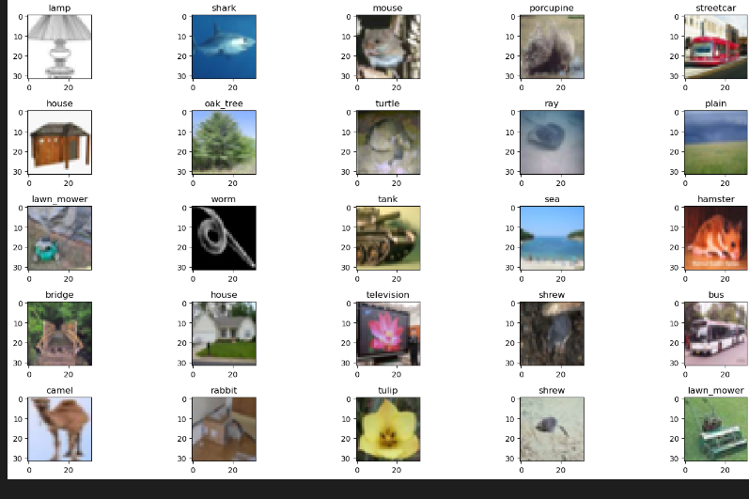
Randomly sample 25 images
- From the above, I cant see the rabbit in these 25 photos, further emphasising the low quality of the photos

Slide 4
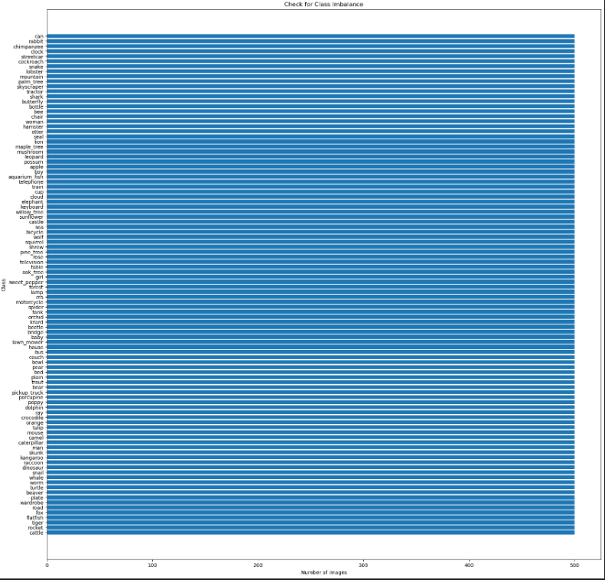
Check for class imbalance – 100 classes
Lack of data
- The 100 classes task has only 500 images per class, making the data prone to overfitting
Class balance/imbalance
- No Class imbalance, making accuracy as main metric to be used

Slide 5
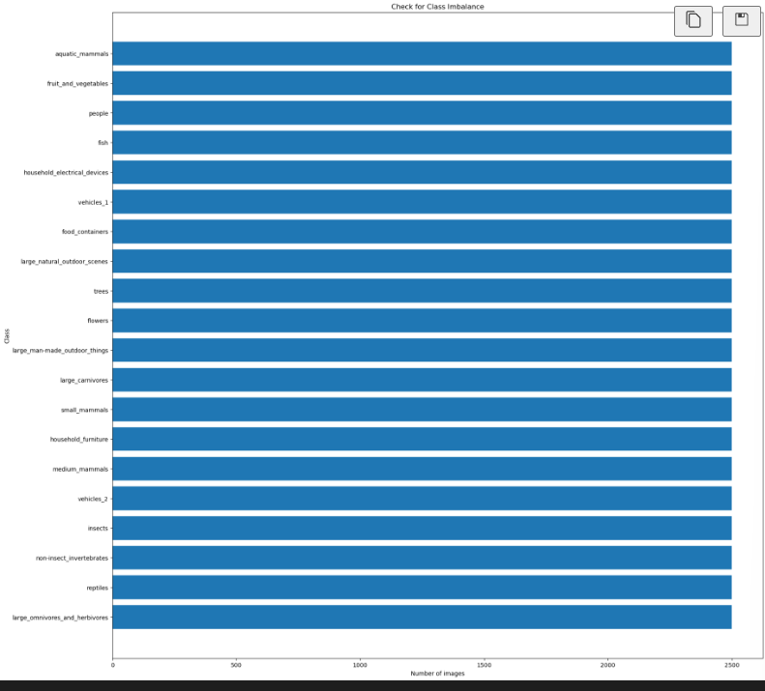
Check for class imbalance – 20 classes
- No Class imbalance for 20 classes making accuracy the main metric for modelling
- The 20 classes task has 2500 images per class making it easier than the 100 classes task.

Slide 6
EDA
Modelling - Data Preprocessing
> Divide the pixel values by 255
- leads to faster computation when values are in range of 0 to 1 instead of 0 to 255
Modelling - spliting the data
Split the training data into train and validation with sklearn's `train_test_split` with a split size of 0.2 to ensure that validation set is large enough.
Validation set used to evaluate if model generalize to unseen data

Slide 7
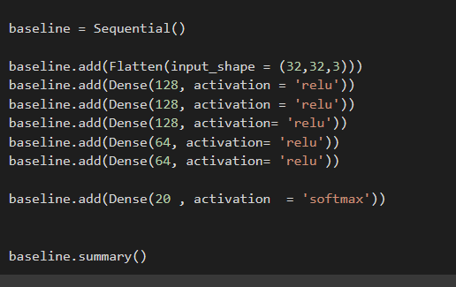
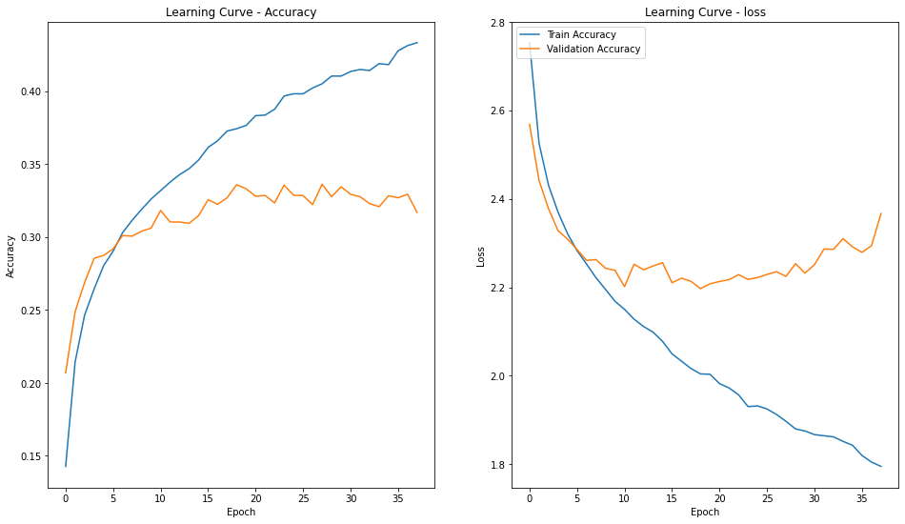
CIFAR-20 BASELINE
Use a Multilayer perceptron baseline to classify images
Underfitting as accuracy is low at 45% after 35 epochs
Notes:
PCA generates new features that are orthogonal to each other , and not correlated with each other

Slide 8
CIFAR-20 BASELINE
Use a Multilayer perceptron baseline to classify images
Underfitting as accuracy is low at 45% after 35 epochs
Also Overfitting as validation loss increases after 20 epochs while the training loss remains the same
Notes:
PCA generates new features that are orthogonal to each other , and not correlated with each other

Slide 9
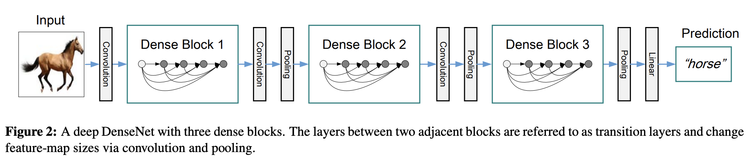
CIFAR 20 – CNN Dense Net
The connections are similar to the resnet, except the resnet uses addition operation and the dense net uses concatenation
Dense net paper authors suggested that the addition operator might 'impede the information flow in the network'
The architecture also includes transition blocks with max pooling layers to decrease the dimensions of the image by half
Bottleneck blocks (extra 1x1 convolution) with compression value of 0.5 to reduce the number of feature maps by half in each transition layer, Dense net with bottleneck blocks and compression are "Dense Net BC"
I choose the smallest Dense Net BC with depth of 100 and increasing factor of 12 as Dense Nets are memory intensive
Notes:
Pca is also able to remove the noise in the data, by excluding the principle components that capture very little variance. 4
There are presence of outliers for torque and rotation speed , but these are mostly faultly machines, which make sense, as machines that are spinning too fast will probably break down.

Slide 10
CIFAR 20 – CNN Dense Net
ReduceLROnPlateau
The loss and accuracy will stagnant when the training reaches an minimum point and the loss function will hover around the same value, using ReduceLROnPlateau,to decrease the learning rate will cause the loss function to be fine tuned more.
I decided to use a patience of 4 epochs and monitor the val_categorical_accuracy
Batchsize
I decrease the batchsize from normal value of 128 to 64 as the Dense Net is more memory intensive
Cutmix Augmentation
Cutmix Augmentation randomly overlays images on one another and by a certain proprotion and the one hot encoded labels are also mixed
For e.g, if image1 from class 1 is overlayed on image 2 from class 2 , the one hot encoded label for that image might be [ 0.2, 0.8] where 20% of the original image is covered by another image
Notes:
Pca is also able to remove the noise in the data, by excluding the principle components that capture very little variance. 4
There are presence of outliers for torque and rotation speed , but these are mostly faultly machines, which make sense, as machines that are spinning too fast will probably break down.

Slide 11
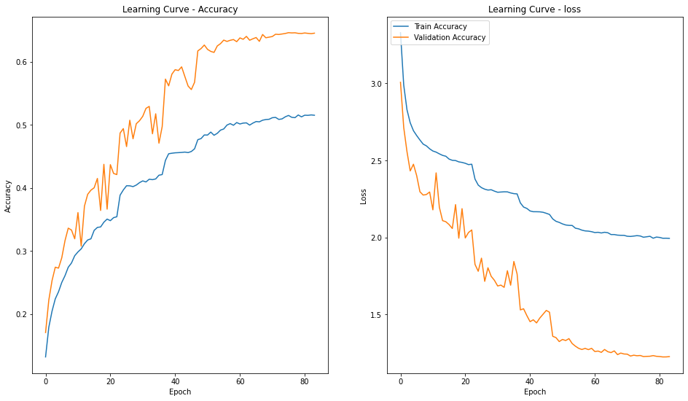
CIFAR 20 – Dense Net
First pleateau around 20 epochs, causing the learning rate to be decreased
The model pleateauing at such an early number of epochs is concerning
The dense net reaches 60% accuracy around epoch 55 after the learning rate was being decreased 3 times
As the Learning Rate is being decreased many times, the loss and accuracy does not increase anymore
Additional point:
The dense net is very memory and computationally expensive to train with
Hence, considering the lower-than-expected validation score after so many epochs, I have decided to move on to try other models like the Wide Res Net
Notes:
Before pca can be performed, scaling need to be done on the

Slide 12
CIFAR 20 – Wide Res Net with Cosine Annealing
Cosine Annealing with warm restarts
It is a learning rate scheduler that explores the solution space effectively
The learning rate starts higher and the learning rate decreases to 0 and increases rapidly to the highest learning rate again
Cosine Annealing
it is a learning rate scheduler that uses cosine function to decrease the learning rate throughout training which allows for more fine tuning
Warm Restarts
Neural network / cnn loss function is non convex, and a lot of local minimum exist
Hence there is a need to find a better local minimum
It is going to reset the learning rate back to max_lr at the end of each cycle to escape the local minimum and find a better local minimum that is more stable

Slide 13
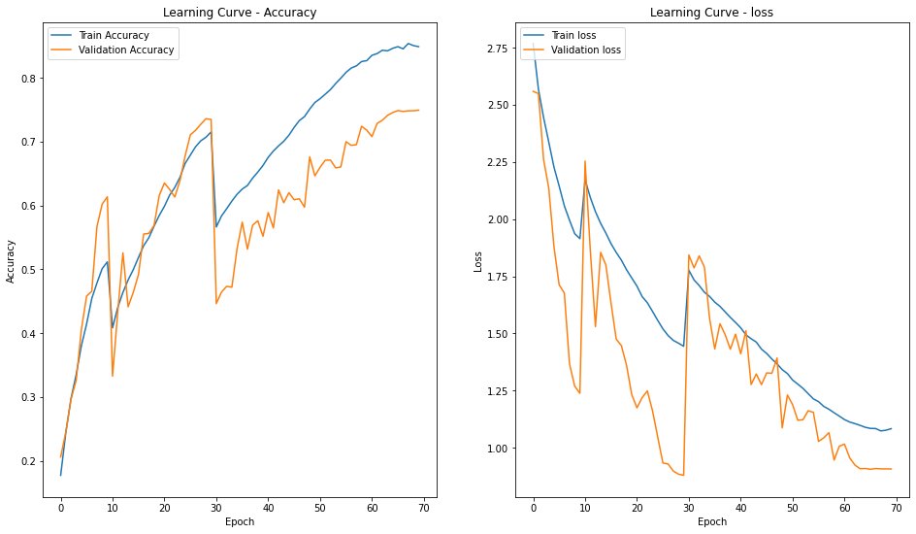
Wide Res Net
Model is overfitting after 30 epochs with higher train accuracy than validation accuracy

Slide 14
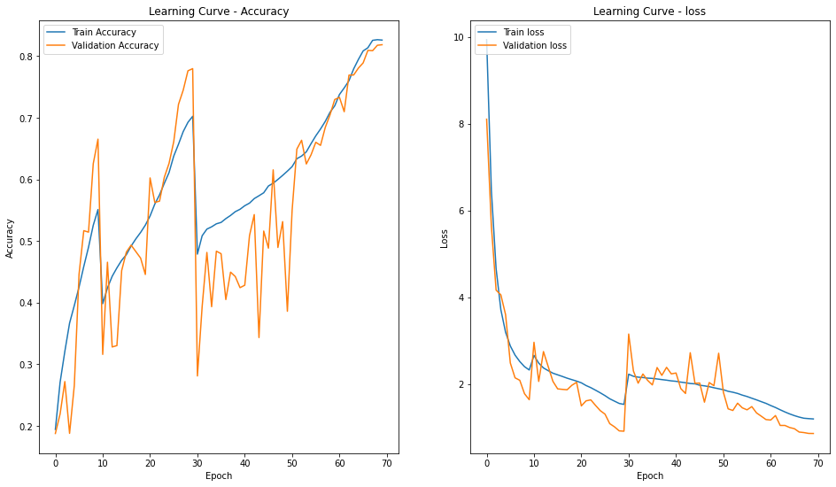
Wide ResNet with width of 28 and widening factor of 10 and [Double Fully Connected Competitive Inner Imaging Block1x1]
Initially overfits a bit from 30 epoch to 50 epoch but the validation accuracy 'catches up' to the training accuracy
Achieved 81% validation accuracy with the new competitive inner imaging block and increasing the Wide ResNet to depth of 28 and width of 10

Slide 15
Hyperband parameter tuning
Batch size
To increase the batch size for better stability during training
Regularization Parameter (L2)
Test values 0.0005 , 0.005, 0.05
Test Optimizers
SGD , ADAM
Notes:
Power is probably useful for differentiating between faulty and normal machines, as power is energy used by the machine in each second.
Too much energy being used is probably an indication that the machine is faulty.
These 3 features have phik correlation of 37 , 20 and 56 against machine , the correlation looks to exist between these variables and the machine status
We will now be moving on into modelling which consist of choosing a model and improving on it
However we need to choose a metric to use

Slide 16
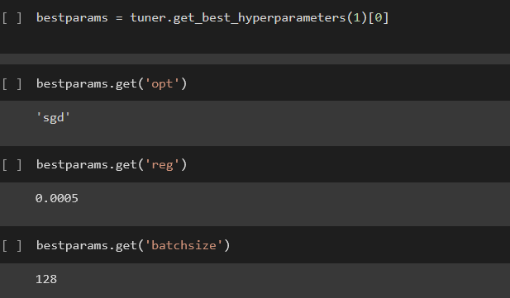
Hyperband parameter tuning
The hyperparameters are the same as the original parameters, showing that the original parameters are decent
The hyperparameters are the same as the original parameters, showing that the original parameters are decent
Notes:
Power is probably useful for differentiating between faulty and normal machines, as power is energy used by the machine in each second.
Too much energy being used is probably an indication that the machine is faulty.
These 3 features have phik correlation of 37 , 20 and 56 against machine , the correlation looks to exist between these variables and the machine status
We will now be moving on into modelling which consist of choosing a model and improving on it
However we need to choose a metric to use

Slide 17
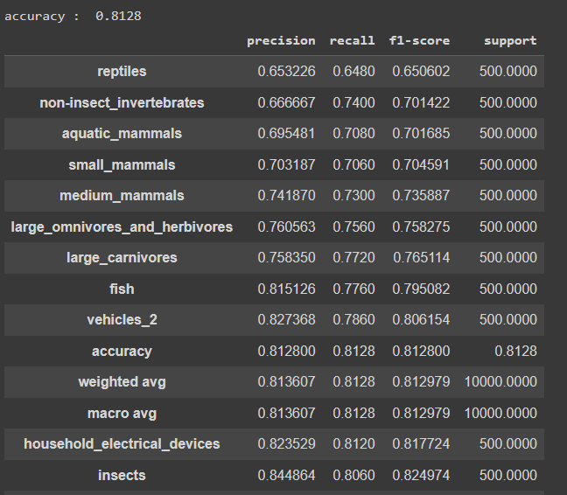
Evaluation on test set
Achieved 80% accuracy on the train set

Slide 18
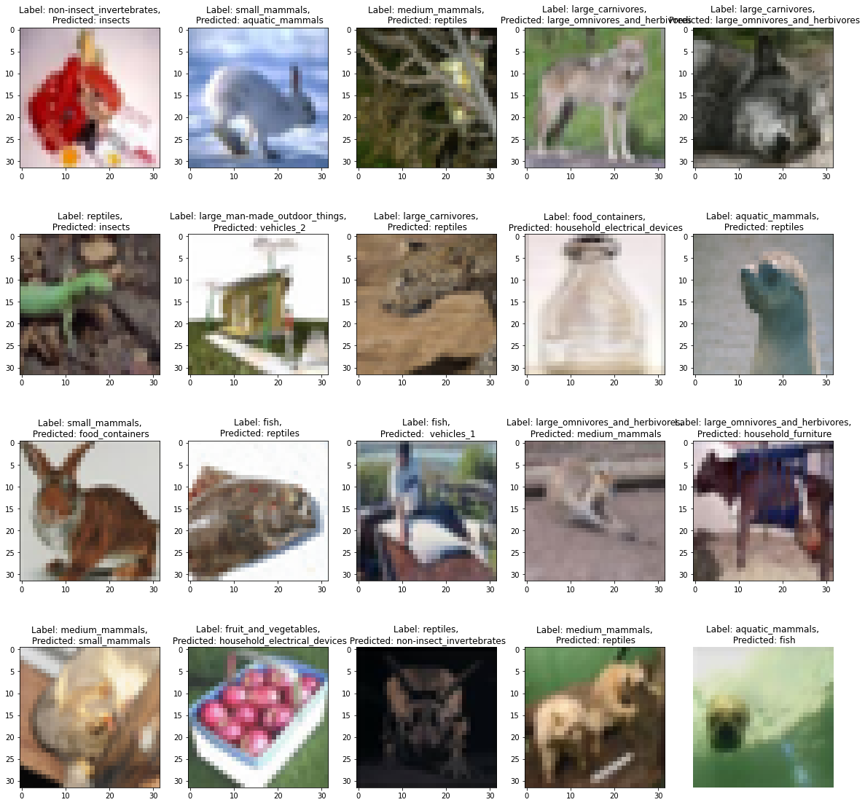
Evaluation on test set- Error analysis

Slide 19
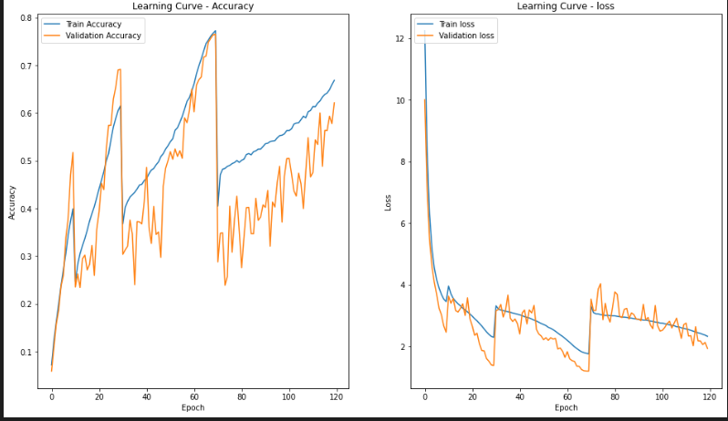
100 Classes Task – WIDE RESNET 28-10
Decided to try Wide ResNet 28-10 With CutMix Augmentation and Double Fully Connected Competitive Inner Imaging Block due to the good results of wide resnet on the 20 classes task
Performs decently at a peak of 76% validation score
The model does not overfit for the first 3 cycles, but overfits for the fourth cycle.
First and second cycle : the validation accuracy is higher than the train accuracy
Third cycle Cycle : the train accuracy is higher than the validation accuracy
To decrease the number of epochs to 70, where validation accuracy is highest, and 70 epochs the point before overfitting occurs

Slide 20
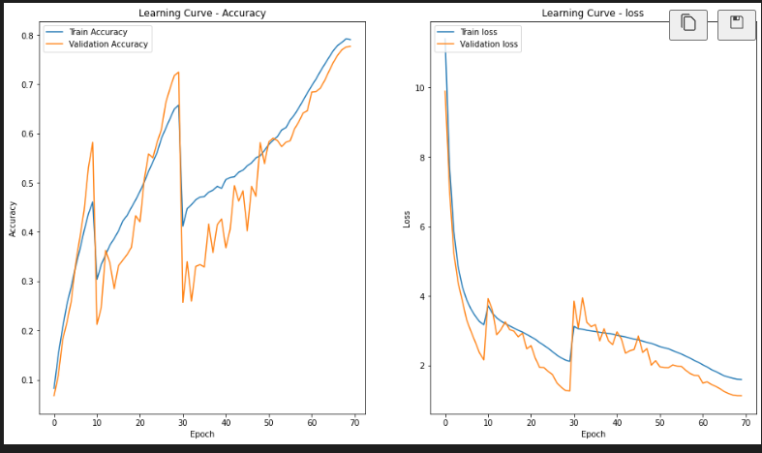
Competitive_Inner_Imaging_SE_Block_1x1
Change the competitive inner imaging to Competitive_Inner_Imaging_SE_Block_1x1 , which is an alternative block in the same paper
- Achieved 77.7% validation accuracy score
- For the third cycle From epoch 30 to 50 Model initially overfits
- Epoch 50 to 70, the validation score 'catches up' to the training score

Slide 21
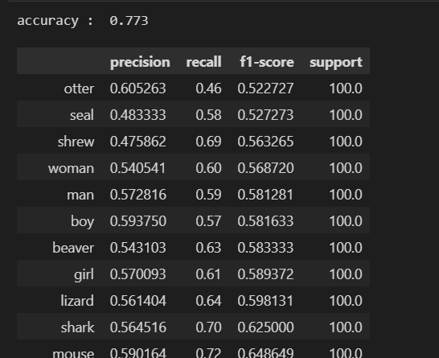
Model evaluation on test set
Achieved 77% accuracy, which is surprising to me as the number of classes is a lot more than the task with 20 classes

Slide 22
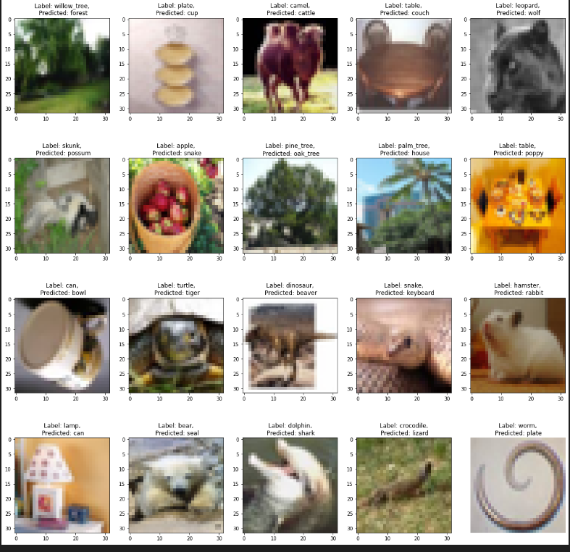
Error analysis – 100 classes

