Slide 1
Insurance Prediction Web Application
By: Yee Hang

Slide 2
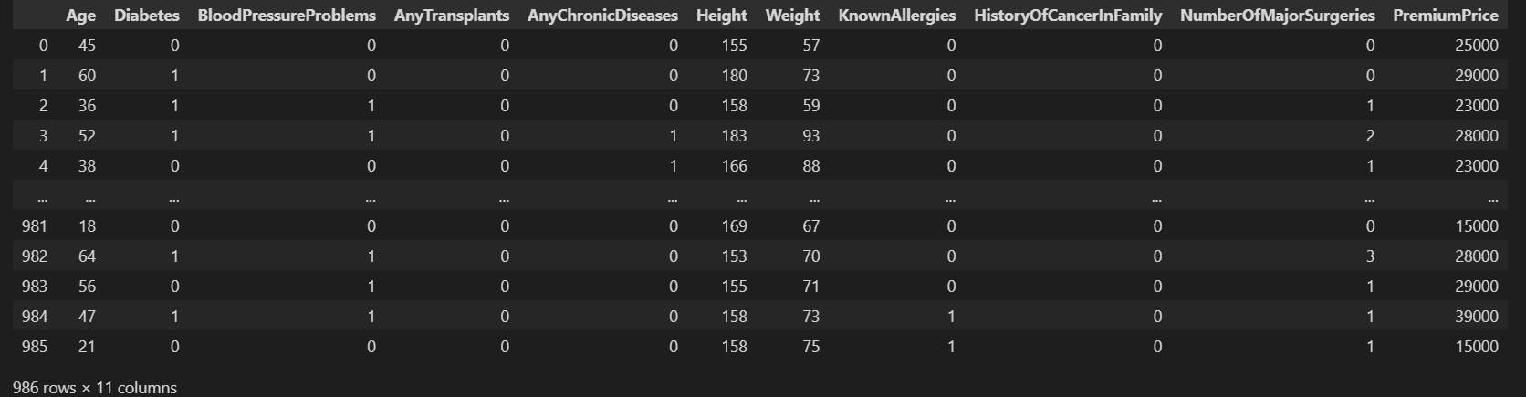
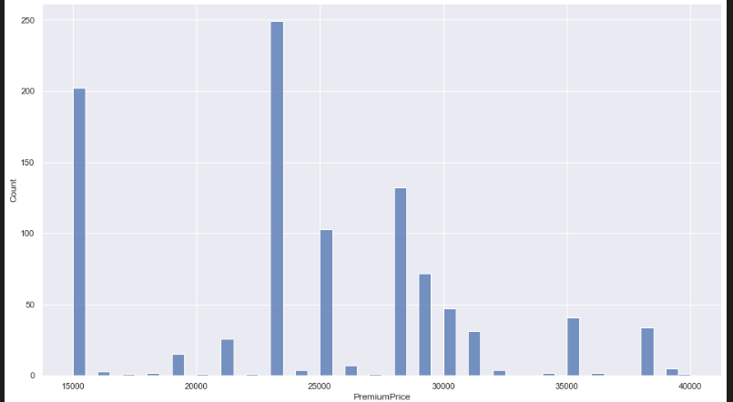
Dataset Info,
Insurance Data:
Contains health information and the insurance price they have to pay yearly
Nowadays, a lot of insurance companies and agents offering plans
The web application is useful for customers who want to buy health insurance but want to know the approximate premium they have to pay
Price distribution

Slide 3
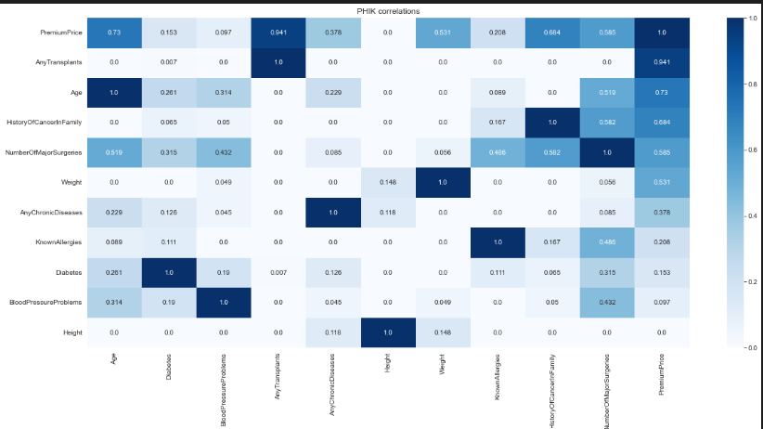
EDA phik correlation
Any transplants have highest correlation with the target
- Followed by age and the history of transplant in family
Height has small amount of correlation hence, dropped from data

Slide 4
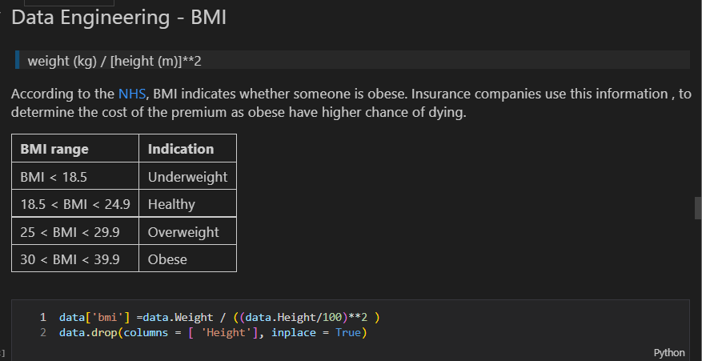
Feature Engineering

Slide 5
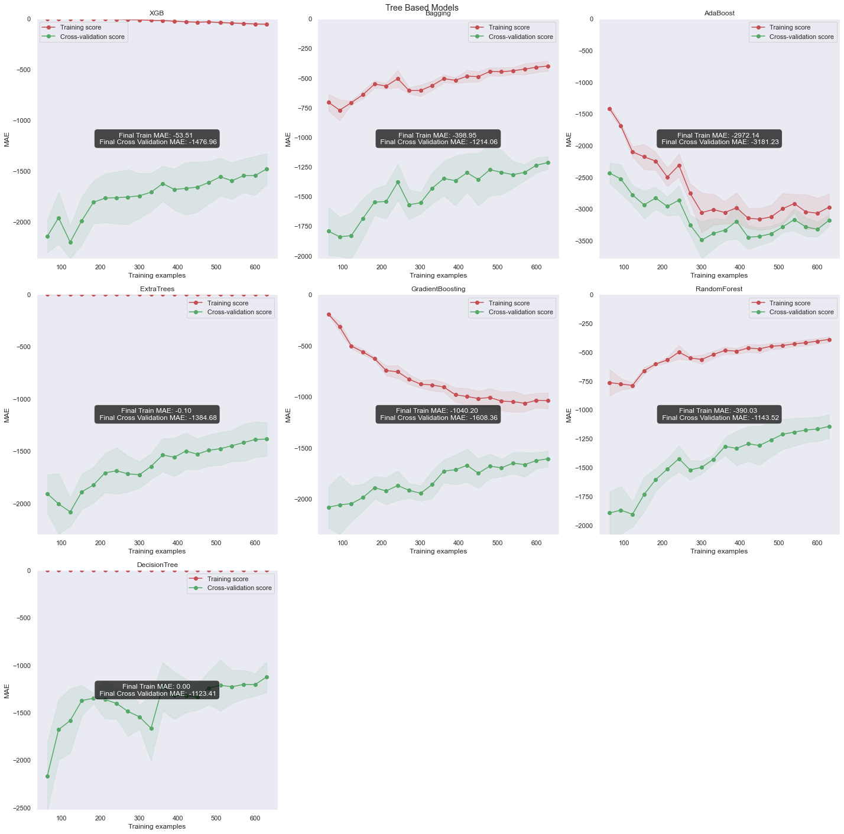
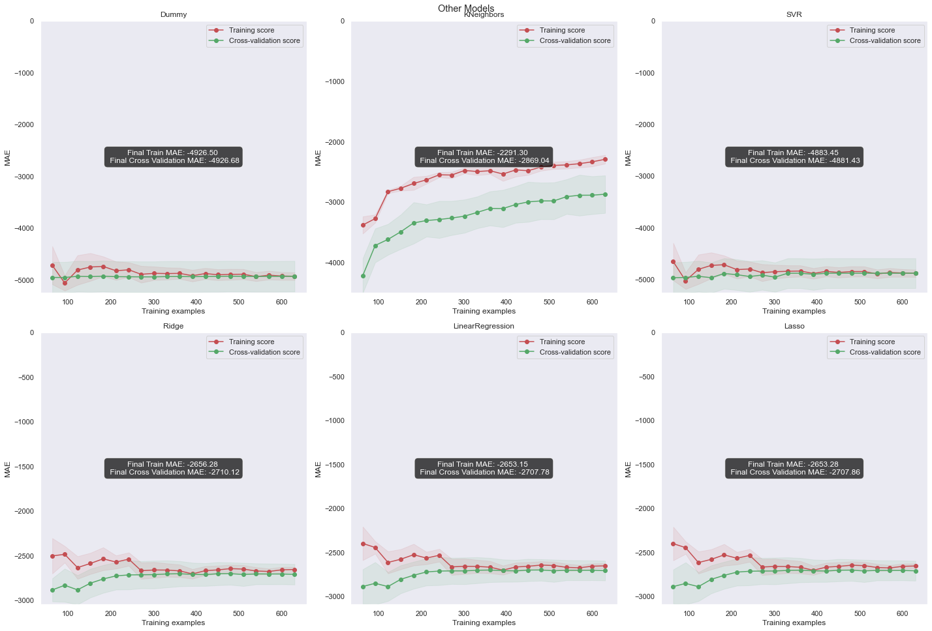
Models
Testing and evaluation
Decision Tree, best validation score

Slide 6

Tuning and results
After tuning the decision tree, Achieved better validation score
Final MAE is 1271
although the MAE, looks very high, the percentage error on the test set is 5% which is decent
- Thus, such predictions will also likely to be useful
Mean average percentage error is 5%

Slide 7

Application – Front end - Homepage
Convince user why important to buy insurance
Peace of mind
Convince user why get a prediction first
Avoid buying plans that don’t worth/too expensive
Notes:
PCA generates new features that are orthogonal to each other , and not correlated with each other

Slide 8
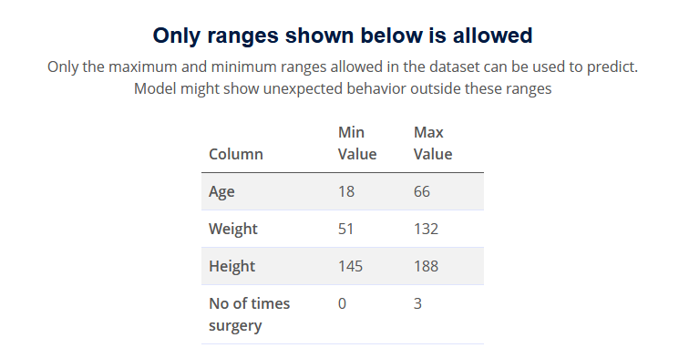
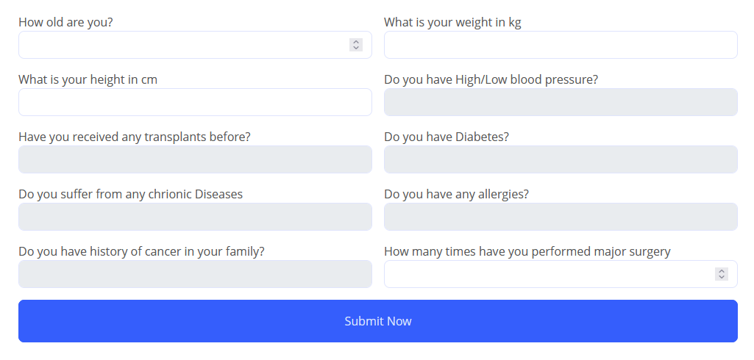
Application – Prediction Page
Show User allowed values for numerical features
Easier for user to make a prediction
Use Dropdown instead of radio button to save space and more aesthetically pleasing (personal view)
Notes:
PCA generates new features that are orthogonal to each other , and not correlated with each other

Slide 9
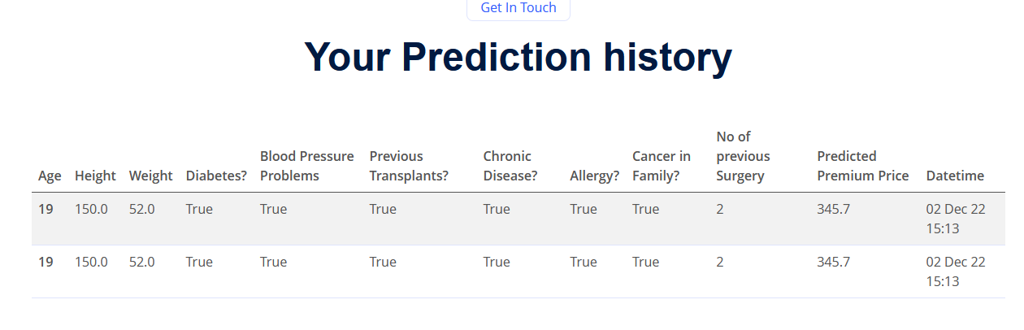
Application – Prediction History Page
Show the history of the prediction with a date and time
Notes:
PCA generates new features that are orthogonal to each other , and not correlated with each other

Slide 10
Application – Testing
Expected fail test, test inserting invalid input
Consistency testing, whether model return same result every time same set of input given
Range testing, different ranges of inputs are given
Notes:
PCA generates new features that are orthogonal to each other , and not correlated with each other

