Slide 1
ICI AI BUILDER'S DAY
WatchTower
SolarWinds + Splunk
keep observing
An AI operations copilot that helps the 24/7 monitoring team spot, explain and escalate network and OpenShift issues faster.
WatchTower agents
investigate and connect the dots
24/7 SRE
TEAM
Dyne LAI · CHAN Lip Ann · Marcus LIAU · Harry LEE · WONG Yi Hao
gets cause, evidence, next steps
Notes:
WatchTower is an AI copilot for the people who watch our monitoring tools. It sits above SolarWinds and Splunk, investigates when something looks wrong, and tells the SRE the likely cause, the evidence and what to do next.

Slide 2
The problem: people connect the dots by hand
When something goes wrong, the 24/7 team pulls evidence from several consoles and joins it up by hand.
2 A.M., ONE ALARM
1
Splunk alert: master node NotReady
Back a minute later. What happened?
WHO
24/7 monitoring team and on-call SREs for Cisco switching and Red Hat OpenShift
2
Check SolarWinds
Weak signals across domains stay below thresholds; diagnosis is slow, manual and depends on who is on shift
The switch port looks fine: below its alert threshold
IMPACT
3
Search Splunk logs
REAL CASE
An OpenShift master's API calls timed out over a congested network path; the node dropped out and came back
Which logs, which node, which time window?
4
Decide and escalate
WHY NOW
GAIA, an on-prem Gemma model, is available inside the air gap, with read-only access to the systems
Network or platform team? Often a best guess
Three consoles, manual correlation, no single view of the evidence.
Notes:
The real incident: an OpenShift master's calls to the kubernetes service timed out, probably because of a network bottleneck, and the node briefly dropped out and came back without rebooting. Each clue lived in a different tool, and none crossed an alarm threshold on its own.

Slide 3
The solution: an AI copilot above our tools
INPUT
AI PROCESSING
OUTCOME
Data we already have
Agents investigate
The SRE gets guidance
SolarWinds: switch metrics
Splunk: OpenShift events and logs
Live device checks only when needed
Network and OpenShift agents spot weak signals
A parent agent connects them and tests likely causes
Confidence comes from evidence, not opinion
Likely cause, with the evidence
Next read-only checks
Which team to escalate to
AI PLATFORM AND TOOLS
WHAT MAKES IT DIFFERENT
Built with: Claude Opus 5.5
Agents run on: Gemma (GAIA), on-prem inside the air gap; Gemma 3 via Ollama in the prototype
Reuses Splunk and SolarWinds; no new data collection
Every conclusion traces back to evidence
Read-only: it recommends, people act
Notes:
Monitoring stays deterministic: thresholds, baselines and basic correlation are plain code. The AI does what people do today: forms hypotheses, reads the evidence, explains it and suggests next steps. Scope is Cisco and OpenShift only for now.

Slide 4
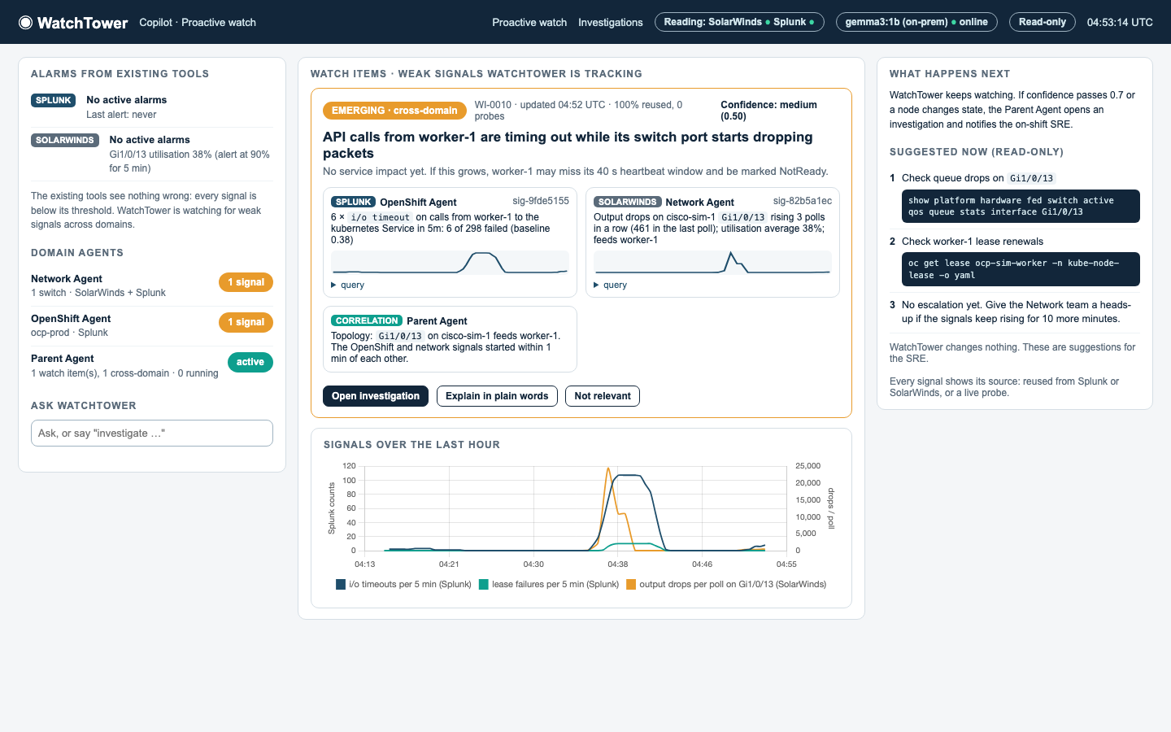
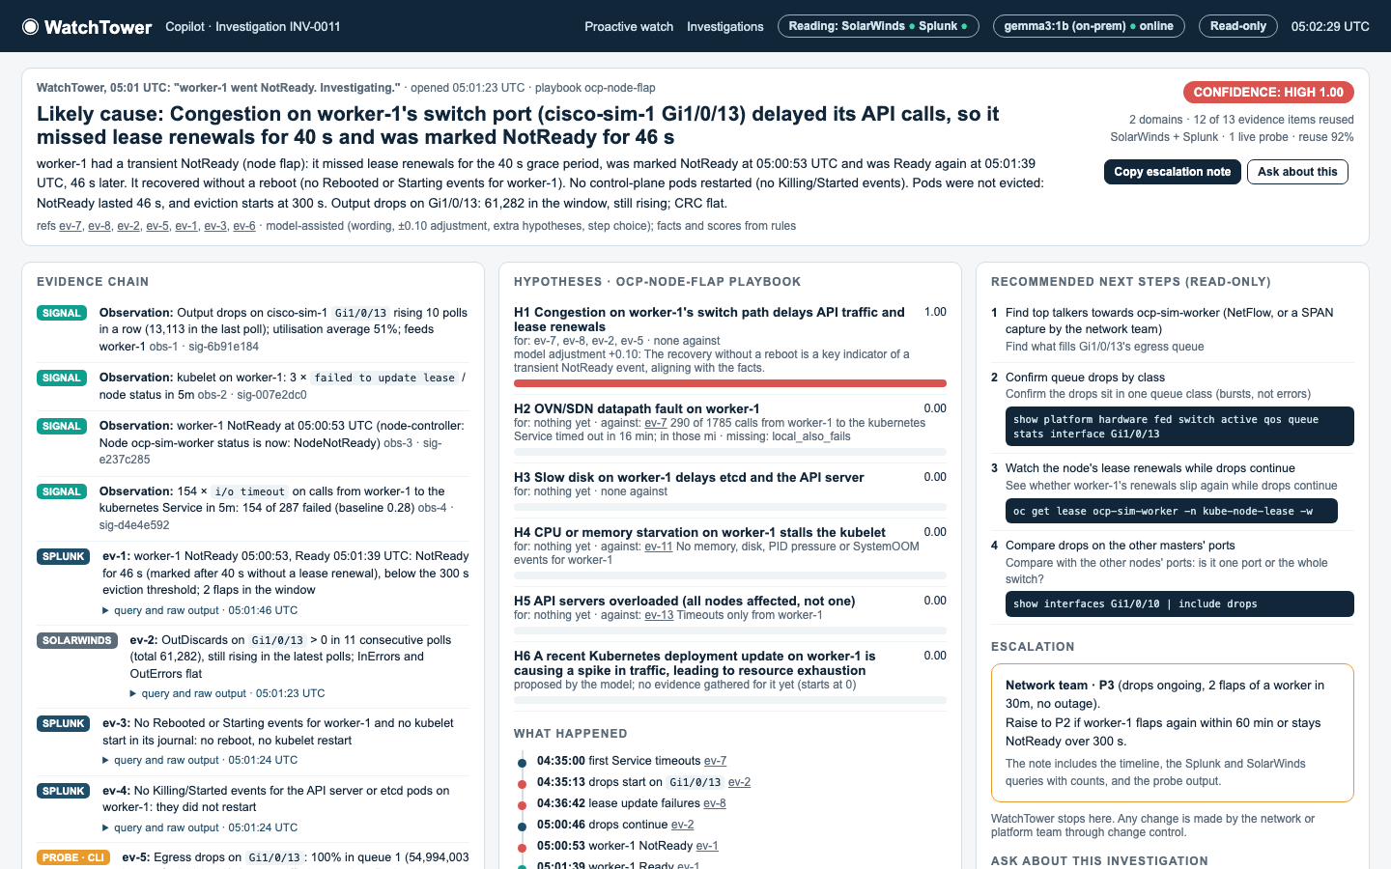
Demonstration: the working prototype
1
Proactive watch
2
Incident investigation
1
A node's switch port slowly congests; Splunk and SolarWinds stay quiet
2
WatchTower links timeouts and port drops into an early watch item
3
The node flaps NotReady for 46 s; the SRE clicks Investigate
4
Likely cause, 12 of 13 evidence items reused, Network team P3
Screenshots from the prototype on an 8 GB MacBook Air lab
Notes:
Real screenshots from the prototype. It runs on an 8 GB MacBook Air against stand-ins: a small Kubernetes cluster for OpenShift, a simulated Cisco switch, and Splunk and SolarWinds stand-ins with the real API shapes. The agents, playbooks and Copilot are real code. One injected fault shows both modes: the watch item appears while the tools are quiet, then the node flaps and the investigation explains it. It recovered without a reboot, which matches the real incident.

Slide 5
Value and learning
VALUE
LEARNING & NEXT STEPS
1
Faster first-level diagnosis
Agentic workflows can diagnose smartly from data we already have: improve the human workflow, don't reinvent the tools
Keep the model's job narrow: rules ranked the right cause in all 7 recorded cases, with or without the model
Position AI as a copilot that explains, not a system that predicts
Cause, evidence and next steps in one place
2
Earlier warning
Cross-domain issues flagged while each tool is still below threshold
3
Builds on what we have
12 of 13 evidence items in the demo came from Splunk and SolarWinds
NEXT
Pilot on one real OpenShift cluster with real Splunk, SolarWinds and GAIA
Score GAIA with the same eval; add playbooks and domains
4
Reusable by other teams
Add a domain agent, e.g. Palo Alto or Nutanix, without a redesign
Notes:
Value is framed as expected benefits: the prototype runs against stand-ins, so real time savings are for the pilot to measure. From the prototype's eval on recorded runs: the rules ranked the right cause in all 7 cases; gemma3:4b cited evidence correctly 86% of the time and gemma3:1b 57%, which is why the model only words, suggests and explains. The pilot is where we would measure time to first diagnosis and how often the top cause is right. Remediation stays out of scope; WatchTower stops at recommending.

