Slide 1
WatchTower
An AI operations copilot for the 24/7 monitoring team
Sits above SolarWinds and Splunk · Cisco and OpenShift first
ICI Builders Day proposal · October 2026 · Draft 3
Notes:
WatchTower does not replace our monitoring tools. It sits above them and helps the people who watch them: it spots issues that are building up, investigates alarms, explains the likely cause with evidence, and tells the SRE what to check next and who to escalate to.

Slide 2
What WatchTower is, and what it is not
AN OPERATIONS COPILOT THAT
IT IS NOT
1
Detects emerging issues
Another monitoring dashboard
A failure-prediction engine
A replacement for SolarWinds or Splunk
An auto-remediation tool: it stops at Recommend
through weak-signal and cross-domain correlation, before major impact
2
Does first-level diagnosis
when an alarm fires or an SRE asks it to investigate
3
Explains the likely cause
with the supporting evidence and where each piece came from
The existing tools keep observing. WatchTower adds the investigation and explanation a person does today by hand.
4
Recommends next steps
read-only diagnostic checks and the right escalation
Notes:
This is the positioning to land early. The value is in the minutes after something looks odd: pulling evidence from several tools, joining it up, deciding what it means and who to call.

Slide 3
Today the tools observe; people connect the dots
Tool | What it does well | What is left to the 24/7 team
SolarWinds | Polls Cisco switches over SNMP: status, utilisation, errors, discards; threshold alerts | Spotting a slow rise that never crosses a threshold; knowing which server a port feeds
Splunk | Collects OpenShift and switch logs and events; saved-search alerts | Knowing what to search for, and when; joining log lines to network counters
OpenShift console | Node, pod and operator status for one cluster | Seeing the switch port and network path underneath a node
The SRE on shift | Judgement, context, owns the decision | Pivoting across consoles at 2 a.m., correlating by hand, picking the right escalation
Scope for now: Cisco switching and Red Hat OpenShift only. Palo Alto and Nutanix follow the same pattern later.
Notes:
Every tool is good inside its own domain. The incidents we care about cross domains: a congested switch port shows up as an unhealthy OpenShift master.

Slide 4
The OpenShift incident, explained
1
2
3
4
Network path congests
API calls time out
Node marked NotReady
Node comes back
Drops build on the switch path to a master node. Average utilisation looks normal, so no alarm.
The master calls the kubernetes Service (172.30.0.1). It spreads calls across all three API servers, so about 2 in 3 leave the node and some time out.
The kubelet cannot renew its heartbeat lease (every 10 s). After 40 s without one, the control plane marks the node NotReady.
Once traffic gets through, the next renewal marks it Ready. No reboot, no restart of key services, no evictions (they start at 300 s).
The accurate name: a transient NotReady, or "node flap". The control plane briefly lost contact with the node; the node itself did not go down. This is consistent with what was seen: no physical reboot, key services not fully restarted.
Notes:
Inferred from the description and OpenShift's default timings (Red Hat worker latency profiles: 10 s status updates, 40 s grace period, 300 s eviction toleration). To confirm against the real incident: the NodeNotReady/NodeReady event times, the node's boot ID before and after, static pod restart counts, and switch drops on the master's port at the time.

Slide 5
Problem statement
Our monitoring tools see each domain separately and alert on thresholds. Weak signals that only make sense together, like a congested switch port slowing an OpenShift master, go unnoticed until something breaks. Then first-level diagnosis depends on an SRE pulling evidence from several consoles by hand.
Notes:
Read it out. Everything after this slide answers it.

Slide 6
The end state
1
2
3
4
Existing tools observe
Domain agents investigate
Parent agent connects the dots
WatchTower explains and guides
SolarWinds and Splunk keep collecting, baselining and alerting, unchanged.
A Network Agent and an OpenShift Agent read those tools, watch for weak signals and gather evidence on request.
Correlates across domains by topology and time, tests hypotheses, scores confidence from evidence.
Tells the SRE the likely cause, shows the evidence, suggests next checks and the escalation.
Read-only, human in the loop. WatchTower stops at Observe → Detect → Diagnose → Recommend. People decide and make any change through change control.
Notes:
This is the one-line architecture: existing tools observe, domain agents investigate, the parent agent connects the dots, WatchTower explains and guides the SRE.

Slide 7
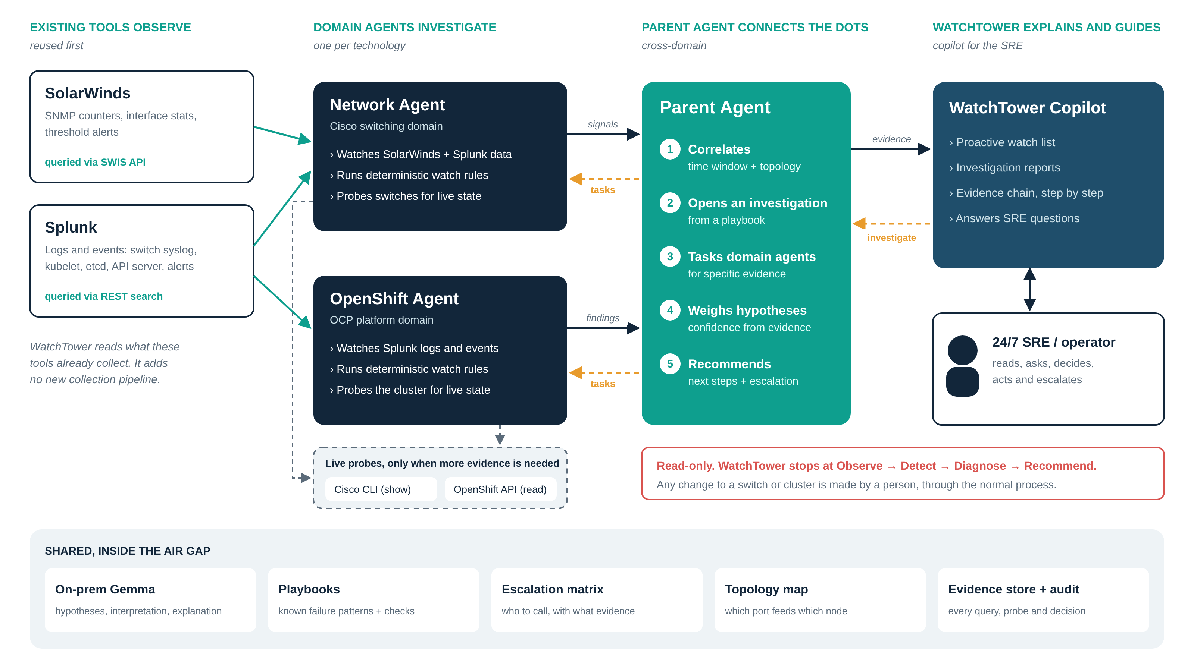
How the agents interact
Notes:
Domain agents query the existing tools first and probe devices only when they need live state. They publish signals to the Parent Agent and answer its evidence requests. The Parent Agent correlates, runs playbooks and scores hypotheses. The Copilot is where the SRE sees watch items and investigations, and asks questions. Everything shares the on-prem Gemma, the playbooks, the escalation matrix, the topology map and an evidence store with a full audit log.

Slide 8
Design principles
1
Domain agents
2
Parent agent
3
Reuse first, probe second
One agent per technology (Network, OpenShift), not per device. New domains add an agent, not a redesign.
Owns cross-domain investigation and correlation across the domain agents' findings.
Splunk for logs and events, SolarWinds for metrics. CLI and APIs only for live state or deeper evidence.
4
Deterministic + AI-assisted
5
Evidence before opinion
6
Read-only, human in the loop
Thresholds, baselines, collection and basic correlation are plain code. AI does hypotheses, interpretation, explanation, next steps.
Observation → evidence → correlation → hypothesis → confidence → recommended actions, all traceable.
Stops at Recommend. No remediation. Show-only CLI, get/list/watch APIs, full audit log.
Notes:
These are the principles from the refinement brief. They are also what gets this through security review: read-only, auditable, on-prem model, no new data collection where a tool already has the data.

Slide 9
Reuse first, probe second
Question during an investigation | First: reuse | Second: probe, only if needed
Are API calls from master-2 timing out? | Splunk: API client and kubelet logs | None needed
Did it go NotReady, and for how long? | Splunk: NodeNotReady / NodeReady events | None needed
Did it reboot, or did key services restart? | Splunk: Rebooted, Starting and pod restart events | None needed
Any evictions or resource pressure? | Splunk: eviction and pressure events; SolarWinds node CPU | None needed
Are drops rising on the port that feeds it? | SolarWinds: interface discards | CLI, only if the last poll is over 2 min old
Congestion or a bad link? | SolarWinds: CRC and input errors | CLI per-queue drops: the one probe (not polled)
Has any existing alarm fired? | SolarWinds and Splunk alerts | None needed
With OpenShift events in Splunk, 11 of 12 evidence items in the master-2 investigation are reused. Each item records its source and the exact SPL, SWQL or command. Nothing Splunk or SolarWinds holds is collected again.
Notes:
The rulebook for this lives in the PoC kit as contracts/sources.yaml. Probes are capped at three per investigation and rate-limited per device. Reboot and restart checks use the kubelet's Rebooted and Starting events and pod restart events in Splunk, so the OpenShift API is only a fallback when Splunk has a gap. The only probe the node-flap playbook expects is per-queue drops on the switch, which SolarWinds does not poll (unless CBQoS polling is enabled, in which case that is reused too).

Slide 10
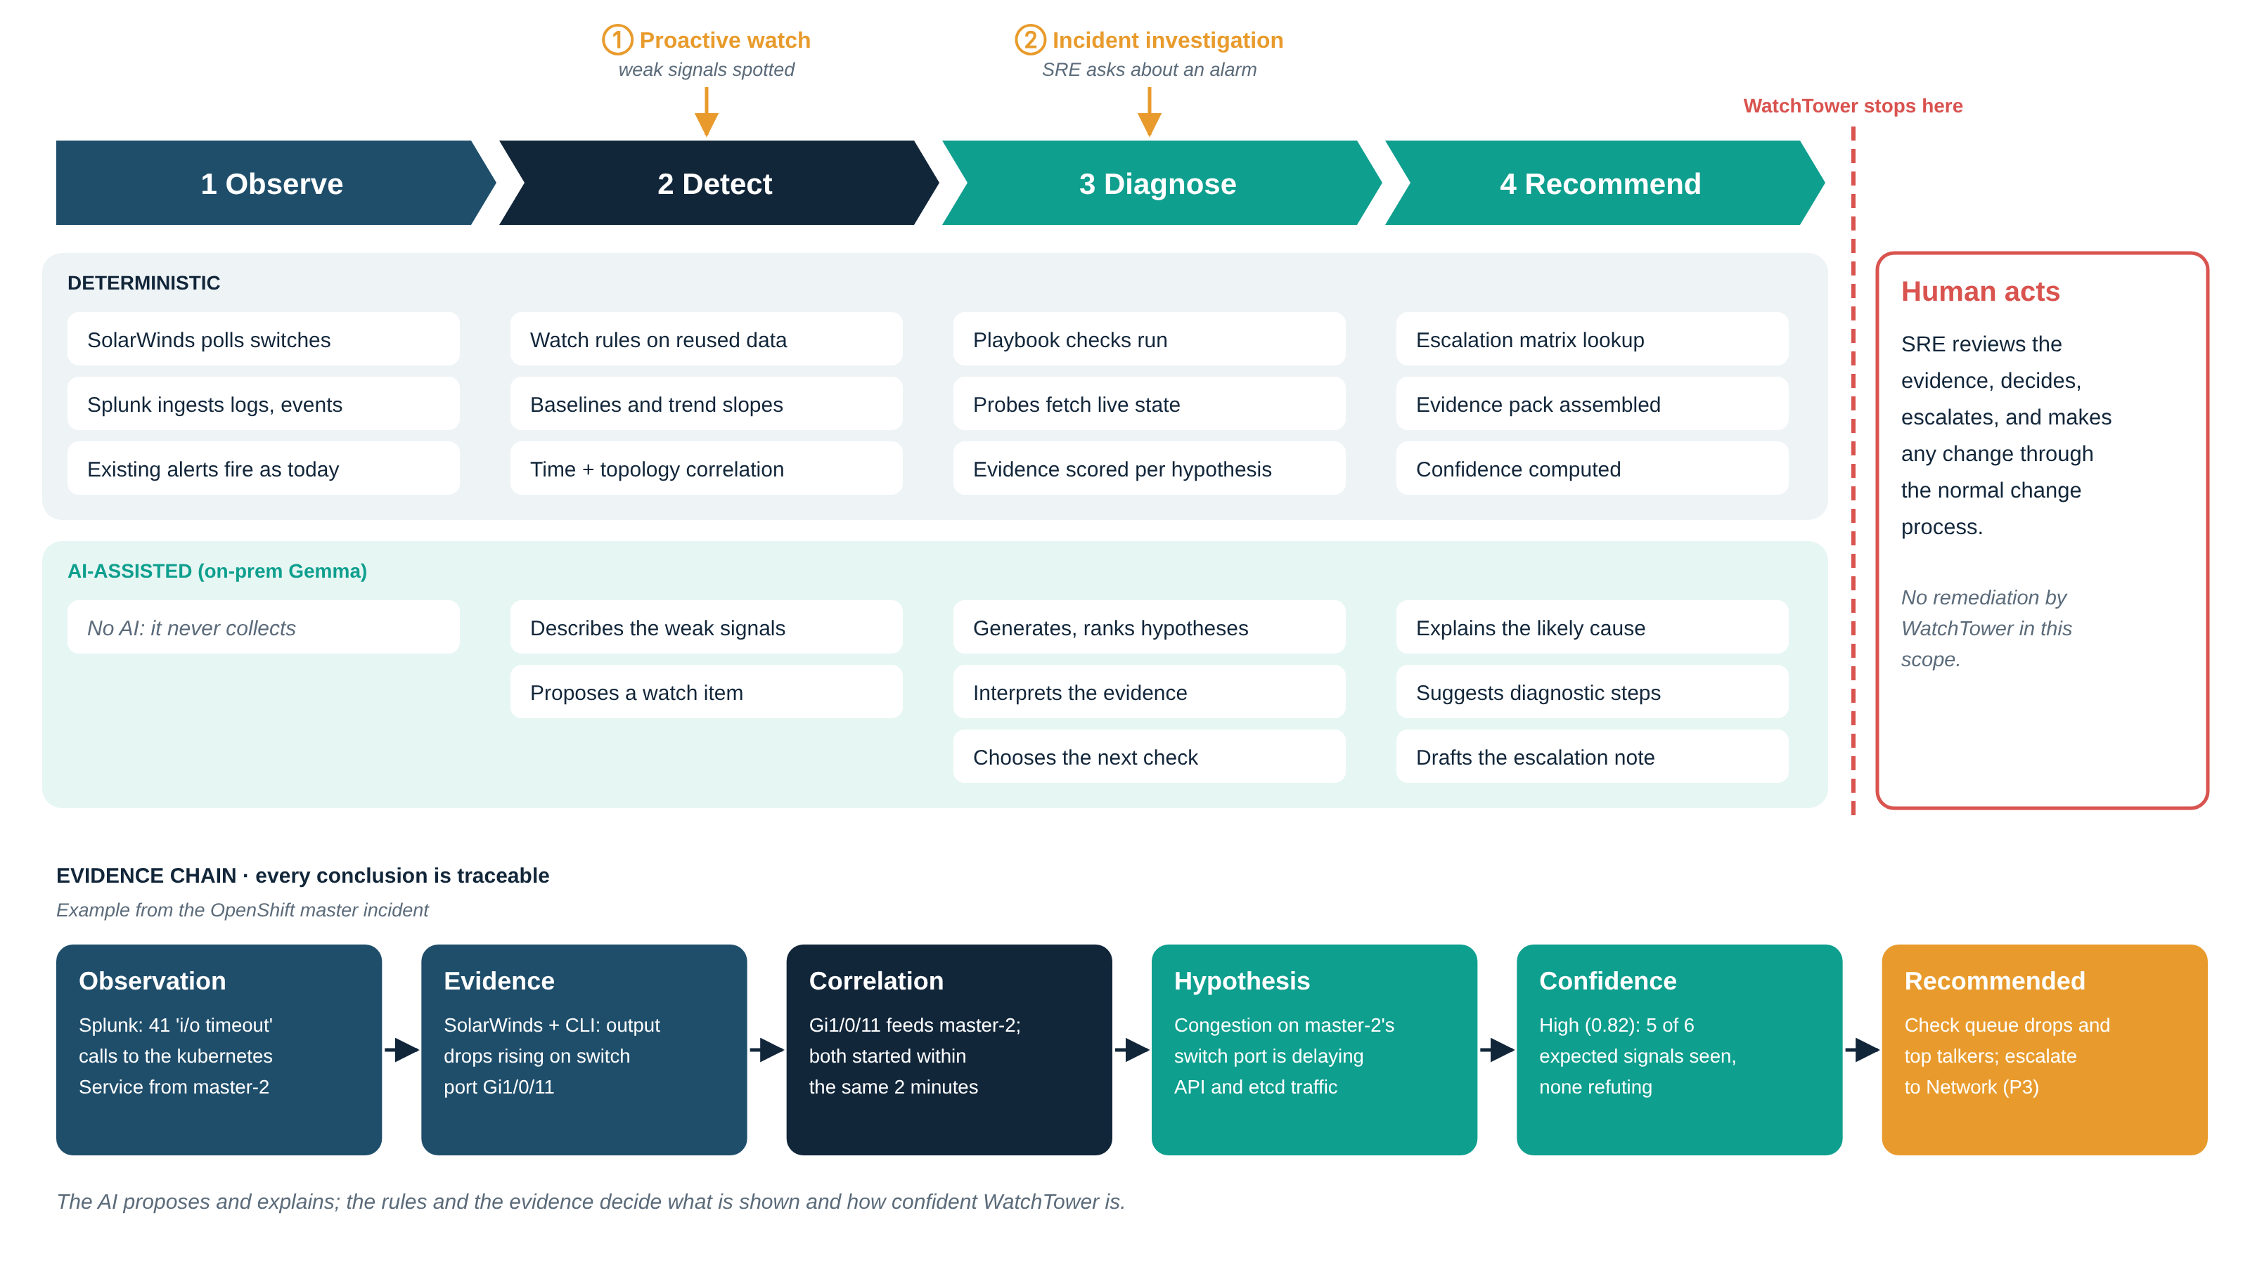
Observe → Detect → Diagnose → Recommend
Notes:
Two ways in: proactive watch enters at Detect from weak signals; incident investigation enters at Diagnose when an SRE asks about an alarm. The top row is plain code; the bottom row is where the on-prem Gemma helps. The evidence chain at the bottom is the master-2 example.

Slide 11
Confidence comes from evidence, not opinion
Hypothesis (node-flap playbook) | Evidence for | Evidence against | Confidence
H1 Congestion on master-2's network path | Partial timeouts, lease failures, drops rising on Gi1/0/11, drops in one queue, no CRC | None | 0.82 high
H2 SDN / OVN datapath fault | Timeouts from the node | Only calls that leave the node fail | 0.18
H3 etcd slow disk | etcd latency warnings | No fsync warnings; peer latency instead | 0.12
H4 Node resource starvation | None | No pressure events; CPU 22% (SolarWinds) | 0.06
How it is scored
Where the AI helps
Each playbook lists the evidence each hypothesis expects and what would refute it, with weights. Score = (for − against) ÷ expected. Plain code.
Proposes extra hypotheses, reads evidence that has no rule (a log excerpt), explains the result. It may move a score by at most 0.10, with a reason.
Notes:
Values are the wireframe example, not measured results. The point is that an SRE can see why WatchTower ranked one cause over another, and that a weaker model cannot talk the ranking into something the evidence does not support.

Slide 12
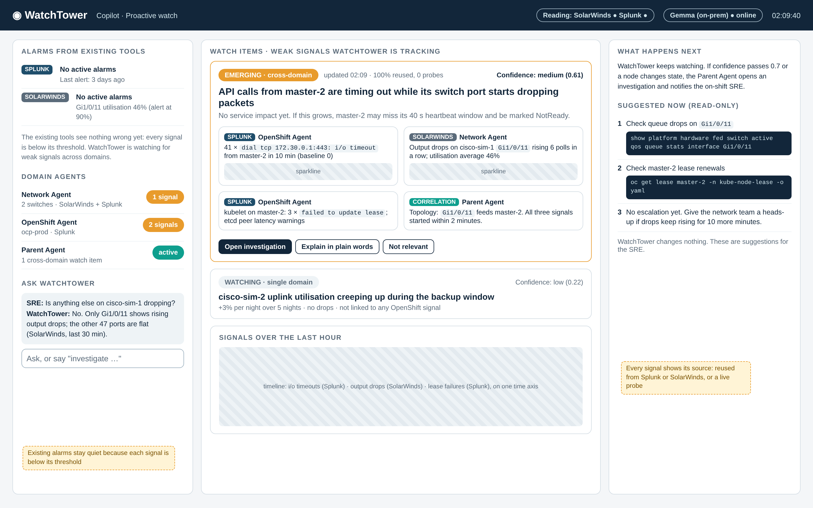
Mode 1: Proactive watch
1
Tools are quiet
SolarWinds and Splunk: every signal below threshold
2
Weak signals joined
Timeouts (Splunk) + port drops (SolarWinds) + topology
3
Emerging, not alarming
Medium confidence; explains the risk if it grows
4
Read-only suggestions
What to check now; no escalation yet
Notes:
Detect and correlate an emerging issue before major service impact. Neither tool would alert: the port averages 46% and the timeouts are a log pattern nobody searches for. Together, and joined by the topology map, they tell a story.

Slide 13
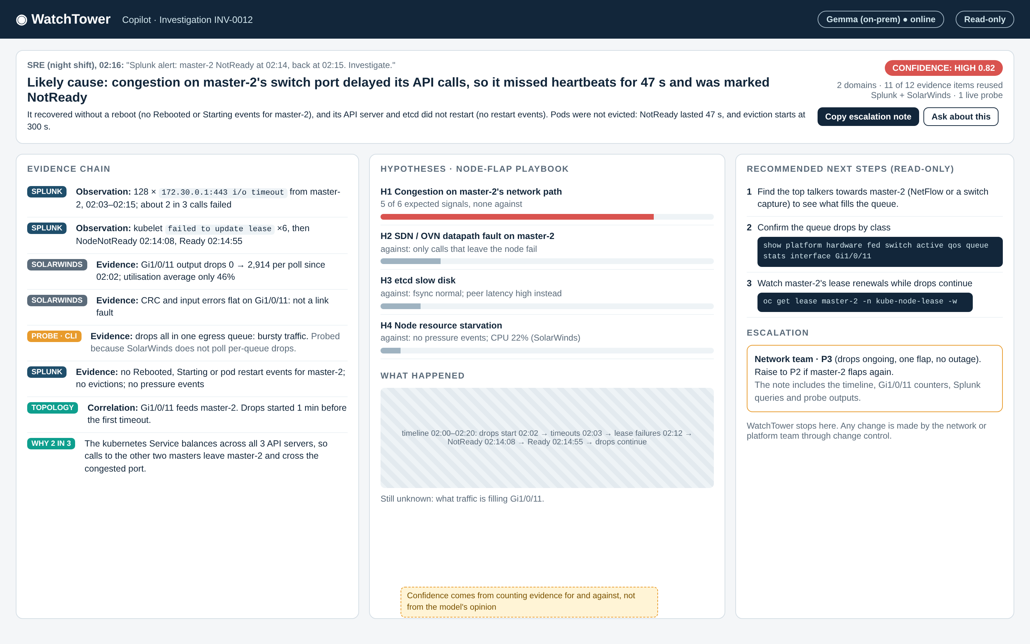
Mode 2: Incident investigation
1
The SRE asks
Investigate the Splunk NodeNotReady alert
2
Likely cause + what happened
Congestion; node flap of 47 s, no reboot, no eviction
3
Evidence chain
11 of 12 items from Splunk or SolarWinds; one live probe
4
Next steps + escalation
Read-only checks; Network team, P3. Stops there.
Notes:
A human SRE asks WatchTower to investigate an alarm. WatchTower picks the node-flap playbook, tasks both domain agents, and answers with the likely cause, the evidence, and what to do next. It does not fix anything.

Slide 14
Making a modest on-prem model useful
The on-prem Gemma (about 40B) may not be fully competent at agentic work, so it gets six narrow jobs and firm guard rails.
1
Summarise a watch item
in plain words
Guard rails
2
Propose hypotheses
Detection, correlation and scoring never depend on the model; the demo ranks the right cause with it switched off
JSON schema and two worked examples per job
Must cite evidence ids; one retry, then a rule-based fallback
Can move confidence by at most 0.10
Called only when inputs change
An eval scores any model on these jobs, so we measure Gemma rather than guess
up to two beyond the playbook
3
Interpret evidence
that no rule covers
4
Explain the cause
including reboot or not
5
Choose next steps
from a fixed catalogue; draft the escalation
6
Answer SRE questions
only from stored evidence
Notes:
On the 8 GB demo Mac the PoC uses gemma3:1b (gemma3:4b on a 16 GB machine): same family and far smaller, a harsher test. If a small one copes with these narrow jobs, the on-prem one should. The demo also works with the model switched off.

Slide 15
What already exists, and the gap
OpenShift Lightspeed
HolmesGPT, K8sGPT
The gap
Red Hat's AI assistant in the OCP console. One cluster, chat-driven, no network view.
Open-source CNCF projects that diagnose Kubernetes issues; work with local models.
Existing assistants are single-domain or need the cloud. None investigates across the switch and the cluster together, from the tools we already run, inside an air gap. WatchTower reuses the open pieces and adds cross-domain investigation with evidence.
MCP servers
Red Hat FSE 2026 paper
Open-source tool servers for Kubernetes and Prometheus; a safe way for agents to query.
Industry report on LLM agents for AIOps on OpenShift: useful, with clear limits.
OpsBot (SolarWinds community)
Commercial AIOps
Multi-agent AIOps idea on top of SolarWinds data.
Dynatrace, Splunk ITSI and others: strong, but costly and often cloud-tied.
Notes:
Sources are in the Word document. Check Lightspeed's disconnected-mode support against our OCP version; it could complement the OpenShift Agent.

Slide 16
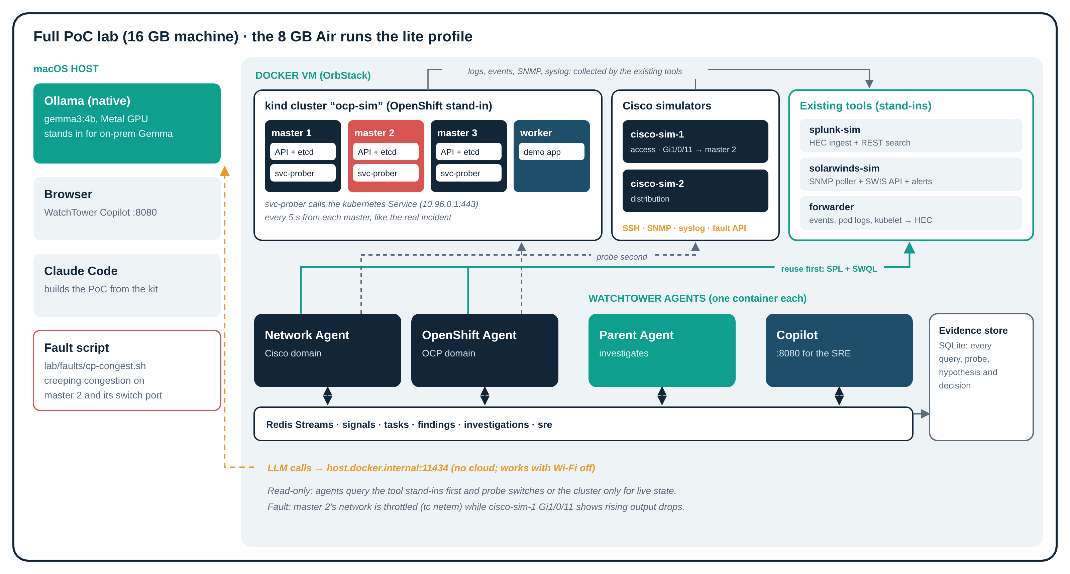
The PoC runs on one MacBook Air
On the 8 GB Air: lite profile with 1 master + 1 worker, one switch simulator, gemma3:1b and the fault on the worker; about 6 to 7.5 GB.
Notes:
kind with three control-plane nodes stands in for OpenShift, so the kubernetes Service really spreads calls across three API servers, which is what the incident needs. Small simulators stand in for the Cisco switches, Splunk and SolarWinds; the agents talk to them through the real API shapes (SPL search, SWIS/SWQL), so pointing at the real tools later is configuration.

Slide 17
What is feasible on an M2 Air
Stand-in | Mimics | Fit on an M2 Air | Verdict
kind lite: 1 master + 1 worker | OpenShift | About 1.5 GB; fault goes on the worker | Use on 8 GB
kind full: 3 masters + 1 worker | OpenShift, HA control plane | 4.5 to 5.5 GB | 16 GB only
OpenShift Local (CRC) | Real OpenShift | Single node, about 10.5 GB on its own | Not on an Air
Cisco simulator x2 | IOS-XE CLI, SNMP, syslog | Native; repeatable faults | Recommended
GNS3, vrnetlab, CML | Real Cisco IOS | x86 VMs; no nested virtualisation on M2 | Not feasible
splunk-sim, solarwinds-sim | Splunk search, SolarWinds SWIS | Native, small; real API shapes | Recommended
gemma3:1b in Ollama (4b on 16 GB) | On-prem Gemma | About 1 GB, Apple GPU; or run with the model off | Use on 8 GB
8 GB Air: lite profile, estimated 6 to 7.5 GB (not yet measured). Walkthrough and replay first, live run as the finale.
Notes:
The M2 has no nested virtualisation (Apple added it from M3), so VM-based Cisco images are out. Simulators behave like the real CLI and APIs and are reliable on stage.

Slide 18
Demo: one fault, both modes
1
2
3
4
5
Inject
Proactive watch
Node flap
Investigate
Answer
0:00
~5:00
~10:30
11:00
~13:00
cp-congest.sh starts creeping congestion on master-2's path and its switch port
Tools quiet; WatchTower raises a cross-domain watch item, medium confidence
master-2 NotReady for about 45 s, then Ready; Splunk alert fires
SRE clicks Investigate; agents gather evidence live
Likely cause, no reboot, evidence chain, next steps, Network team P3
Definition of done
Watch item naming master-2 and switch port Gi1/0/11 within 6 minutes, while neither stand-in tool has alarmed
Investigation within 3 minutes: congestion ranked first at ≥ 0.7, "no reboot" shown from boot-ID evidence, 3+ read-only steps, Network team P3
Same top cause with the LLM off; the recorded replay reproduces both screens with the lab stopped
Notes:
Presenting: slides and wireframes first, then the replay; finish live if the Mac is behaving. A short version shows only Mode 2 (flap after about 3 minutes). The build is eight phases with a master prompt and four Claude Code skills in the PoC kit.

Slide 19
Build plan
1
2
3
4
5
6
7
8
Skeleton
Lab
Tools
Domain agents
Parent
Copilot
Demo
Eval
Contracts, bus, LLM client, source and probe adapters
kind HA, svc-prober, Cisco sims, fault script
Splunk and SolarWinds stand-ins, forwarder
Watch rules; reuse first, probe second
Correlate, playbooks, confidence, escalation
Both screens, Investigate, Ask
Script, record, replay
Score the model; offline runs
In the PoC kit
Master prompt and CLAUDE.md for Claude Code, eight phase prompts with "done when" checks, four skills (lab control, domain agent, investigation playbooks, demo), contracts (signal, investigation, sources, topology, escalation), two playbooks, the wireframes and the fault script.
Notes:
Commit after every phase. Record a clean run the evening before so the replay can carry the walkthrough.

Slide 20
From PoC to production
BUILDERS DAY
NEXT
LATER
NOT NOW
PoC
Pilot
Expand
Out of scope
MacBook Air lab: Cisco + OpenShift, one fault, both modes
One real OCP cluster and its switches, real Splunk and SolarWinds, on-prem Gemma, read-only
More playbooks and clusters; Palo Alto and Nutanix agents on the same pattern
Remediation. Only ever with SRE approval and change control, if at all
Pilot sizing depends on the open questions on the last slide.
Notes:
Deliberately no dates beyond the PoC.

Slide 21
Risks and how we handle them
Risk | Mitigation
Wrong or invented explanation | Rules rank hypotheses; the model must cite evidence; schema-validated; rule fallback; ±0.10 cap
Noisy watch items erode trust | Only cross-domain, topology-linked items rise to medium; SRE "not relevant" feedback tunes rules
Probes add load or risk on devices | Reuse first; show-only allowlist; probe cap per investigation; rate limit per device; audit log
Splunk or SolarWinds lack a needed signal | Sources map shows the gap; add it to the existing tool rather than a new collector where possible
On-prem Gemma not competent enough | Narrow jobs, few-shot, schemas; demo works with the model off; eval measures it
Agent credentials widen attack surface | Read-only scoped accounts in a vault; RBAC get/list/watch; security review before pilot
Notes:
The biggest real risk is trust: if the first watch items are noisy or the first explanations wrong, the team will ignore it. Hence evidence first.

Slide 22
What we know, and what is still open
CONFIRMED
STILL OPEN
Copilot above SolarWinds and Splunk, Cisco + OpenShift first
OpenShift events go into Splunk
On-prem Gemma (~40B) is available
Read-only access; no remediation
Reuse Splunk and SolarWinds; do not re-ingest
MacBook Air M2 with 8 GB: lite profile; walkthrough first, live if possible
Incident data to confirm the node-flap explanation (event times, switch drops)
Do kubelet and control-plane logs reach Splunk too? (assumed)
Which switch metrics SolarWinds polls (discards, errors)
Gemma's serving API and context window
Notes:
None of the open items blocks the PoC; they shape the pilot.

