Slide 1

Introduction To Information Security
Midterm Proposal
Multimedia Security
Face De-identification
B10933029呂欣怡 B10932017張祐禎 B10931040吳閩閩

Slide 2
CONTENTS
What Is Face De-identification
Why We Need Face De-identification
How We Practice Face De-identification

Slide 3

What is Face De-identification

Slide 4
What is Face De-identification
Goal
The goal of face de-identification is to prevent the identification of an individual in a dataset, while still preserving the overall structure and appearance of the face.
Application
commonly used in research and data collection, particularly in areas such as healthcare and law enforcement, where the privacy of individuals must be protected.
Approach
blurring or pixelating the face, adding noise or distortion, or replacing the face with a synthetic one.
Notes:
人臉去識別化，是從面部的圖像或影像中，藉由修改或刪除部分或全部識別特徵以保護個人隱私的過程。
人臉去識別的目標，是防止某些識別的特定的數據集中於特定的某些人，同時仍然保留人臉的整體結構和外觀。
面部去識別通常用於研究和數據收集，特別是在醫療保健和執法等必須保護個人隱私的領域。 它還用於機場或購物中心等公共場所，出於安全目的使用視頻監控，以保護可能被鏡頭捕捉到個人的隱私。
人臉去識別化有多種方法，包括對人臉進行模糊處理或像素化、添加噪聲或失真，或者用合成人臉替換人臉， 這些技術可應用於靜止圖像或視頻片段。

Slide 5
Why We Need Face De-identification

Slide 6

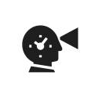

Why We Need Face De-identification
Privacy
Legality
Security
Notes:
隱私保護：對於在公共場所或透過監視器捕捉臉部圖像的個人隱私而言，在人臉去識別化對隱私保護是相當重要的一環。
安全性：對於未經授權訪問的某些敏感數據。 例如，在醫療保健領域，人臉去識別化可以防止未經授權訪問醫療記錄。
合法性：許多法規和法律要求對人臉進行去識別化處理，以確保符合數據隱私和安全標準。

Slide 7
How We Practice Face De-identification

Slide 8
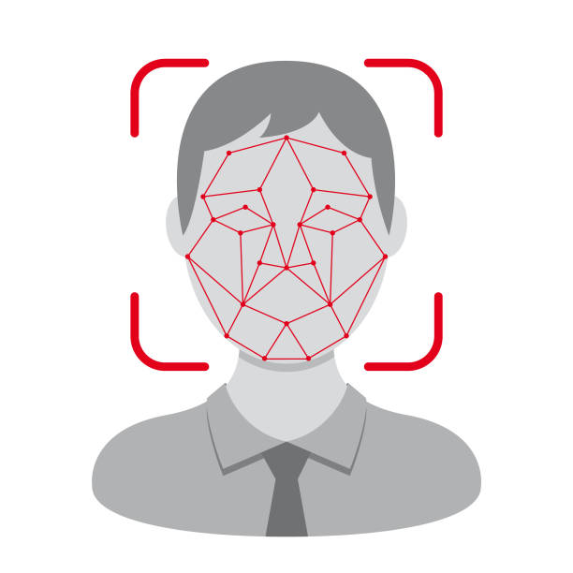
How We Practice Face De-identification
STEP1.1 : Face Detection
-Cascade Classifier
-detectMultiScale
STEP1.2 : Face de-identification
- Gaussian Blur
STEP2 : Attack face de-identification
- Neural Network
- Mnist
- CIFAR-10
STEP2.2 : AT&T dataset

Slide 9
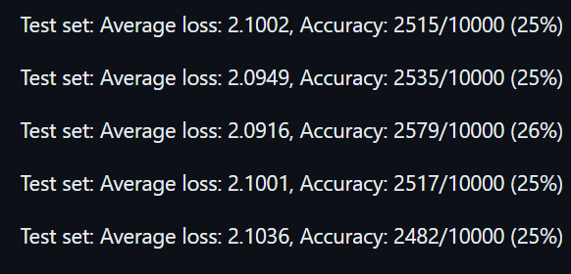
Mnist Database Training Result
Std=15
Notes:
//batch 小 準確率高 ATT 就可以開高一點

Slide 10
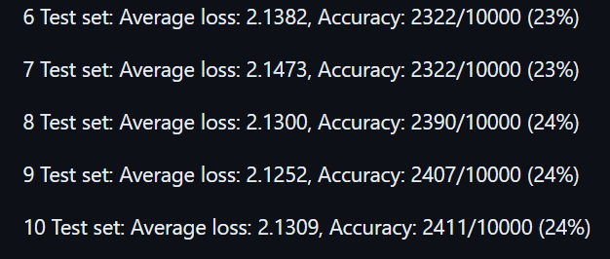
Mnist Database Training Result std=45

Slide 11
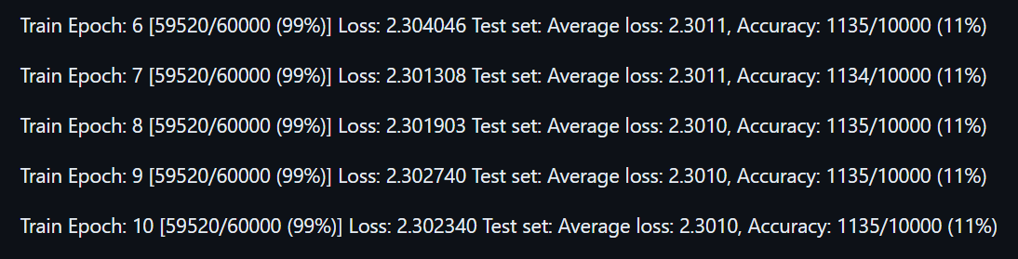
Mnist Database Training Result std=99

Slide 12
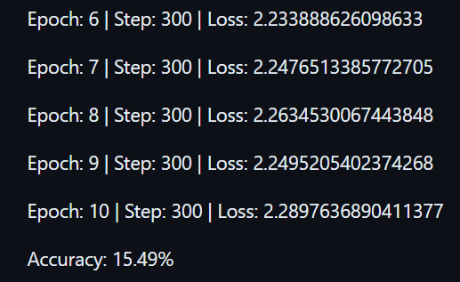
CIFAR-10 Database Training Result std = 15

Slide 13
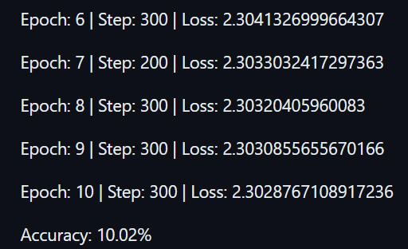
CIFAR-10 Database Training Result std =45

Slide 14
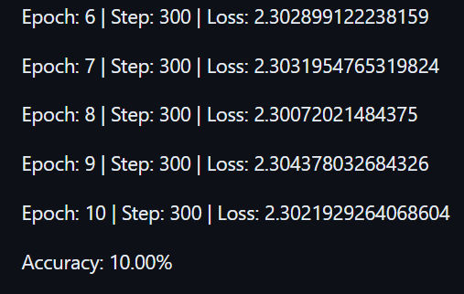
CIFAR-10 Database Training Result std = 99

Slide 15
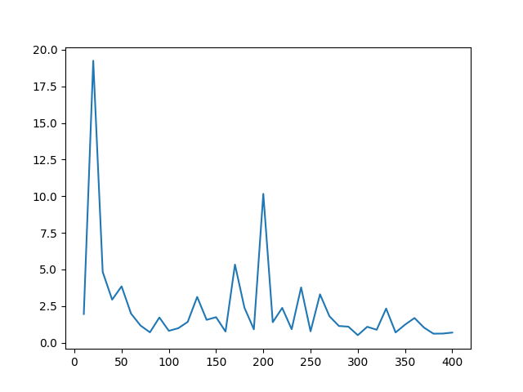
AT&T Database Training Result
Loss function change curve
Without Gaussian
Notes:
縱軸是Current loss 橫軸是圖片數

Slide 16
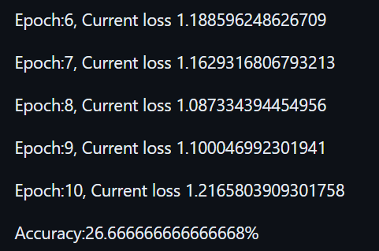
AT&T Database Training Result
std = 15
Notes:
AT&T 數據集相對較小，只有 40 個個體，每個個體只有 10 張圖像。
Batch 都用128

Slide 17
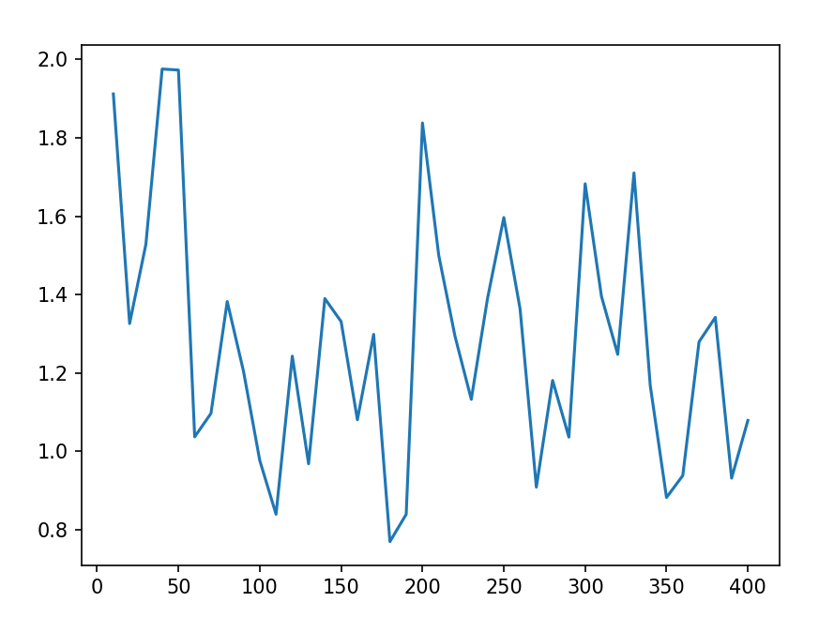
AT&T Database Training Result
Loss function change curve
std = 15

Slide 18
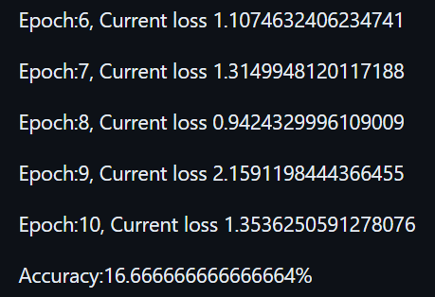
AT&T Database Training Result
std = 45

Slide 19
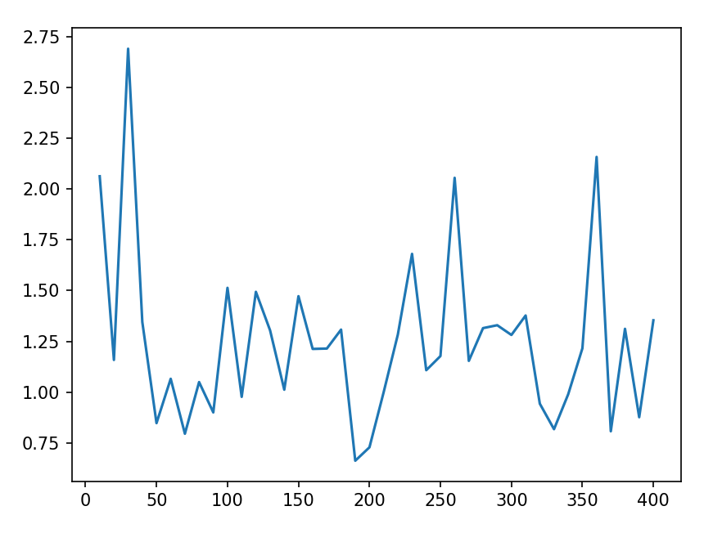
AT&T Database Training Result
Loss function change curve
std = 45

Slide 20
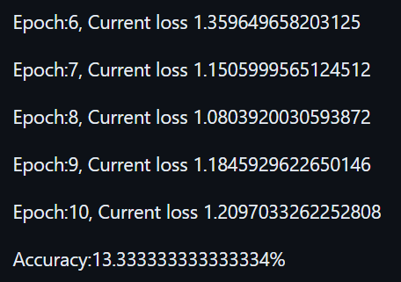
AT&T Database Training Result
Loss function change curve
std = 99

Slide 21
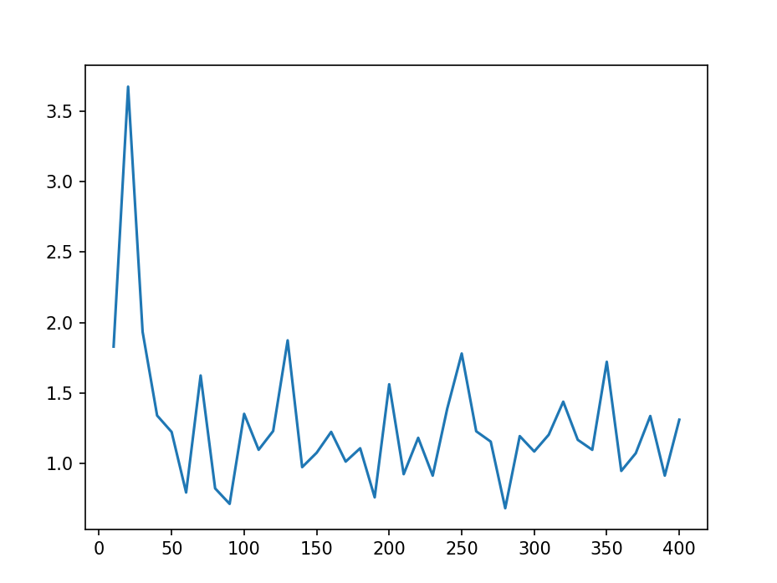
AT&T Database Training Result
Loss function change curve
std = 99

Slide 22
Accuracy from each dataset
Database | Original | Gaussian 15 | Gaussian 45 | Gaussian 99
MNIST | 98.49 | 24.82 | 24.11 | 11.35
CIFAR-10 | 70.40 | 15.49 | 10.02 | 10.00
AT&T | 95.00 | 26.67 | 16.67 | 13.33
Notes:
越來越小
batch

Slide 23
thanks

