Slide 1

Business Analytics of
YouTube trending videos & top YouTubers
Business Analysis
Group5
Monica-Yingshan Qu
Olivia-Yumeng He
Frank-Yifei Zhao
Notes:
亮亮图文旗舰店https://liangliangtuwen.tmall.com

Slide 2

Introduction
Contents
EDA
Recommendation

Slide 3


１
Introduction
YouTube
Data

Slide 4

1.1 Background
largest and strongest UGC(User Generated Content) Internet video site in the world
While YouTube's sophisticated creators' channels are already booming, many new YouTube creators are facing difficulties getting off to a start. a platform, we're thinking about how we can get new YouTubers to quickly build their own new channels and attract more views.

Slide 5
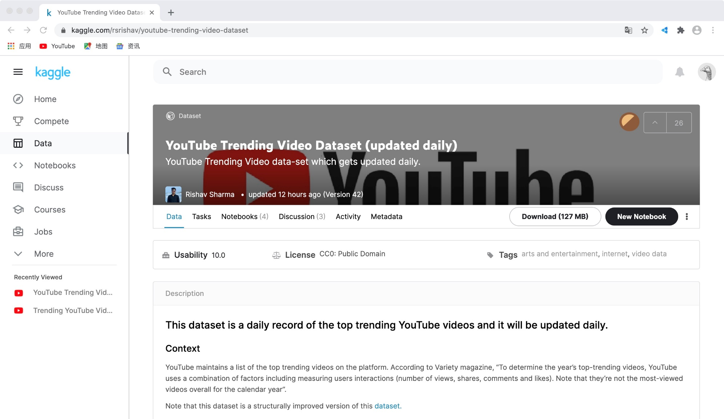
1.2 Data

Slide 6
2
EDA
Categories
Publishing Time
Advanced parameters
Descriptive indicators

Slide 7
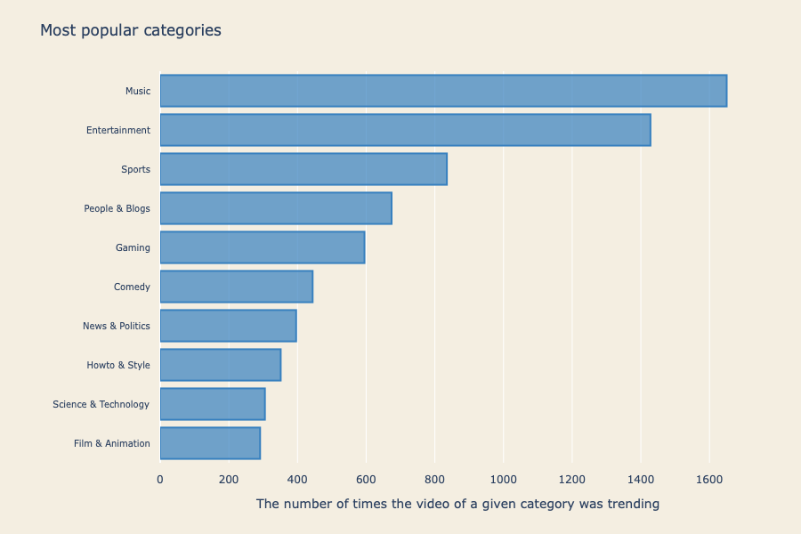
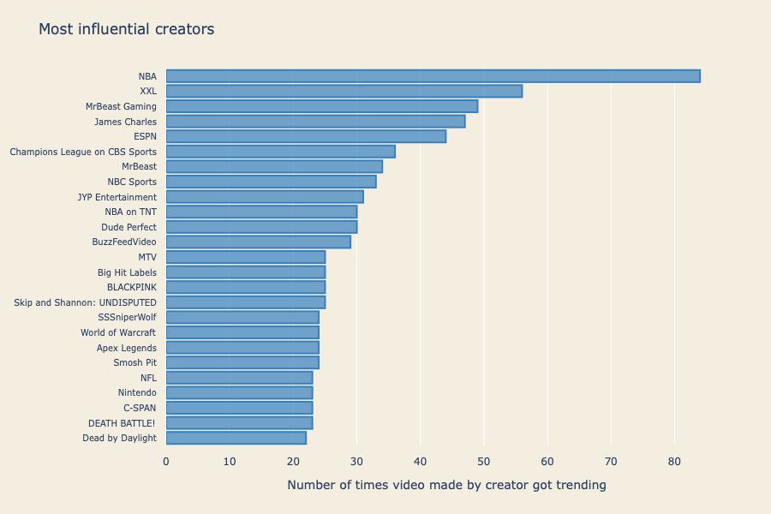
2.1 Categories & Influential creators

Slide 8
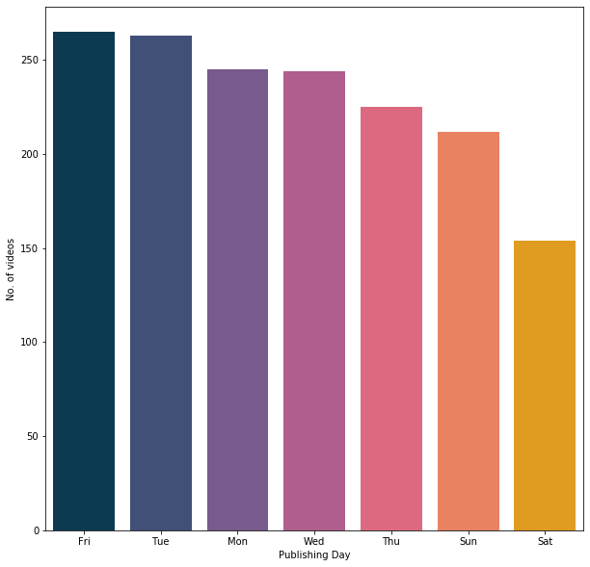
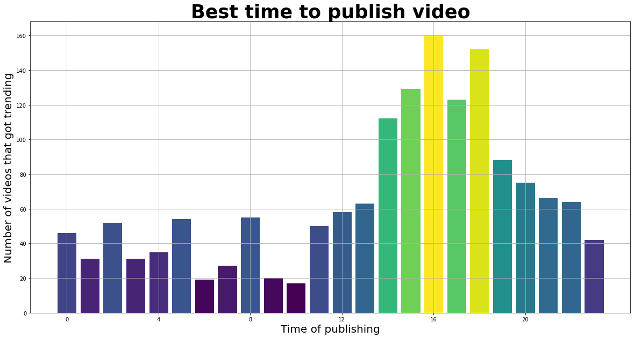
2.2 Publishing time

Slide 9
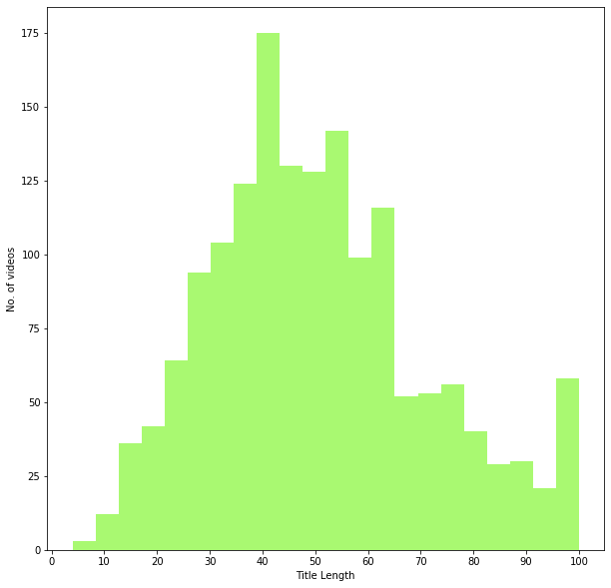
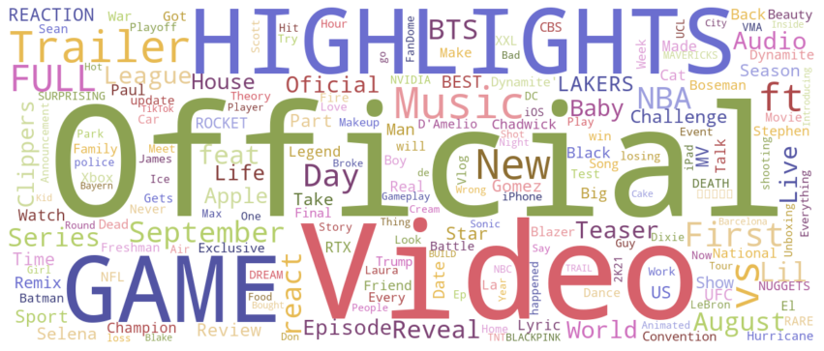

2.3 Video Tile

Slide 10
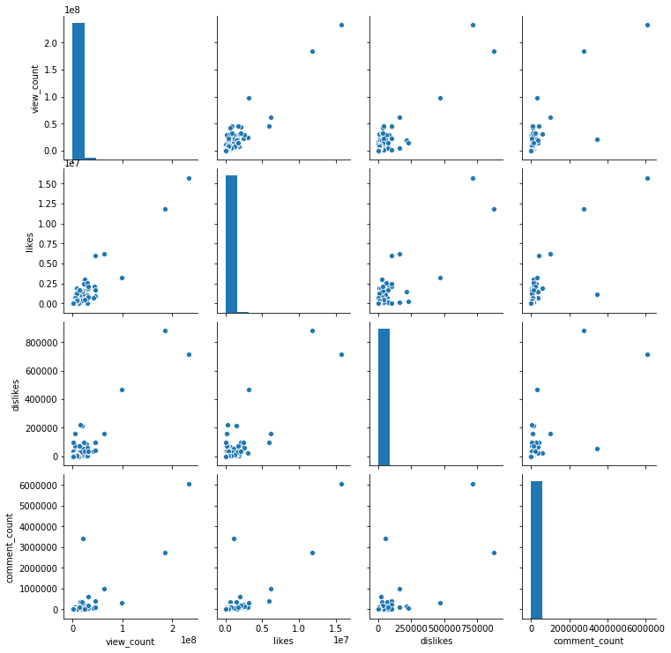
2.4 Pairplot

Slide 11
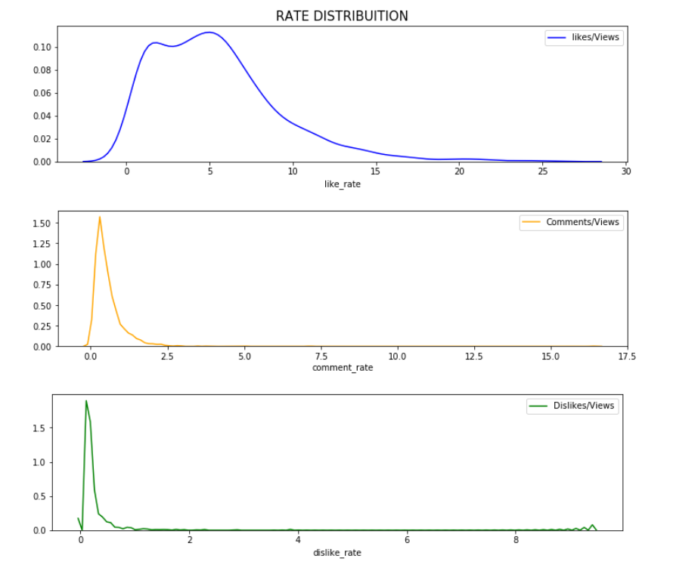
2.5 Rate Distribution

Slide 12
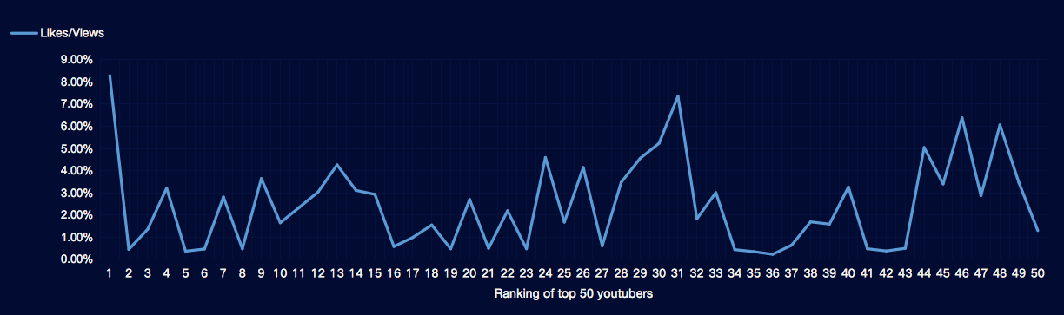
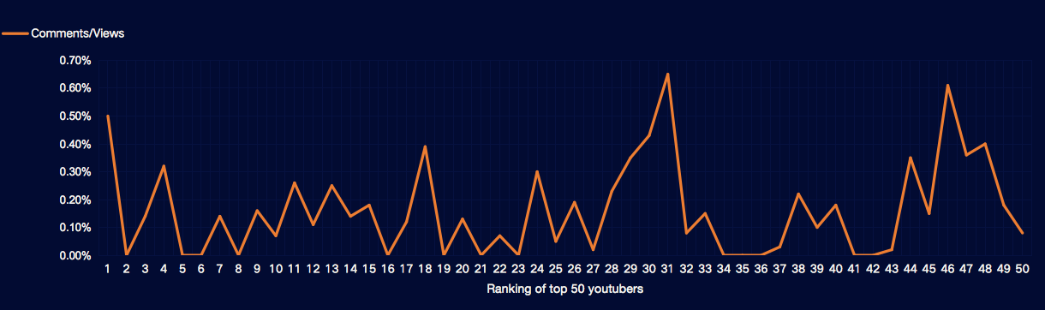
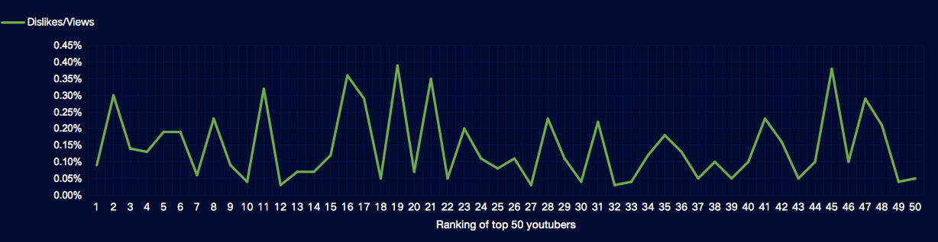
2.6 Top 50 YouTubers rate

Slide 13
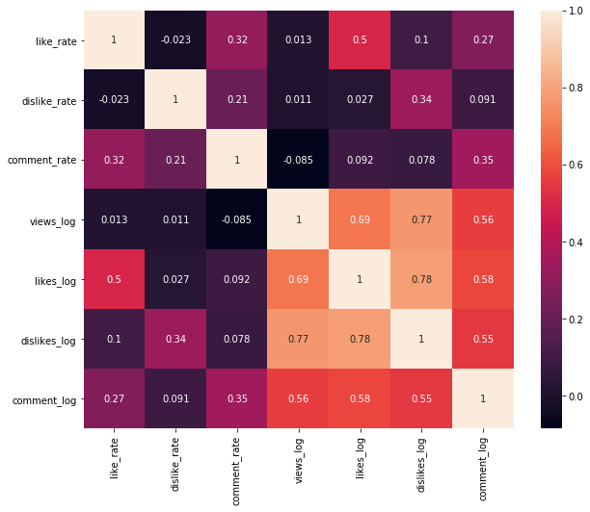
2.7 correlations

Slide 14
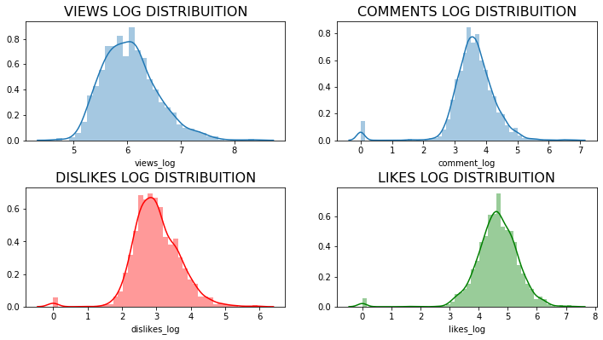
2.8 parameters distribution

Slide 15
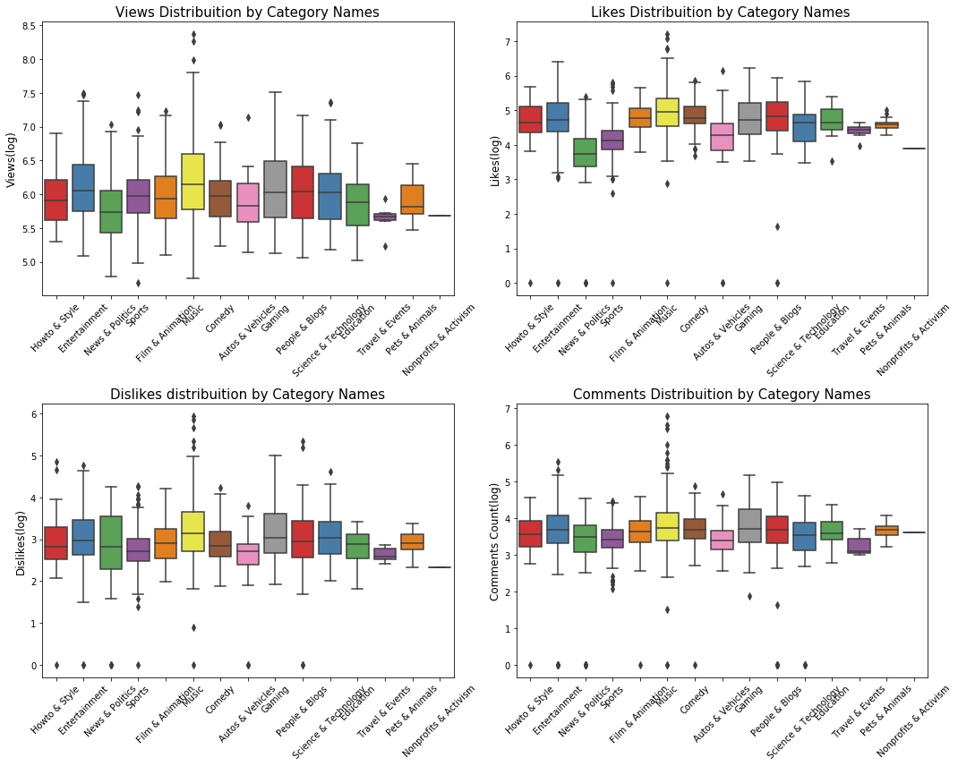

Slide 16
3
Conclusion &
Recommendation

Slide 17
3.1
Conclusion & Recommendation
Consider current popular elements,
such as billboard music, Super Bowl
publish in weekdays rather than weekends， also afternoon & evening better
Proper title length
sincerity to subscribers, humor and diversity of content
Entertainment, music are two attractive categories
Gaming, people & blogs are not bad choices
Not related to news & politics, sports,

Slide 18
Presentation finished
Thanks for listening
Business Analysis
Group 5
Monica-Yingshan Qu
Olivia-Yumeng He
Frank-Yifei Zhao
Notes:
亮亮图文旗舰店https://liangliangtuwen.tmall.com

