Slide 1
Brief introduction and use of Webpack

Slide 2
contents
What is Webpack
1
Webpack install and package
2
Webpack Entry and Output
3
Webpack Loader
4
4
Webpack Plugins
5
5
Webpack Server
6

Slide 3
Webpack introduction
PART 01

Slide 4
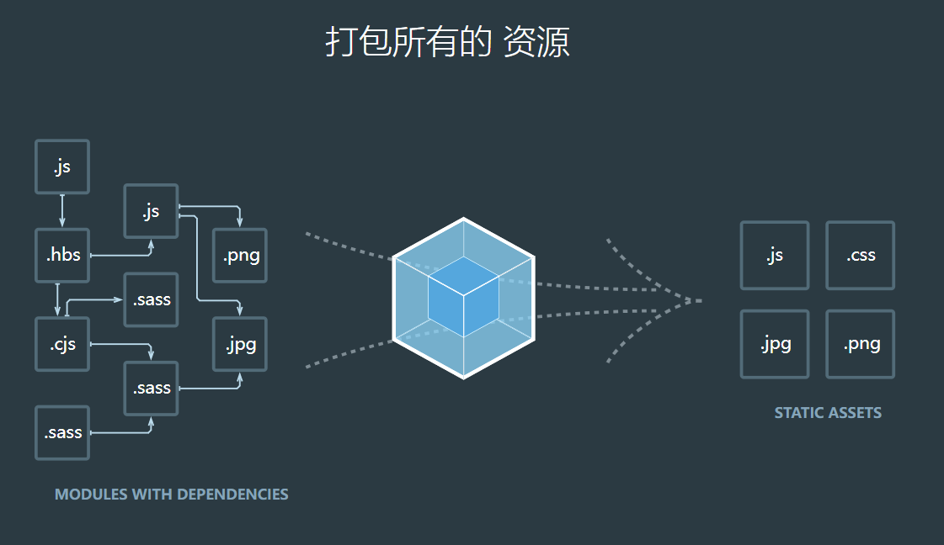
Webpack introduction
Webpack is similar to Maven's position in the Java language. At present, Vue / React scaffolds are built by Webpack.
In essence, webpack is a static module bundler for modern JavaScript applications. When webpack processes an application, it recursively builds a dependency graph that contains each module required by the application, and then packages all these modules into one or more bundles
Four core concepts:
Entry
Output
loader
Plugins
Official website: https://www.webpackjs.com/
Notes:
本质上，webpack 是一个现代 JavaScript 应用程序的静态模块打包器(module bundler)。
当 webpack 处理应用程序时，它会递归地构建一个依赖关系图(dependency graph)，其中包含应用程序需要的每个模块，然后将所有这些模块打包成一个或多个 bundle.
入口(entry)
输出(output)
loader
插件(plugins)
You can log in to the official website to learn more about webpack if you need.

Slide 5
Webpack install and package
PART 02

Slide 6
Webpack install
Local install:
npm install --save-dev webpck npm install --save-dev webpck@<version>
Global install:
npm install -global webpck
Webpack CLI install:
npm install --save-dev webpack-cli@3.3.12
Notes:
You can install the latest version or the specified version.

Slide 7
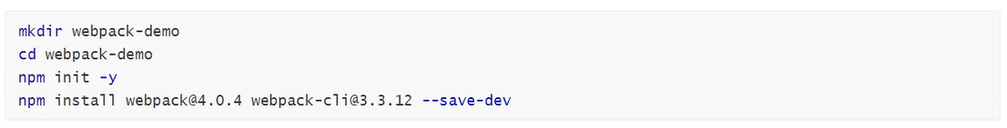
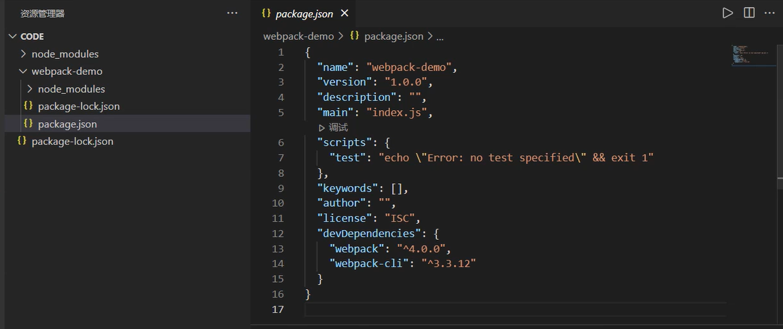
Webpack install
Notes:
You can install the latest version or the specified version.

Slide 8
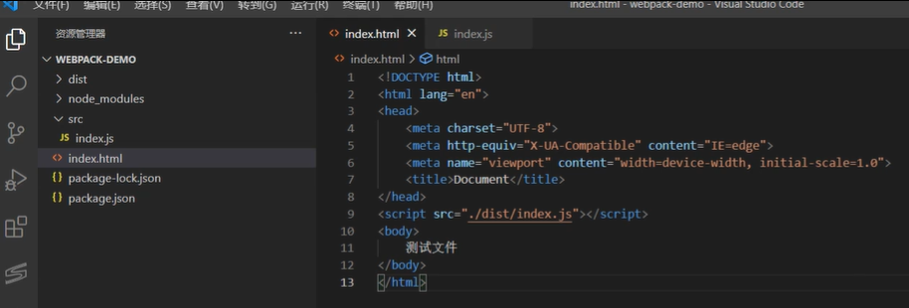
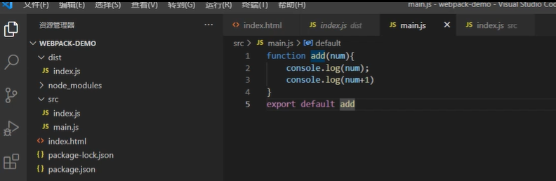
Webpack package
Notes:
First, we create 1 index.html and 2 test demo files, index.js and main.js
and the import script from dist folder.

Slide 9
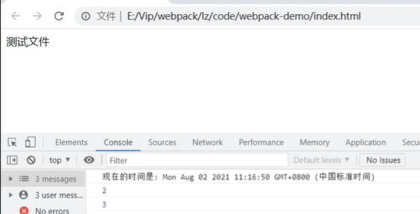
Webpack package
package command: npx webpack src/index.js -0 dist/index.js

Slide 10
Webpack Entry and Output
PART 03

Slide 11
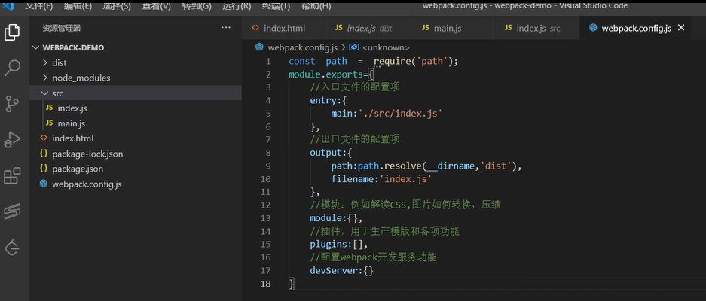
Webpack Entry and Output
1. Create webpack.config.js

Slide 12
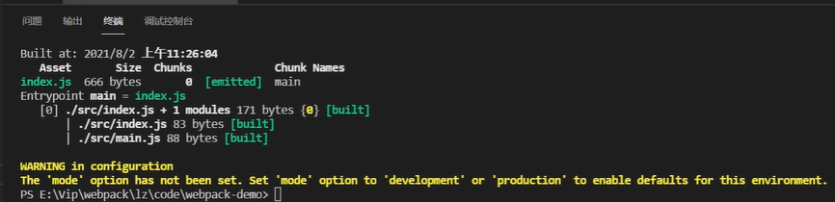
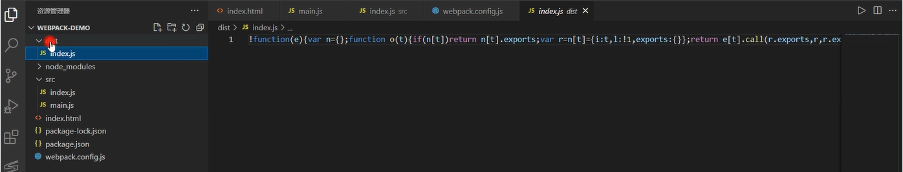
Webpack Entry and Output
2. Run package command: npx webpack --config webpack.config.js
Package into a compressed file.

Slide 13
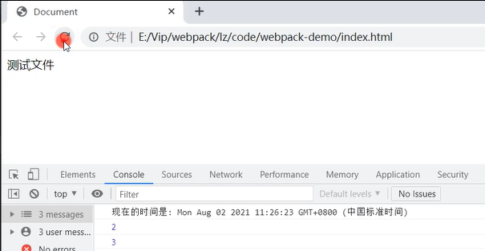
Webpack Entry and Output
3. Check by browser

Slide 14
Webpack loader
PART 04

Slide 15
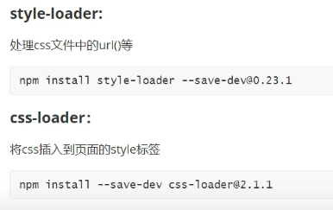
Webpack loader
Loaders are transformations that are applied to the source code of a module. They allow you to pre-process files as you import or “load” them. Thus, loaders are kind of like “tasks” in other build tools and provide a powerful way to handle front-end build steps. Loaders can transform files from a different language (like TypeScript) to JavaScript or load inline images as data URLs. Loaders even allow you to do things like import CSS files directly from your JavaScript modules!
1. Loader install: Loaders
Notes:
You can install the latest version or the specified version.

Slide 16
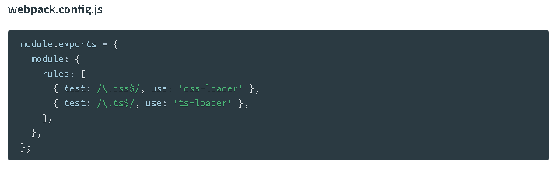
Webpack loader
2. And then instruct webpack to use the css-loader for every .css file and the ts-loader for all .ts files:
For more information, please refer to: https://v4.webpack.js.org/concepts/loaders/

Slide 17
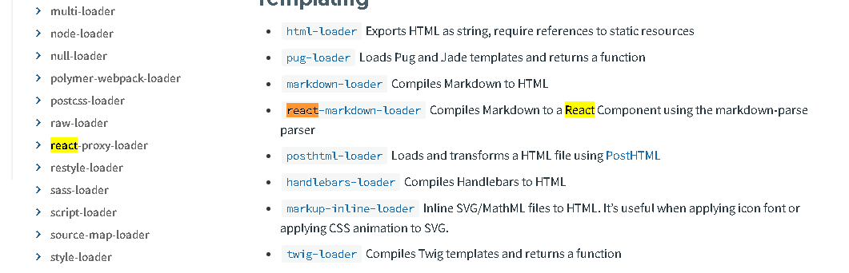
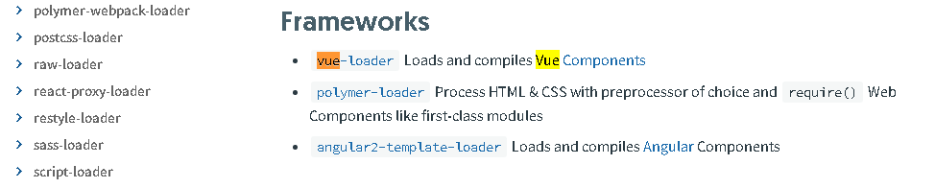
Webpack loader

Slide 18
Webpack Plugins
PART 05

Slide 19
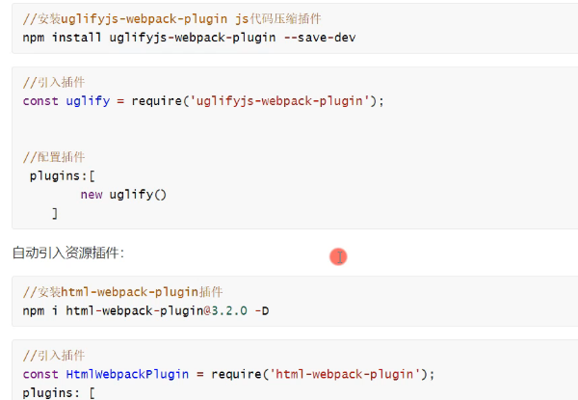
Webpack Plugins
Plugins are the backbone of webpack. webpack itself is built on the same plugin system that you use in your webpack configuration!
They also serve the purpose of doing anything else that a loader cannot do.
Notes:
You can install the latest version or the specified version.

Slide 20
Webpack server
PART 06

Slide 21
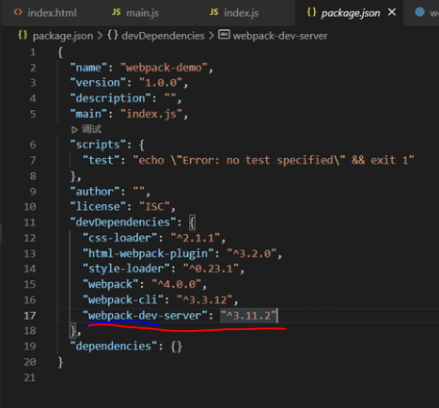
Webpack server
Install server:
npm i webpack-dev-server@3.11.2 npm i webpack-dev-server@<version>
Notes:
You can install the latest version or the specified version.

Slide 22
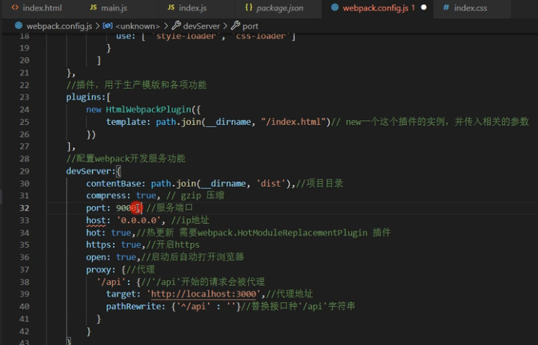
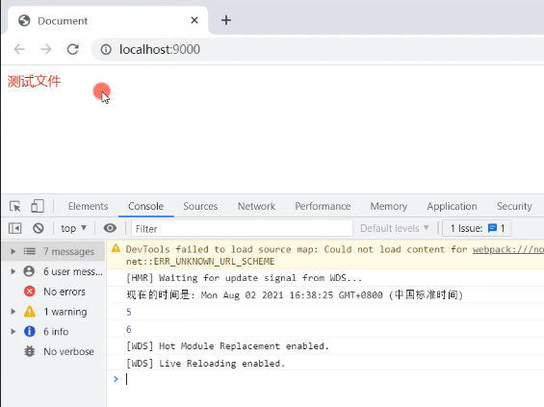
Webpack server
Notes:
You can install the latest version or the specified version.

Slide 23
End and Thanks

