Slide 1
Brief introduction and use of Webpack

Slide 2
contents
Webpack introduction
1
Webpack install and package
2
Webpack Entry and Output
3
Webpack loader
4
4
Webpack Plugins
5
5

Slide 3
Webpack introduction
PART 01

Slide 4
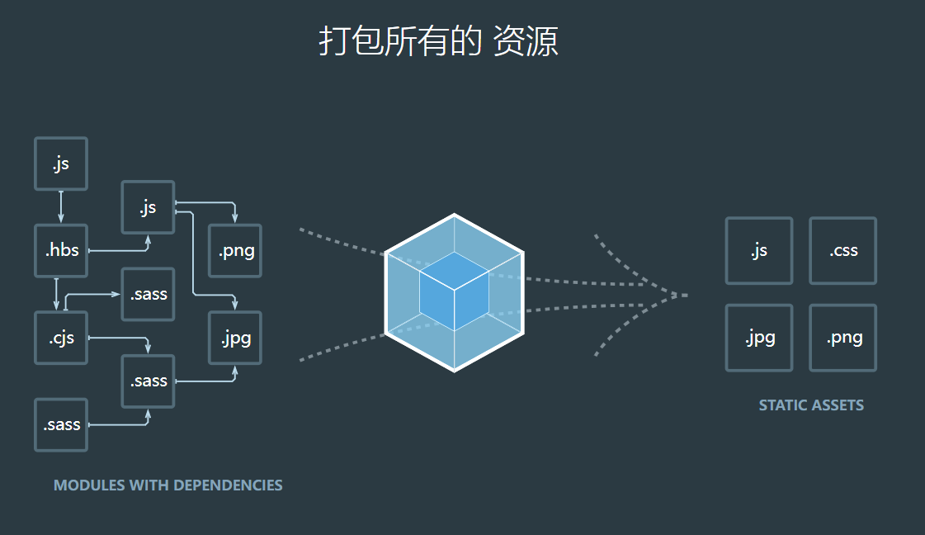
Webpack introduction
Webpack is similar to Maven's position in the Java language. At present, Vue / React scaffolds are built by Webpack.
In essence, webpack is a static module bundler for modern JavaScript applications. When webpack processes an application, it recursively builds a dependency graph that contains each module required by the application, and then packages all these modules into one or more bundles
Four core concepts:
Entry
Output
loader
Plugins
Official website: https://www.webpackjs.com/
Notes:
本质上，webpack 是一个现代 JavaScript 应用程序的静态模块打包器(module bundler)。
当 webpack 处理应用程序时，它会递归地构建一个依赖关系图(dependency graph)，其中包含应用程序需要的每个模块，然后将所有这些模块打包成一个或多个 bundle.
入口(entry)
输出(output)
loader
插件(plugins)
You can log in to the official website to learn more about webpack if you need.

Slide 5
Webpack install and package
PART 02

Slide 6
Webpack install
Local install:
npm install --save-dev webpck npm install --save-dev webpck@<version>
Global install:
npm install -global webpck
Webpack CLI install:
npm install --save-dev webpack-cli@3.3.12
Notes:
You can install the latest version or the specified version.

Slide 7
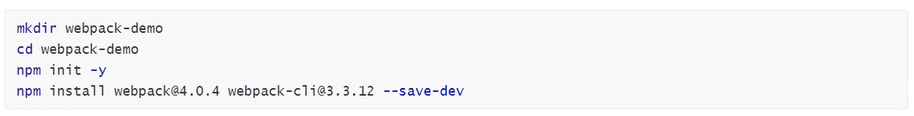
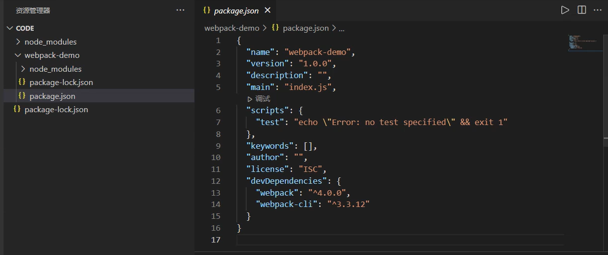
Webpack install
Notes:
You can install the latest version or the specified version.

Slide 8
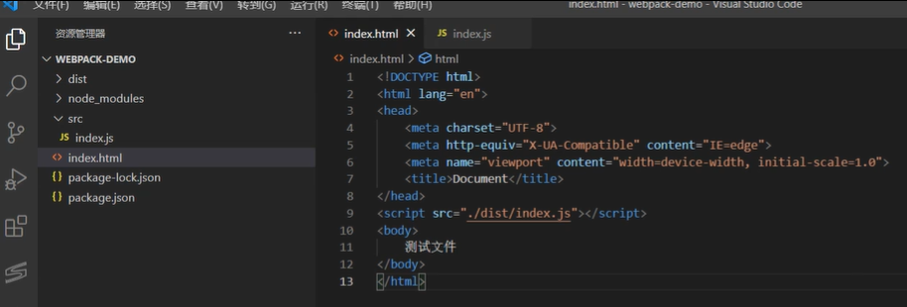
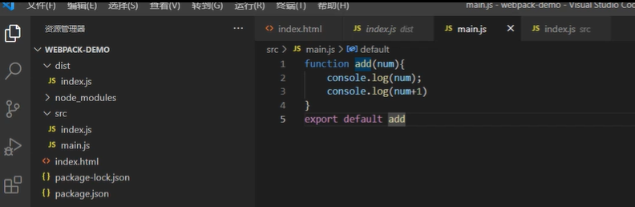
Webpack package
Notes:
First, we create 1 index.html and 2 test demo files, index.js and main.js
and the import script from dist folder.

Slide 9
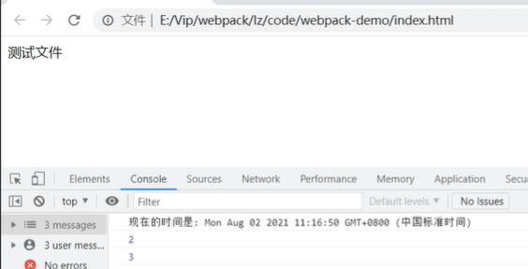
Webpack package
package command: npx webpack src/index.js -0 dist/index.js

Slide 10
Webpack Entry and Output
PART 03

Slide 11
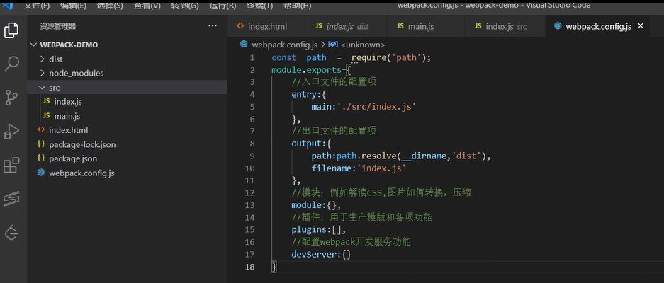
Webpack Entry and Output
1. Create webpack.config.js

Slide 12
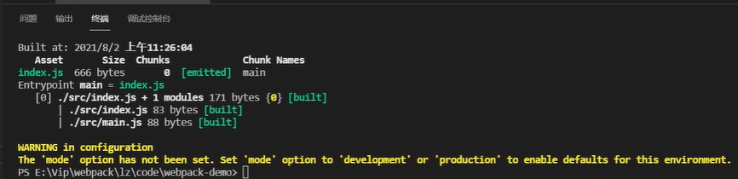
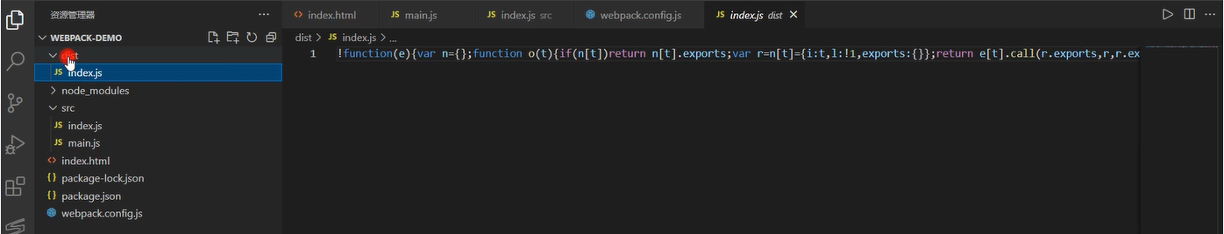
Webpack Entry and Output
2. Run package command: npx webpack --config webpack.config.js
Package into a compressed file.

Slide 13
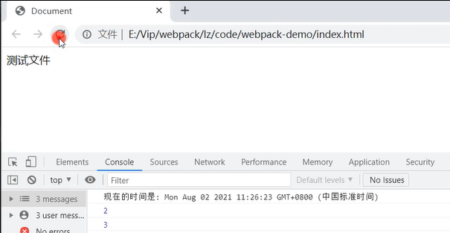
Webpack Entry and Output
3. Check by browser

Slide 14
End and Thanks

