Slide 1
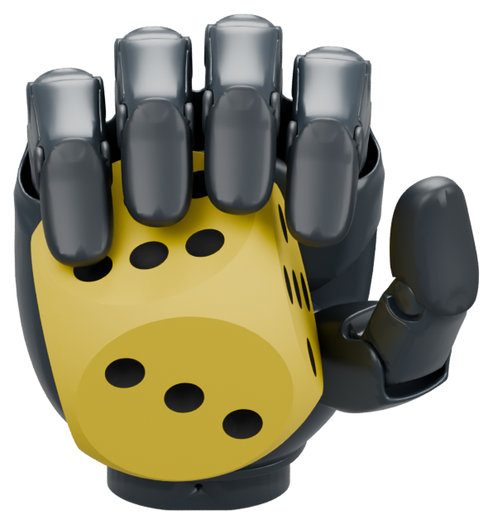

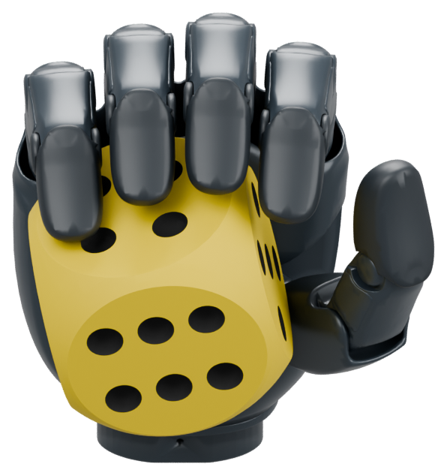
“Show me the six-dot face.”
Inspect another side
Observe again
Target still covered
Choose a clearer view
Target unseen
Present the target
REVEAL
Agentic In-Hand Manipulation
Language-Guided Target Presentation
New visual evidence guides each decision
Task illustration using simulation assets · staged views, not a recorded rollout
Notes:
Central-title candidate 2. Three task views surround the central title. The intermediate view is deliberately subordinate and the two flanking hands anchor the composition. Short labels identify intended decisions, and the lower return connector indicates repeated observation after action. These are staged renderings, not a measured rollout or verified finger-occlusion policy. Source assets: /home/yin/DexManipulation/agentic-inhand-manipulation/agent-inhand-manipulation/outputs/reveal_teaser_v2_20261102/assets/hidden.png, occluded.png, clear.png. Original Revo3 meshes and approved yellow-black rounded die. Images are staged task illustrations, not consecutive policy frames, measured agent utterances or real photographs. Phrases describe intended decisions, not hidden chain-of-thought. Static presentation view does not demonstrate sustained holding. No claim of visibility-aware control performance. All text, arrows and semantic diagram boxes are editable. Die attribution: Wooden rounded-edge die by Glowbox 3D, CC Attribution, https://sketchfab.com/3d-models/wooden-rounded-edge-die-03c7f64e5fdd4786862b4828b9dbe9e8 .

Slide 2

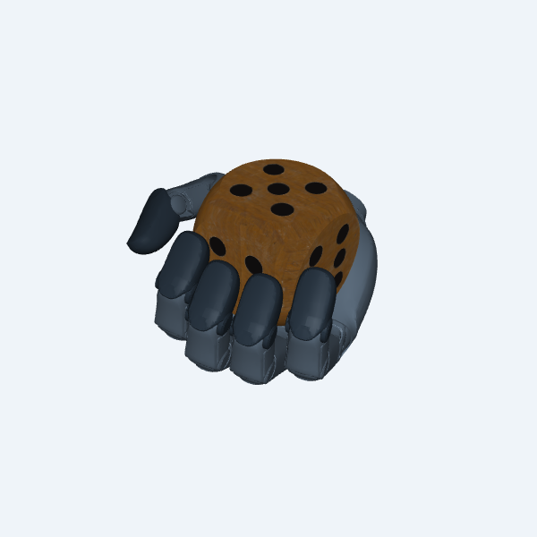
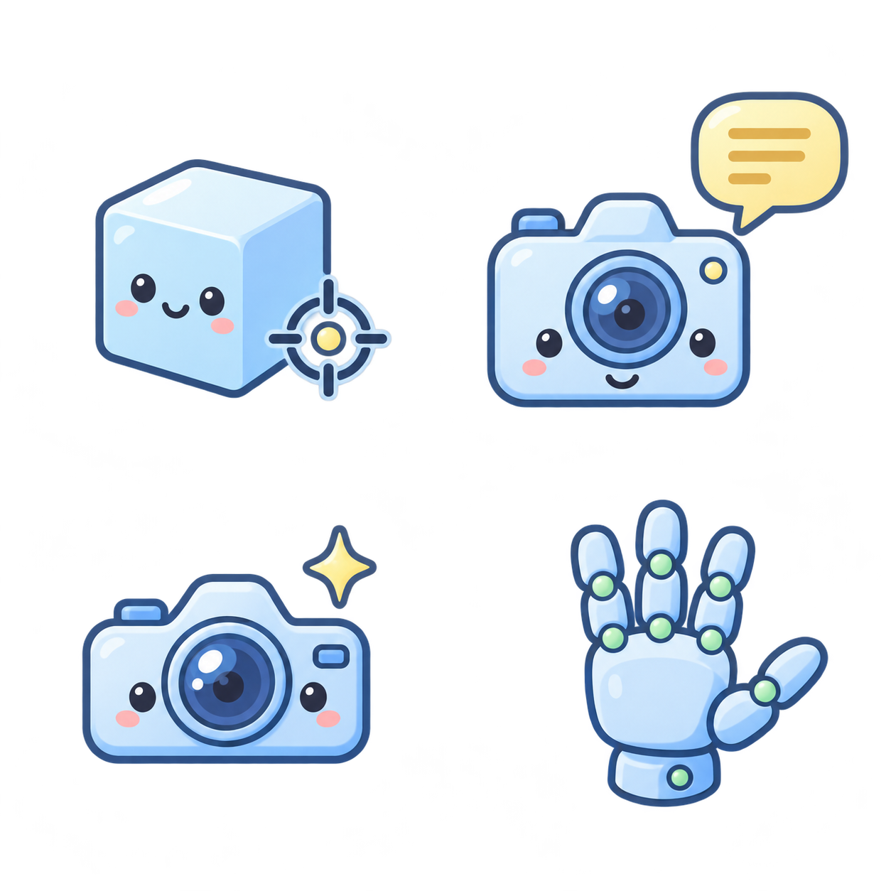
(a) Privileged teacher supervision
Simulation ground truth
Proprioception
Object pose
& velocity
Goal orientation
& error
Hand state +
prev. action
Teacher network
Teacher action
Simulator
Actor MLP
Critic MLP
Reward / PPO
Frozen teacher
(b) Distill a goal-conditioned student
Forward
Supervision
Language
Semantic
agent
SigLIP2
skill bank
Goal-bank vector
Goal projection
Linear + tanh
Public skill selection
g
RGB observation
Sampled during training
z_g
Observed RGB
(simulation / camera)
Frozen pose
CNN
Pose encoder
MLP
Student policy
Distillation
Concat
Recurrent encoder
Action
a_S
Action MSE
Training input: noisy sim pose
Actor MLP
State MSE (training)
Hand state
Proprioception + history
Training only
State decoder MLP
Deploy student
(c) Closed-loop execution
Physical hand (pending)
Live agent
Student policy
Wait / move
controllers
Hand actions
Target occluded
Target presentation
TODO: physical setup
No hardware result shown
Language instruction
TODO: physical
inspection frame
TODO: physical
target frame
Present the face marked T
New RGB
Notes:
Training-centered method figure revised after user correction. Stage 1: privileged actor-critic teacher trained with PPO in simulation; the current audited release reuses its provided frozen PPO teacher rather than claiming fresh training in this edit. Stage 2: latent interface and policy distillation. Source scripts/pose_latent_student_v1/model.py: Linear(768,64)+tanh, concatenated with target-free proprioception (109D), measured pose (7D) through the inherited extero encoder and recurrent BeliefStudent. Figure abbreviates internal actor skip connections and normalizers. The recurrent module is deliberately not labelled GRU/LSTM because the external pinned BeliefStudent source is not present locally. Agentic latent means a public agent-selected SigLIP2 bank vector, not an extracted hidden VLM representation or end-to-end agent training. Runtime binding source scripts/pose_latent_student_v1/semantic.py StudentGoalBank.from_astra_tool. Training uses sampled bank vectors (train.py latent=vectors[ids]), not live agent inference; the figure's top branch explains the semantic origin and runtime interface. In training, interface warmup fits new goal coefficients against the released student, followed by adaptation with teacher action MSE and 0.2 state reconstruction MSE, teacher/student mixed rollouts. The compact loss panel represents the adaptation stage; warmup is omitted for readability. Teacher actions and privileged reconstruction targets are supervision only. Visual pose CNN is frozen for runtime; the frozen training release uses simulated pose noise, with gs_cnn training supported separately. The image/CNN branch depicts deployment sensing, not a claim that all recorded distillation used RGB. Sources: model.py, train.py, prepare.py, control_modules.py, /home/yin/paper/CVPR/2027/sections/04_method.tex. Stage 3 retains waiting/execution controllers; teacher-label training for these controllers is omitted from this compact overview. Real remains a planned blank image/interface slot; no completed real result is asserted. Original hand render is an asset-fit illustration only. Modules, gradients, vector strips and connectors remain editable PowerPoint objects. Four small input icons are decorative AI-generated transparent PNG illustrations, generated with imagegen on 2026-10-31. They are not experimental robot imagery. Text uses Comic Sans MS. The shared RGB image input branches to both the frozen pose CNN and the embodied agent. Language is a separate input to the embodied agent. Embodied Agent is the functional display name for the same existing visual-language agent, not a new architecture. Skill selection describes its public semantic choice; the training/runtime distinctions in the preceding notes still apply. The single RGB input stays on row 2. Its original rightward connection to the frozen pose CNN is preserved; an additional separate connection leaves the upper-right edge and turns upward into the first-row Embodied Agent. Privileged inputs are now spelled out: simulator object position/orientation and linear/angular velocity, plus commanded goal orientation and relative orientation error. Joint state and previous action are shown separately as shared teacher inputs, not claimed as inherently privileged. Verified against local ViserDex tasks/manipulation/inhand/inhand_env_cfg.py ObservationsCfg and current pose-latent migration contracts. The exact frozen external teacher checkpoint is not newly re-audited here. Database/key is a generated decorative access symbol, not evidence. Numerical feature dimensions are intentionally omitted from visible labels. Revision: one integrated editable page contains only stages (a), (b), and (c). Teacher action supervision is a continuous dashed line into the distillation loss. The trained student has a continuous transfer connection to the deployed student. The teacher stays frozen during distillation. Four image frames are intentionally blank: RGB camera input in (b), and real hand/camera setup plus initial occlusion and final stable presentation inside (c). RGB sensing represents deployment; the training pose-noise caption remains to avoid implying real RGB distillation data. No real result is asserted. Numerical dimensions are omitted. The larger page keeps all content on canvas.

Slide 3
Goal-conditioned control
Agentic latent g
Sensor state
Wait / execute controller
Goal MLP
Fusion MLP
Sensor MLP
Scale α
Residual Δa
Adjusted hand action
Real hand: waiting
Real hand: executing
Real photo
Real photo
Notes:
Square single-column mechanism figure. Sources: scripts/pose_latent_student_v1/control_modules.py (SensorGoalEncoder, MaintenanceActor, features) and evaluate_agent.py (request-status controller selection). Agentic latent and measured sensor state pass through Goal MLP and Sensor MLP, then Fusion MLP to action interpolation scale and bounded residual. Sensor state abbreviates proprioception, measured pose, belief, action proposal, anchor pose/action, fit error, known/pending flags and request age. The selected wait/execute controller architecture is drawn once; this does not imply that separate checkpoints share weights. Execution scale is fixed to one in fixed-speed mode, or learned when that supported mode is selected. Final action is clip(q + alpha*(clamped student proposal - q) + residual). Current state and student proposal are available to the command composition; their bypass edges are omitted for compactness. Actual action quality is not inferred from this diagram. Two named real-hand photo slots are deliberately empty: during pending agent inference and during execution of a delivered skill. Use the same physical setup and matched camera view. They are not proof of successful or stable operation. This is a freshly laid-out 1000 x 1000 px square, centered at left=550, top=160 in the full 2100 x 1320 PPT canvas. For a 3.25-inch paper column, 35 px text becomes 8.19 pt. Main labels are 34–43 px and the secondary selector is 31 px. Font Comic Sans MS, lilac/rose gradients. Existing teaser, full pipeline, Sim/Real and comparative real-world figure remain unchanged.

Slide 4

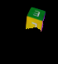
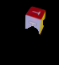
Agentic target search
“Show the face marked T.”
1 Observe
2 Inspect
Reference
Real hand
Reference
Real hand
Inspect green
Inspect red
3 Bind target
4 Present
Reference
Real hand
Reference
Real hand
Present red
Completion check
Reference crops; real-hand frames pending
Notes:
Square qualitative decision figure. Recorded simulation reference source: /home/yin/paper/CVPR/2027/data/cube_v1/astra_phase_analysis.json record trial_seed=183101000, and assets/cube_trial183101000_request01.png through request03.png. Public calls: inspect_face(green), inspect_face(red), reorient_target(red) for symbol T. Titles are brief stage descriptions and action labels paraphrase these public calls; they are not invented agent reasoning. The terminal stage is local completion, not an additional fabricated agent call. Fourth reference crop is intentionally blank. All four large Real hand frames are empty and explicitly pending. They are planned physical-trial slots, not synchronized real recordings of the simulation reference trajectory. When real logs become available, replace reference crops and stage decisions with the same real episode's observations and logged calls; do not imply sim and real were one trial. This example demonstrates semantic target search in the existing record; it does not establish finger-occlusion recovery or sustained physical presentation. Native layout is 1000 x 1000 px square, with row-major order 1,2,3,4 shown by arrows. Centered at left=550, top=160 in the full deck. Main labels 34–43 px (about 8–10 pt at 3.25-inch width), secondary reference labels 29 px. Font Comic Sans MS. Coral and warm-gray gradients distinguish this from the lilac/rose mechanism. All text, frames and arrows remain editable.

Slide 5
Sim / Real presentation
REVEAL
Matched task and camera view
Hidden target
Reveal target
Stable display
Sim
Paired views
Real
Planned comparison. Add matched simulation and real-hand images.
Notes:
Paper figure layout for a planned sim/real qualitative comparison. Sim thumbnail is a genuine simulation asset-fit rendering. The physical setup thumbnail and all paired temporal frames are intentionally blank. Down/up dashed arrows denote corresponding views for the same task, not a learned alignment objective, demonstrated domain transfer, or completed real-robot result. Fill hidden/reveal/hold panels only from matched recorded episodes. No quantitative plot or results table.

Slide 6
Qualitative comparisons and real-robot cases
REVEAL
(a) Matched comparison
Same start, instruction and action budget
Target initially hidden
Target obscured by fingers
Initial view
REVEAL
Fixed decision
Initial view
REVEAL
Fixed decision
Shared start
End of trial
End of trial
Shared start
End of trial
End of trial
(b) Real-world target presentation
Hand + camera setup
Die: six-dot face
Camera: lens
Milk carton: label
Planned comparison and real-robot image slots. Outcomes remain unfilled until matched trials and photos are available.
Notes:
Planned qualitative evidence figure, no results asserted. Top panels compare full REVEAL with a proposed ablation that keeps the initial high-level decision fixed. This ablation label is a proposed experimental condition, not a claim that matched trials already exist. Fill only after equalizing the task, starting hand/object state, low-level policy, controllers, camera and action/time budget. The two cases should isolate hidden-surface search and finger-occlusion handling. All end-of-trial frames are blank, so no successes or failures are invented. Bottom: one actual hardware setup photo and three proposed real-world cases for die six-dot face, camera lens and milk-carton label. These object/task labels are suggestions based on the user's asset set; none implies validated transfer. No quantitative plots. Consolidates earlier redundant multi-object, sim/real and hardware placeholder pages. All frame boxes have descriptive PHOTO SLOT names for replacement. Source: user's task description and accepted figure plan.

