Slide 1


IAQF Project
Report
Yipei Zhang, James Fan, Elaine Huang, Ruiyi Wu, Zhi Zhong
Dec 4, 2020

Slide 2
Overview
What is the project about?
Compare the historical performance of two portfolios: Democratic Portfolio (A), Republican Portfolio (B).
Each consists of 15 equally weighted stocks
Figure out whether election factor have influence on the performance of two portfolios
Construct Structured Notes for investors to hedging the potential effects brought by presidential election.
What is the goal of the project?
Formulate different strategies for investors who want to participate into the stock market based on their opinions on the US presidential election
The scope of the project.
Use the data from year 2000 to year 2020
*
2

Slide 3

Section
Quantitative Differences
Effects of Election
Structured Notes

Slide 4
Part A
Quantitative Differences
Quantitative Differences

Slide 5
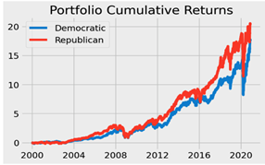
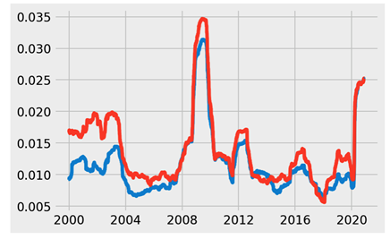
Cumulative Return
Aggregate change of stock price in a period of time for each portfolio
Compare overall performance
Similar growth trends
Republican portfolio is always greater than Democratic portfolio, especially after year 2012
Cumulative Return & Volatility
Volatility
measure of the dispersion of return
Higher the volatility, riskier the portfolio
Almost all the period, the volatility of the Republican portfolio is greater than that of the Democratic portfolio.
Peaked in the 2018-2012 time period

Slide 6
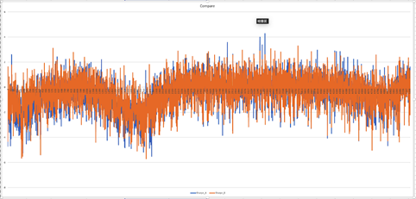
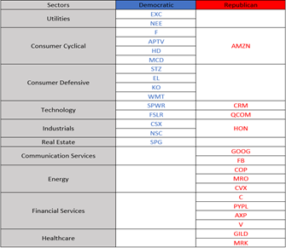
Sharpe ratio
Average return earned per unit of volatility
excess return of investments compared to risk
Similar trend, Democratic slightly better
Sharpe ratio & Sector
Sector
Democratic portfolio: consumer cyclical, consumer defensive and utility sectors
Republican portfolio: energy, financial service, communication service sectors.

Slide 7
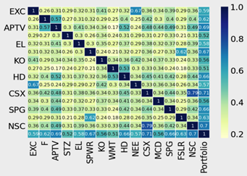
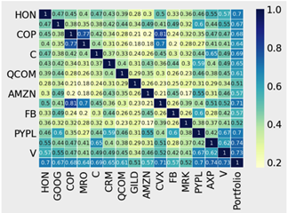
Correlation
Republican portfolio has stronger correlation than that of stocks in Democratic portfolios
Democratic more diversified
Republican more concentrated
Correlation & Beta
Democratic
Republican
Beta
Relationship between expected return for stocks and systematic risk.
More detailed in next part

Slide 8
Part B
B. Effects of Election
Multi-factors Model with Election factors

Slide 9
Fama-French three factor model
Model: E[R_{it}]​−R_{ft}​ = α_{it} ​+ β₁​(R_{Mt}​−R_{ft}​) + β₂​SMB_{t}​ + β₃​HML_{t}​ + ϵ_{it}
R_{Mt}​−R_{ft}​: excess return on the market portfolio
HML: High-Minus-Low
SMB: Small-Minus-Big
Model 1:
Fama-French
Model
Model 2: Consider Election
Model: E[R_{it}]​−R_{ft}​= α_{it} ​+ β₁​(R_{Mt}​−R_{ft}​) + β₂​SMB_{t}​+ β₃​HML_{t}​ + β₄θ(R_{Mt}​−R_{ft}​) + β₅θ​SMB_{t}​ + β₆​θHML_{t} + β₇θ + ϵ_{it}
R_{Mt}​−R_{ft}​: excess return on the market portfolio
HML: High-Minus-Low
SMB: Small-Minus-Big
Θ: Dummy Variable (1:Democrat; 0: Republican)

Slide 10
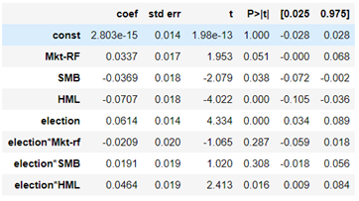
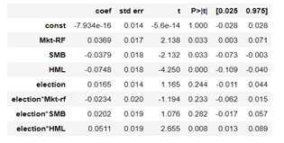
Summary Table Analysis
Fama-French + Election Factor Model Summary
Democrat
No factor has large coefficient
SMB, HML, election, and election*HML are significant to stock prices based on p-value
Republican
Still no factor has large coefficient
Mkt-RF, SMB, HML, and election*HML are significant to the stock prices based on p-value
Election is not significant for Republican

Slide 11
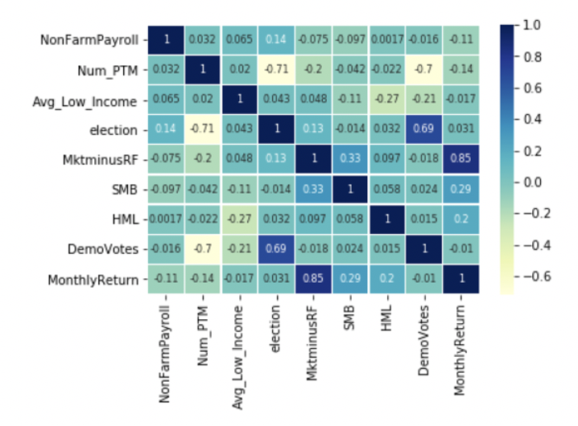
Model 3: Multi-factor model with Macro-economic influences
Compare to Model 2, three macroeconomic factors and one election factor added
New non-farm employment in Private, Commodity production, and Manufacturing industry (NonFarmPayroll)
Employment number in production, transportation and handling occupations (Num_PTM)
Low-income households with 20% of mean income of all household (Avg_Low_Income)
Percentage of Democratic votes in president election (DemoVotes)

Slide 12
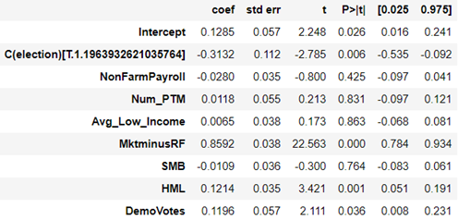
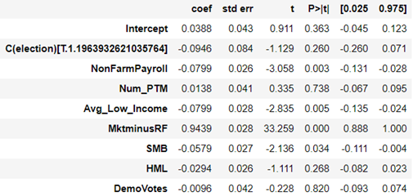
Summary Table Analysis
When Interaction Term Not Considered:
Democrat
Mkt-RF has the most impact (largest coefficient) to the cumulative return in all factors
Mlt-RF, HML, election, and DemoVotes are statistically significant factors.
Republican
Mkt-RF also has the most impact (largest coefficient) to the cumulative return in all factors
Mlt-RF, Avg_Low_Income, and NonFarmPayroll are statistically significant factors.
Conclusion:
Election and Demovotes are not significant to stock prices for Republican again.

Slide 13
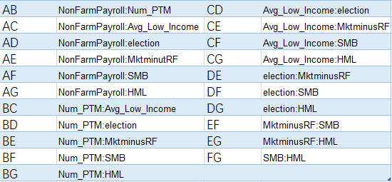
When additional 2-way Interaction Term are Considered:
Interaction Factor Table

Slide 14
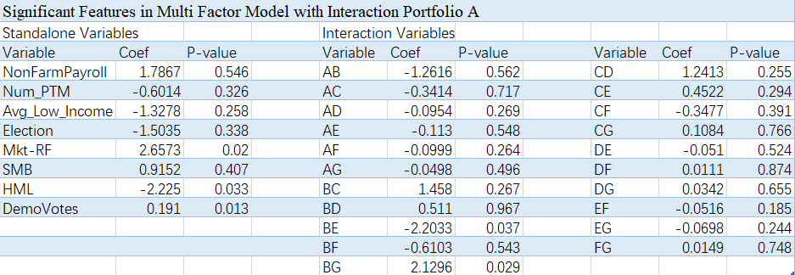
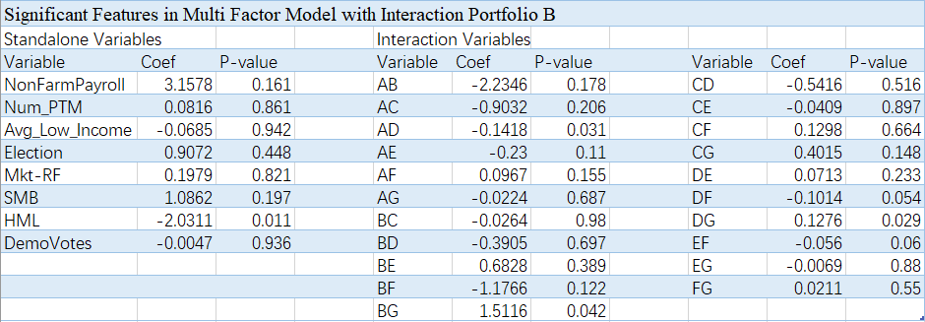
When 2-way Interaction Term are Considered:
Democrat
Mkt-Rf, HML, and DemoVotes are statistically significant factors
Republican
HML is the only statistically significant factors.

Slide 15
Part C
C. Structured Notes
Structured Note
Team Quantinomics
Yipei Zhang, James Fan, Elaine Huang, Ruiyi Wu, Zhi Zhong

Slide 16
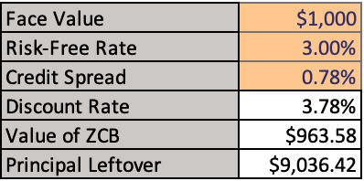
Structured note = zero coupon bond + option
Maturity: 1 year
Issue: at par($1000)
Redemption: par + option payment
Zero coupon bond valuation:
Face value: $1000
Discount rate: 3.78%
Risk-free: 3%
Credit spread: 0.78
Option design:
Underlying assets:
Democratic portfolio
Republican portfolio
Strategy:
Bull spread call
Bear spread call
Butterfly spread call

Slide 17
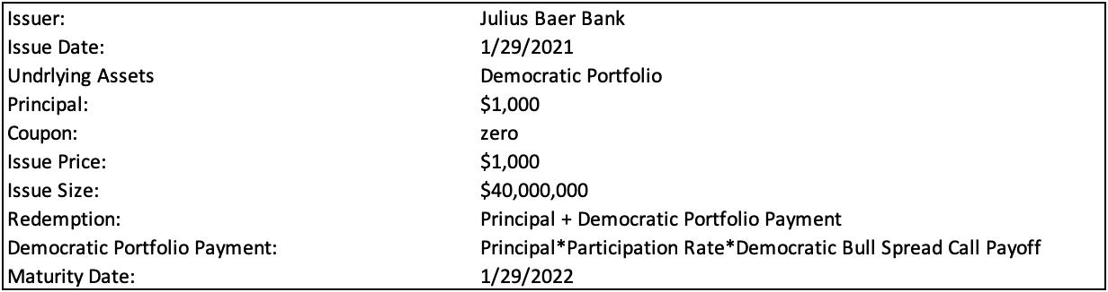
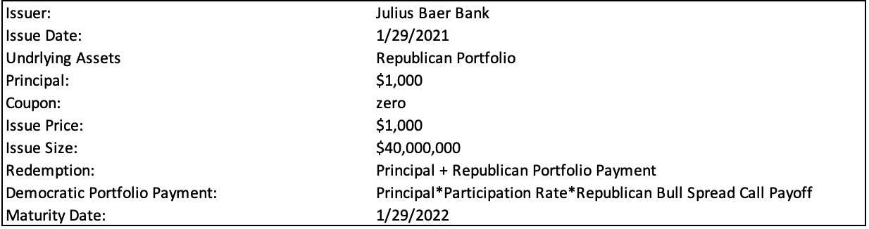
Bull Spread Call
Bull spread design:
Democratic portfolio:
Long Democratic portfolio call at strike price 126
Short Democratic portfolio call at strike price 140
Republican portfolio:
Long Republican portfolio call at strike price 440
Short Republican portfolio call at strike price 481
Option payment = principal*participation rate*option payoff
Participation rate = (100 - ZCB value) / option value

Slide 18
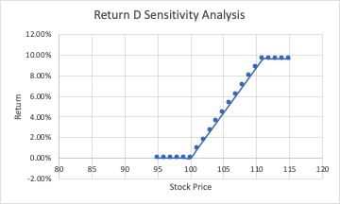
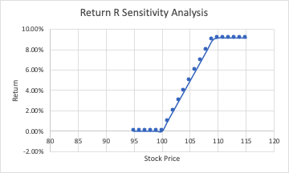
Bull Spread Call
Performance evaluation

Slide 19
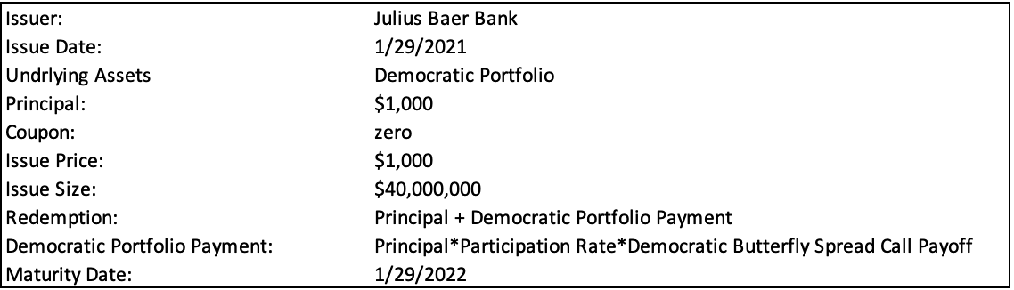
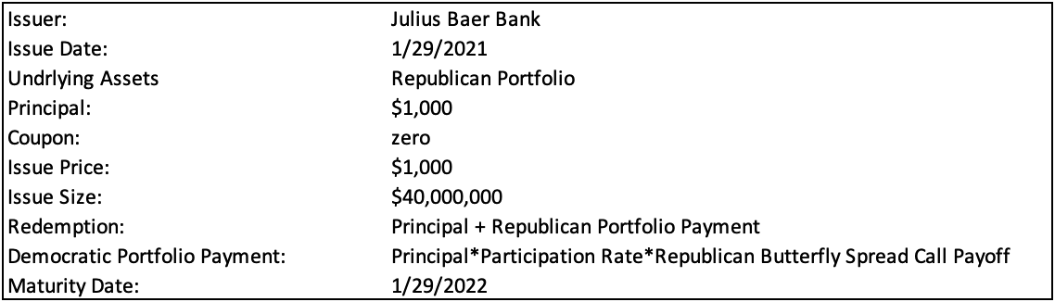
Butterfly Spread Call
Butterfly spread design:
Democratic portfolio:
Long Democratic portfolio call at strike price 100
Short 2 Democratic portfolio call at strike price 125
Long Democratic portfolio call at strike price 150
Republican portfolio:
Long Republican portfolio call at strike price 400
Short 2 Republican portfolio call at strike price 450
Long Republican portfolio call at strike price 500
Option payment = principal*participation rate*option payoff
Participation rate = (100 - ZCB value) / option value

Slide 20
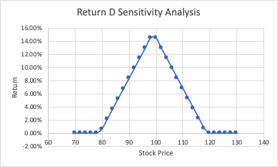
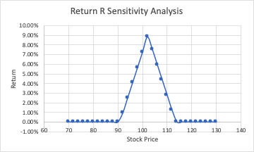
Butterfly Spread Call
Performance evaluation

Slide 21
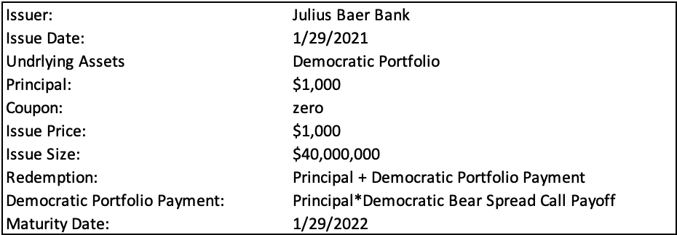
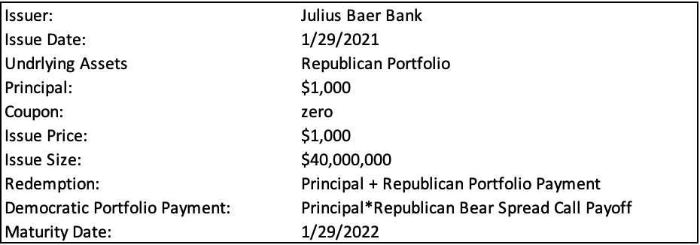
Bear Spread Call
Bear spread design:
Democratic portfolio:
Short Democratic portfolio call at strike price 126
Long Democratic portfolio call at strike price 142
Republican portfolio:
Short Republican portfolio call at strike price 440
Long Republican portfolio call at strike price 481
Option payment = principal*participation rate * (option payoff + option value)

Slide 22
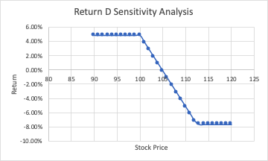
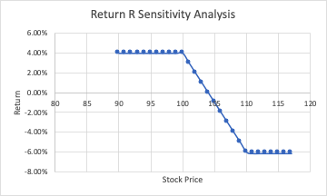
Bear Spread Call
Performance evaluation

Slide 23
The End

