Slide 1
Financial NER

Slide 2
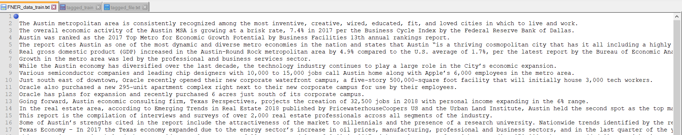
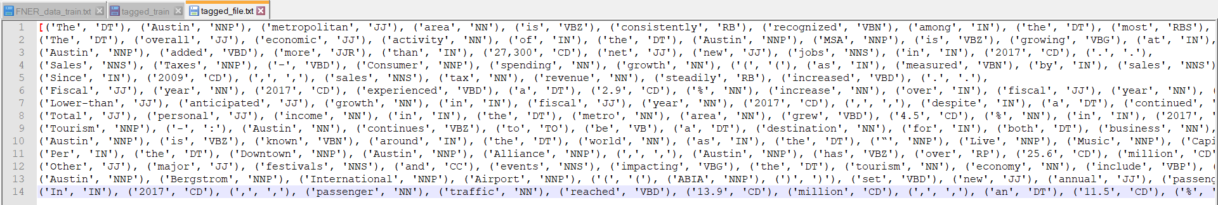
Data Pre-processing

Slide 3
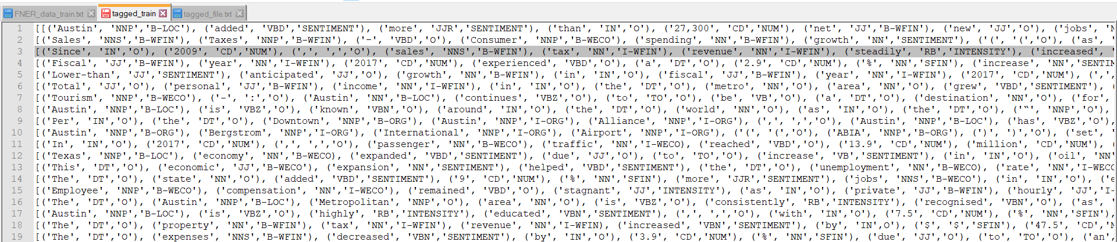
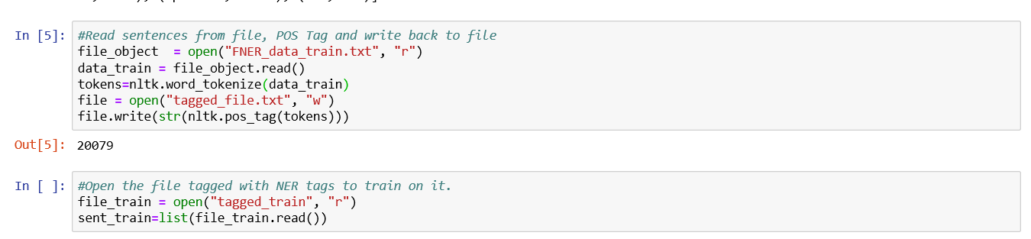
Final Form of Dataset

Slide 4
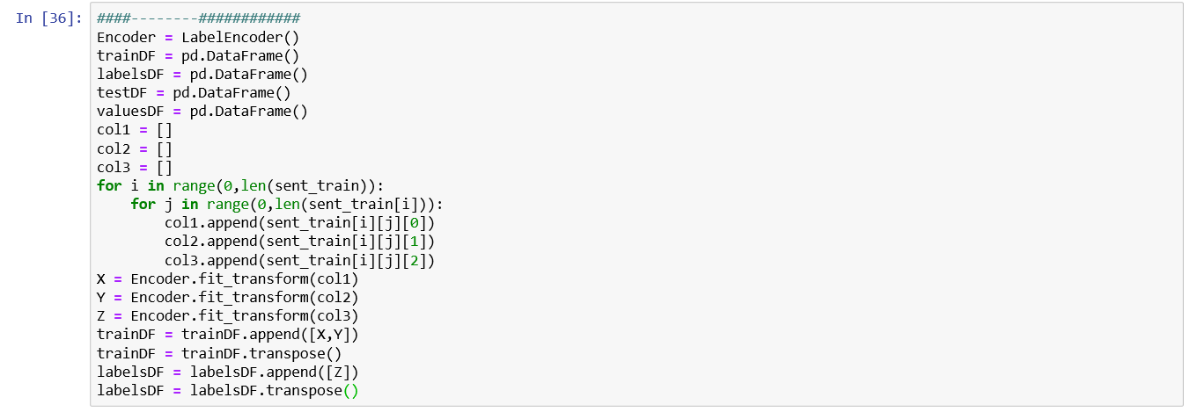
Pre-processing for Naïve Bayes

Slide 5
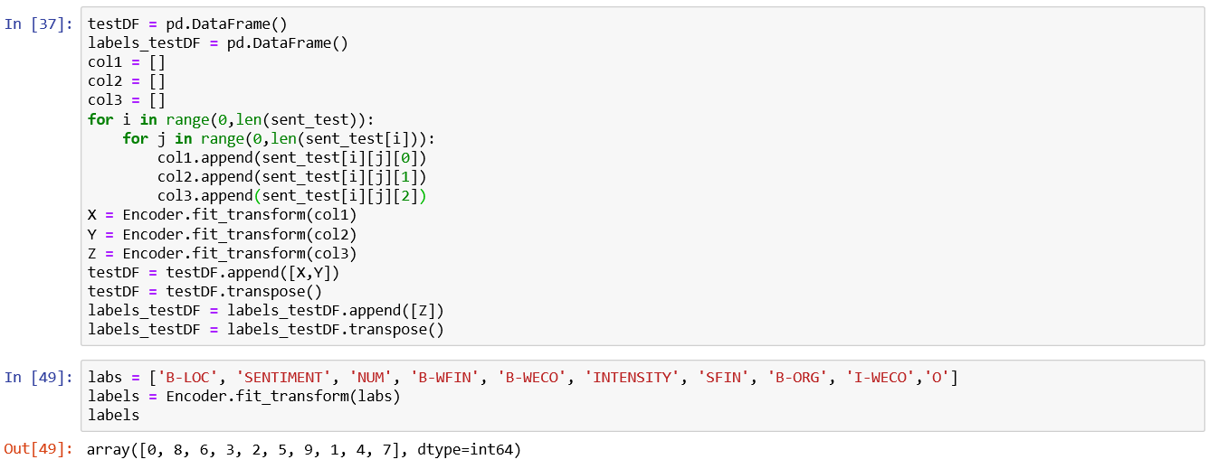
Pre-processing for Naïve Bayes

Slide 6
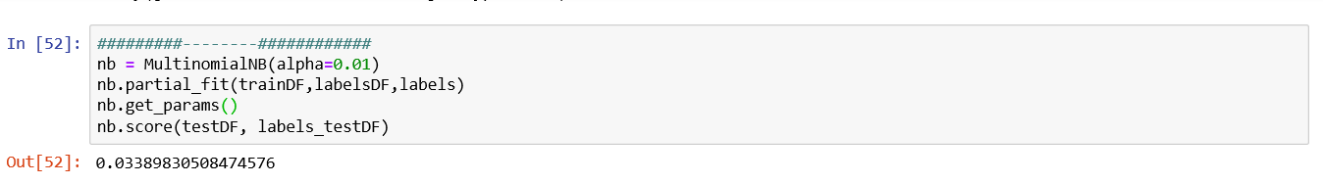
Multinomial Naïve Bayes

Slide 7
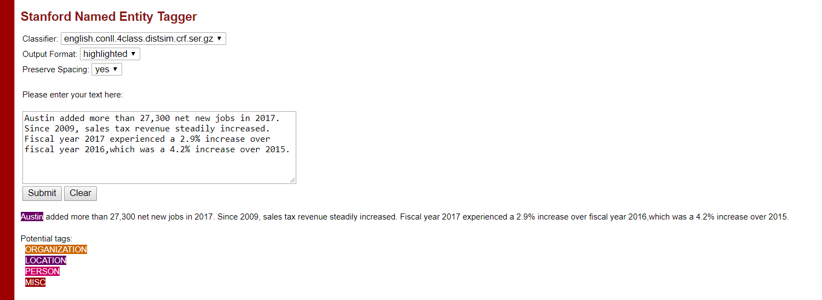
Stanford NER Tagging

Slide 8
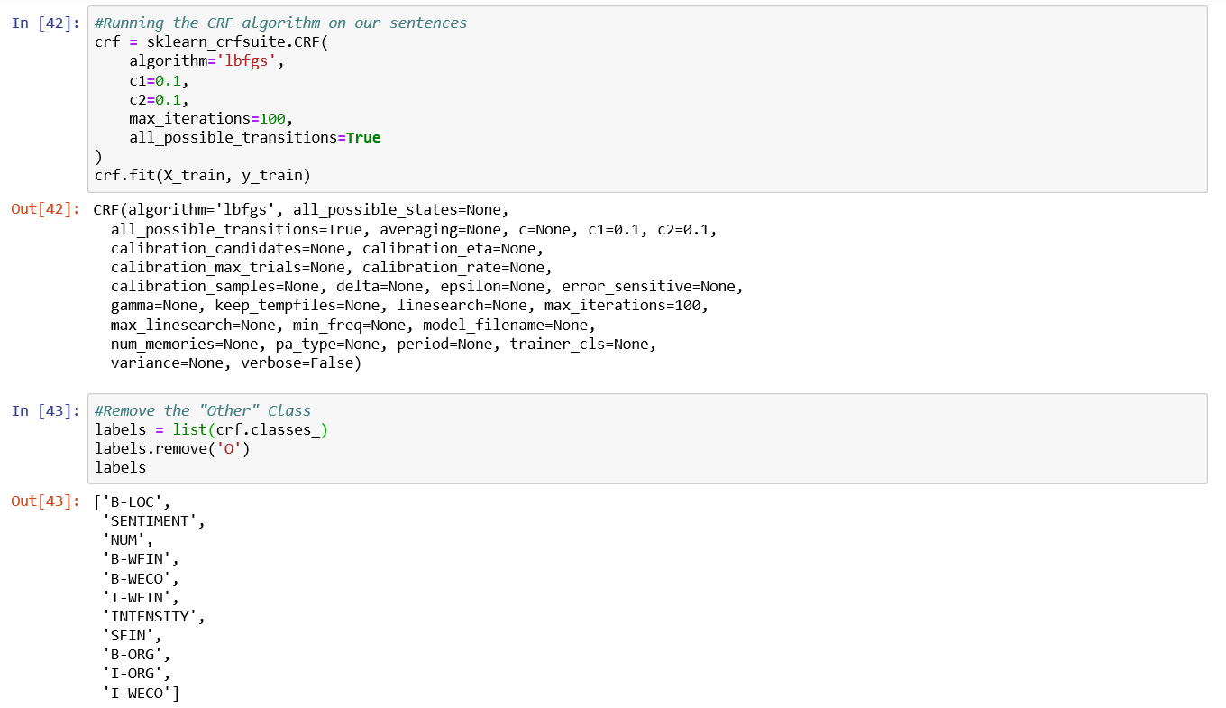
CRF!

Slide 9
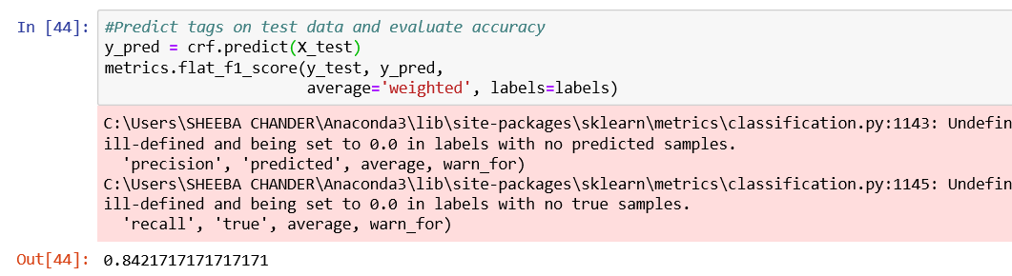
Evaluation of results

Slide 10
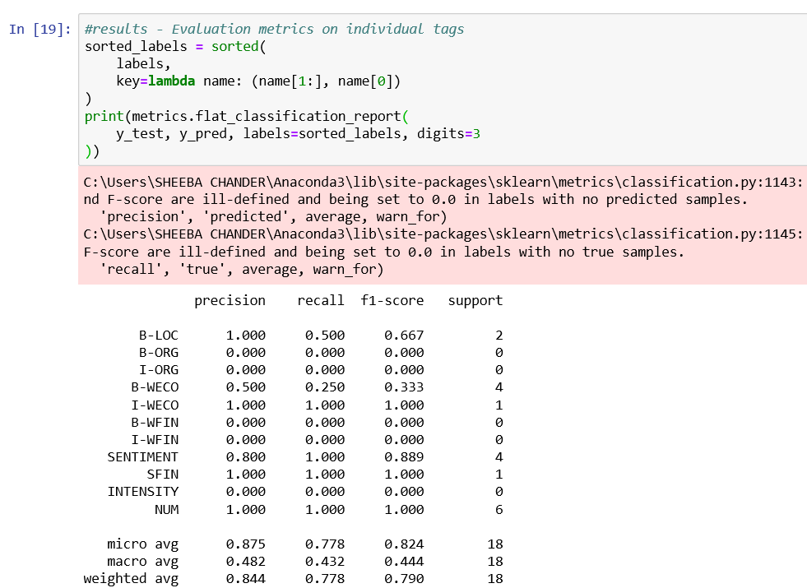
Individual Evaluation Metrics

Slide 11
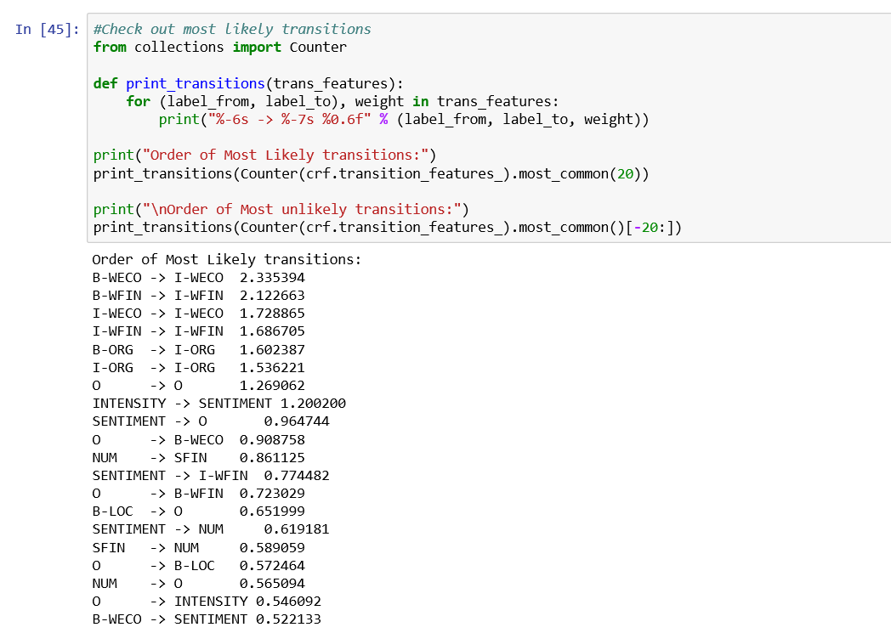
Most Likely Transitions

Slide 12
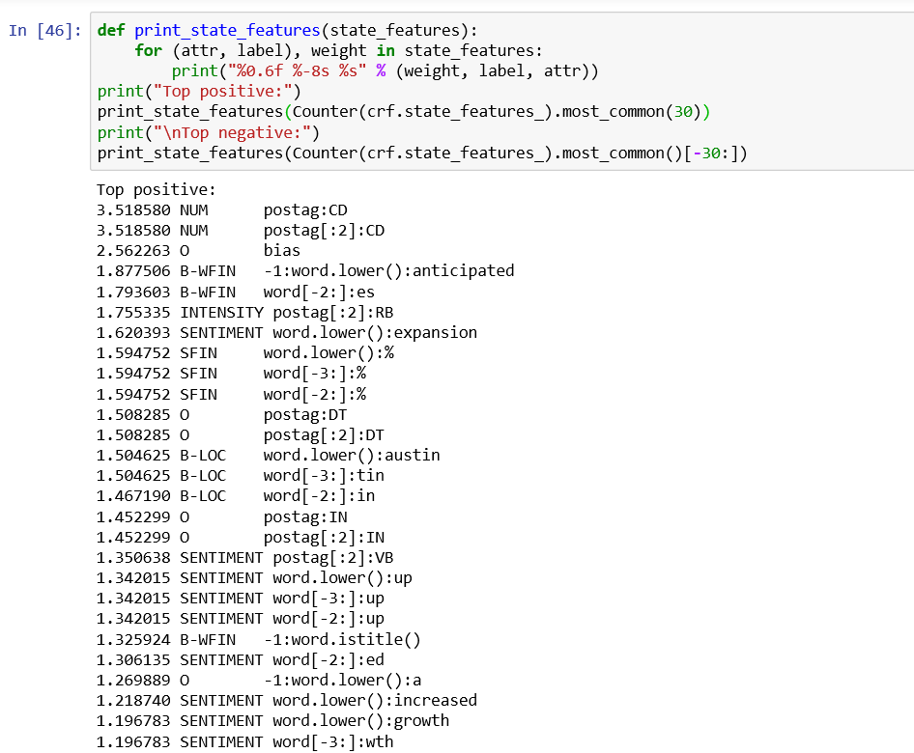
State features

Slide 13
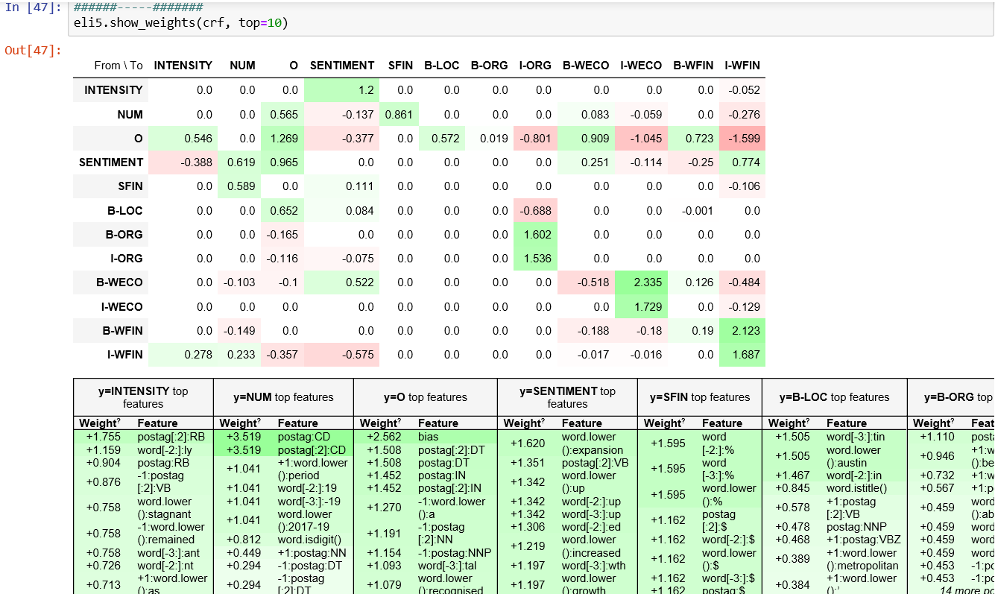
Eli5 Visualisation

