Slide 1

Software architecture

Slide 2
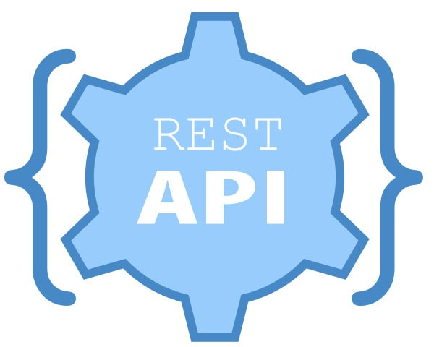

Slide 3
SOAP
First of all, you need to remind about the parent of all services
Simple Object Access Protocol(SOAP) is a network protocol for exchanging structured data between nodes.
It uses XML format to transfer messages. It works on top of application layer protocols like HTML and SMTP for notations and transmission.
The SOAP specification describes a standard, XML-based way to encode requests and responses, including:
Requests to invoke a method on a service, including incoming parameters
Responses from a service method, including return value and out parameters
Errors from a service

Slide 4
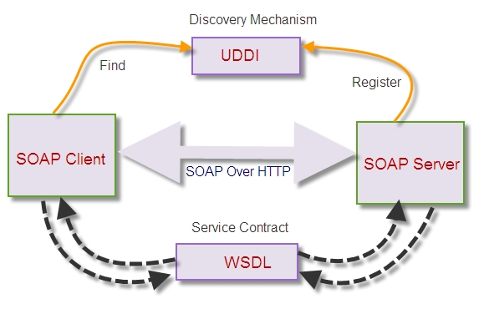
SOAP allows processes to communicate throughout platforms, languages and operating systems, since protocols like HTTP are already installed on all platforms
UDDI – is a special service that is designed to search the network for a specific SOAP service
An WSDL document describes a web service. It specifies the location of the service, and the methods of the service

Slide 5
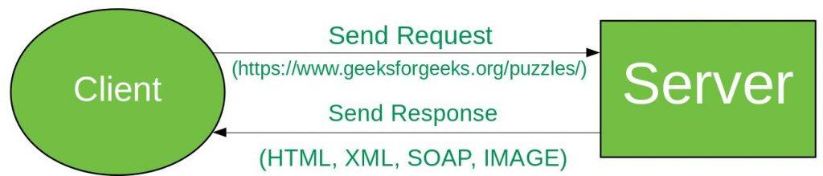
REST
REpresentational State Transfer (REST) is an architectural style that defines a set of constraints to be used for creating web services. REST API is a way of accessing the web services in a simple and flexible way without having any processing.
A request is send from client to server in the form of web URL as HTTP GET or POST or PUT or DELETE. After that a response is come back from server in the form of resource which can be anything like HTML, XML, Image or JSON. But now JSON is the most popular format being used in Web Services.

Slide 6
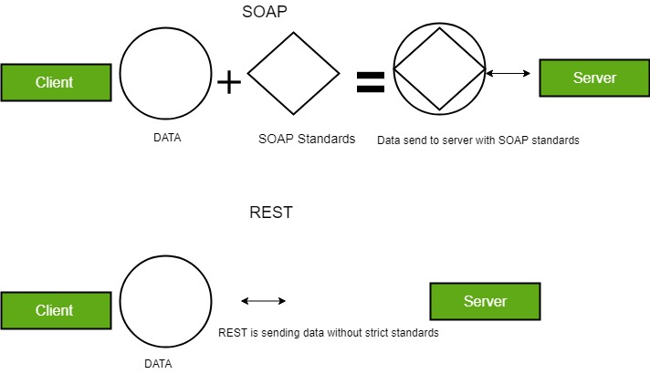
Difference between REST API and SOAP API
SOAP stands for Simple Object Access Protocol SOAP uses only XML for exchanging information in its message format whereas REST is not restricted to XML and its the choice of implementer which Media-Type to use like XML, JSON, Plain-text. Moreover, REST can use SOAP protocol but SOAP cannot use REST.

Slide 7
CRUD
GET: The HTTP GET method is used to read (or retrieve) a representation of a resource. In the safe path, GET returns a representation in XML or JSON and an HTTP response code of 200 (OK). In an error case, it most often returns a 404 (NOT FOUND) or 400 (BAD REQUEST).
POST: The POST verb is most-often utilized to create new resources. In particular, it’s used to create subordinate resources. That is, subordinate to some other (e.g. parent) resource. On successful creation, return HTTP status 201, returning a Location header with a link to the newly-created resource with the 201 HTTP status. NOTE: POST is neither safe nor idempotent.
PUT: It is used for updating the capabilities. However, PUT can also be used to create a resource in the case where the resource ID is chosen by the client instead of by the server. In other words, if the PUT is to a URI that contains the value of a non-existent resource ID. On successful update, return 200 (or 204 if not returning any content in the body) from a PUT. If using PUT for create, return HTTP status 201 on successful creation. PUT is not safe operation but it’s idempotent.
PATCH: It is used for modify capabilities. The PATCH request only needs to contain the changes to the resource, not the complete resource. This resembles PUT, but the body contains a set of instructions describing how a resource currently residing on the server should be modified to produce a new version. This means that the PATCH body should not just be a modified part of the resource, but in some kind of patch language like JSON Patch or XML Patch. PATCH is neither safe nor idempotent.
DELETE: It is used to delete a resource identified by a URI. On successful deletion, return HTTP status 200 (OK) along with a response body.

Slide 8
REST API Architectural Constraints
Uniform Interface: It is a key constraint that differentiate between a REST API and Non-REST API. It suggests that there should be an uniform way of interacting with a given server irrespective of device or type of application (website, mobile app). There are four guidelines principle of Uniform Interface are:
Resource-Based: Individual resources are identified in requests. For example: API/users.
Manipulation of Resources Through Representations: Client has representation of resource and it contains enough information to modify or delete the resource on the server, provided it has permission to do so. Example: Usually user get a user id when user request for a list of users and then use that id to delete or modify that particular user.
Self-descriptive Messages: Each message includes enough information to describe how to process the message so that server can easily analyses the request.
Hypermedia as the Engine of Application State (HATEOAS): It need to include links for each response so that client can discover other resources easily.

Slide 9
REST API Architectural Constraints
Stateless: It means that the necessary state to handle the request is contained within the request itself and server would not store anything related to the session. In REST, the client must include all information for the server to fulfill the request whether as a part of query params, headers or URI. Statelessness enables greater availability since the server does not have to maintain, update or communicate that session state. There is a drawback when the client need to send too much data to the server so it reduces the scope of network optimization and requires more bandwidth.
Cacheable: Every response should include whether the response is cacheable or not and for how much duration responses can be cached at the client side. Client will return the data from its cache for any subsequent request and there would be no need to send the request again to the server. A well-managed caching partially or completely eliminates some client–server interactions, further improving availability and performance. But sometime there are chances that user may receive stale data.

Slide 10
Client-Server: REST application should have a client-server architecture. A Client is someone who is requesting resources and are not concerned with data storage, which remains internal to each server, and server is someone who holds the resources and are not concerned with the user interface or user state. They can evolve independently. Client doesn’t need to know anything about business logic and server doesn’t need to know anything about frontend UI.
Layered system: An application architecture needs to be composed of multiple layers. Each layer doesn’t know any thing about any layer other than that of immediate layer. There can be lot of intermediate servers between client and the end server. Intermediary servers may improve system availability by enabling load-balancing and by providing shared caches.

Slide 11
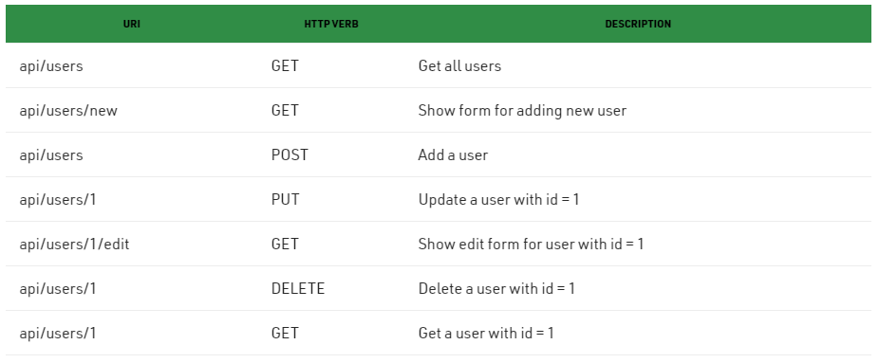
A resource has a unique identifier for clients to access to make requests.
URI of a resource should always end with a noun
HTTP methods are used to identify the action of modifycation those resources
Do not think of this as a database entity or domain entity.
Server should send a proper HTTP code to indicate a success or error status.

Slide 12
Useful links
https://martinfowler.com/architecture/
https://www.geeksforgeeks.org/difference-between-rest-api-and-soap-api/?ref=lbp

Slide 13

Microservice architecture

Slide 14
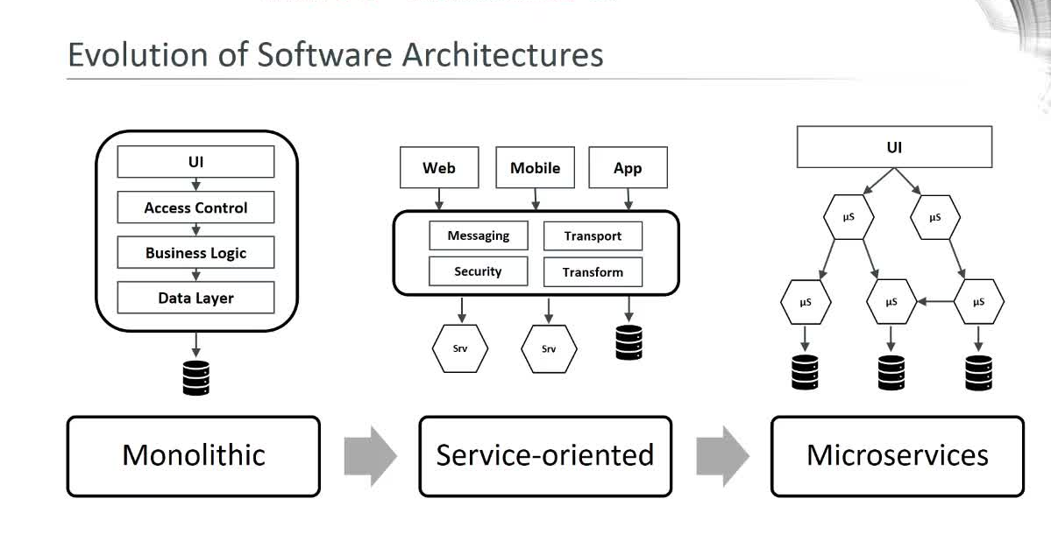

Slide 15
Microservices architectures, where applications include multiple low coupled components, which can be developed using different languages frameworks, and platforms, have become one of the most popular alternatives to traditional monolithic enterprise applications.
Microservice architecture divides the single application into a small set of services, each running on its own but communicating with each other through APIs.
These services are deployed independently using a fully automated environment. There is an absolute minimum of centralized management of these services.
Since these modules are deployed independently and only communicate over standard protocols or APIs, they lend themselves to continuous delivery and continuous integration processes, reducing costs and risks of developing new features.

Slide 16
Microservices - also known as the microservice architecture - is an architectural style that structures an application as a collection of services that are
Highly maintainable and testable
Loosely coupled
Independently deployable
Organized around business capabilities
Owned by a small team

Slide 17
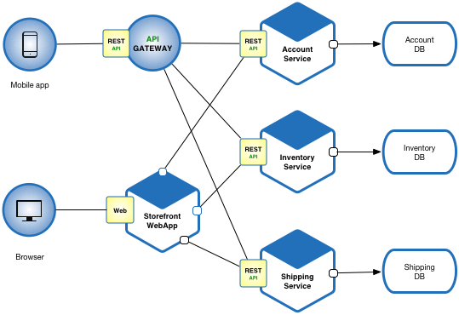

Slide 18
Advantages
Developer independence: Small teams work in parallel and can iterate faster than large teams.
Isolation and stability: If a component dies, you spin up another while and the rest of the application continues to function.
Technology heterogeneity − Microservice supports different technologies to communicate with each other in one business unit, which helps the developers to use the correct technology at the correct place. By implementing a heterogeneous system, one can obtain maximum security, speed and a scalable system.
Small in size − Microservices is an implementation of SOA design pattern. It is recommended to keep your service as much as you can. Basically, a service should not perform more than one business task, hence it will be obviously small in size and easy to maintain than any other monolithic application.
Autonomous − Each microservice should be an autonomous business unit of the entire application. Hence, the application becomes more loosely coupled, which helps to reduce the maintenance cost.

Slide 19
Lifecycle automation: Individual components are easier to fit into continuous delivery pipelines and complex deployment scenarios not possible with monoliths.
Relationship to the business: Microservice architectures are split along business domain boundaries, increasing independence and understanding across the organization.
Focused − As mentioned earlier, each microservice is designed to deliver only one business task. While designing a microservice, the architect should be concerned about the one point of the service. By definition, one microservice should be full stack in nature and should be committed to delivering only one business property.

Slide 20
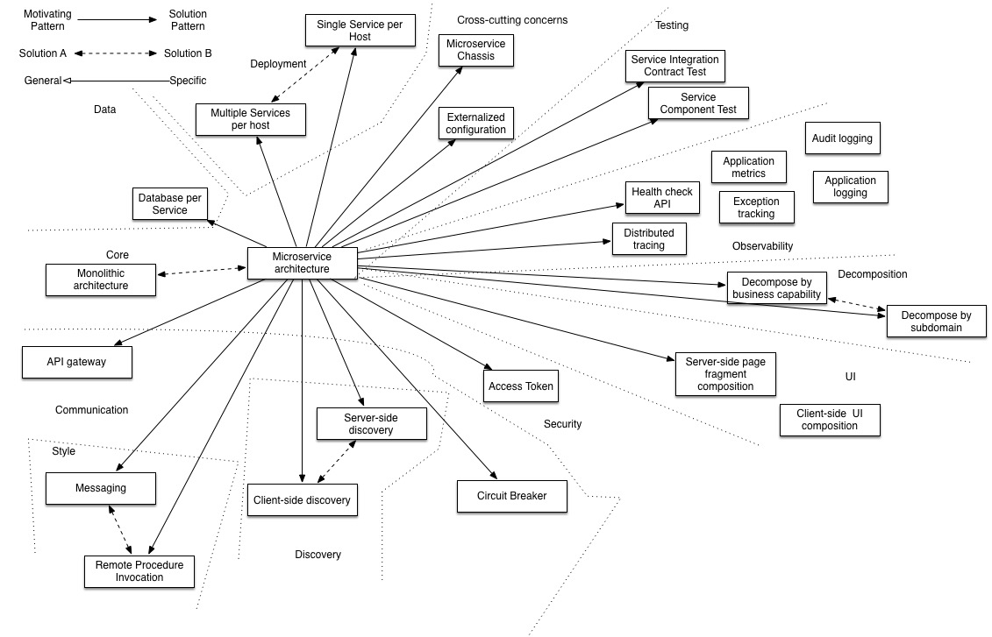
Linked patterns

Slide 21
Discovery Service
In order to make a request, your code needs to know the network location (IP address and port) of a service instance.
How are service instances registered with and unregistered from the service registry?
Solution
A service instance is responsible for registering itself with the service registry.
On startup the service instance registers itself (host and IP address) with the service registry and makes itself available for discovery.
The client must typically periodically renew its registration so that the registry knows it is still alive.
On shutdown, the service instance unregisters itself from the service registry.

Slide 22
Externalized configuration
How to enable a service to run in multiple environments without modification?
Solution
A separate service can be used for centralized storage of service settings in a microservice system. This service should also provide services access to their part of the configuration information.
Externalize all application configuration including the database credentials and network location. On startup, a service reads the configuration from an external source, e.g. OS environment variables, etc.

Slide 23
Circuit Breaker
How to prevent a network or service failure from cascading to other services?
Solution
The basic idea is to stop cascading failure in a distributed system.
A service client should invoke a remote service via a proxy that functions in a similar fashion to an electrical circuit breaker.
When the number of consecutive failures crosses a threshold, the circuit breaker trips, and for the duration of a timeout period all attempts to invoke the remote service will fail immediately.
After the timeout expires the circuit breaker allows a limited number of test requests to pass through.
If those requests succeed the circuit breaker resumes normal operation.
Otherwise, if there is a failure the timeout period begins again.

Slide 24
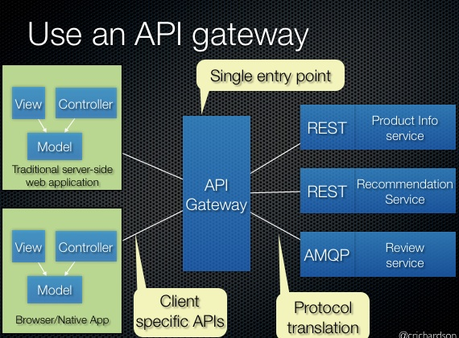
The API gateway pattern

Slide 25
How do the clients of a Microservices-based application access the individual services?
Implement an API gateway that is the single entry point for all clients. The API gateway handles requests in one of two ways. Some requests are simply proxied/routed to the appropriate service. It handles other requests by fanning out to multiple services.

Slide 26
The API gateway pattern
The API Gateway is the entry point to all the services that your application is providing.
It’s responsible for service discovery (from the client side), routing the requests coming from external callers to the right microservices, and fanning out to different microservices if different capabilities were requested by an external caller.
If you take a deeper look at the API Gateways, you’ll find them to be a manifestation of the famous façade design pattern.

Slide 27
Using an API gateway has the following benefits:
Isolates the clients from how the application is partitioned into microservices
Isolates the clients from the problem of determining the locations of service instances
Provides the optimal API for each client
Reduces the number of requests. For example, the API gateway enables clients to retrieve data from multiple services with a single round-trip. Fewer requests also means less overhead and improves the user experience. An API gateway is essential for mobile applications.
Simplifies the client by moving logic for calling multiple services from the client to API gateway
Translates from a “standard” public web-friendly API protocol to whatever protocols are used internally

Slide 28
The API gateway pattern has some drawbacks:
Increased complexity - the API gateway is yet another moving part that must be developed, deployed and managed
Increased response time due to the additional network hop through the API gateway - however, for most applications the cost of an extra roundtrip is insignificant.

Slide 29
Security
A microservice architecture is a distributed architecture. Each external request is handled by the API gateway and at least one service.
Each service must implement some aspects of security.
In order to implement security in a microservice architecture we need to determine who is responsible for authenticating the user and who is responsible for authorization.

Slide 30
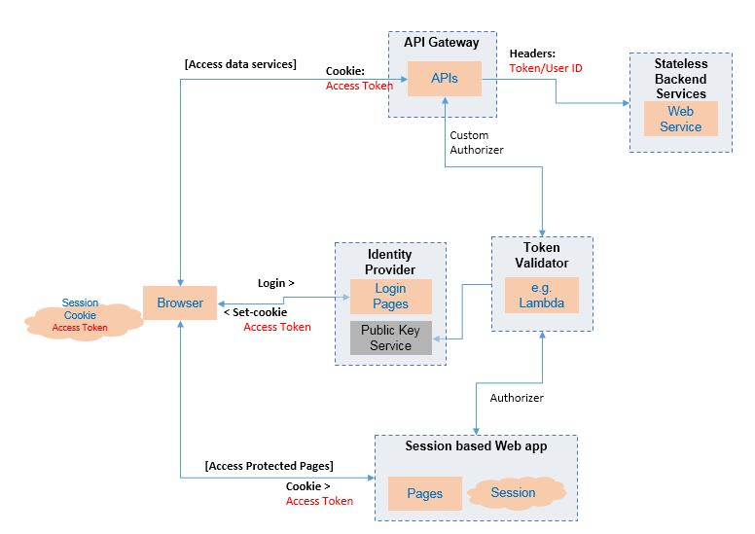
Authentication

Slide 31
Clients authenticate with the API gateway. API clients include credentials in each request.
Login-based clients POST the user’s credentials to the API gateway’s authentication and receive a session token.
Once the API gateway has authenticated a request, it invokes one or more services.

Slide 32
JWT
One such popular standard for transparent tokens is the JSON Web Token (JWT). JWT is standard way to securely represent claims, such as user identity and roles, between two parties.
A JWT has a payload, which is a JSON object that contains information about the user, such as their identity and roles, and other metadata, such as an expiration date. It’s signed with a secret that’s only known to the creator of the JWT, such as the API gateway and the recipient of the JWT, such as a service.

Slide 33
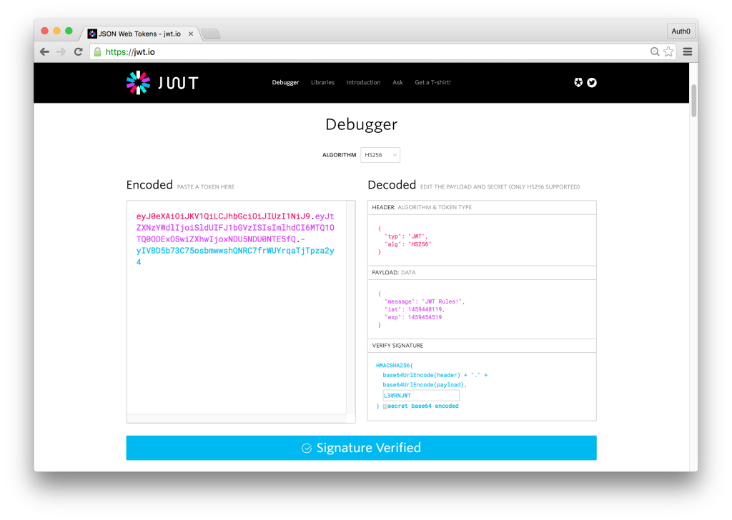

Slide 34
First a user has to log in to the authorization service with his/her login data. The authorization service now checks the login data and creates a new JWT.
The name of the user is set as the subject; the claim method sets the user's payload for the authorization information. This is followed by a unique ID by means of which the token can be identified at any time. Finally, an expiry date is set. The token is signed with the private key and serialized into a compact string before it is returned.
Now the user can send the compact token seen in the following listing in the browser's authorization header in order to authenticate him-/herself to the website. The individual parts of the JWT are separated by periods

Slide 35
By design, a service will perform the request operation after verifying the JWT’s signature and expiration date.
As a result, there’s no practical way to revoke an individual JWT that has fallen into the hands of a hateful third party.
The solution is to issue JWTs with short expiration times, because that limits what a malicious party could do.
One drawback of short-lived JWTs, is that the application must somehow continually reissue JWTs to keep the session active. Fortunately, this is one of the many protocols that are solved by a security standard calling OAuth 2.0

Slide 36
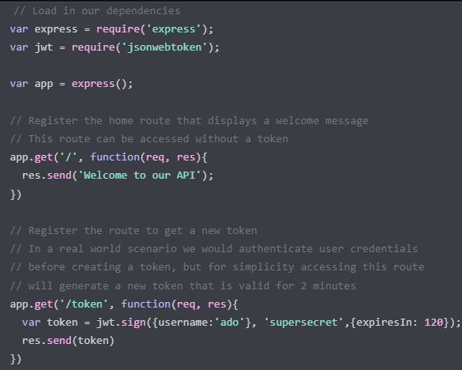

Slide 37
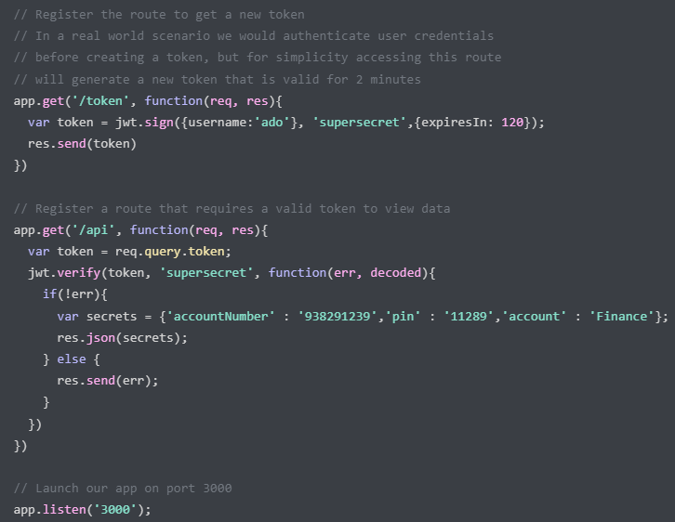

Slide 38
OAuth 2.0
OAuth 2.0 is an authorization protocol that was originally designed to enable a user of a public cloud service, such as GitHub or Google, to grant a third-party application access to its information without revealing its password.
For example, OAuth 2.0 is the mechanism that enables you to securely grant a third party cloud-based Continuous Integration (CI) service access to your GitHub repository

Slide 39
The sequence of events is as follows:
The client makes a request, supplying its credentials using basic authentication.
The API gateway makes an OAuth 2.0 Password Grant request to the OAuth 2.0 authentication server.
The authentication server validates the API client’s credentials and returns an access token and a refresh token.
The API gateway includes the access token in the requests it makes to the services. A service validates the access token and uses it to authorize the request.

Slide 40
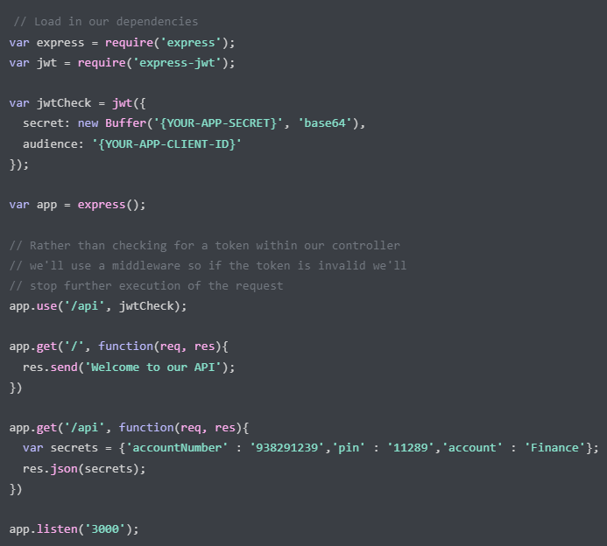

Slide 41
This module provides Express middleware for validating JWTs through the jsonwebtoken module. The decoded JWT payload is available on the request object.

Slide 42
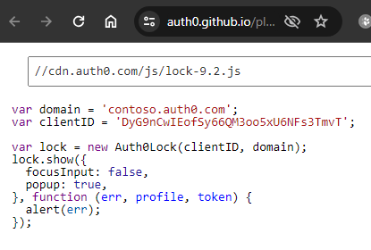

Slide 43
https://auth0.com/learn/token-based-authentication-made-easy

Slide 44
How to setup Passport authentication in Node.JS with example using Express.JS
https://medium.com/@mohan.velegacherla/how-to-setup-passport-authentication-in-node-js-with-example-using-express-js-bf44a51e8ca0

Slide 45
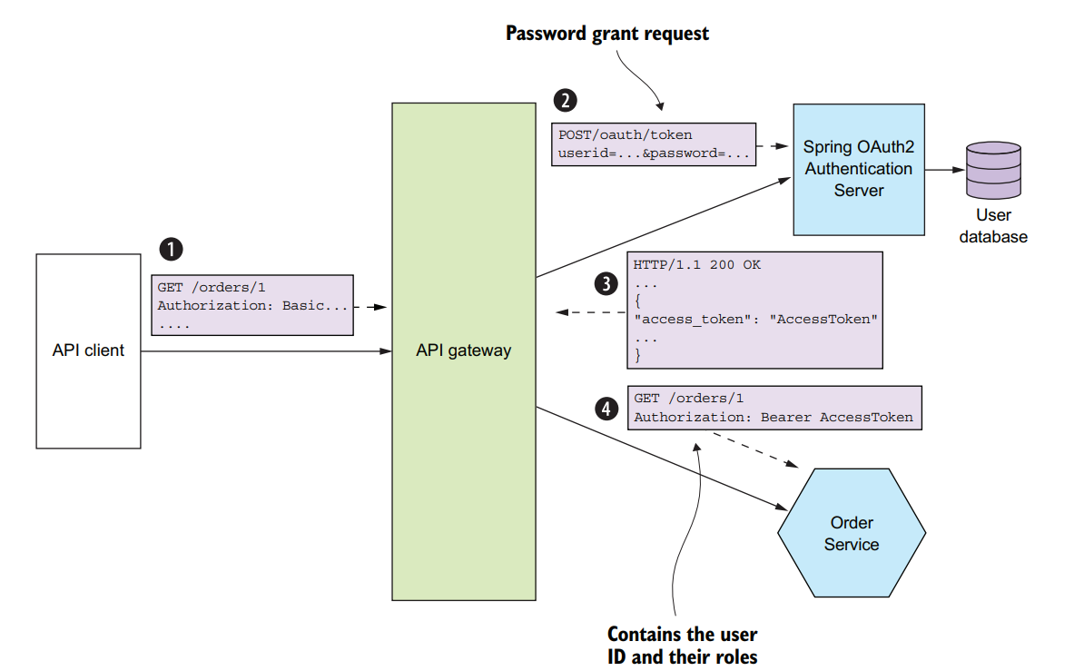

Slide 46
A service invoked by the API gateway needs to know the principal making the request.
It must also verify that the request has been authenticated. The solution is for the API gateway to include a token in each service request.

Slide 47
The sequence of events for API clients is as follows:
1 A client makes a request containing credentials.
2 The API gateway authenticates the credentials, creates a security token, and passes that to the service or services.
The sequence of events for login-based clients is as follows:
1 A client makes a login request containing credentials.
2 The API gateway returns a security token.
3 The client includes the security token in requests that invoke operations.
4 The API gateway validates the security token and forwards it to the service or services.

Slide 48
Health check API pattern
How to detect that a running service instance is unable to handle requests?
Solution
A service has an health check API endpoint (e.g. HTTP /health) that returns the health of the service. The API endpoint handler performs various checks, such as:
the status of the connections to the infrastructure services used by the service instance
the status of the host, e.g. disk space
application specific logic
A health check client - a monitoring service, service registry or load balancer - periodically invokes the endpoint to check the health of the service instance.

Slide 49
Log aggregation pattern
How to understand the behavior of users and the application and troubleshoot problems?
It is useful to know what actions a user has recently performed: customer support, compliance, security, etc.
Solution
Record user activity in a database.

Slide 50
https://livebook.manning.com/book/spring-microservices-in-action/chapter-7/

Slide 51
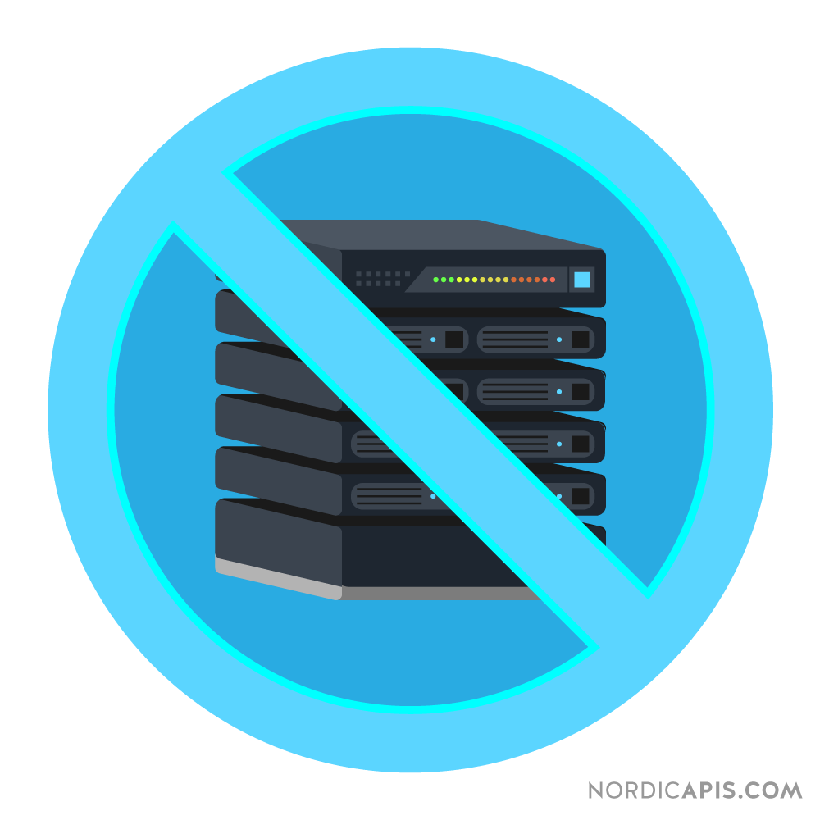
Serverless

Slide 52
Serverless was first used to describe applications that significantly or fully incorporate third-party, cloud-hosted applications and services, to manage server-side logic and state.
These are typically “rich client” applications—think single-page web apps, or mobile apps—that use the vast ecosystem of cloud-accessible databases (e.g., Parse, Firebase), authentication services (e.g., Auth0, AWS Cognito), and so on.

Slide 53
Serverless can also mean applications where server-side logic is still written by the application developer, but, unlike traditional architectures, it’s run in stateless compute containers that are event-triggered, ephemeral (may only last for one invocation), and fully managed by a third party.
One way to think of this is “Functions as a Service” or "FaaS". AWS Lambda is one of the most popular implementations of a Functions-as-a-Service platform at present, but there are many others, too.

Slide 54
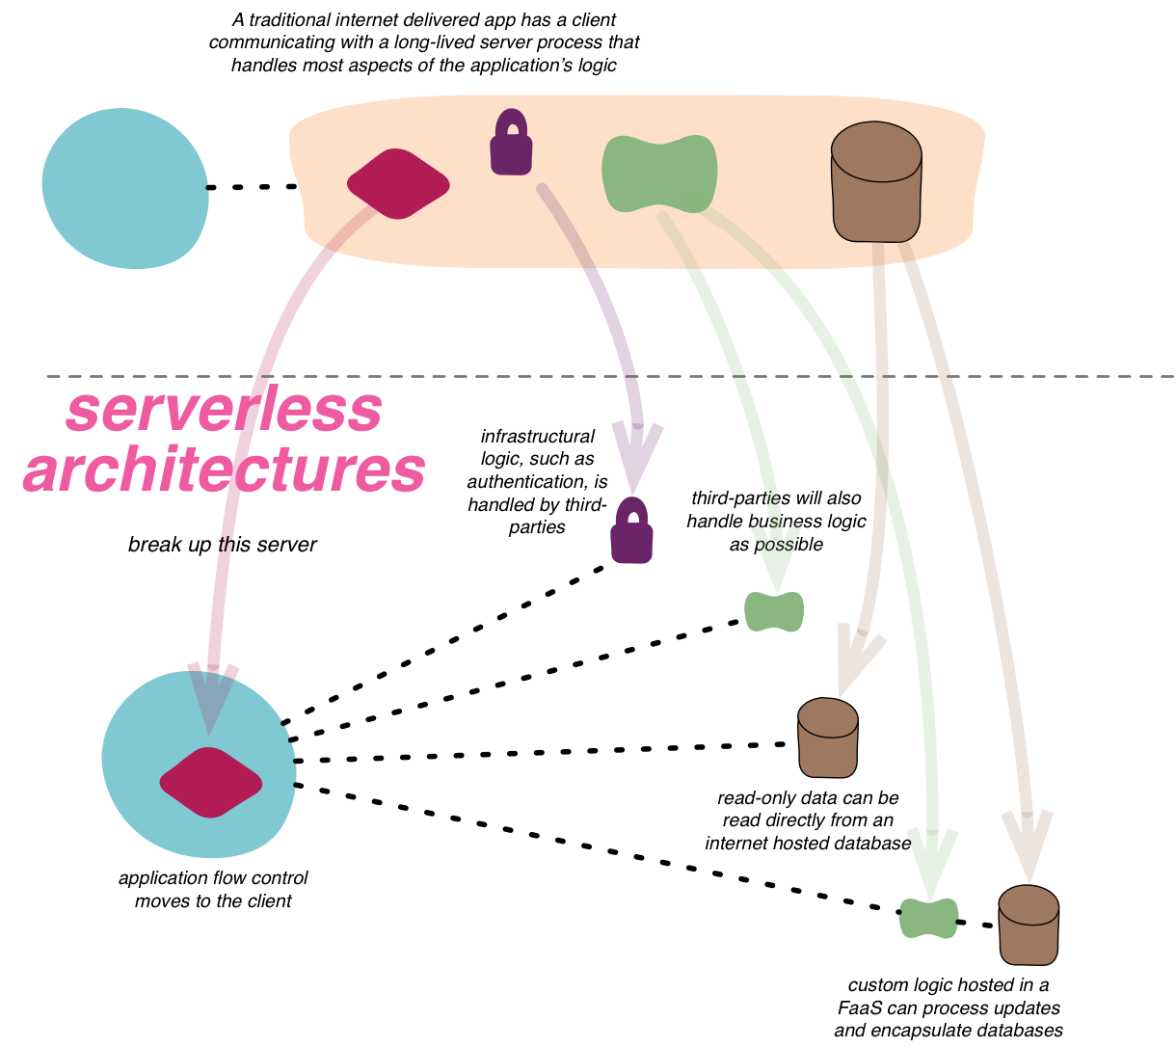

Slide 55
In the original version, all flow, control, and security was managed by the central server application.
In the Serverless version there is no central arbiter of these concerns. Instead we see a preference for choreography over orchestration, with each component playing a more architecturally aware role—an idea also common in a microservices approach.

Slide 56
Function as a Service
Fundamentally, FaaS is about running backend code without managing your own server systems or your own long-lived server applications.
FaaS offerings do not require coding to a specific framework or library. FaaS functions are regular applications when it comes to language and environment. For instance, AWS Lambda functions can be implemented “first class” in Javascript, Python, Go, any JVM language (Java, Clojure, Scala, etc.), or any .NET language.

Slide 57
Function as a Service
Deployment is very different from traditional systems since we have no server applications to run ourselves. In a FaaS environment we upload the code for our function to the FaaS provider, and the provider does everything else necessary for provisioning resources, instantiating VMs, managing processes, etc.

Slide 58
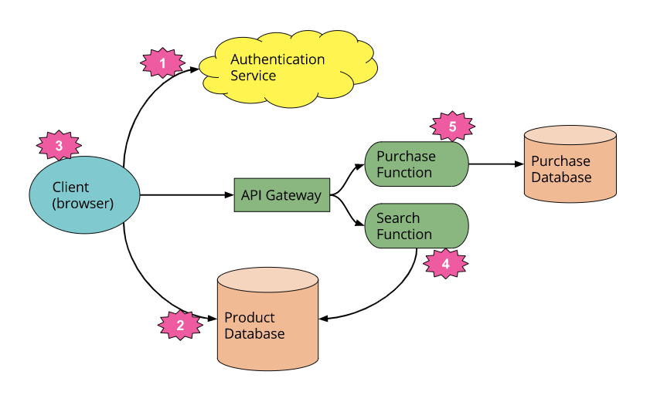

Slide 59
Significant changes
We’ve deleted the authentication logic in the original application and have replaced it with a third-party service (e.g., Auth0.)
Using another example, we’ve allowed the client direct access to a subset of our database, which itself is fully hosted by a third party (e.g., Google Firebase.) We likely have a different security profile for the client accessing the database in this way than for server resources that access the database.
These previous two points imply a very important third: some logic is now within the client—e.g., keeping track of a user session, understanding the UX structure of the application, reading from a database and translating that into a usable view, etc.

Slide 60
4. We may want to keep some UX-related functionality in the server, if, for example, it’s compute intensive or requires access to significant amounts of data. For example is “search.” Instead of having an always-running server, as existed in the original architecture, we can instead implement a FaaS function that responds to HTTP requests via an API gateway. Both the client and the server “search” function read from the same database for product data.
If we choose to use AWS Lambda as our FaaS platform we can port the search code from the original server to the Search function without a complete rewrite, since Lambda supports Java and Javascript—our original implementation languages.

Slide 61
5. Finally, we may replace our another functionality with another separate FaaS function, choosing to keep it on the server side for security reasons, rather than reimplement it in the client. It too is fronted by an API gateway. Breaking up different logical requirements into separately deployed components is a very common approach when using FaaS.

Slide 62
Horizontal scaling
Horizontal scaling is completely automatic, elastic, and managed by the provider. If your system needs to be processing 100 requests in parallel the provider will handle that without any extra configuration on your part.
The “compute containers” executing your functions are ephemeral, with the FaaS provider creating and destroying them purely driven by runtime need. Most importantly, with FaaS the vendor handles all underlying resource preparation and allocation—no cluster or VM management is required by the user at all.

Slide 63
Triggering
Functions in FaaS are typically triggered by event types supported by the provider. With Amazon AWS such stimuli include S3 (file/object) updates, time (scheduled tasks), and messages added to a message bus (e.g., Kinesis).
Most providers also allow functions to be triggered as a response to inbound HTTP requests; in AWS one typically enables this by way of using an API gateway.

Slide 64
State
FaaS functions have significant restrictions when it comes to local (machine/instance-bound) state (data that you store in variables in memory, or data that you write to local disk).
You do have such storage available, but you have no guarantee that such state is persisted across multiple invocations, and, more strongly, you should not assume that state from one invocation of a function will be available to another invocation of the same function.
FaaS functions are therefore often described as stateless, but it’s more accurate to say that any state of a FaaS function, that is required to be persistent, needs to be externalized outside of the FaaS function instance.

Slide 65
FaaS functions are typically limited in how long each invocation is allowed to run. At present the “timeout” for an AWS Lambda function to respond to an event is at most five minutes, before being terminated.
This means that certain classes of long-lived tasks are not suited to FaaS functions without re-architecture—you may need to create several different coordinated FaaS functions (in a traditional environment you may have one long-duration task performing both coordination and execution).

Slide 66
Drawbacks
With any outsourcing strategy you are giving up control of some of your system to a third-party vendor. Such lack of control may manifest as system downtime, unexpected limits, cost changes, loss of functionality, forced API upgrades, and more.
Service vendors try to make customers feel that they each are the only ones using their system, and typically good service vendors do a great job of that.
But no one’s perfect and sometimes multitenant solutions can have problems with security (one customer being able to see another’s data), robustness (an error in one customer’s software causing a failure in a different customer’s software), and performance (a high-load customer causing another to slow down).

Slide 67
It’s very likely that whatever Serverless features you’re using from one vendor will be implemented differently by another vendor. If you want to switch vendors you’ll almost certainly need to update your operational tools (deployment, monitoring, etc.), you’ll probably need to change your code ( to satisfy a different FaaS interface), and you may even need to change your design or architecture if there are differences to how competing vendor implementations behave.

Slide 68
Security concern
Each Serverless vendor that you use increases the number of different security implementations contained by your ecosystem. This increases your surface area for hateful intent and ups the possibility of a successful attack.

Slide 69
With a full BaaS architecture there is no opportunity to optimize your server design for client performance. The ‘Backend For Frontend’ pattern exists to abstract certain underlying aspects of your whole system within the server, partly so that the client can perform operations more quickly and use less battery power in the case of mobile applications. Such a pattern is not available for full BaaS.

Slide 70
AWS Lambda,
Google Cloud Functions
Microsoft Azure Functions

