Slide 1
Stealthy Activities Detection
Notes:
In this lecture, we will discuss stealthy activities detection and prevention, for example, data hiding and detection.

Slide 2
Data Hiding and Detection
Notes:
In this lecture, we will study data hiding and detection.

Slide 3
Data Hiding
Data hiding: Alice and Bob who want to communicate secretly without others knowing about it
Trudy will not notice the presence of the information
Alice and Bob can see the message exchanged between them
Alice
Bob
Trudy

Slide 4

Confidentiality
The data must be hidden and kept confidential from unauthorized parties (e.g., Trudy)
Trudy cannot see the message
Alice and Bob can see the message exchanged between them
Alice
Bob
Trudy
Notes:
Confidentiality means the data must be hidden and kept confidential from unauthorized parties (for exmaple, Trudy in the follwoing example when Alice and Bob talk to each other). It means two things: Trudy cannot see the message, and Alice and Bob can see the message exchanged between them.

Slide 5

Discussion
What is the difference between data hiding and confidentiality?

Slide 6

Dose of Reality:
Information hiding has posed big challenges for forensic experts.
The biggest concern in law enforcement agencies is that covert techniques are being used to ensure stealth communication among terrorist/ criminals and cybercriminals.
[1] Wojciech Mazurczyk, Steffen Wendzel. Information Hiding: Challenges For Forensic Experts. Communications of the ACM, vol. 61, no. 1, pp. 86-94, January 2018

Slide 7

Let’s Start With Everyday Techniques
The Usual right click and hide; the hidden attribute.
Assign the file a system attribute.
Rename it as a system file and paste it in the windows directory.
Most often used by Malware, for example, Svchost.exe
etc
Notes:
Let’s start with everyday techniques on how to hide our files.
For example, we assign the file a hidden or system attribute. Then, the file becomes invisible to a regular user.
It is also often used by Malware, for example, viruses, worms, and Trojans deliberately name themselves the Service Host Process (svchost.exe) to hide their existence. Note that The true svchost.exe file is a safe Microsoft Windows system process.

Slide 8
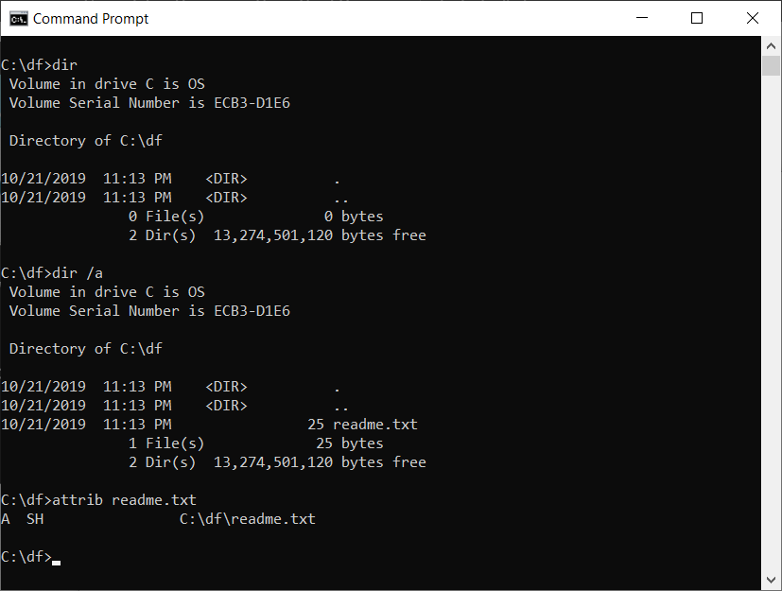

Assigning the Hidden and System Attribute
Visible now
Hidden and System Attributes Assigned
Notes:
This is an example of a hidden file in Windows. If you simple use the command dir to show the files in the current folder, you see no file. But, you use the /a switch with the DIR command, you will see a file named readme.txt.
What happened? This is because readme.txt is a hidden file, making it invisible.
[clcik]
This can be verified by using “attrib” command, which displays, sets, or removes attributes assigned to files or directories. The output of “attrib” command of readme.txt shows readme.txt is a hidden file as well as system file.

Slide 9


How can we hide data?
so many ways to hide data
Notes:
How can we hide data?
[click]
There are so many ways to hide data.

Slide 10
Data Hiding Techniques
Unpartitioned disk space
Hidden partition
Volume slack
Slack space
Disk space in Abnormal States
Bad MFT Entries
etc
so many ways to hide data
[1] Data Hiding and Detection Techniques.
https://faun.pub/data-hiding-and-detection-techniques-2c661b6522f3
Notes:
This slide shows some popular ways to hide data in a disk volume. I am pretty sure that you already know them, and are also able to come out more creative data hiding methods.

Slide 11


How can we detect hidden data?
Notes:
Then, how can we detect hidden data? It could be very challenging.
Unfortunately, this is an attacker’s field at present, and will always be the case.
In other words, this is a field which is in favor of the attackers. People will find many new creative ways to hide data, but could be very challenging for us to detect the existence of these hidden data.

Slide 12

Notes:
Actually, we are playing a Hide and Seek game here. Nevertheless, if you know the ways of how a suspect hide data, we can use the same way to detect these hidden data. Therefore, it becomes very important to know these popular data hiding techniques.

Slide 13


Unpartitioned disk space
Master Boot Record (MBR) disks
Partitions
MBR
digital storage devices
Notes:
First, we take a look at unpartitioned disk space. As you already know, when you partition a disk, some disk space can be left unpartitioned, allowing for data hiding.

Slide 14
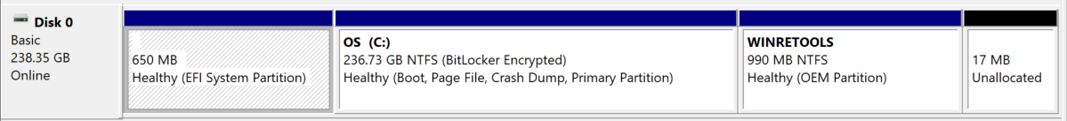
Hidden partition
Hidden partitions
Notes:
Also, sometimes a partition can be configured hidden. So we can save or hide data within it.

Slide 15
Volume slack
The size of the file system = the size of the volume in which it is located?
If the volume is larger, the sectors after the file system are called volume slack and could be used to hide data.
Partition
File system volume
volume slack
Notes:
As mentioned, a partition must be formatted with a file system for data storage. Be default, when formatting a partition, the new filesystem volume takes up the entire partition. However, something could happen: the partition is larger than the filesystem volume. The sectors after the file system are called volume slack and could be used to hide data.

Slide 16
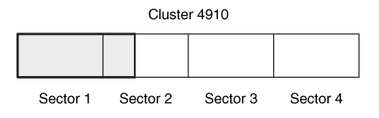
Slack Space
Slack space occurs when the size of a file is not a multiple of a data unit size. A file must allocate a full data unit, even if it needs only a small part of it, and the unused bytes in the last data unit are called slack space.
For example, if a file is 100 bytes, it needs to allocate a full 2,048-byte data unit, and the final 1,948 bytes would be slack space.
Slack space is considered allocated data. It may contain hidden data
Slack space of a 612-byte file in a 2048-byte cluster.
Notes:
Similarly, a file may not use up all the disk space allocated to it. The unused bytes in the last data unit are called slack space, and may contain hidden data.
Note that slack space is considered allocated data.

Slide 17
Disk space in Abnormal States
Notes:
Also, disk space in abnormal states may contain hidden data.

Slide 18
Bad Sectors On Hard Disk
Hard drives are mechanical devices and all mechanical devices will eventually fail. back up your hard drive on a regular basis.
A bad sector is a sector on the disk which data cannot be written or read due to a physical damage or inconsistencies of parity checking bits on disk. Any data that is written or stored on that area is likely to be lost or corrupted.
A bad sector cannot be repaired, but it can be marked as unusable.
It is easy to hide data using the file system functionality, if it exists.
Many consistency-checking tools will not verify a data unit that the file system reports as being damaged is actually damaged.
A user could manually add a data unit to the damaged list and place data in it. (having data but marked damaged - suspicious)
Notes:
Bad sector may not be actually damaged. A user could manually add a data unit to the damaged list and place data in it. (having data but marked damaged - suspicious)

Slide 19
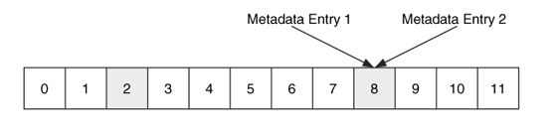
Orphan data units
The file system is in a suspicious state. For example,
Orphan data units (allocated data units that do not have a corresponding metadata structure) and be found in this manner.
all data units have one and only one metadata entry pointing to them.
Notes:
You also need to pay attention other suspicious states in a file system. For example,
Orphan data units, which are allocated data units that do not have a corresponding metadata structure. In the example here, data unit 2 is an Orphan data unit.
Also, all data units have one and only one metadata entry pointing to them. But, in the example here, two metadata entries (metadata entries 1 and 2) point to Data Unit 8.
Therefore, a further investigation is required here.

Slide 20
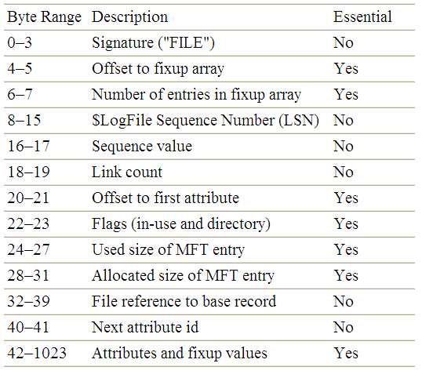
Bad MFT Entries in NTFS
"BAAD" if chkdsk found an error in it
Notes:
A standard (good) MFT entry will start with the MFT entry signature, "FILE".
However, a user could manually mark a MFT entry bad or damaged, and the place data in it. (having data but marked bad or damaged - suspicious)

Slide 21
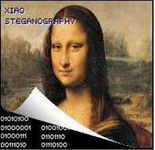
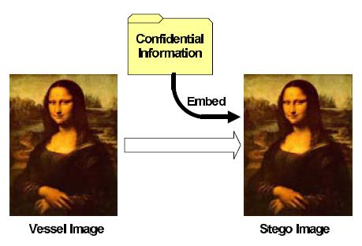
Steganography
Only sender and received can view
Notes:
Another data hiding technique is Steganography.

Slide 22
Steganography
Steganography is the art and science of writing hidden messages in such a way that no one, apart from the sender and intended recipient, suspects the existence of the message, a form of security through obscurity.
Steganography tools bring you the capability of concealing files within an innocent-looking medium.
host media
(e.g., an image or video file)
[1] http://en.wikipedia.org/wiki/Steganography
[2] Michael T. Raggo. Steganography, Steganalysis, & Cryptanalysis. VeriSign
Notes:
Steganography is a technique used for hiding secret information in an innocent-looking medium such as an image or video file.
Apart from the sender and intended recipient, no body suspects the existence of the message.

Slide 23
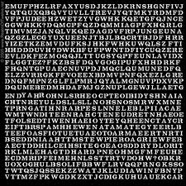

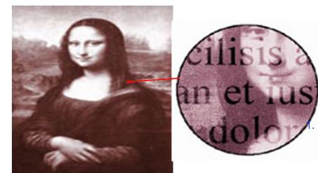
Steganography Vs. Encryption
Encryption
Ciphertext
The University of Guelph (U of G) is a top comprehensive public research university in Guelph, Ontario, Canada.
Steganography
Notes:
Next, I would like to distinguish Steganography from Encryption.
Encryption uses an encryption algorithm to convert the original message or plaintext, into the ciphertext, which is unreadable to unauthorized users. Only authorized parties can decipher a ciphertext back to plaintext and access the original information.
[click]
But, Steganography is a technique used for hiding secret information in an innocent-looking medium, for example, an image here. No body suspects the existence of the message or sees the message except the sender and intended recipient.

Slide 24
Steganography Vs. Encryption (cont’d)
Encryption protects data confidentiality.
Steganography is the science of hiding information.
The goal:
cryptography is to make data unreadable by a third party.
steganography is to hide the data from a third party.
The different:
cryptography, one can tell that a message has been encrypted, but he cannot decode the message without knowing the proper key.
In steganography, the message itself may not be difficult to decode, but most people would not detect the presence of the message
Notes:
In summary, encryption protects data confidentiality, whereas Steganography is the science of hiding information.
Their goals are different:
Cryptography is to make data unreadable by a third party. But the public knows the sender and receiver exchange some confidential information, but can figure out what they are talking about.
Steganography is to hide the data from a third party.

Slide 25


Steganography Vs. Encryption (cont’d)
Ciphertext
What is your encryption key?
Forget it!
you will have a big trouble!
Notes:
You may be wondering that it seems that both Steganography and Encryption can protect secret information from being intercepted by the third party.
From a forensic point of view, there is some big difference, though we are not talking about a technical problem here.
If a suspect uses Encryption to protect his or her data, an investigator knows it. So the investigator may interrogate the suspect to get the encryption key.

Slide 26


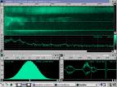
Steganography (cont’d)
Steganography:
“Covered Writing”
Examples:
Invisible ink
Use low-order bits of image encoding
Communication frequency
Hide message among irrelevant data.
Etc.
Drawbacks:
Fails Kerckhoff’s principle!
secret
secret
Notes:
Steganography is not new too, and dates back to ancient times. For example, using Invisible ink, also known as security ink, which is a material or substance used for writing, which is invisible either on application or soon thereafter, and can later be made visible by some means.
Now, it becomes very common to hide information into a steganographic image.
Unfortunately, Steganography fails a security principle, Kerckhoff’s principle, which will detailed later.

Slide 27


Steganography In Action
padiel aporsy mesarpon omeuas peludyn malpreaxo
which hides "prymus apex”
every other letter in every other word.
secret
Notes:
An example of Steganography: every other letter in every other word is the secret information.
By taking a look at the original message in plain sight, you will not suspect the existence of the message if you don’t know the hiding rule.

Slide 28
Kerckhoff’s Principle
The security of a cryptosystem must not depend on keeping the algorithm secret. In other words, all algorithms must be public; only the keys are secret.
Notes:
Unfortunately, Steganography fails a fundamental principle of cryptosystem, Kerckhoff’s principle. The security of a cryptosystem must not depend on keeping the algorithm secret. In other words, all algorithms must be public; only the keys are secret.

Slide 29
Countermeasures and Detection
-
Steganalysis
Notes:
Steganography has also been widely used for online criminal activities. Steganography provides a method of covert communication for criminals, since they can post images to social media that are entirely non-suspicious yet conceal hidden messages. Terrorist organizations have also been known to use steganography as a means of communication.
As such, we need to detect the presence of steganography.

Slide 30
Steganalysis
Definition
Identifying the existence of a message
Not extracting the message
Note: Technically, Steganography deals with the concealment of a message, not the encryption of it
Steganalysis essentially deals with the detection of hidden content
How is this meaningful?
Notes:
Steganalysis essentially deals with the detection of hidden content.
How is this meaningful?

Slide 31
Steganalysis (cont’d)
By identifying the existence of a hidden message, perhaps we can identify the tools used to hide it.
If we identify the tool, perhaps we can use that tool to extract the original message.
Notes:
By identifying the existence of a hidden message, perhaps we can identify the tools used to hide it.
If we identify the tool, perhaps we can use that tool to extract the original message.
Or, at least, we can discard the hidden secret information to hinder criminal communication.

Slide 32


Steganography + Encryption
Dose of Reality:
Steganalysis meets Cryptanalysis
Notes:
Unfortunately, we face a big challenge in this field. Steganography is often applied in combination with cryptography; thus, deciphering secret messages that were hidden with steganography is often a cryptanalysis problem.
It is widely known that without knowing the encryption key, deciphering secret messages is often near
impossible.

Slide 33

Detection of physical steganography
Detection of physical steganography (conventional or traditional steganography), such as invisible ink, requires careful physical examination, including the use of magnification, developing chemicals and ultraviolet light
Notes:
As mentioned, Steganography is not new too, and dates back to ancient times. For example, using Invisible ink.
It is also known as physical steganography (conventional or traditional steganography). Detection of physical steganography requires careful physical examination, including the use of magnification, developing chemicals and ultraviolet light.
But, this is not the focus in our class.

Slide 34

Modern Steganography Techniques
Least Significant Bit (LSB) Insertion: The most common and popular method of modern day steganography is to make use of the LSB of a picture’s pixel information. Thus the overall image distortion is kept to a minimum while the message is spaced out over the pixels in the images. This technique works best when the image file is larger then the message file and if the image is grayscale.
[1] Bender, W., D. Gruhl, and N. Morimoto, “Techniques for data hiding”, IBM Systems Journal , vol. 35, no. 3/4, 1996, pp. 131-336.
Notes:
Next, we will introduce an image steganography technique, Least Significant Bit (LSB) steganography, one of the oldest and best-documented methods for steganography. It takes advantage of the least significant bits of images; they can be modified without affecting the appearance of the image.

Slide 35

Review of Fundamentals of images
An image consists of pixels (picture elements)
Each pixel represents luminance (and colour)
Typically, 8-bits per pixel
Colour
Colour spaces (representations)
RGB (red-green-blue)
Notes:
Before I proceed to discuss how Least Significant Bit (LSB) steganography works, I would like to briefly review the fundamentals of digital images.
An image consists of pixels (picture elements).
For a black and white image, each pixel represents one byte (8 bits) of the image.
In a colour image, each pixel is represented by 3 bytes: 1 byte for red, 1 byte for green, and 1 byte for blue (hence they are known as RGB images).

Slide 36
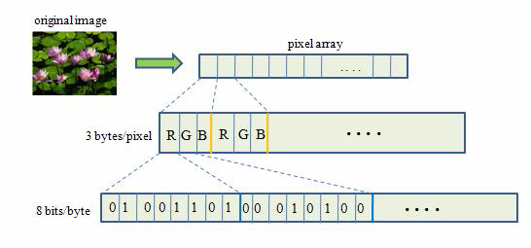
Least Significant Bit (LSB) Insertion
Least Significant Bit (LSB)
Notes:
The last bit of each byte/pixel is called the least significant bit (LSB). It is observed that the LSBs have very little impact on the appearance of an image.

Slide 37


We don’t need all these bits.
8-bits per pixel
7-bits per pixel
An image represented with 8 and 7-bits per pixel
Notes:
In the example here, the figure (Left) displays an image using all 8-bits for each pixel, and the figure (Right) displays the same photo, but only using 7-bits for each pixel (without using the LSBs). Obviously, the human eye cannot detect the difference between them.

Slide 38
Least Significant Bit (LSB) Insertion
Hidden Message
Notes:
As a result, LSB is a very popular method for transmitting hidden information due to its simple implementation and the difficulty for an interceptor to suspect the existence of the secret message.

Slide 39
Countermeasures and Detection - Steganalysis
Methods of detecting the use of Steganography
Visual Detection (JPEG, BMP, GIF, etc.)
Detecting Steganography by viewing it
Statistical Detection (changes in patterns of the pixels or LSB – Least Significant Bit)
Structural Detection - View file properties/contents
size difference
date/time difference
contents – modifications
checksum
Notes:
There are some methods of detecting the use of Steganography:

Slide 40

Steganography - Tools
Steganography Tools
Steganos
S-Tools (GIF, JPEG)
StegHide (WAV, BMP)
Invisible Secrets (JPEG)
JPHide
Camouflage
Hiderman
Many others…
Notes:
There are many Steganography Tools available on the Internet. We will use S-Tools as an example to see how a Steganography Tool works.

Slide 41

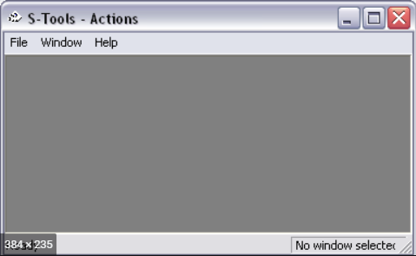

Steganography – Tools (cont’d)
(a)
Three zebras and a tree
(b)
Three zebras, a tree, and the complete text of six plays by William Shakespeare.
Notes:
We take a look at two images, the zebras image (Left) and the other one with some hidden secret messages (Right).
Apparently, we cannot see any difference between two images with the naked eye,
In other words, the hidden messages are invisible to the naked eye.

Slide 42
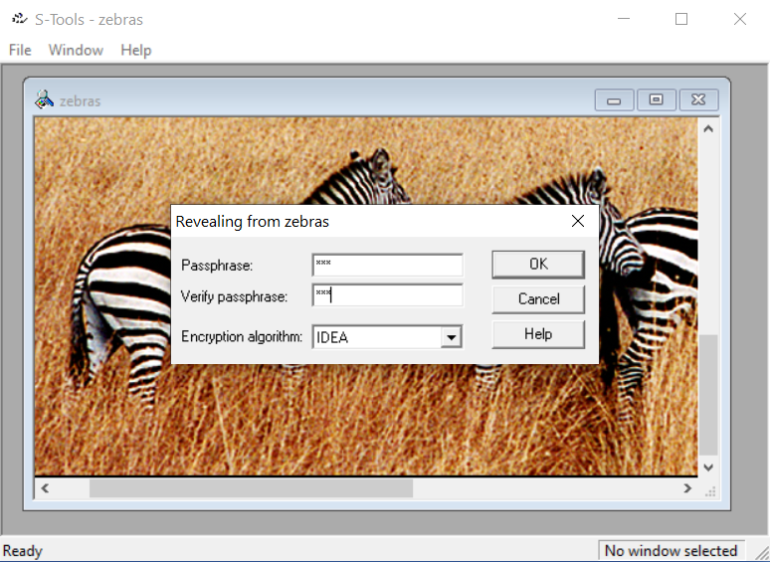
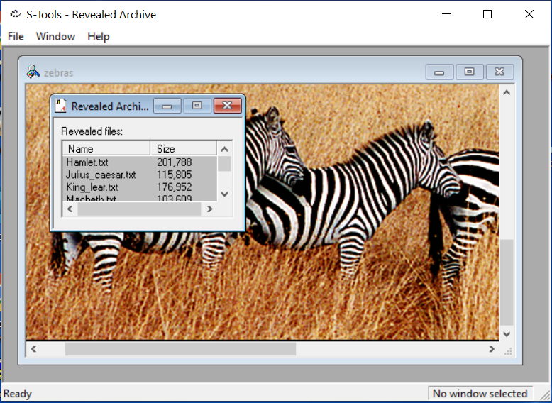
Steganography - Tools (cont’d)
Notes:
Note that the hidden messages are encrypted using an encryption key 'abc' (without the quotes) with IDEA as the encryption algorithm. So you can use S-Tools to reveal the hidden messages, which are William Shakespeare's works.

Slide 43





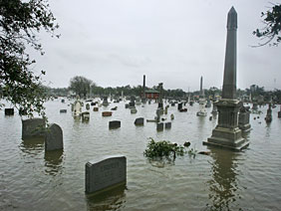







Steganography (cont’d) Send a Secret Message?
Notes:
Today steganography has also been used extensively for the purpose of illegal activities, as it supplies a
means of covert communication between criminals.

Slide 44
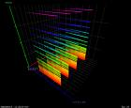
Non-graded hands-on exercise
- HTML steganography
In this non-graded lab exercise, you are required to use Deogol, an HTML steganography tool, to embed small messages into a HTML container file. Note that the real HTML file and the modified HTML file is indistinguishable by the browser.
[1] Data Hiding and Detection Techniques.
https://faun.pub/data-hiding-and-detection-techniques-2c661b6522f3
[2] Deogol. https://hord.ca/projects/deogol/

Slide 45
It is very challenging to detect hiding data.
We can target the hidden message by destroying and filtering the hidden message. This is because the interception and analysis of hidden data is not always necessarily needed. What is important is preventing the intended party from receiving the hidden data.
Notes:
It is very challenging to detect hiding data.
However, we can target the hidden message by destroying and filtering the hidden message. This is because the interception and analysis of hidden data is not always necessarily needed. What is important is preventing the intended party from receiving the hidden data.

Slide 46
Least Significant Bit (LSB) Insertion
Hidden Message
0
0
[1] William Jamieson. Destruction of Steganography. Targeting the Least Significant Bit in 24 bit Images. https://pdfs.semanticscholar.org/ec28/68b10ab3ea4864fccabde5152a50faf7ff5a.pdf
[2] Nihad Ahmad HassanRami Hijazi. Data Hiding Techniques in Windows OS: A Practical Approach to Investigation and Defense. September 8, 2016. Syngress
Notes:
Let’s still use Least Significant Bit (LSB) steganography as an example. It puts the secret information into the least significant bits of an image.
Please note that whether or not we use Least Significant Bits (LSBs) will affect the appearance of the image.
So we can destroy Steganography content by simply removing the least significant bits of an image.

Slide 47
Roadmap
Data Hiding Methods
Hidden Data Detection
Sometimes, the ability to destroy hidden data can be the only available choice for investigators when they cannot prove the existence of concealed data and/or cannot extract it.
Destroy hidden data
[1] Nihad Ahmad HassanRami Hijazi. Data Hiding Techniques in Windows OS: A Practical Approach to Investigation and Defense. September 8, 2016. Syngress
Notes:
Finally, I would like to review the analysis roadmap for data hiding and detection. It is very important for us to know various Data Hiding Methods. So we can also detect these hidden message. Sometimes, the ability to destroy hidden data can be the only available choice for investigators when they cannot prove the existence of concealed data and/or cannot extract it.

Slide 48
Data Exfiltration and Infiltration
Notes:
Next, we talk a look at data exfiltration.

Slide 49
Data Exfiltration
Data exfiltration is sometimes referred to as data extrusion, data exportation, or data theft. All of these terms are used to describe the unauthorized transfer of data from a computer or other device.
Data exfiltration can be conducted manually, by an individual with physical access to a computer, but it can also be an automated process conducted through malicious programming over a network.
For example, DNS is increasingly being used as a pathway for data exfiltration either by malware-infected devices or by malicious insiders. Also, DNS tunneling is the method of tunneling other protocols such as SSH or HTTP within DNS. DNS tunneling has been around for a long time, and popular toolkits include Iodine, OzymanDNS, SplitBrain, and TCP over DNS. Using a DNS tunnel, malicious actors can also fully and remotely control a compromised internal host or exfiltrate data.
[1] https://digitalguardian.com/blog/what-data-exfiltration

Slide 50
Data Infiltration
Data Infiltration: In a method similar to exfiltration, the hacker can use DNS to move a payload or sneak in malicious code, thereby getting it past many protection methods in place, such as firewalls, IDS, and content filters.

Slide 51
DNS (Domain Name System)
Notes:
Next, we take a look at spoofing issue in a popular application protocol, DNS (Domain Name System).

Slide 52
DNS: domain name system
People: many unique identifiers:
SIN, name, driver’s license #, passport #
Internet hosts, routers:
IP address (32 bit) - used for addressing datagrams
“name”, e.g., www.uoguelph.com - used by humans
We need to map between IP address and name, and vice versa
Solution: Domain Name System (DNS)
Notes:
Anyone knows the IP address of our university website? I don’t think so.
But you must know our university website domain name.
The Domain Name System (DNS) is the phonebook of the Internet. Humans access information online through domain names, like www.uoguelph.com. Web browsers interact through Internet Protocol (IP) addresses. DNS translates domain names to IP addresses so browsers can load Internet resources.
Each device connected to the Internet has a unique IP address which other machines use to find the device. DNS servers eliminate the need for humans to memorize IP addresses such as 192.168.1.1.

Slide 53


How DNS works
2
What is the ip address of www.example.com?
ns.uoguelph.ca
3
1
4
ns.example.com
The ip address of www.example.com is 208.77.188.166?
computer10.SoCS.uoguelph.ca
ping www.example.com.

Slide 54
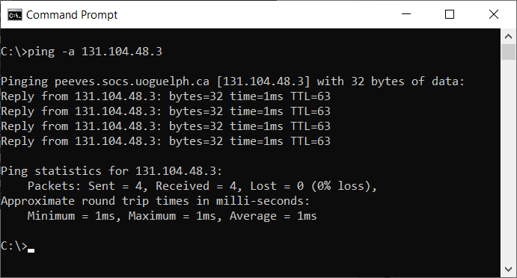
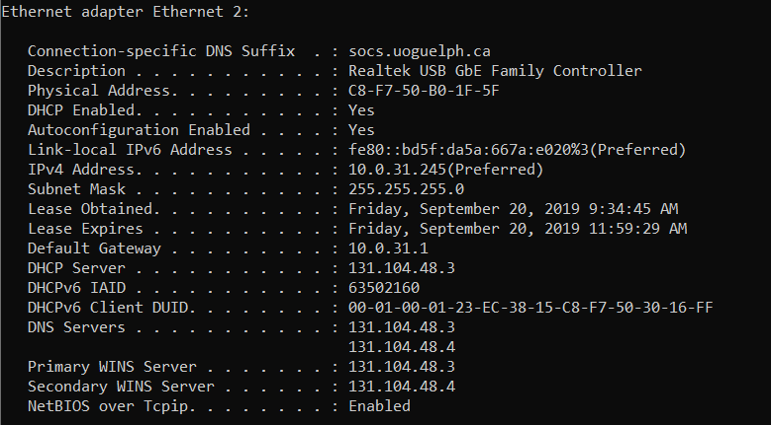
“ipconfig /all”, which displays all IP configuration information

Slide 55
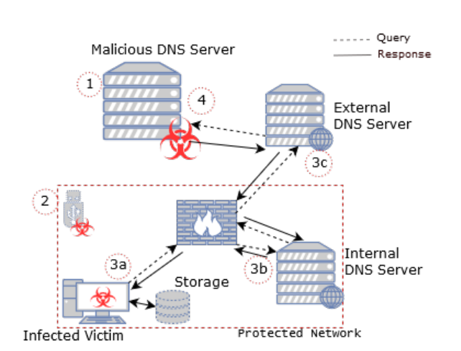
A typical DNS Data Exfiltration Attack
[1] Steadman, J., & Scott-Hayward, S. (2019). DNSxD: Detecting Data Exfiltration over DNS. In Proceedings of the IEEE Conference on Network Functions Virtualization and Software-Defined Networking Institute of Electrical and Electronics Engineers.
Notes:
1: The attacker must have control of an authoritative DNS
server, which will be the end point for the DNS requests
transmitted from the victim.
2: Exfiltration tools consist of two component applications; the client on the victim machine, and the server
controlled by the attacker. The victim machine must
be infected with the client tool. For example, within a
malware payload.
3a: With control of the victim’s machine, the exfiltration
tool is used to encapsulate selected data from the victim
into DNS requests.
3b/c: The request is forwarded through DNS servers
until it reaches the attacker. This reflects standard DNS
operation i.e. if a server is unable to resolve the DNS
request, it forwards it to a higher-level DNS server. Note:
this process can involve many more DNS servers than shown in the figure.
4: Once the request reaches the authoritative DNS server,
the server side of the exfiltration tool strips the data from
the request and reconstructs it into the original format.

Slide 56



Example: DNS Exfiltration
msg1.attacker.com?
msg2.attacker.com?
msg3.attacker.com?
msg4.attacker.com?
msg5.attacker.com?
msg1.attacker.com?
msg2.attacker.com?
msg3.attacker.com?
msg4.attacker.com?
msg5.attacker.com?
Malware
DNS server
Authoritative Server for attacker.com
[1] Pratyusa K. Manadhata. Enterprise Data Exfiltration Detection and Prevention
Hewlett Packard Labs

Slide 57
A real world example
Queries
BLGCOFDAGOOOESDULBOOBOOOOOOOOOOOOOOOOOOLDOSESKGKHHF.detacsufbo.ru
EUJSFLDAGOOOESDUDBOOBOOOOOOOOOOOOOOOOOOOSSJHGHFCLFOHCHLGHSAHAHU.CHLAAFHLSGHAFGFUOOEUGDKLCSHEKLJBOCOSECHFFUGBSKGDJGGGHOJHJCGJG.KCDOELDUOEGUCUOUHJUAKEGGGFGEKHLGFDFESJOEL.detacsufbo.ru
SHUDHFDAGOOOESDUGBOOBOOOOOOOOOOOOOOOOOOEDKDFBBHLEGGJLGUFABHCCU.DHDFFCHHKSHGHAOUBGEGEJLGFHUBDFGUGJDFFEAKFSBFFGSDACGHCSKBHLSCGHH.EHSHHJFHUAAOOGKKSDDAHAUBBJDCCKGSHKLGJGAS.detacsufbo.ru
OHDOBHDAGOOESDUGBOOHOOOAOOOOOOOOOOOOOOO.detacsufbo.ru
HBSGGCDAGOOESDUUSOOBOOOOOOOOOOOOOOOOOOO.detacsufbo.ru
Responses (TXT records)
LLCDGHDABOOOSSUHOOOFOOOOOOOOOOOOOOOOOOO
KJGDUDABOOOSBSUHOOOFOOOOOOOOOOOOOOOOOOO
JJDHUDABOOOSBSUHOOOFOOOOOOOOOOOOOOOOOOO
HBEAGDABOOOSBSUHOOOUOOOOOOOOOOOOOOOOOOO
KALFCSDAOOOSBSUHOOOFOOOOOOOOOOOOOOOOOOO
[1] Pratyusa K. Manadhata. Enterprise Data Exfiltration Detection and Prevention
Hewlett Packard Labs

Slide 58
DNS Data-exfiltration Protection

Slide 59
DNS Data-exfiltration Detection
Data exfiltration seems like an easily preventable process, but the advanced attacks that occur regularly in the modern threat landscape require an all-encompassing approach for protecting confidential data theft.
Attackers will often use a predetermined protocol, such as DNS, HTTP, HTTPS or File Transfer Protocol (FTP), to transmit the data. However, these activities would almost certainly deviate from normal user behavior patterns. For example, the data volume may be much greater than most users would transmit. They may also be accessing the environments from a known TOR exit node. Thus, one promising data exfiltration protection method is detecting data exfiltration.
For example, use machine learning to perform real-time analytics on live DNS queries to detect data exfiltration.
The analytics engine examines host.subdomain and TXT records in DNS queries and uses entropy, lexical analysis, time series, and other factors to determine presence of stolen data in queries.
[1] https://digitalguardian.com/blog/what-data-exfiltration
Notes:
uses machine learning to perform real-time streaming analytics on live DNS queries to detect data exfiltration. The analytics engine examines host.subdomain and TXT records in DNS queries and uses entropy, lexical analysis, time series, and other factors to determine
presence of data in queries. T

Slide 60
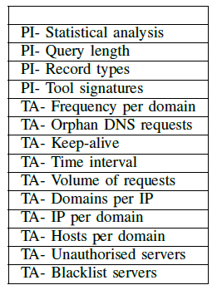
DNS Data-exfiltration Detection (cont’d)
Features
PI (Packet Inspection)
TA (Traffic Analysis)
Notes:
Features used in DNS data exfiltration Detection (PI: Packet Inspection, TA: Traffic Analysis)

Slide 61

Preventing DNS-based Data Exfiltration
Blocking of Data Exfiltration: Not only detects but also blocks communications to destinations associated with data-exfiltration attempts.
Automating Security Response to accelerate response to and remediation of data exfiltration threats
[1] Data Exfiltration: What You Should Know to Prevent It
https://threatpost.com/data-exfiltration-prevent-it/167413/
[2] https://www.infoblox.com/wp-content/uploads/infoblox-solution-note-preventing-dns-based-data-exfiltration.pdf

Slide 62

Reading materials
Chapters 13 and 21
[1] R. Chandramouli and N. Memon, "Analysis of LSB based image steganography techniques," Proceedings 2001 International Conference on Image Processing (Cat. No.01CH37205), Thessaloniki, Greece, 2001, pp. 1019-1022 vol.3.
doi: 10.1109/ICIP.2001.958299
[2]http://poseidon.csd.auth.gr/LAB_SEMINARS/DigDays/Lectures/Information_Hiding.ppt

