Slide 1

Data reverse engineering
1
Notes:
In this lecture, we will study a fundamental technical in digital forensics, Data reverse engineering.

Slide 2

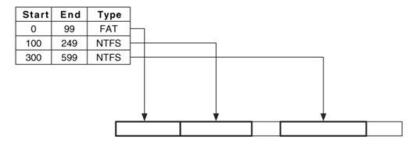


Dose of Reality:
partition table
The hard disk layout

Slide 3



Digital Forensics vs Data storage questions
Data storage questions: what is the information stored (e.g., GPS); where is the information stored (e.g., file path); and how the information is stored (e.g., the structure of a database table).
Finding data
[1] X. Lin, T. Chen, T. Zhu, K. Yang, F. Wei, “Automated forensic analysis of mobile applications on Android devices,” DFRWS USA 2018.
Notes:
As for Digital forensics, in other words, we need to find data generated in computer systems ( by applicatons).

Slide 4
What is Data Reverse Engineering?
Data reverse engineering deals with the problem of
What information is stored in a computer system
How this information can be extracted and used
[1] J. Lee, T. Avgerinos and D. Brumley, “TIE: Principled Reverse Engineering of Types in Binary Programs,” NDSS 2011
[2] A. Slowinska, T. Stancescu and H. Bos, “Howard: A Dynamic Excavator for Reverse Engineering Data Structures,” NDSS 2011

Slide 5
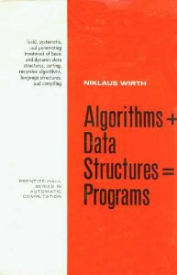
Data Structure Reverse Engineering
Data Structure: A data structure is a particular way of organizing data in a computer so that it can be used effectively.
Data in computer is usually structured
Program is used to process data
Data structure can be reverse engineered

Slide 6
Data Structure Reverse Engineering (cont’d)
Uncovering the syntax and semantics of the data structure.
Syntax
Layout
Size
Offset
Semantics
Meaning
Context

Slide 7
Data Structure Reverse Engineering (cont’d)
Two options:
Static analysis: inspect source code or run automated method.
Dynamic analysis: Run code, possibly under instrumented conditions.
State-of-the-art techniques:
Dynamic analysis
Static analysis
Static + Dynamic analysis
Notes:
Currently, there are two options.

Slide 8
Static vs Dynamic Analysis
Static
Consider all possible inputs (in summary form)
usually faster than dynamic analysis but less precise
Dynamic
Need to choose sample test input

Slide 9

Graph Theory
9

Slide 10
Definition: Graph
A graph G = (V,E) consists of two finite sets V and E. The elements of V are called the vertices (or nodes) and the elements of E the edges of G. Each edge is a pair of vertices.
For instance, V = {1, 2, 3, 4, 5} and E = {{1, 2}, {2, 3}, {3, 4}, {4, 5}}.
10

Slide 11
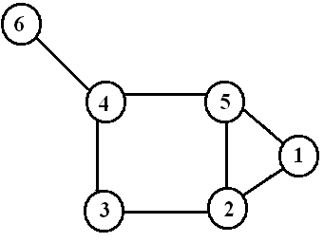
Example
V:={1,2,3,4,5,6}
E:={{1,2},{1,5},{2,3},{2,5},{3,4},{4,5},{4,6}}
11

Slide 12
Path
A path is a sequence of vertices such that there is an edge from each vertex to its successor.
A path is simple if each vertex is distinct.
1
3
A
B
C
2
Cycle
4
5
6
D
E
F
Cycle
Unreachable
Simple path from 1 to 5 = [ 1, 2, 4, 5 ]
If there is path p from u to v then we say v is reachable from u via p.
12

Slide 13
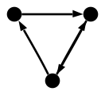
Directed Graph (digraph)
Edges have directions
An edge is an ordered pair of nodes
13

Slide 14
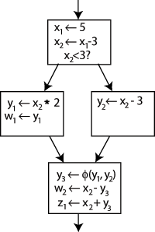
Graph-based representations of Programs
Representing a problem as a graph can provide a different point of view
Representing a problem as a graph can make a problem much simpler
More accurately, it can provide the appropriate tools for solving the problem
……
x = a+b;
y = a*b;
if (c) {
x=x+1;
y=y+1;
}
else {
x=x-1;
y=y-1;
}
z = x+y;
……
Graph algorithms
14

Slide 15
Control-Flow Graph (CFG)
Graph representation of computation and control flow in the program:
Each node represents a statement or a basic block (statement group (a sequence of instructions with no branches into or out of the block))
Edges represent possible flow of control from the end of one block to the beginning of the other
15

Slide 16



Control-Flow Graph (cont’d)
……
x = a+b;
y = a*b;
if (c) {
x=x+1;
y=y+1;
}
else {
x=x-1;
y=y-1;
}
z = x+y;
……
c
T
F
16

Slide 17
Dataflow analysis
Data-flow analysis derives information about the dynamic behavior of a program by only examining the static code
17

Slide 18
Dataflow analysis (cont’d)
n₀
……
x = a+b;
y = a*b;
if (c) {
x=x+1;
y=y+1;
}
else {
x=x-1;
y=y-1;
}
z = x+y;
……
def(n₀)={x}
c
T
F
n₁
use(n₁)={x}
18

Slide 19


Dataflow analysis (cont’d)
n₀
def(n₀)={x}
def(n₀)={x}
End user input, such as username and password
c
use(n₁)={x}
T
F
SELECT UserList.Username
FROM UserList
WHERE UserList.Username = 'Username'
AND UserList.Password = 'Password'
n₁
use(n₁)={x}
19

Slide 20
Dataflow analysis (cont’d)
n₀
def(n₀)={x}
def(n₀)={x}
Top Secret (Level 3)
Read a Top-Secret file
c
T
F
use(n₁)={x}
Unclassified (Level 0)
Write to a Unclassified file
n₁
use(n₁)={x}
20

Slide 21
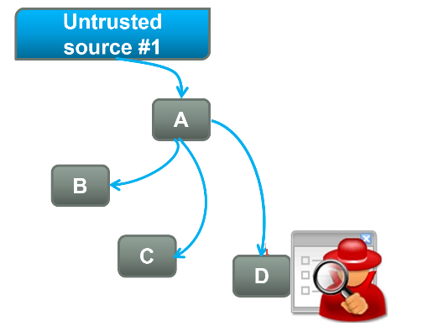



Static Analysis for Digital Forensics
Taint analysis
What info is stored locally or on cloud?
Taint analysis
Taint source (e.g., getLastKnownLocation()):
Originally, associate taint marker (tokens) with untrusted input as it enters the program or sensitive information leaving the program.
Here, we mark any data input or generated within the program.
Taint sink (e.g., Write()):
Originally, mark sensitive sinks and report vulnerabilities when tainted strings are passed to these sinks.
Here, we report local data storage operations, such as written into a file.
Data, e.g., GPS location of the device, mobile user name, etc
Data flow analysis
sink
e.g., Outgoing SMS
Sink (Local data storage operations, e.g., Writing Files, or cloud storage)
[1] D. Denning and P. Denning. "Certification of programs for secure information flow“, Communication of the ACM, 1977
[2] J. Newsome and D. Song. "Dynamic Taint Analysis for Automatic Detection, Analysis, and Signature Generation of Exploits on Commodity Software“, NDSS 2005
[3] X. Lin, T. Chen, T. Zhu, K. Yang, F. Wei, “Automated forensic analysis of mobile applications on Android devices,” DFRWS USA 2018.
Notes:
Static analysis approaches have been proposed to assess the security of Android apps, by searching for known
vulnerabilities or actual malicious code.
Taint analysis can be seen as a form of Information Flow Analysis.

Slide 22
Static vs Dynamic Analysis (cont’d)
Manual testing
only examines small subset of behaviors
Entry
Entry
1
1
2
2
4
4
1
3
4
1
1
1
2
4
1
2
4
1
2
4
1
3
4
2
2
3
. . .
1
2
4
1
2
4
1
3
4
4
4
Exit
Exit
Software
Behaviors
Notes:
The current popular approach is using dynamic analysis.
Specifically, we install applications on computer systems, and play for a while. Then, we catch the data and analyze them.
This is because of one major reason: path explosion. It is very challenging to cover all the execution paths and analyze all possible runs of a program.

Slide 23

Dynamic Analysis - Limitations
Hard to trigger all interesting program paths. Consequently, some behaviors of an application may not be discovered by dynamic analysis
Nontrivial to identify what information is stored and how it is stored
Hard to automate dynamic analysis given a large number of applications due to the differences in their runtime environments
dynamic analysis
[1] N. Scrivens and X. Lin. “Android digital forensics: data, extraction and analysis”. ACM TUR-C 2017
[2] C. Anglano. “Forensic analysis of whatsapp messenger on android smartphones”, Digital Investigation. 11 (2014): 201-213
Notes:
First, it is hard to …..

Slide 24
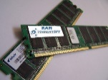
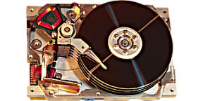


Differential forensics analysis (DFA)
Differential forensic analysis compares two different digital forensic images (or, more generally, any pair of digital artifacts) and reports the differences between them.
Operations
Acquiring Data
……
Disk Image at T₁
Disk Image at T₂
Disk Image at T_{n}
Difference
Difference
Differential Analysis
[1] Garfinkel, S., Nelson, A.J. and Young, J., 2012. A general strategy for differential forensic analysis. Digital Investigation, 9, pp.S50-S59.
Notes:
The popular dynamic analysis in digital forensics is Differential forensics analysis (DFA).

Slide 25
Static Analysis
Combining static and dynamic analysis
+
Dynamic Analysis

