Slide 1

KLE DR. M. S. Sheshgiri College of Engineering and Technology Department of Electronics and Communication Engineering
Micro project on
“IOT BASED PROJECT”
Smart Secure safe HELMET
S3 HELMET
Team members with USN: Under the Guidance of
Vaibhav Alur-2KL18EC118 Prof. Arun S. Tigadi
Yash B Joshi-2KL18EC116
Akshata Hakki-2KL18EC008
Akshata V Ingale-2KL18EC010

Slide 2
INTRODUCTION
S3 helmet is an IOT based module that helps in preventing accidents and also assists the driver with its smart features.
National Highway Traffic Safety Administration (NHTSA) says, 11% of accidents in 2013 and 37% in 2015 is caused because of drowsiness.
According to Environmental Research and Public Health, Work-related fall was the second leading cause of death among work-related injuries after motor vehicle crashes.
Smart helmet have wide application in industries, construction places, for drivers etc.

Slide 3
OBJECTIVES
To detect dizziness using this module.
Alarming the person who is wearing this module when the individual is suffering from drowsiness and induced drowsiness due to lethargy.
To ensure safety of user.
To inform weather condition to the user.

Slide 4
METHODOLOGY
The main principle involved is IOT interface of microcontroller with the module.
In this module, we have used sensors(Blink Sensor, Shock Sensor), Microcontroller, Wi-Fi launch pad and GSM module.
The drowsiness is detected using blink sensor.
In case of accidents, the shock and blink sensors will indicate the warning parameters.

Slide 5
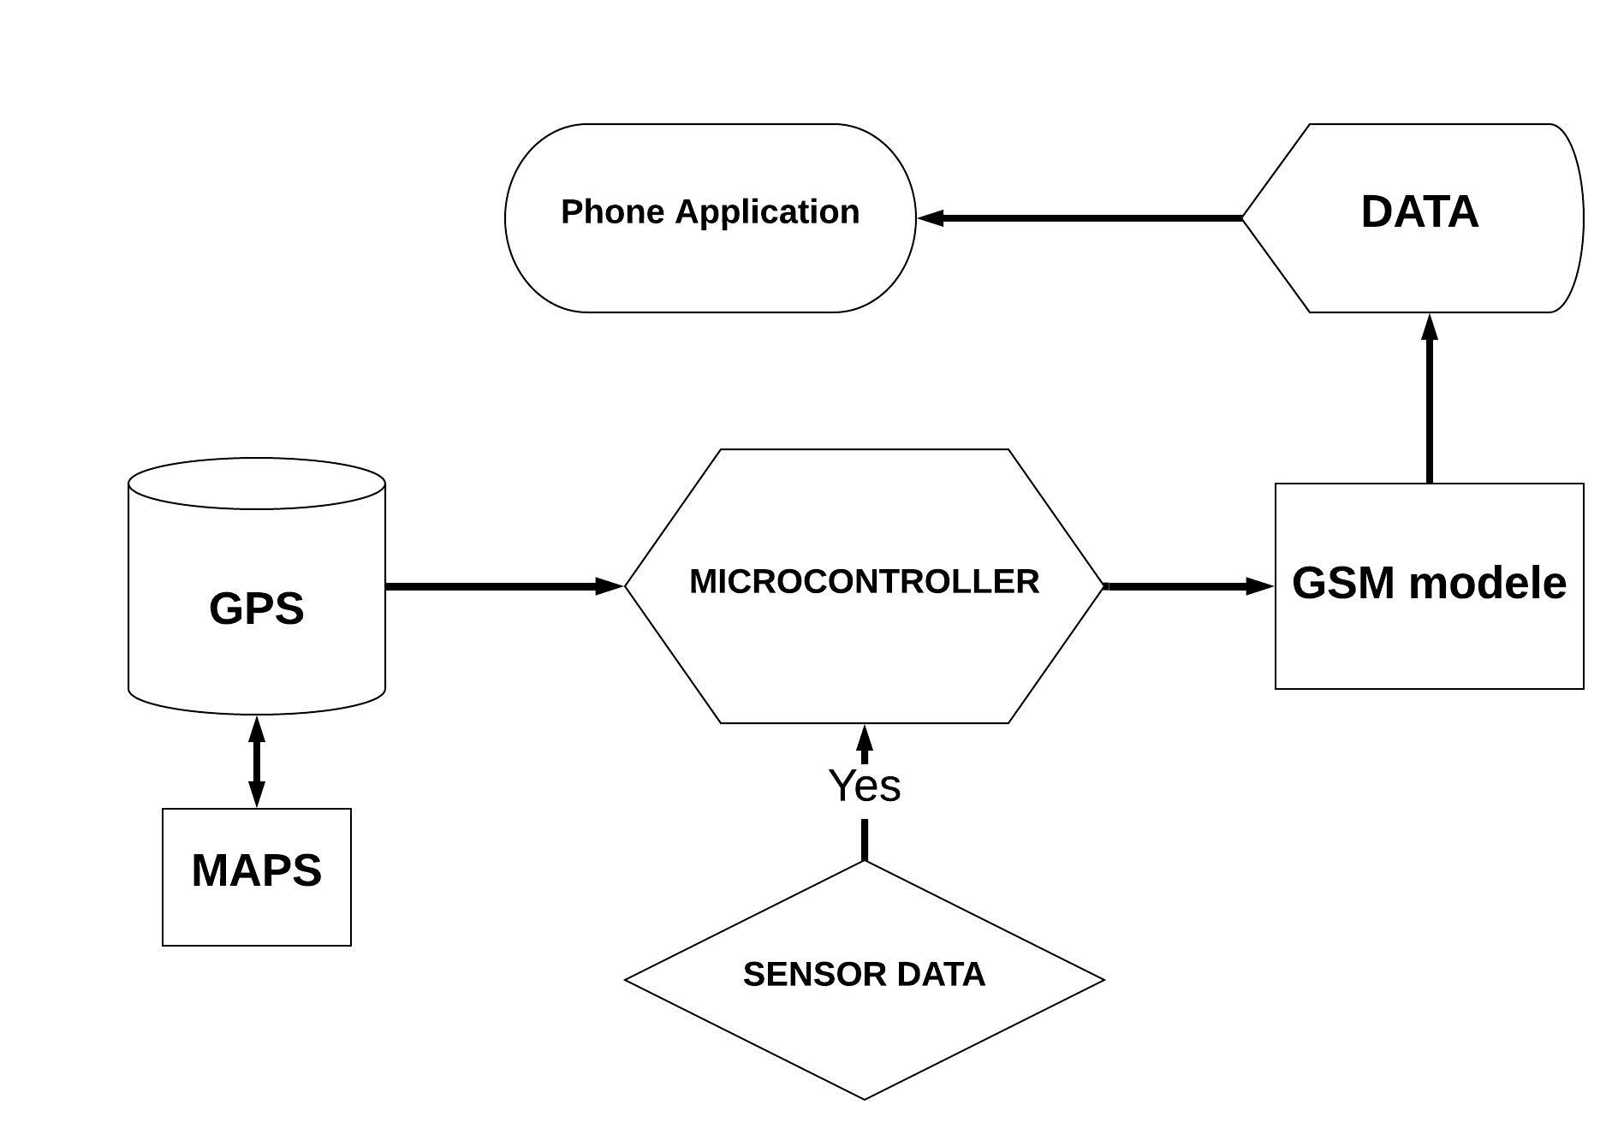
FLOW CHART OF THE MODULE

Slide 6
OUTCOMES
This has wide application in long distance travelling, for construction workers, for workers in industries.
Non manual communication is being ensured.
This module will add a level of protection and safety with SOS feature.
It can provide weather information which can help people in getting informed about the changes in environment.

Slide 7
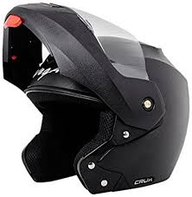
THANK YOU

