Slide 1


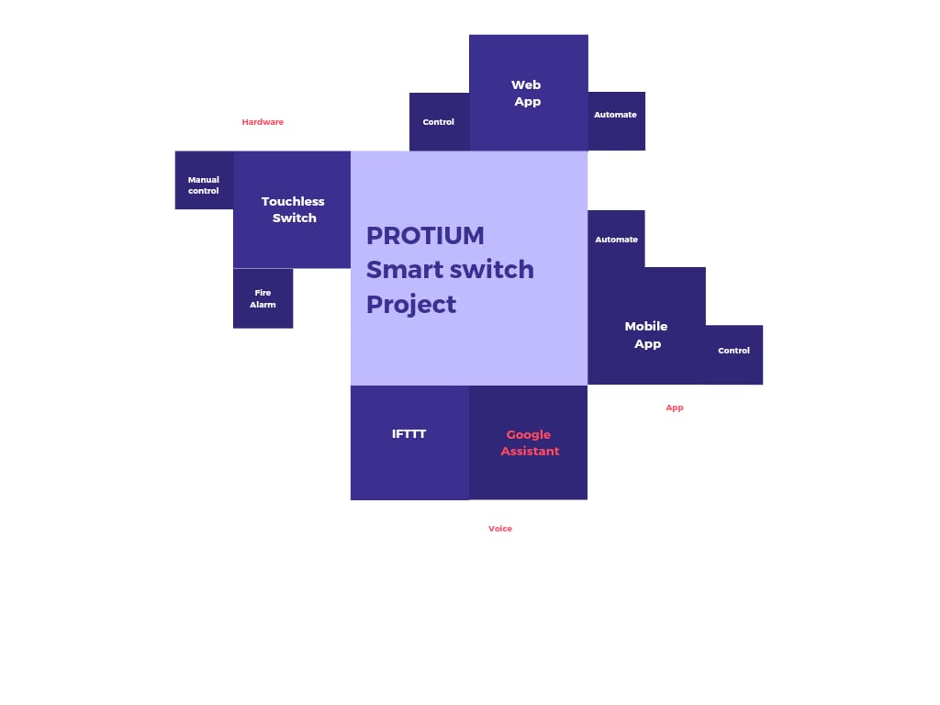
K. L. E. Dr. M. S. SHESHGIRI COLLEGE OF ENGINEERING AND TECHNOLOGY
BELGAVI– 590008 (2020-21)
DEPARTMENT OF ELECTRONICS AND COMMNUNICATION ENGINEERING
6th SEM
MINIPROJECT
BATCH: 31
TEAM:
Yash B. Joshi
Vaibhav Alur
GUIDE: Arun Tigidi

Slide 2
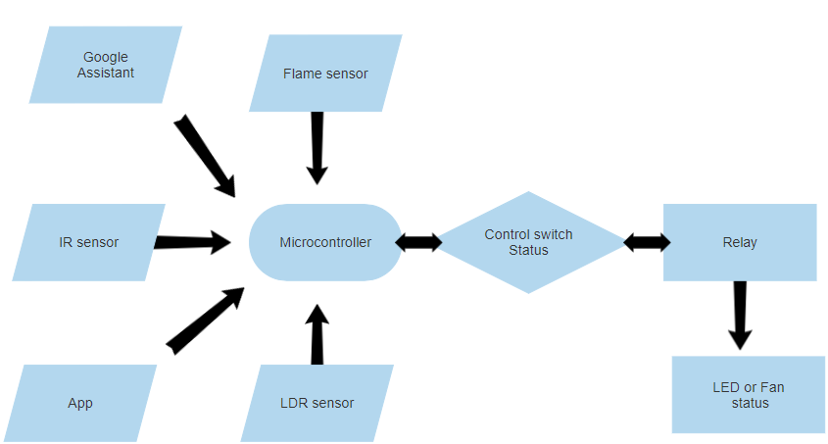
INTRODUCTION
One-Switch Multiple controls
Key features:
Contactless switch
App Control
Google Assistant
Web App
Automation
Fire Alarm
Competitors:
Smart Touch Combo Switch @ 4600/-
LCARE Smart Wi-Fi Modular Switch for Home Automation @ 3000/-
ONOFF T0EU3C TX Smart Wi-Fi White wall touch switch @ 2500/-

Slide 3
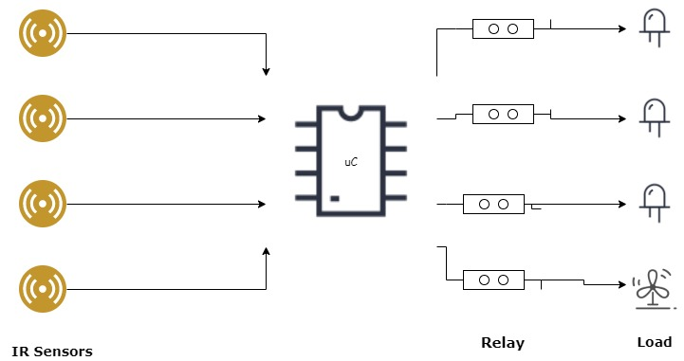
Contactless Switch
Controls the flow of current
Quick response time
Capable to control from internet
Gets disabled during fire alarm or automation.

Slide 4
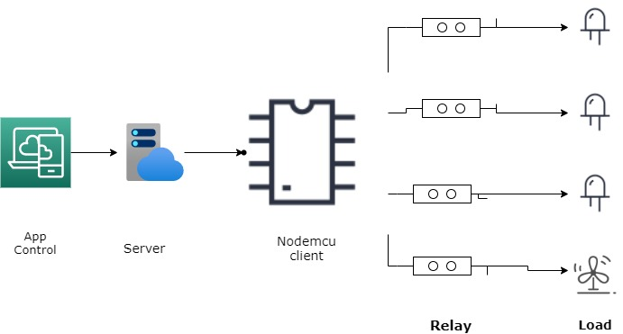
Controlling using App
Easy control of switches
Connected to Web app
Location independence
Greater Convenience
Turn ON/OFF Automation feature

Slide 5
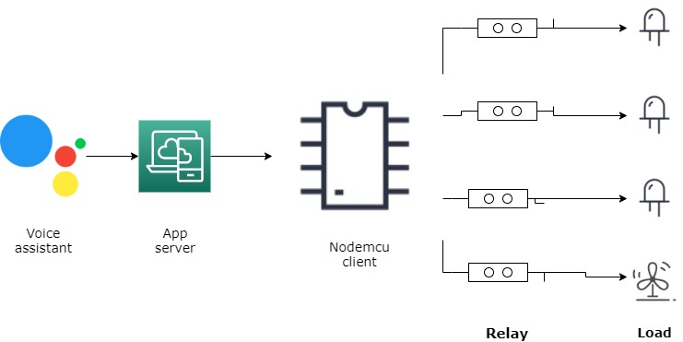
Google Assistant
Controlling switch using voice assistant
Location independence
Personal google assistant commands

Slide 6
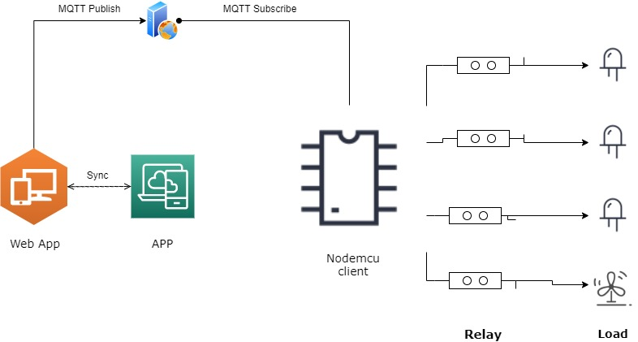
Web Application
MQTT Based Protocol
Synchronised with App
Web Based: No installation of Application
Faster and secure communication
Location independence.

Slide 7
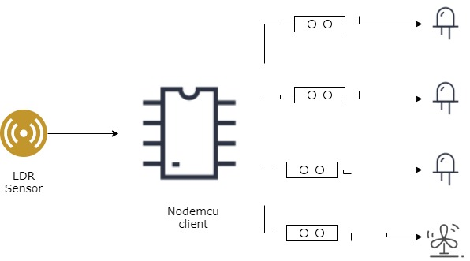
Automation
Automatic control of switches
No Human intervention
Can be enabled by App/Google assistant

Slide 8
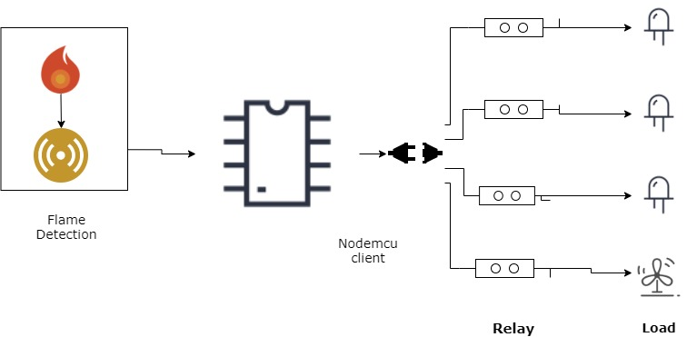
FIRE ALARM
Disconnects all connection
Alarms people inside room using buzzer

Slide 9
Project Demonstration PROTIUM-Smart-Switch-Demo. EC_Batch-31_Project-Report

