Slide 1
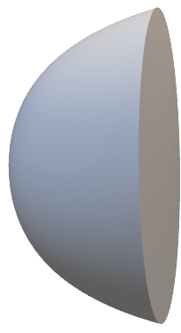

Slide 5







E
$m_{j}$=3/2
$m_{j}$=1/2
j=3/2
$m_{j}$=-1/2
$m_{j}$=-3/2
$m_{j}$=1/2
j=1/2
$m_{j}$=-1/2
0
$$|\vec{r}|$$

