Slide 1
Final Assessment
VB.NET

Slide 2
Question 1
Which of the following is a valid variable name in VB.NET?
(A) firstName
(B) first Name
(C) 1stName
(D) Both (A) and (C) .

Slide 3
Question 2
Which of the following is NOT one of the three steps for creating a Visual Basic program?
(A) Creating a user interface
(B) Changing the properties of each object on the interface
(C) Writing requirement specifications
(D) Writing code

Slide 4
Question 3
Which selection process is an example of multiple branches from a single expression?
a.) If…Then
b.) Select Case
c.) Do…Loop
d.) For…Next
e.) All of the above.

Slide 5
Question 4
Which method will return the number of elements in an array?
a.) Dimension
b.) Length
c.) Number
d.) Size
e.) UpperBound

Slide 6
Question 5
Which control is an example of an object in VB.NET?
a.) Button
b.) Label
c.) Textbox
d.) Both a and b.
e.) All of the above.

Slide 7
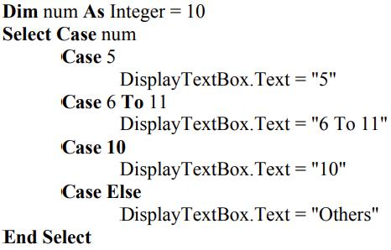
Question 6
What will be displayed in the DisplayTextBox by the following code?

Slide 8
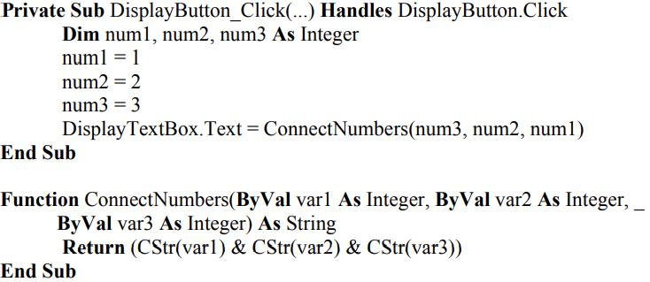
Question 7
What will be displayed in the DisplayTextBox after clicking the button?

Slide 9
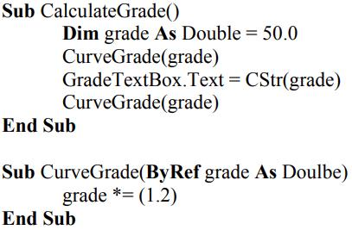
Question 8
What is the value of grade displayed in the GradeTextBox after the following code is executed?

Slide 10
Question 9
Define a function that takes a family name and a gender as its inputs and returns the family name along with an appropriate title determined by the gender. Examples of the returning values are “Mr. Smith” and “Ms. Smith”.

Slide 11
Question 10
Write a program that performs math calculations between two numbers.
Use two textboxes to allow users to enter two numbers.
Use a comboBox to let users select from three options: addition, subtraction, and multiplication.
The result should be displayed in the third textbox.
The “Clear” button clears the textboxes and combobox so that the next calculation can be performed.
Extras: Remind the user if no operator is selected. Also control the situation when the user entered letters (instead of numbers) into the textboxes. Use msgbox to alert the user what is wrong.

