Slide 1
Application-Managed Flash
Sungjin Lee, Ming Liu, Sangwoo Jun, and Shuotao Xu, Jihong Kim, Arvind
14th USENIX Conference on File and Storage Technologies (FAST ‘16). 2016.
2021. 06. 02
Presentation by Han, Yejin
hyj0225@dankook.ac.kr

Slide 2
Introduction
Motivation
AMF
3-1. Block I/O interface
3-2. ALFS
3-3. AFTL
4. Evaluation
5. Conclusion

Slide 3
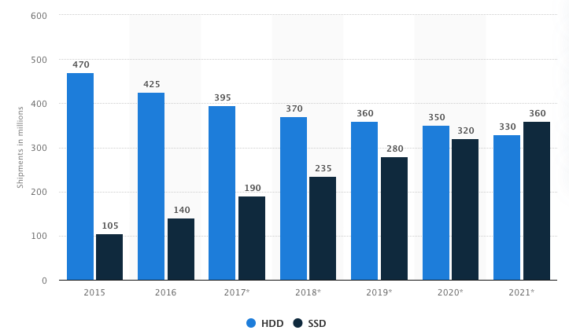
1. Introduction
NAND flash SSD become the preferred storage device in consumer electronics and data centers
FTL provide an block I/O abstraction for interoperability with HDDs
File System
File System
Block Device Interface
Read Sectors
Write Sectors
Read Sectors
Write Sectors
Read Sectors
Write Sectors
Read /Write Erase
FTL
Pages
Block
Device Driver
Device Driver
Flash Memory
Flash Memory

Slide 4
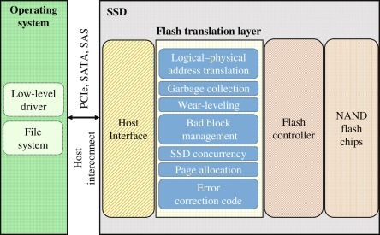
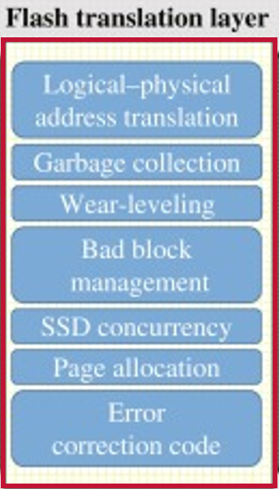

2. Background
What are the purposes of the FTL?
Managing address translation, Garbage collection, wear-leveling, …
Z
Require significant hardware resources
Extra I/Os for flash management (GC)
Host applications cannot predict the
bahavior of flash storage

Slide 5
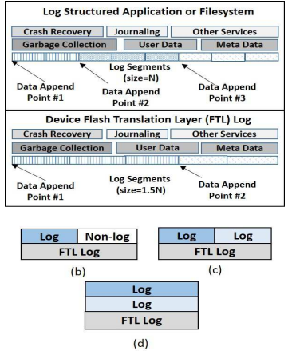
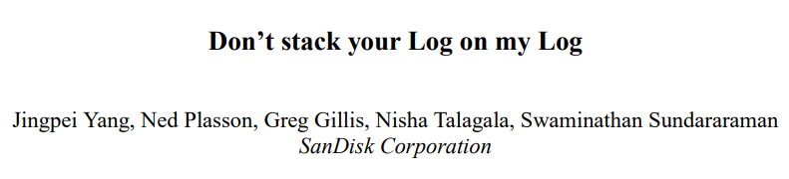



2. Background
What are more issues of the FTL?
Double logging between the FTL and the Host (double logging)
Wastes hardware resource and increases write pressure to flash devices
Z
Duplicate Functionality

Slide 6
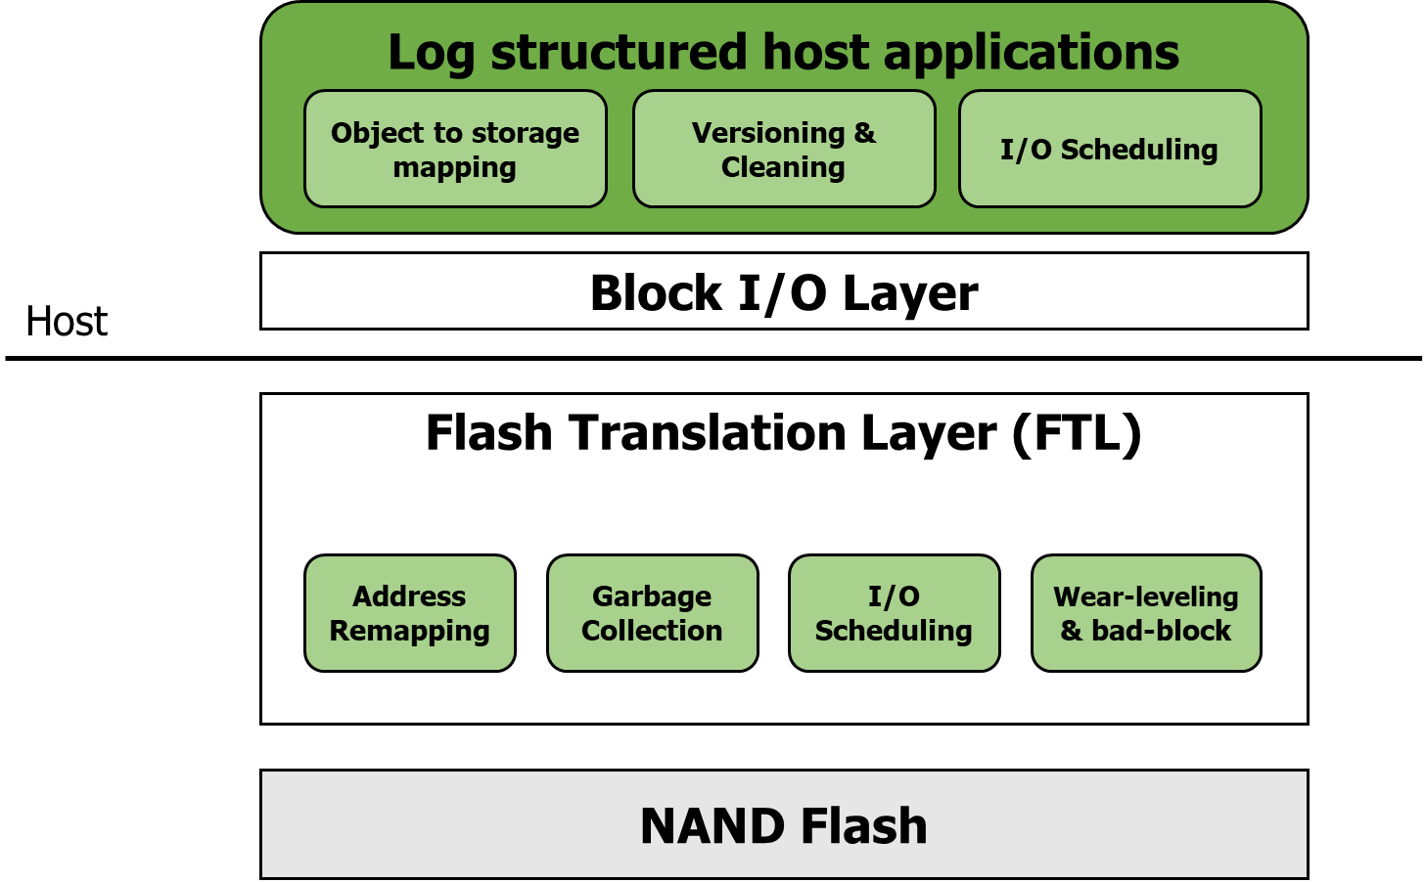
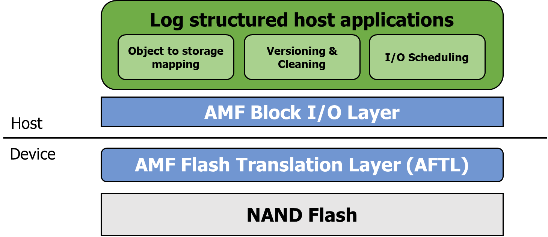

3. AMF
Device-managed Flash
Application-managed Flash
moves flash management
from the device to applications

Slide 7
3. AMF
Application-Managed Flash
Block I/O interface
ALFS (AMF Log-structured File System)
AFTL (AMF Flash Translation Layer)

Slide 8
3. AMF
Block I/O Interface
AMF I/O is based on conventional block I/O
Host Application
4KB Sector
(IO: READ/WRITE)
Appending
0
1
2
3
4
5
6
7
8
9
10 11 12 13 14 15 16 17 18 19 20 21 22 23 24 25 26 27 28 29 30 31
…
Logical Segment 0
(IO:TRIM)
Logical Segment 1
Host
Device
Channel #0
Channel #1
Channel #2
Channel #3
0
1
2
3
Physical
Segment 0
4
5
6
7
8
9
10
11
12
13
14
15
…
…
…
…

Slide 9
3. AMF
Block I/O Interface
Append-only Write
Host Application
Appending new data (WRITE)
Logical Segment 0
Logical Segment 1
Host
Device
…

Slide 10
3. AMF
Block I/O Interface
Only sequential writes with no in-place updates
Sectors can be reused after the segment has been deallocated by TRIM
Host Application
Unable to overwrite
Appending
TRIM
Logical Segment 0
Logical Segment 1
Host
Device
…
Notes:
기존 OS는 NVM을 효과적으로 이용할 수 없다.

Slide 11
3. AMF
Application-Managed Flash
Block I/O interface
ALFS (AMF Log-structured File System)
AFTL (AMF Flash Translation Layer)

Slide 12
3. AMF
ALFS (AMF Log-structured File System)
AMF Log-structured File System (ALFS)
(based on F2FS)
AMF Block I/O Layer
Host
Device
AMF Flash Translation Layer (AFTL)
Segment-level
Address Remapping
Wear-leveling &
Bad-block management
NAND Flash
Notes:
기존 OS는 NVM을 효과적으로 이용할 수 없다.

Slide 13
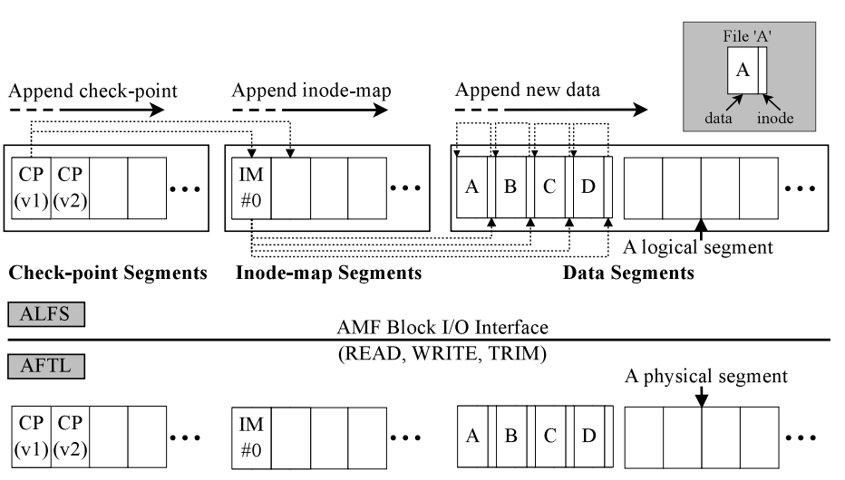
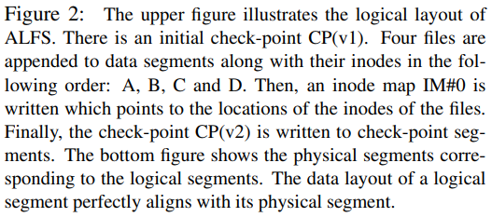
3. AMF
ALFS (AMF Log-structured File System)
File Layout and Operation
Notes:
기존 OS는 NVM을 효과적으로 이용할 수 없다.

Slide 14
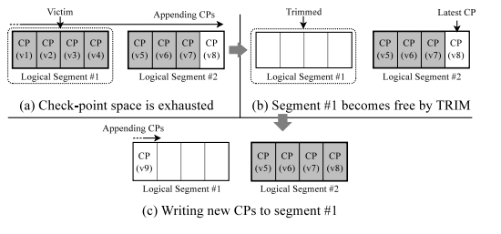
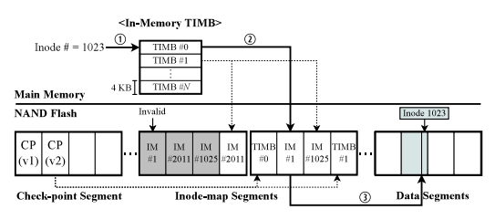
3. AMF
ALFS (AMF Log-structured File System)
Check-point segments for quick mount and recovery
Inode-map segments for fast searches of inodes
Check-point segment handling
Managing inode-map block
Notes:
Inode map size=2GB-> 4KB의 inode-map block으로 나눠서 관리
TIMB=2MB

Slide 15
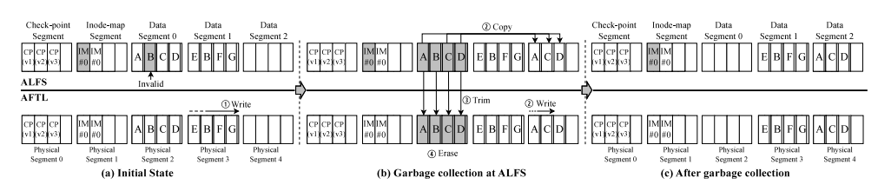
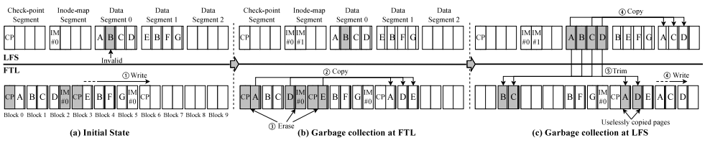
3. AMF
ALFS (AMF Log-structured File System)
ALFS (AMF Log-structured File System)
Comparison with conventional LFS
3 page copies + 2 block erasures
ALFS
with
AFTL
LFS
with
FTL
6 page copies + 3 block erasures
Notes:
기존 OS는 NVM을 효과적으로 이용할 수 없다.

Slide 16
3. AMF
Application-Managed Flash
Block I/O interface
ALFS (AMF Log-structured File System)
AFTL (AMF Flash Translation Layer)

Slide 17
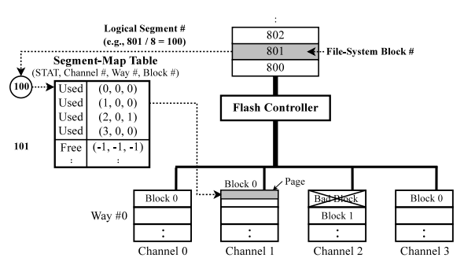
3. AMF
AFTL (AMF flash Translation Layer)
Notes:
기존 OS는 NVM을 효과적으로 이용할 수 없다.

Slide 18
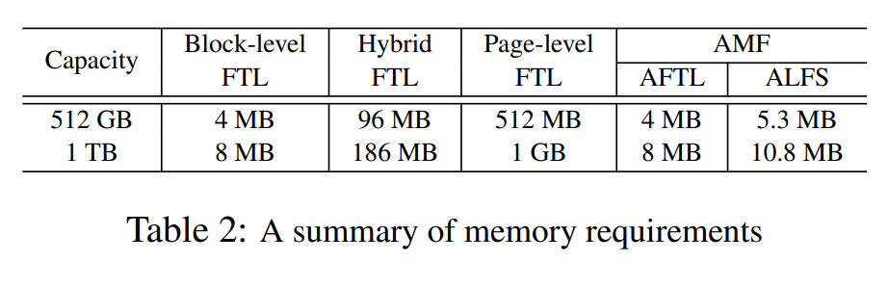
4. Evaluation
AFTL maintains a smaller mapping table than the page-level FTL
Data structures including TIMB need tiny amount of host DRAM

Slide 19
4. Evaluation
Performance measurment
EXT4: only the FTL performed GC
F2FS: both F2FS and the FTL performed GC
AMF: only ALFS performed GC
PFTL: no extra swapping I/Os
AFTL: no extra swapping I/Os
DFTL: incurred extra I/Os
Notes:
Pftl-> tables in DRAM
aftl=->
Dftl-> in-flash mapping

Slide 20
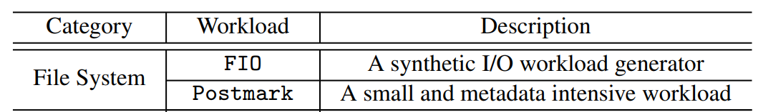
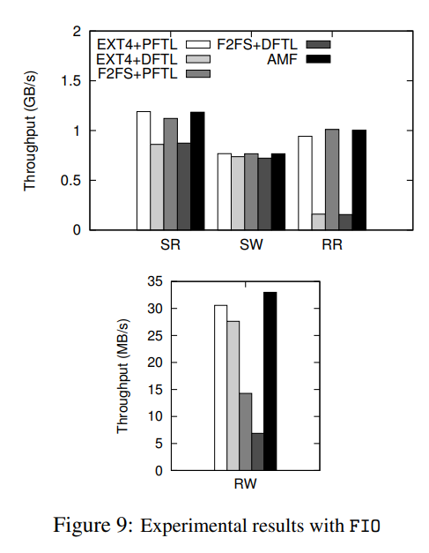
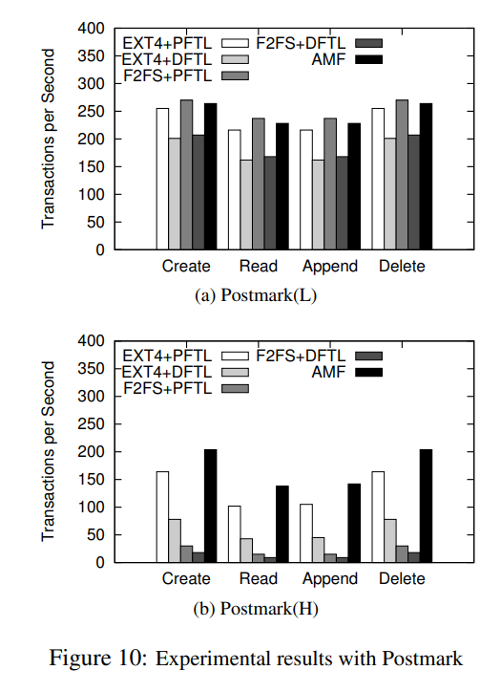
4. Evaluation
For random writes,
AMF outperforms
all other schemes
For the heavy workload,
AMF achieves
the best performance

Slide 21
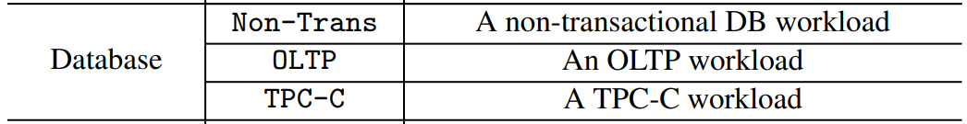
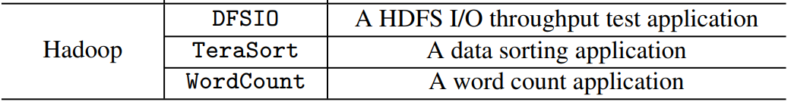
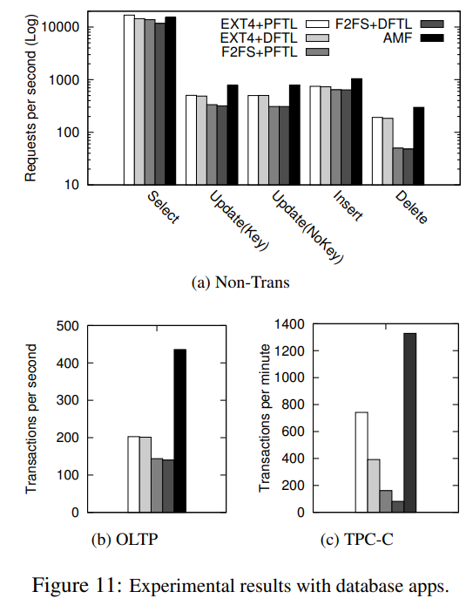
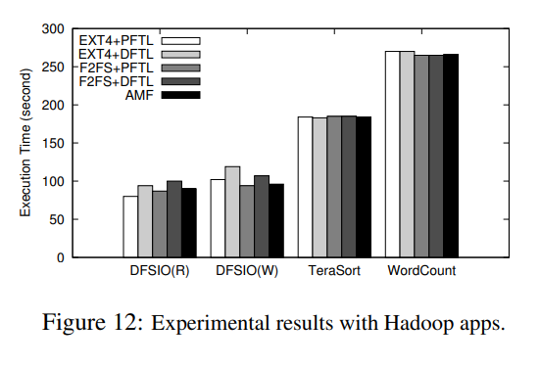
4. Evaluation
AMF outperforms
all other schemes
All five storage configurations show similar performance

Slide 22
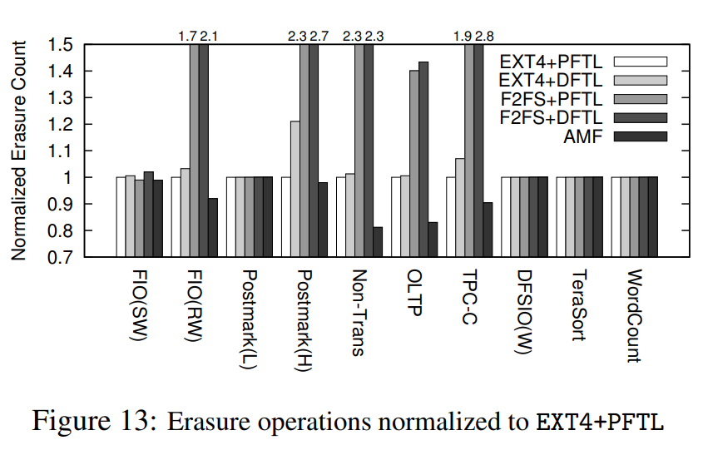
4. Evaluation
AMF incurs 28% fewer erase operations overall compared to F2FS+DFTL

Slide 23
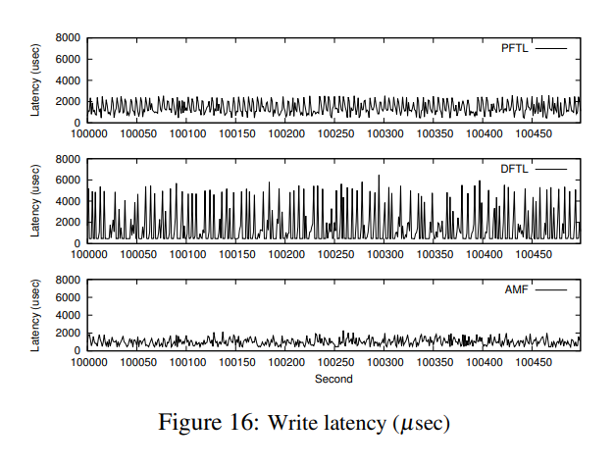
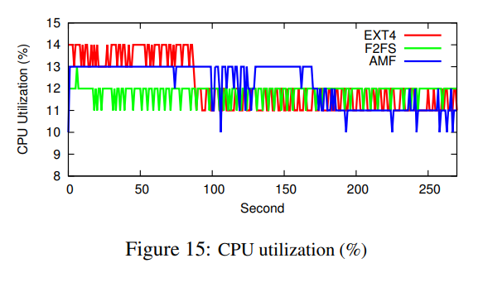
4. Evaluation
The CPU utilization of AMF
is similar to F2FS and EXT4
AMF has the shortest I/O
response times with small fluctuations

Slide 24
5. Conclusions
AMF
New block I/O interface exposing flash storage as append-only segments
Implementing new FTL scheme (AFTL) and a new file system (ALFS)
Reducing DRAM in the flash controller by 128X, impoving performance of the file system by 80%
https://github.com/chamdoo/bdbm_drv.git
https://github.com/sangwoojun/bluedbm.git

Slide 25
Application-Managed Flash
Sungjin Lee, Ming Liu, Sangwoo Jun, and Shuotao Xu, Jihong Kim, Arvind
14th USENIX Conference on File and Storage Technologies (FAST ‘16). 2016.
Thank You!
2021. 06. 02
Presentation by Han, Yejin
hyj0225@dankook.ac.kr
Notes:
Let me begin my presentation.
Today I will give a presentation on “Fully Automatic Stream Management for Multi-Streamed SSDs Using Program Contexts”

