Slide 1
PRISM: Rethinking the RDMA Interface for Distributed Systems
Matthew Burke, Sowmya Dharaniparagada, Shannon Joyner, Adriana Szekeres, Jacob Nelson, Irene Zhang, Dan R. K. Ports
SOSP‘21
2022. 04. 12
Presentation by Han, Yejin
yj0225@dankook.ac.kr

Slide 2
Introduction
Background
Motivation
PRISM
Evaluation
Conclusion

Slide 3
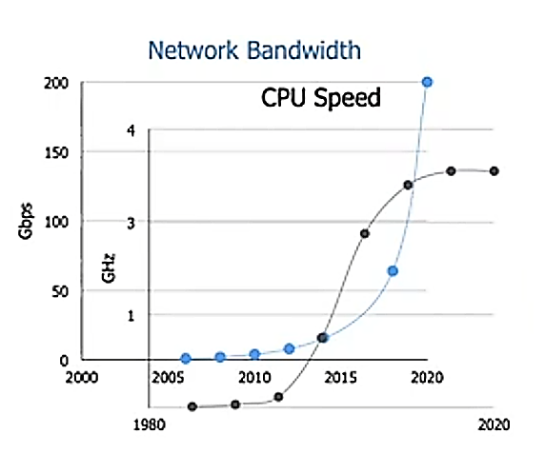
1. Introduction
Remote Direct Memory Access (RDMA)
Network bandwidth increases relative to CPU speed
Kernel bypassing, CPU Offloading technology
Machine A
Network Bandwidth
CPU Speed
DRAM
CPU
NIC
Network
DRAM
CPU
NIC
Machine B

Slide 4
2. Background
RDMA provides two types of operations
Two-sided / One-sided operations
Remote memory
Remote memory
Two
Sided
send()
recv()
Less CPU Efficient
Generalizable Interface
CPU
NIC
NIC
CPU
Remote memory
Remote memory
One
Sided
More CPU Efficient
Restrictive Interface
read/write()
CPU
NIC
NIC
CPU

Slide 5
2. Background
Indirect reads: One-sided vs. Two-sided
Hash Index
Extents Region
Two Sided
Remote memory
“tie:yellow”
Involves CPU
1 Roundtrip
Server memory
CPU
NIC
Network
NIC
CPU
Hash Index
Extents Region
One Sided
Remote memory
“tie:yellow”
No CPU involved
2 Roundtrips
Network
Server memory
read() ptr
read() extent value
CPU
NIC
NIC
CPU

Slide 6



3. Motivation
Difficulty of adapting applications to run on RDMA
Applications are limited to the current RDMA read/write interface
one
round trip
one
round trip
No CPU
involved
No CPU
involved
Extend the RDMA interface

Slide 7

4. PRISM
PRISM’s API design principles
Generality
Minimal interface complexity
Minimal implementation complexity

Slide 8
4. PRISM
PRISM Primitives
Indirect, Enhanced CAS, Allocation, Operation Chaining
Indirect Reads/Writes | The target address specified by the operation can instead be interpreted as a pointer to the actual target
Enhanced Compare And Swap | Extends RDMA CAS to provide support for arithmetic comparisons (>, <) during the compare phase
Allocation | Allows memory allocation on the data-plane from a pre-registered pool of memory
Operation chaining | Allows for the execution of a chain of other PRISM primitives at the NIC

Slide 9

4. PRISM
Indirect Reads with PRISM
No CPU involved
1 Network Roundtrip
Hash Index
Extents Region
“tie:yellow”
Remote memory
“shoes:brown”
Server memory
ptr
CPU
NIC
Network
NIC
CPU
value

Slide 10

4. PRISM
PRISM implementation
Remote memory
Snap inspired Software RDMA Prototype
NIC
CPU
CPU
Remote memory
Remote memory
Mellanox BlueField-1
SmartNIC Prototype
CPU
NIC
Network
smartNIC
CPU
Remote memory
PRISM API could be added to a NIC ASIC
NIC
CPU

Slide 11
5. Evaluation
Applications designed with PRISM
PRISM-KV: a Key-Value Store that implements both read and write operations using the
One Sided PRISM API
PRISM-RS: a replicated storage system that implements the ABD quorum
replication protocol
PRISM-TX: a transactional storage system that implements a timestamp-based optimistic concurrency control protocol using PRISM’s primitives.

Slide 12
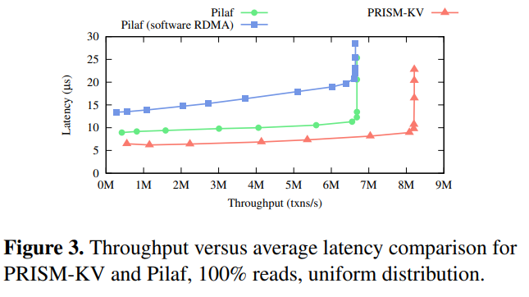
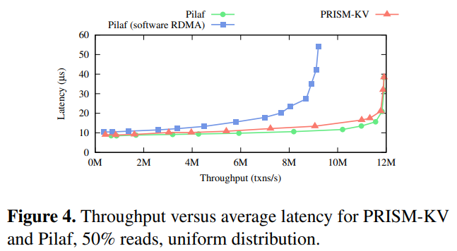
5. Evaluation
PRISM-KV: Key-Value Storage
Latency difference is about 2X
22% higher read throughput
matches RDMA-enabled Pilaf
for 50/50 mixed workload

Slide 13
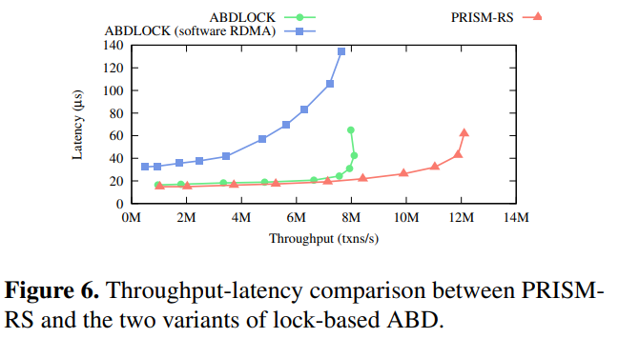
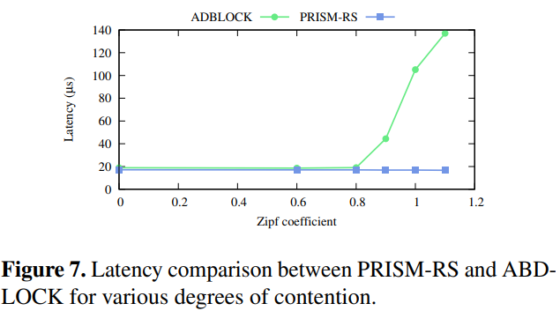
5. Evaluation
PRISM-RS: Replicated Block Store
2μs faster than ABD-LOCK
~4million more ops/sec
Dramatic benefits where there is contention on popular keys

Slide 14
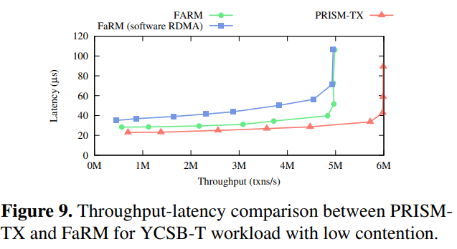
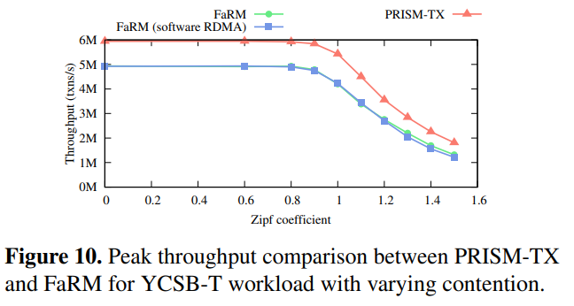
5. Evaluation
PRISM-TX: Distributed Transactions
5.5μs faster than FaRM
1 million more txns/s
Maintains performance benefit under high contention

Slide 15
6. Conclusion
PRISM
The current RDMA Interface isn’t expressive enough to benefit most distributed systems applications
PRISM proposes a set of generic primitives that extend the RDMA API
: Indirect, enhanced CAS, allocation, operation chanining
Demonstrate the PRISM API’s benefits by designing 3 new applications
: PRISM-KV, PRISM-RS, PRISM-TX

Slide 16
PRISM: Rethinking the RDMA Interface for Distributed Systems
Matthew Burke, Sowmya Dharaniparagada, Shannon Joyner, Adriana Szekeres, Jacob Nelson, Irene Zhang, Dan R. K. Ports
SOSP‘21
Thank You!
2022. 04. 12
Presentation by Han, Yejin
yj0225@dankook.ac.kr

