Slide 1
Serverless in the Wild: Characterizing and Optimizing the Serverless Workload at a Large Cloud Provider
Mohammad Shahrad, Rodrigo Fonseca, Íñigo Goiri, Gohar Chaudhry, Paul Batum, Jason Cooke,
Eduardo Laureano, Colby Tresness, Mark Russinovich, and Ricardo Bianchini
USENIX ATC‘20
2022. 05. 31
Presented by Yejin Han
yj0225@dankook.ac.kr

Slide 2

What is Serverless?
Very attractive abtraction to users:
Pay for only usage
No worry about servers
Provisioning, reserving, configuring, patching, managing
Most popular offering: Function-as-a-Service (FaaS)
Intuitive, event-based interface for developing cloud-based applications
Users upload the code, provider enables a handle for the code to run

Slide 3
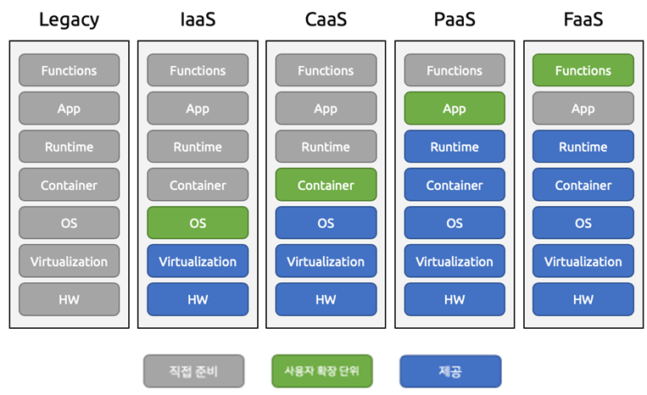
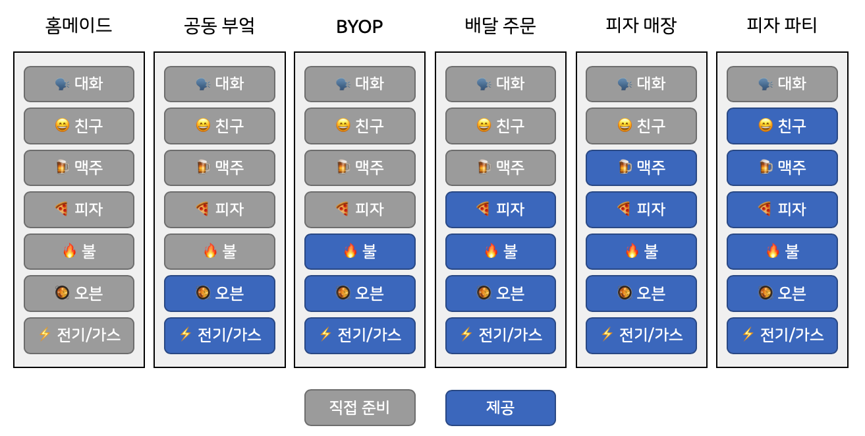
FaaS
FaaS (Function as a Service): users do not provision or configure resources
Function: basic unit of deployment
Application: consists of multiple functions, unit of resource allocation
(source: https://futurecreator.github.io/2019/03/14/serverless-architecture/)

Slide 4
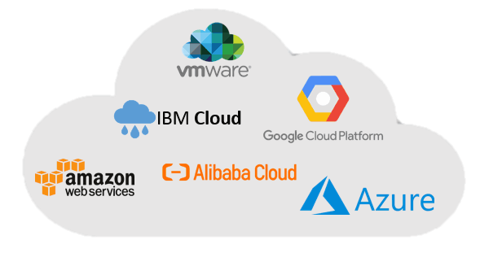
Put yourself in provider's shoes..
Challenges are:
You do worry about servers
Provisioning, scaling, allocating, securing, isolating
Optimize resource usage
Provide the illusion of always-available resources at the lowest cost
Fast function invocations without cold starts
Cloud Providers

Slide 5
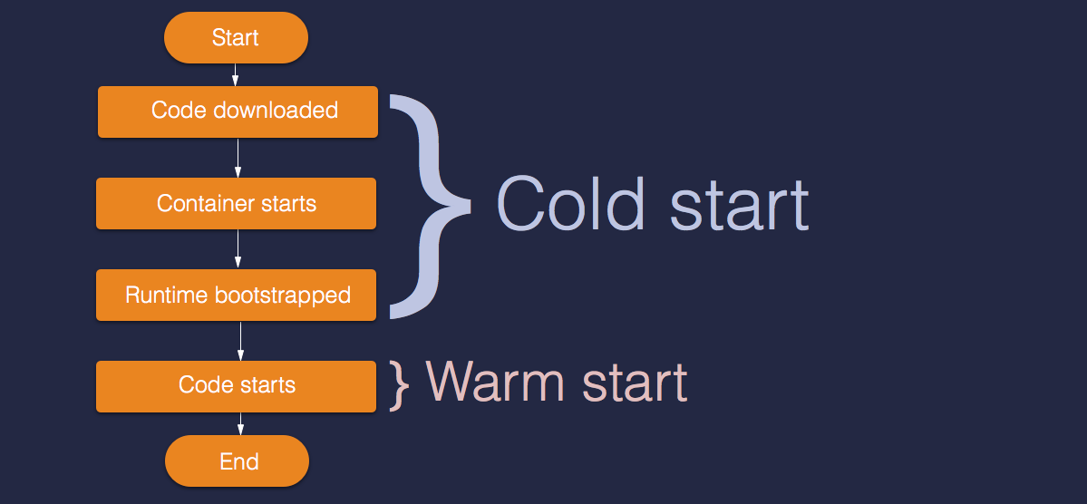
Cold Starts
Providers want to provide high function performance at the lowest cost
Function execution requires the needed code in memory
Warm start (from memory) vs cold start (from storage)
Keeping all resources in memory is prohibitively expensive
Functions have varying resource needs and invocation frequencies
☞ a comprehensive characterization of the FaaS workload is needed!!
(Source: https://medium.com/ssense-tech/the-trade-offs-with-serverless-functions-71ea860d446d)

Slide 6
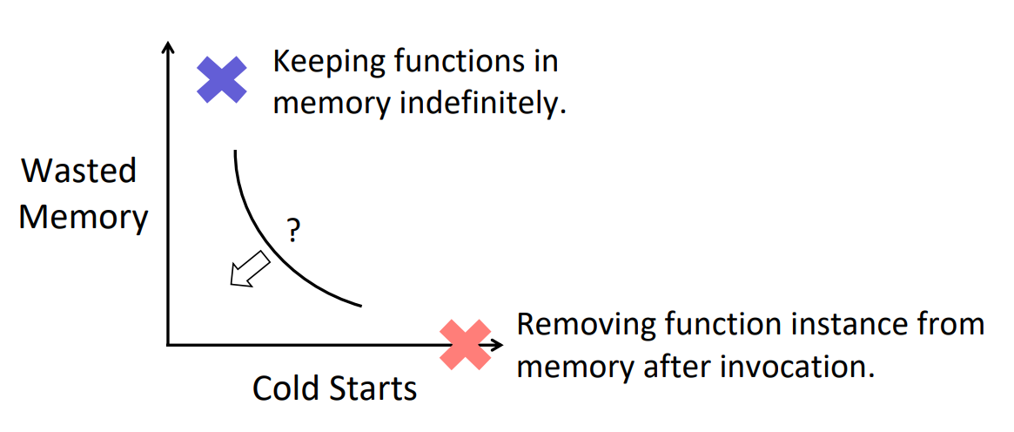
Problem: Cold Starts and Resource Wastage
Trade-off between reducing cold starts and the resources they need
(Source: https://www.usenix.org/system/files/atc20-paper593-slides-shahrad.pdf)

Slide 7
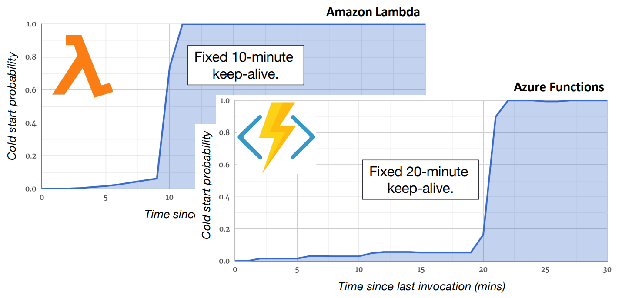
Problem: Fixed keep-alive policy
Application instances are kept loaded in memory for a fixed time
It does not consider the wide variety of application behaviors
Many cold starts with wasting resources
(Source: https://www.usenix.org/system/files/atc20-paper593-slides-shahrad.pdf)

Slide 8
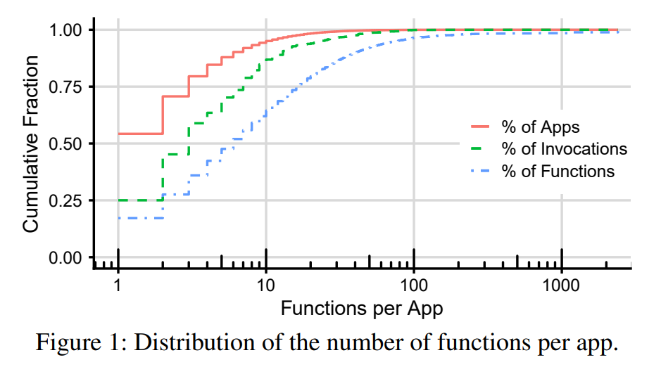
FaaS Workload
2 weeks of all invocations to Azure Functions in July 2019
First characterization of the workload of a large serverless provider
Functions and applications
54% applications only have one function and 95% applications have at most 10 functions
The number of functions in an applications is not useful in resource management

Slide 9
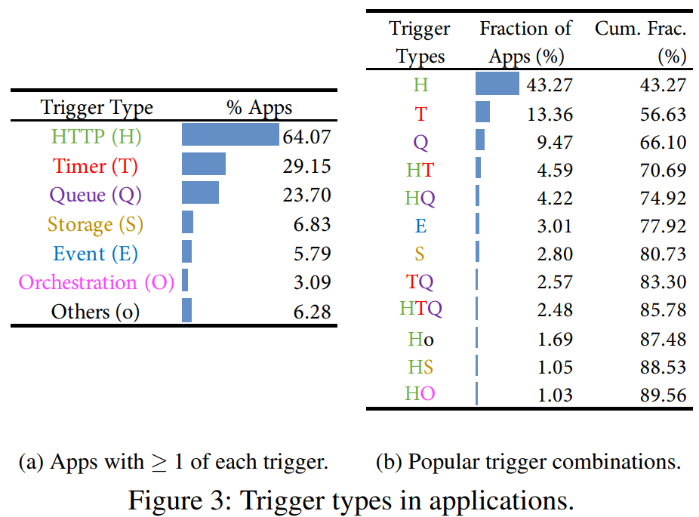
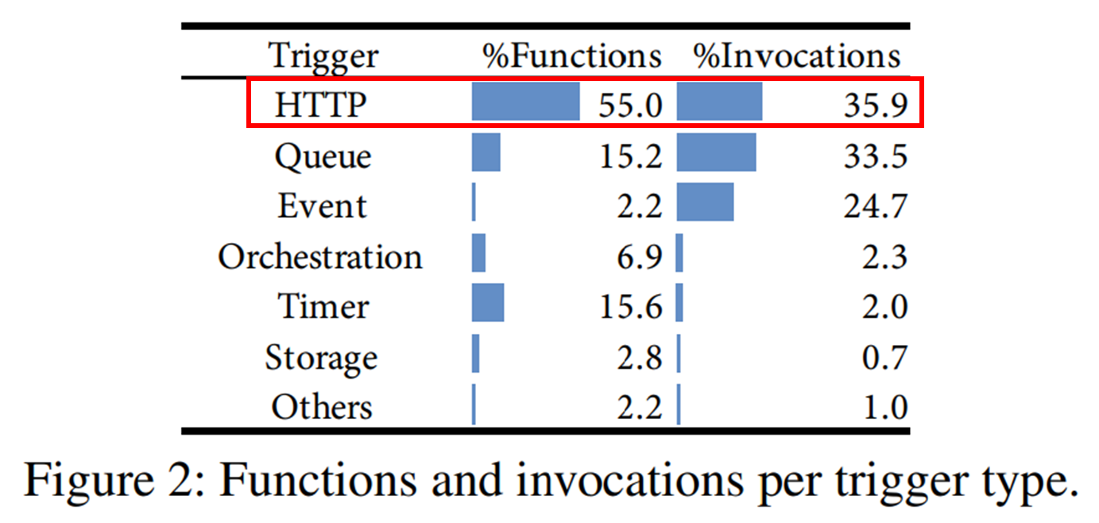
FaaS Workload
2 weeks of all invocations to Azure Functions in July 2019
First characterization of the workload of a large serverless provider
Triggers and applications
For predicting invocations: timers are very predictable, other applications with no timers aren’t

Slide 10
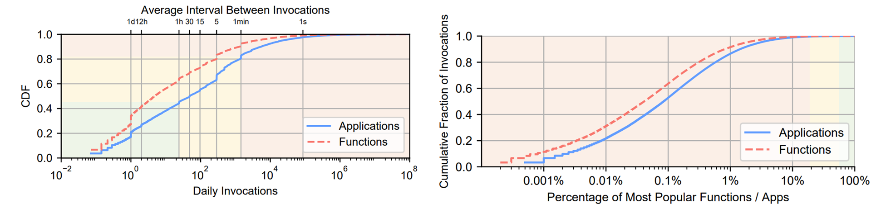
FaaS Workload
2 weeks of all invocations to Azure Functions in July 2019
First characterization of the workload of a large serverless provider
Invocations per application
Daily invocations varies by over 8 orders of magnitude
Vast majority of functions are invoked very infrequently
18.6%
82%
Workload skewness
45%
From IAT (Inter-arrival time) of invocation, we can pre-warming the application

Slide 11
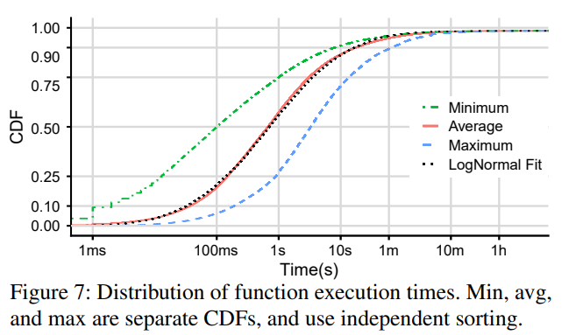
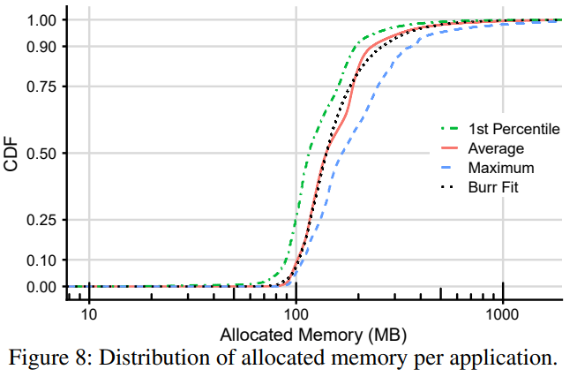
FaaS Workload
2 weeks of all invocations to Azure Functions in July 2019
First characterization of the workload of a large serverless provider
Function execution times
Same sale as the cold start times
Execution times are short
Memory Usage
Applications tend to remain memory resident for longer
Optimizing cold starts is important
Memory is important in keep-alive decision for FaaS

Slide 12
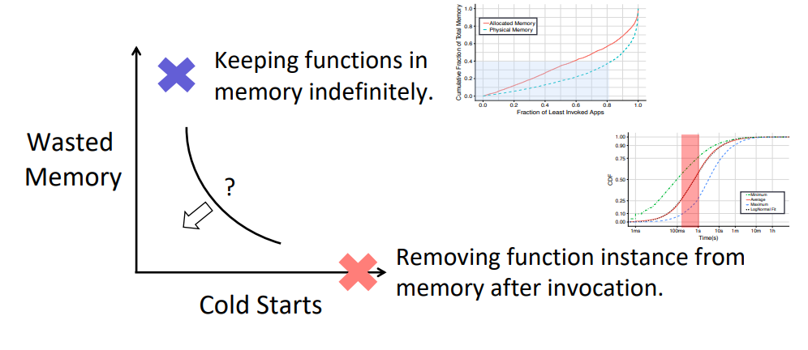
Cold Starts and Resource Wastage
How to manage cold starts in FaaS?

Slide 13
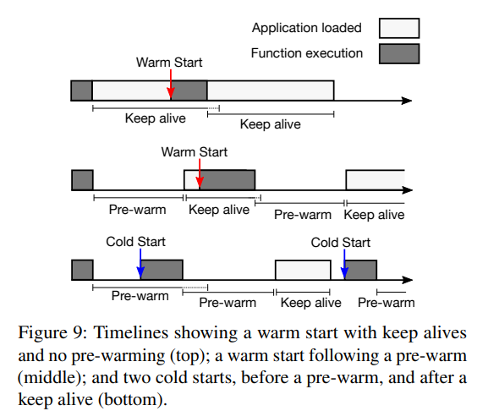
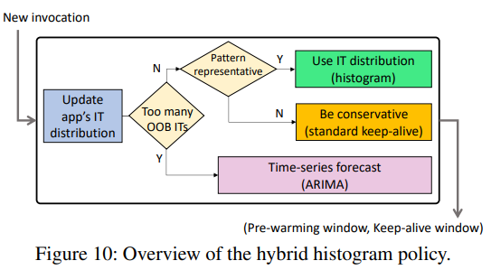
Hybrid Histogram Policy
The policy of hybrid histogram
Pre-warming window / keep-alive window
* ARIMA: Autoregressive Integrated Moving Average

Slide 14
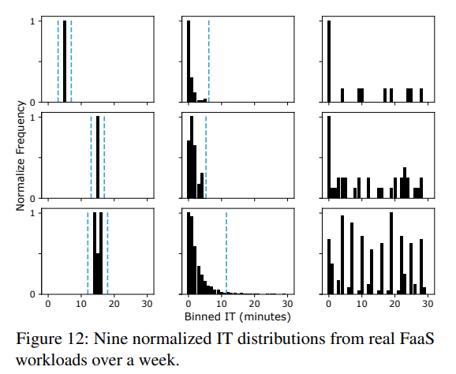
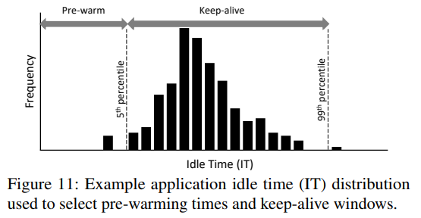
Hybrid Histogram Policy
Three main components of the policy
A range-limited histogram
Standard keep-alive approach
Time-series forecast component

Slide 15
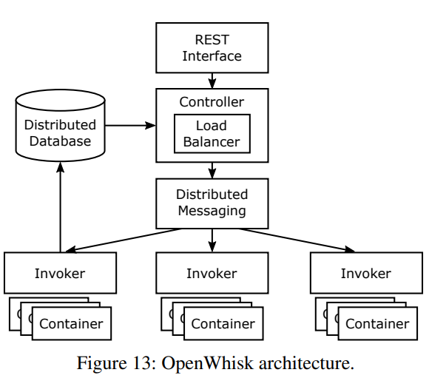

Implementation in Apache OpenWhisk
Apache OpenWhisk
Open-sourced industry-grade (IBM Cloud Functions)
Functions run in docker containers
Uses 10-minute fixed keep-alive
Built a distributed setup with 19 VMs

Slide 16
Evaluation
Experiment Setup
Simulation
Workload: all function invocations across Azure between July 15th and Jylu 20th
Generates an array of invocation times and infer whether each invocation would be a cold start
Real experiments
Workload: scaled-down version of the trace
19VM: One VM with 8 cores, 8GB of memory hosts / 18 VM with 2 cores, 4 GB of memory
☞ Simulation and experimental results show the same trends
in both cold start and memory consumption behaviors

Slide 17
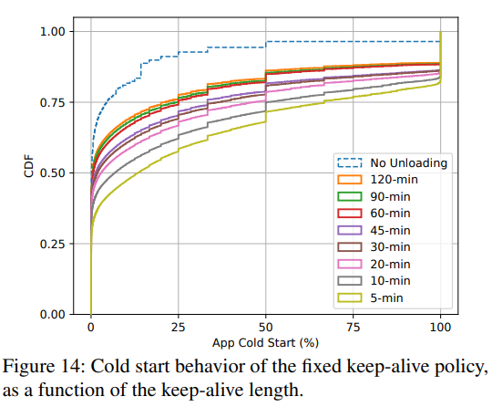
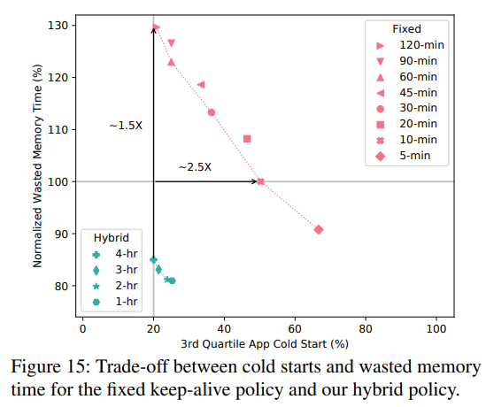
Evaluation: simulation
Fixed keep-alive policy
Hybrid policy using a histogram
Pareto frontier
Longer keep-alive reduces cold starts significantly
Hybrid policies reduce cold starts
significantly with lower memory waste

Slide 18
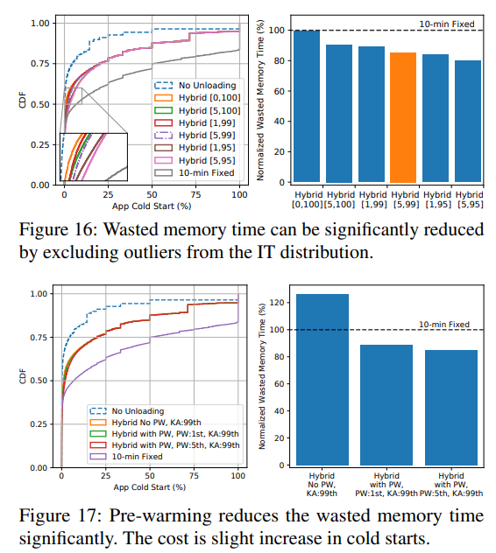
Evaluation: simulation
Impact of the histogram cutoff percentiles
Impact of unloading and pre-warming
wasted memory time goes down by 15%,
compared to with no cutoff [0,100]
PW (Pre-warming) reduce the wasted
memory time significantly

Slide 19
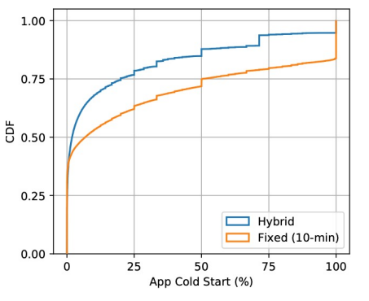
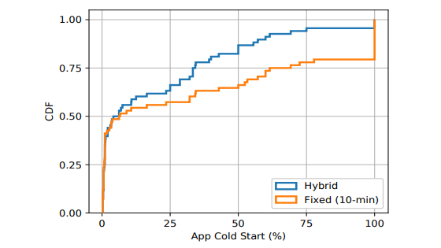
Evaluation: real experiment
Simulation results
Experimental results
Average exec time reduction: 32.5%
99th-percentile exec time reduction: 82.4%
Container memory reduction: 15.6%
Latency overhead: < 1ms (835.7us)

Slide 20
Conclusion
Characterize the users’ real FaaS workloads of Azure Functions from provider’s perspective
A dynamic policy leveraging small histogram to reduce cold starts at a low resource cost
Azure Functions sanitized traces available: https://github.com/Azure/AzurePublicDataset/blob/master/AzureFunctionsDataset2019.md

Slide 21
Serverless in the Wild: Characterizing and Optimizing the Serverless Workload at a Large Cloud Provider
Mohammad Shahrad, Rodrigo Fonseca, Íñigo Goiri, Gohar Chaudhry, Paul Batum, Jason Cooke,
Eduardo Laureano, Colby Tresness, Mark Russinovich, and Ricardo Bianchini
USENIX ATC‘20
Thank You !
2022. 05. 31
Presented by Yejin Han
yj0225@dankook.ac.kr

