Slide 1
Weekly Report
한예진
hbb97225@naver.com

Slide 2
Weekly Report
Last Week
FUSE tutorial
LSYSFS
This Week
Libfuse examples
Passthrough (mirror the contents of the root directory under the mountpoint)
Libfuse high-level, low-level API
기말고사 공부

Slide 3
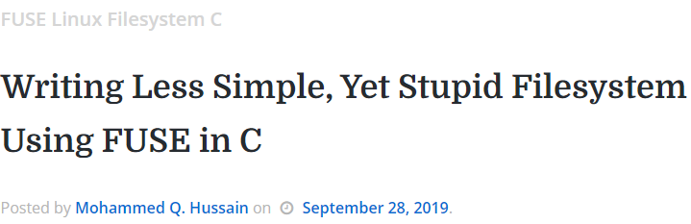
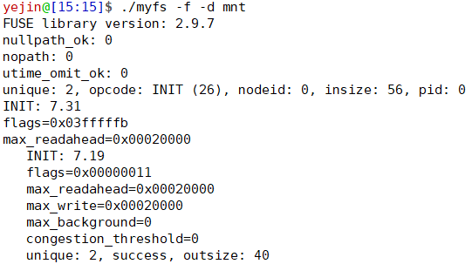
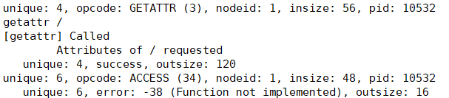

FUSE
LSYSFS(Less Simple, Yet Stupid Filesystem)
Demo

Slide 4
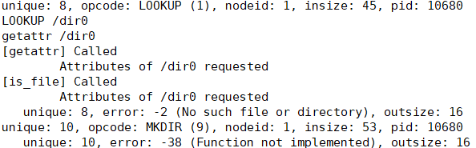
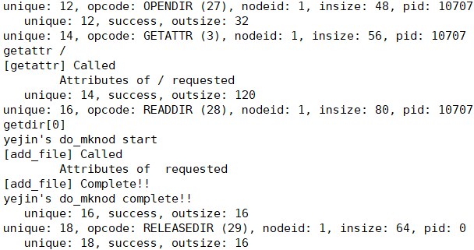

FUSE
LSYSFS(Less Simple, Yet Stupid Filesystem)
Demo
?

Slide 5
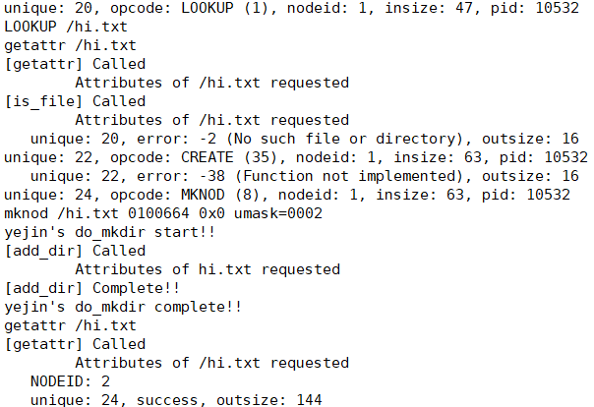

FUSE
LSYSFS(Less Simple, Yet Stupid Filesystem)
Demo
?

Slide 6
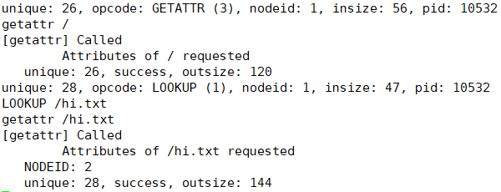

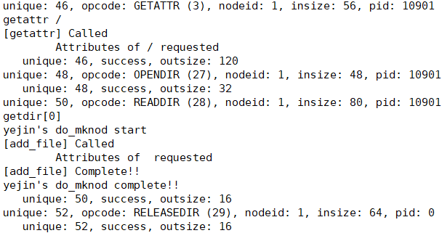

FUSE
LSYSFS(Less Simple, Yet Stupid Filesystem)
Demo
?

Slide 7
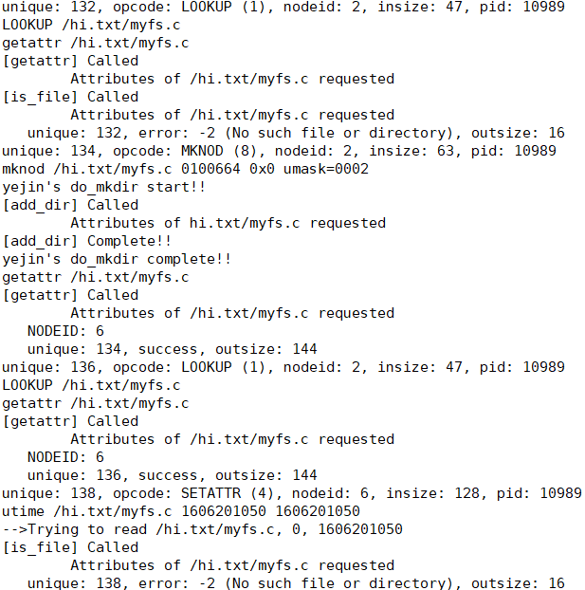
FUSE
LSYSFS(Less Simple, Yet Stupid Filesystem)
Demo
?

Slide 8

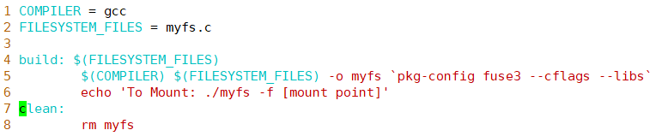
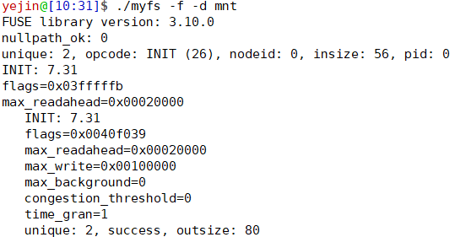
FUSE
LSYSFS(Less Simple, Yet Stupid Filesystem)
Demo

Slide 9
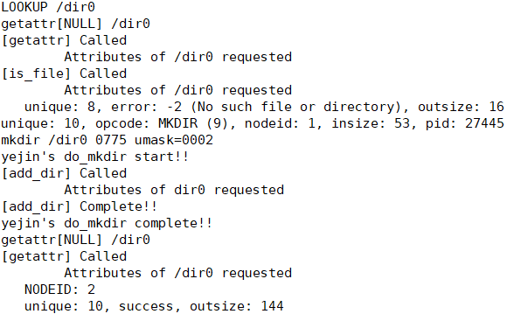

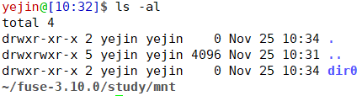
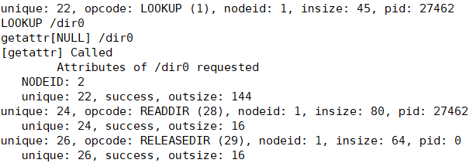
FUSE
LSYSFS(Less Simple, Yet Stupid Filesystem)
Demo
...

Slide 10
FUSE
LSYSFS(Less Simple, Yet Stupid Filesystem)
Demo
...

Slide 11
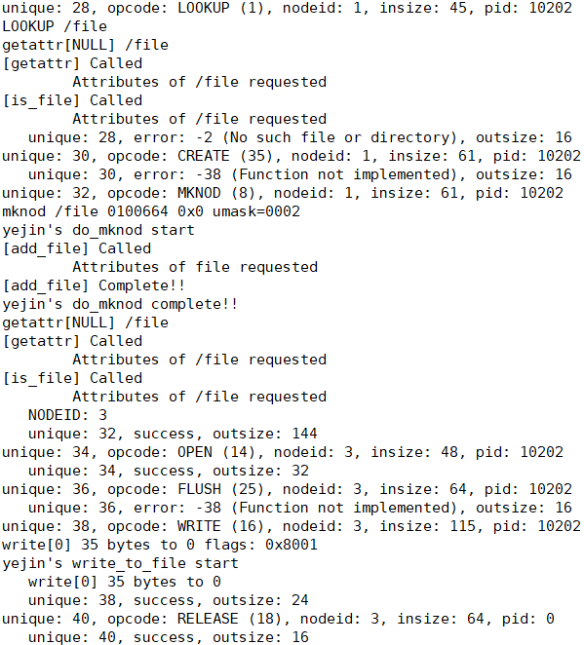

FUSE
LSYSFS(Less Simple, Yet Stupid Filesystem)
Demo

Slide 12
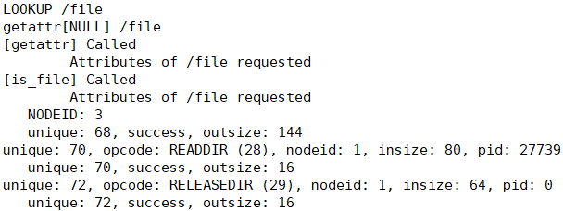
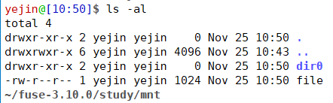
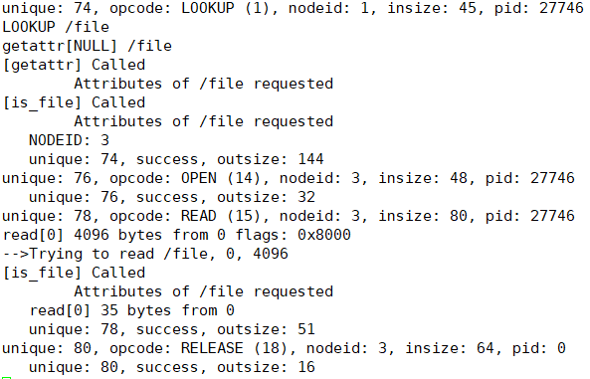

FUSE
LSYSFS(Less Simple, Yet Stupid Filesystem)
Demo

Slide 13
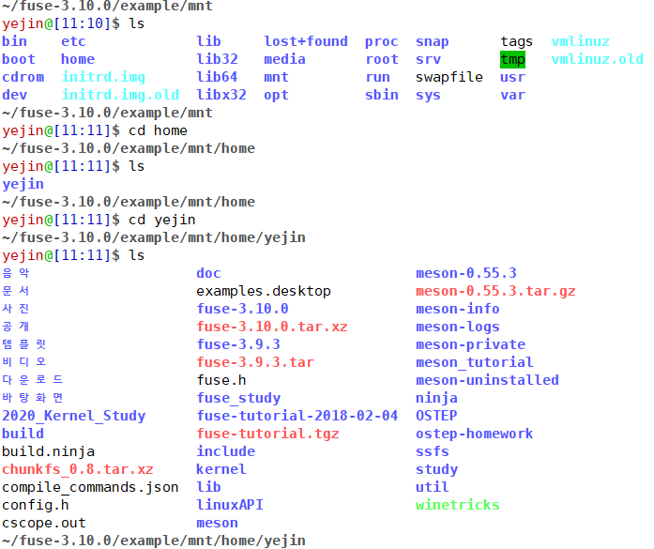
FUSE
passthrough
mount

Slide 14
FUSE
FUSE API
Application
Process
FUSE Filesystem
Daemon Process
FUSE
Filesystem
FUSE
Filesystem
High level
API
Low level
API
libfuse
ls /fuse/mnt
Userspace
glibc
Kernel
VFS
/dev/fuse
FUSE Module

