Slide 1
Weekly Report
한예진
hbb97225@naver.com

Slide 2
Weekly Report
Last Week
ZoAD 코드 분석
ZNS SSD 정리
This Week
ZoAD controller code
NVMe ZNS Specification (TP 4053)

Slide 3
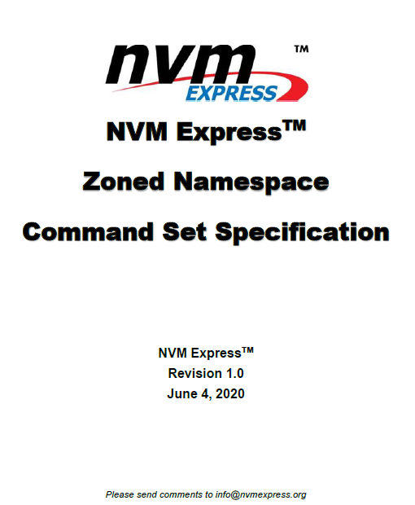
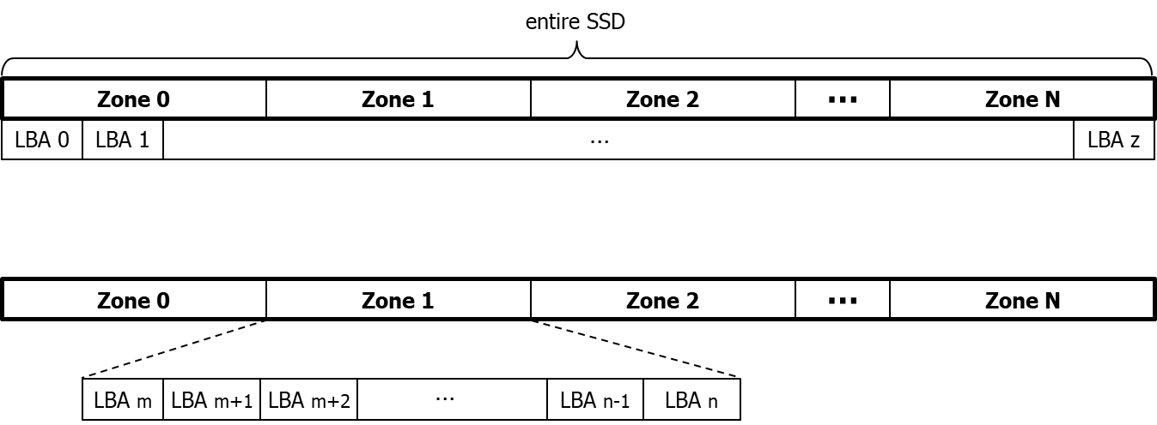
ZNS SSD
Zone Storage Model
NVMe ZNS specification allows host software to communicate with a SSD using Zones.
Zone is defined as a range of logical block addresses that is managed as a single unit.
* LBA: logical block address
- Multi-sector addressing(disk block) : 4KB or 8KB

Slide 4
ZNS SSD
Traditional Storage vs. Zoned Storage
Traditional Storage
(CMR HDD or NVMe SSD)
Zoned Storage
(SMR HDD or ZNS SSD)
File A
File B
File C
File A
File B
File C
File system
File system
Read/Write
Read/Write
LBA Space
Read/Write/Erase
Traditional Device
Zoned Block Device
FTL
LBA Space
Data placement by Zones
erase unit
zone
random/sequential writes, anywhere in LBA space
SSD manages all the data placement
Files with different life expectancy are being stored in a same erase unit.
Sequential writes only, within predefined zones
Host/Device co-manage data placement
Files with similar life expectancy can be placed together.
Notes:
Zns ssd는 zoned block device(zoned storage)의 부분
ZNS SSD는 intelligent하게 data placement함
TrSSD는 -→ b가 w지워진다면?
FTL로 logical block을 physical address로 맵핑
fragment가 일어날 수 밖에 없다. GC필요
Hot-> update가 빈번하게 일어나고 cold-> 오랫동안 수정되지 않음 :

Slide 5
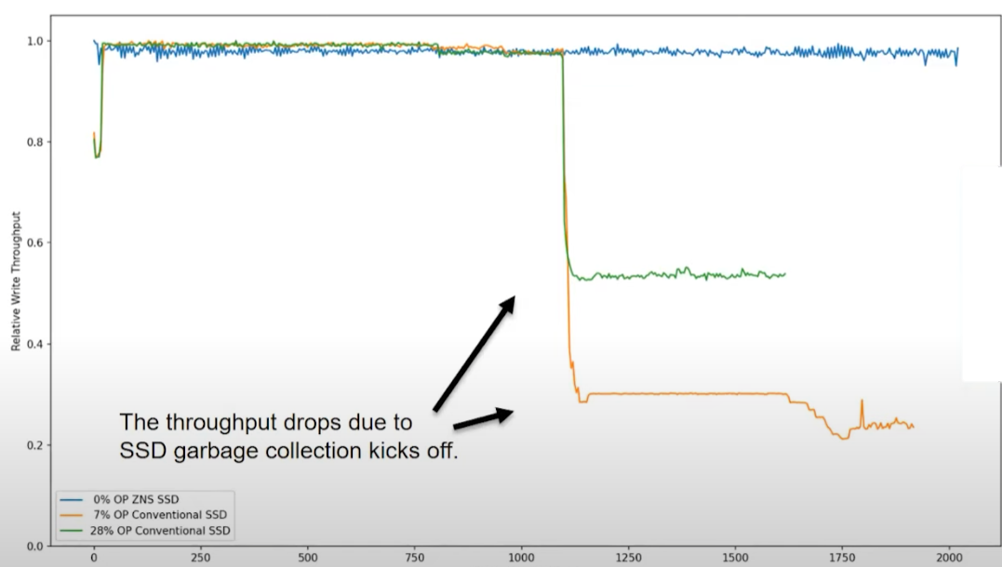
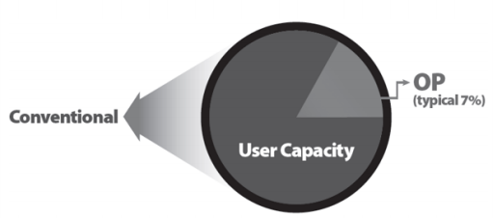
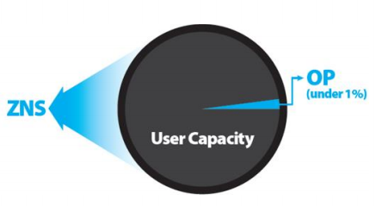
ZNS SSD
ZNS Benefits
1. Performance ↑ (GC ↓ → reducing WAF → incresing the Throughput)
2. Capacity utilization ↑ (over-provisioning area ↓)
3. Cost ↓ (just map first LBA to each zone → logical to physical mapping tables ↓
→ less DRAM in the device)
ZNS SSD
File A
File B
File C
File system
Read/Write
Zoned Block Device
LBA Space
Data placement by Zones
zone
Higher Write Throughput
Lower Read Latencies
Decrease Device Cost
Increase Device Lifetime
Notes:
장점1: 성능향상-> device가 GC때문에 busy하지 않으니까 그 device bandwidth 전체를 이용할 수 있게 됨.
예를들면 TrSSD어떤 블록은 data가 다른 부분으로 copy되고, 어떤 error 블록은 또 지워지고 써지고 그러면 다른 read/write 요청들이 delay가 되고
GC랑 over-provisioning이 write throughput에 영향!! latency가 increase.
그렇지만 ZNS SSD는 device수준의 GC를 없앴ㅇ니까 이런게 안일어나니까 latency predicable
3. Host가 manag하고 ftl이 필요없으니까

Slide 6
ZNS SSD
ZNS issue
Host and storage device collaborate on data placement, such that data is written sequentially.
Device LBA range
Host
Zone 0
Zone 1
Zone 2
…
Zone N
Application 1
Data
Application 2
Data
Application 3
Data
ZNS SSD Controller
Zone Size (e.g. 72MB)
Zoned Block Device
LBA Space
Read/Write/Erase
Zone Capacity (e.g. 70MB)
Zone
ZSLBA
zc
Written blocks
Writable blocks
cannot
read/write
72MB
144MB
Writing
Unable to write
until zone reset
Writing Point (next writable LBA)
Notes:
*** Sequential Write
1. # Zones =
2. Zone Size(ZS) = 72MB, the number of LBAs per zone
3. Zone Start LBA(ZSLBA) = ZS * Zone index
4. Zone Capacity = 70MB, amount of writable LBAs per zone
5. Zone State: Each zone goes through a state machine indicating its current status. Each zone has a state.
WP increments after a write is completed and always points to next writable lba. Zone has to be reset once to be able to write to it again from the start of the zone

Slide 7
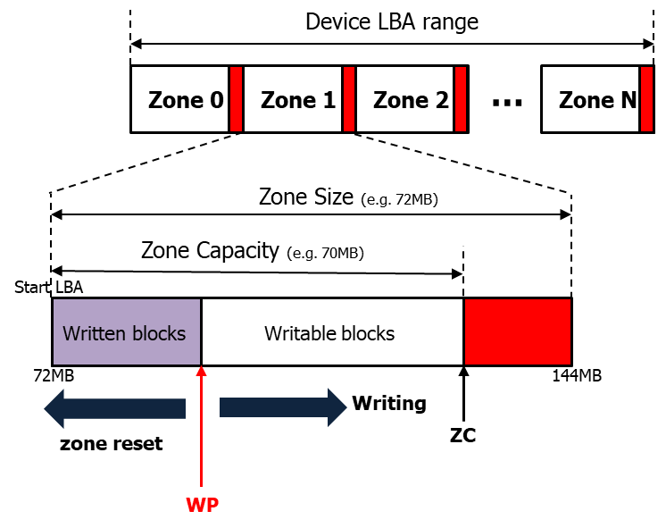
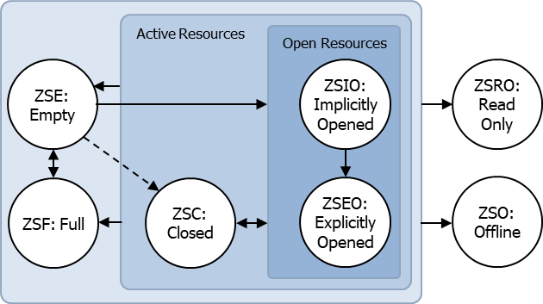
ZNS SSD
ZNS info
Zone state
controller.h
struct zone_descriptor
__u8 type : 4 // Zone Type(ZT)
__u8 state : 4 // Zone State(ZS)
__u64 wp // Write Pointer(WP)
__u64 start_lba // Zone Start LBA (ZSLBA)
__u64 capacity // Zone Capacity (ZCAP)
__u8 zdev : 1 // Zone Descriptor Extension Valid
__u8 rzr : 1 // Reset Zone Recommended
__u8 fzr : 1 // Finish Zone Recommended
__u8 zfc : 1 // Zone Finished by Controller
__u8 rsvd0 : 4 // Reserved
__u8 rsvd1 : 4 // Reserved
__u8 rsvd2 : 4 // Reserved
__u8 rsvd3[5] // Reserved
__u8 rsvd4[32] // Reserved
// Zone Type
#define
Seq_Write_Req 0x2
// Zone state
#define
#define
#define
#define
#define
#define
#define
STATE_EMPTY 0x01
STATE_IMPL_OPEN 0x02
STATE_EXPL_OPEN 0x03
STATE_CLOSED 0x04
STATE_READ_ONLY 0x0D
STATE_FULL 0x0E
STATE_OFFLINE 0x0F
cannot
read/write
Zone State | Description
Empty | Accepts writes | Initial zone state
Implicitly Opened | Accepts writes | directly start writing in an empty zone
Explicitly Opened | Accepts writes | After issuing a open command
Closed | Accepts writes | When Set Zone Descriptor Extension completes
Read Only | No writes | Intermediate state before offline state
Offline | No writes/reads | Unable to service IOs
Notes:
Each zone has an associated state machine. Each state defines the operational characteristics of zone.
Zone starts from empty state. From empty state if we issue a open command, it goes to explicitly open its state.
If we directly start writing into an empty zone, it goes into implicitly opend state.
It goes to full state when obviously we have written entirely to the zone. But we can issue a full command to make it to transition to full state even it is physically not totally filled.
Zone offline is indicating that something is wrong with the zone or that it is basically unable to service IOs

Slide 8
ZNS SSD
New command Set for Zone
Zone management send commands
Reset Zone – Transition zone state to Empty. Erase the zone, reset WP to SLBA.
Open Zone – Transition zone state to explicitly open, allocate zone resources.
Close Zone – Transition zone state to Closed.
Finish Zone – Transition zone state to Full, irrespective of WP position
Zone management receive commands
Report zone descriptor of zone(s)
Zone Append Command
Writes are issued to a zone’s SLBA and the drive returns the LBA within the zone where that write happened.
controller.c
controller.h
zns_set_zone()
zns_get_zone_desc()
zns_append()
// Zone Management
#define
#define
#define
#define
#define
MAN_CLOSE 0x01
MAN_FINISH 0x02
MAN_OPEN 0x03
MAN_RESET 0x04
MAN_OFFLINE 0x05
zns_management_send()
zns_management_recv()
Zone 0
Zone 1
Zone 2
…
Zone N-2
Zone N-1
Zone N
Notes:
Tp4053는 기존 nvme 명령어 셋(r/w/flush~~~) 이외에도 존에 특정적인 명령어가 추가되었는데
Reset zone: erase all the data in the zone. WP는 SLBA로 감. It’s ready to be written again.
Finish zone: zone이 꽉차면 펌웨어나 ssd가 zone state를 full로 바꾸는데 WP position과 상관없다는 얘기는 full이 아니더라도 명령어를 보내서 zone 상태를 full로 바꿀 수 있다.
Zone receive는 zone descriptor, 존 속성 정보를 받아온다.
그다음 Zone append 명령어인데 기본적으로는 write 명령어이다.

Slide 9







ZNS SSD
Regular Writes vs. Zone Append Writes
NVMe base specification allows device to complete commands in any order.
By queuing write requests to a zone and the drive appends the writes in whichever order it receives.
Returns the LBA where the data was actually written.
12K Write 0
16K Write 1
4K Write 2
Regular Write
(Queue Depth = 1)
LBA-0
LBA-n
$$WP_{0}$$
$$WP_{1}$$
$$WP_{2}$$
$$ZC$$
Append(slba, len, data) → Append(0, 8, data)
12K Write 0
16K Write 1
4K Write 2
Zone Append
(Queue Depth = 3)
LBA-0
LBA-n
$$WP$$
$$ZC$$
(after all writes)
Notes:
Ssd 안에서 append는 lba만 넣어주면 내가 알아서 쓸께 요청 한 번에 줘(교수님: append는 그 순간에 한가한 얘한테 쓸텐데 나중에 충돌나서 long tail~생김 갑자기 느려짐, 비어있는데다가 막 쓸껀데 동ㅅ에 읽어달라고 요청되기 시작하면~? 몰라몰라~~)
Zns는 zone이 꼭 sequential하게 쓰여져야 하고 random하게 쓰여지면 안된다. 따라서 만약 쓰기 요청들이 막 순서가 섞여서 도착하면 그 요청이 실패하게 될 것이다.
근데 예를 들어서 위에서 어떤 뭐 충돌이 나서이든지 LBA3에 쓰여져아 하는 요청이 먼저 들어왔다고 해보자. 그런데 nvme base specification은 어떤 임의의 순서로든 명령을 완료할 수 있도록 하기 때문에 사용자도 어떤 순서로든 명령을 받으면 처리할 수 있다. 그니까 lba3에 쓰여져야 하는 요청을 처리할수있다는 것이다. 그렇지만 lba3에 쓰려고 하는데 WP가 0에 있다면 write할 수 없다.
그래서 zone append라는건 뭐냐면 쓰기 요청들을 큐에 넣고 그 요청들이 받아진 순서대로 쓸 수 있다. 그리고 실제 쓰여진 이후 그 자리의 lba에서 WP를 리턴한다.
(만약 serialization한다면? Host가 한번에 하나의 요청만 수행하고 끝나면 쓰기 요청을 하게 한다면? 병렬성도 없애고 CPU 오버헤드가 클것이다./ 그럼 차라리 zone을 여러 개 연다면?얘도별로 왜냐면 nvme 스펙에서 maximum으로 activ한 자원들(mar), maximum으로 open할 수 있는 자원(mor)을 정해놨기 때문에 모든 존을 한번에 열게할 수도 없다)

Slide 10
ZoAD
Controller.h
struct nvme_passthru_cmd
identify_ns()
zns_management_send()
struct nvme_user_io
enum nvme_opcode
identify_ctrl()
zns_set_zone()
enum nvme_admin_opcode
struct nvme_id_power_state
zns_get_info()
zns_management_recv()
struct nvme_id_ctrl
zns_get_wp()
zns_get_zone_desc()
struct nvme_lbaf
struct zone_format
zns_get_total_zone()
zns_write_request()
struct nvme_id_ns
struct controller_identify
zns_get_zone_size()
zns_write()
struct zns_info
struct zone_descriptor
zns_full_zone()
zns_read_request()
zns_format()
zns_read()
zns_set_zone_change_notification()
Notes:
실제벤치마크를 돌리면 쭉 돌아서 성능이 report 되는 그런게 있나?

