Slide 1
Weekly Report
한예진
hbb97225@naver.com

Slide 2
Weekly Report
Last Week
ZoAD 코드 분석
This Week
FUSE API
ZoAD
ZNS SSD 정리

Slide 3
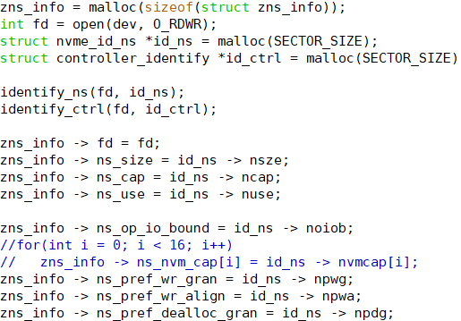
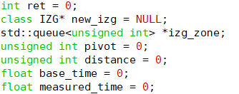
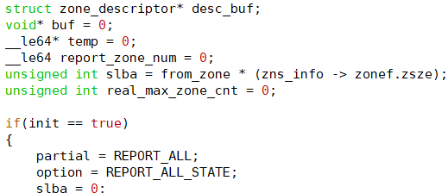
ZoAD
Call graph
main.cpp
int main()
IZG.cpp
controller.cpp
Identify_HW(string dev_str)
int zns_get_info(const char* dev)
zoad.cpp
zoad_init()
zns_get_info(dev)
Identify_HW(dev)
zns_get_zone_desc()
Idendify_IZG()
IZG.cpp
Idendify_IZG()
.
.
.
controller.cpp
controller.cpp
zns_get_total_zone()
int zns_get_info
zns_get_total_zone()
IZG(izg_zone)
IZG(izg_zone)
.
.
.

