Slide 1
Weekly Report
한예진
hbb97225@naver.com

Slide 2
Weekly Report
Last Week
ZoAD + CRIU
This Week
ZoAD + CRIU

Slide 3


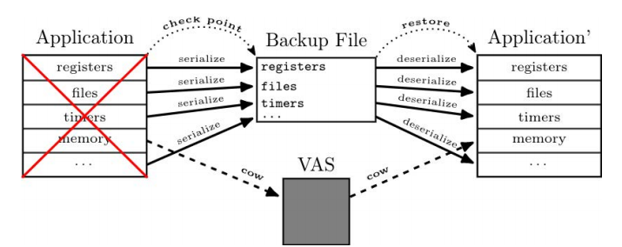
ZoAD-CRIU
Checkpoint/Restore mechanism
Writing pages into files → z_flush, reading pages from a file system → z_load
+
z_load
z_flush
zns
ssd

Slide 4
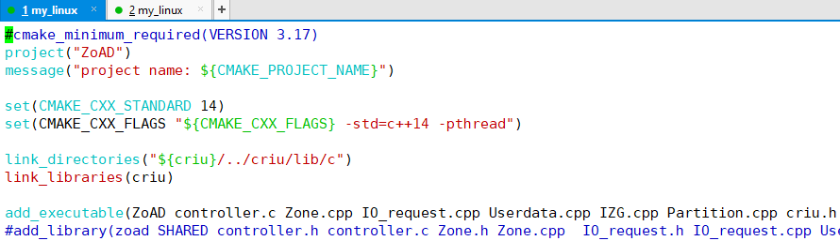
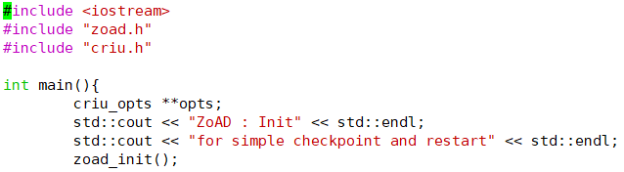
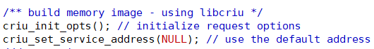
ZoAD-CRIU
Implementation
ZoAD-CRIU : CMakeLists.txt
main.cpp
+

