Slide 1
Weekly Report
한예진
hbb97225@naver.com

Slide 2
Weekly Report
Last Week
Docker+criu
This Week
Docker checkpoint/restore
Criu code 분석

Slide 3
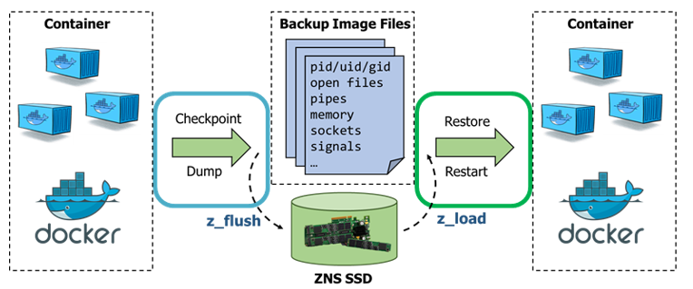
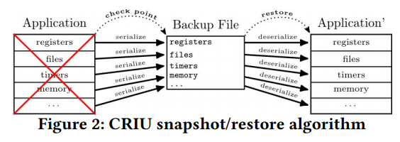
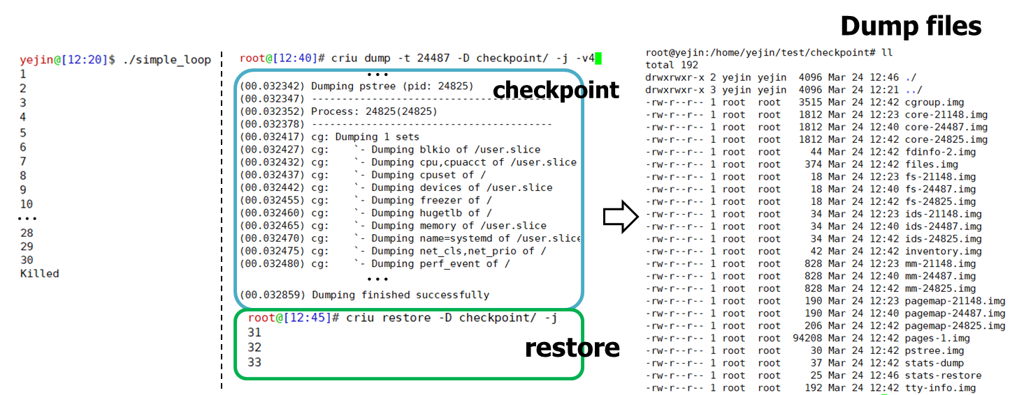
3/22 Weekly Report
CRIU C/R of simple loop process
https://asciinema.org/a/232445

Slide 4
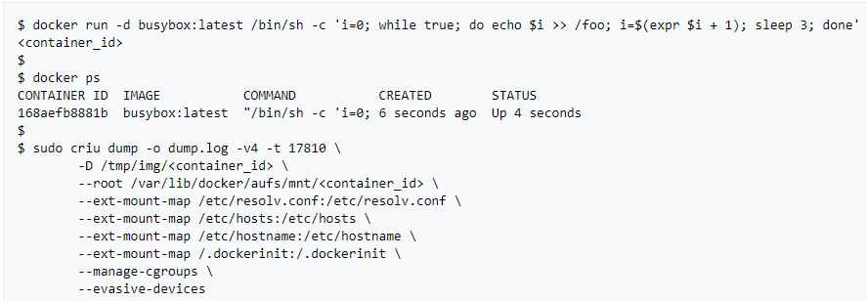
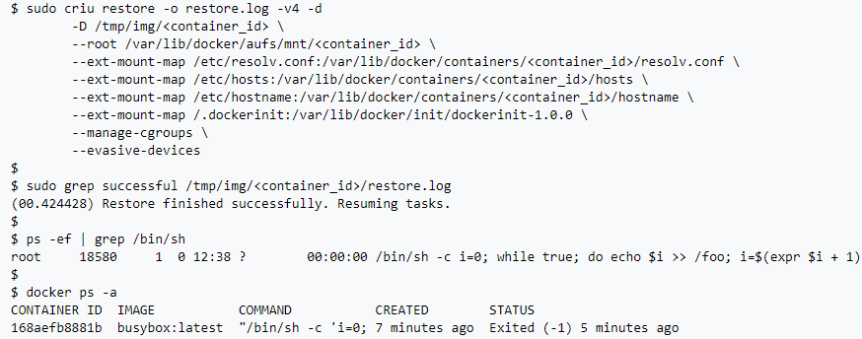
Docker Checkpoint/Restore
Docker external C/R with CRIU
C/R is happening external to the Docker daemon
After checkpoint, the Docker Daemon thinks that the container has exited
After restore, the Docker daemon doesn’t know that the container is running again.

Slide 5
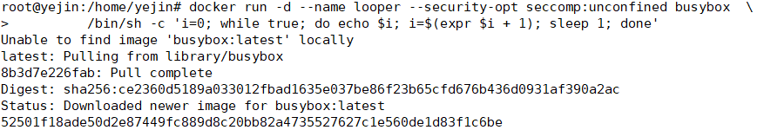
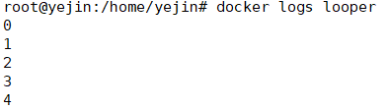
Docker Checkpoint/Restore
CRIU integration with Docker
To enable experimental features (CRIU)
Create container
Printing log to verity the container is running

Slide 6
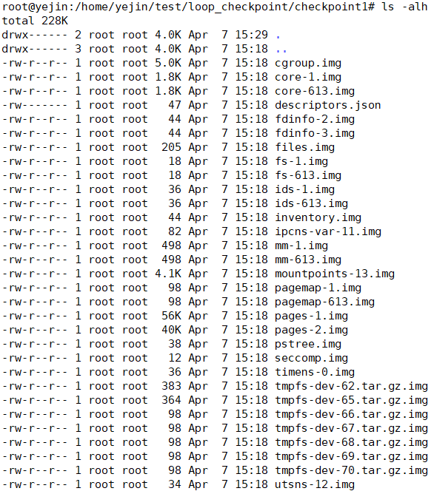
Docker Checkpoint
CRIU integration with Docker
Checkpoint the container
Check Dump files
Total: 224K

Slide 7
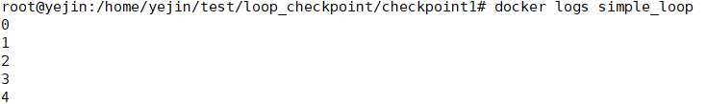

Docker Restore
CRIU integration with Docker
Restoring from a checkpoint
Printing log to verity the container is running
…

Slide 8
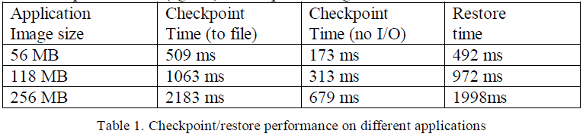
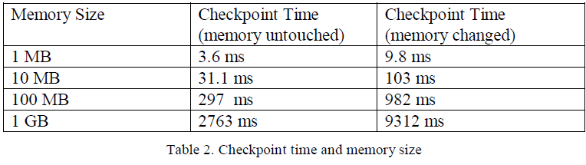
Checkpoint/restore performance

