Slide 1
Weekly Report
한예진
hbb97225@naver.com

Slide 2
Weekly Report
Last Week
  docker
This Week
  CRIU – ZNS SSD
    Docker container C/R testing
  docker study

Slide 3
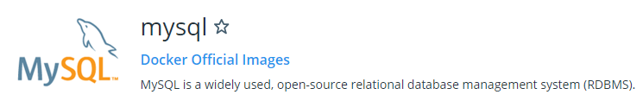
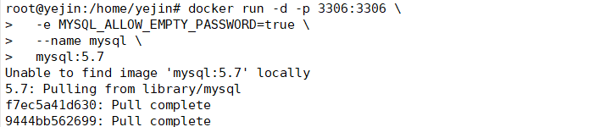
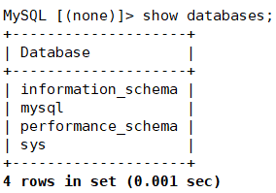
Docker Checkpoint
Docker MySQL container
  Create container
  MySQL test

Slide 4
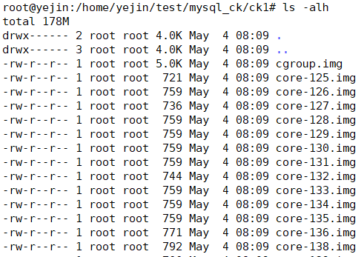
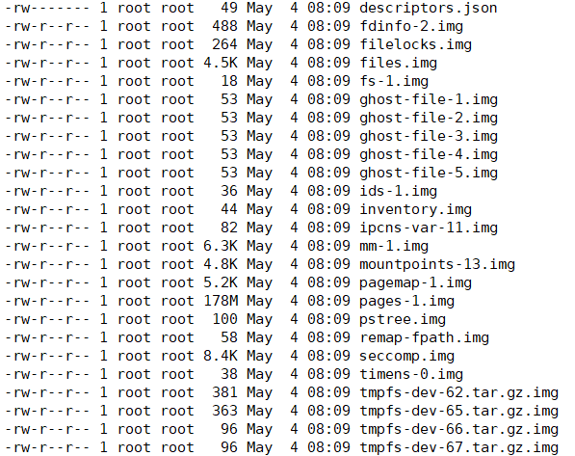
Docker Checkpoint
CRIU integration with Docker
  Checkpoint the container
  Check Dump files
Total: 178M

Slide 5
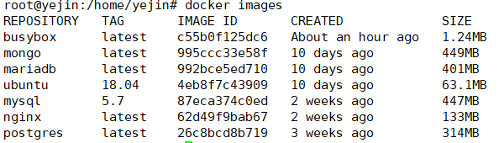
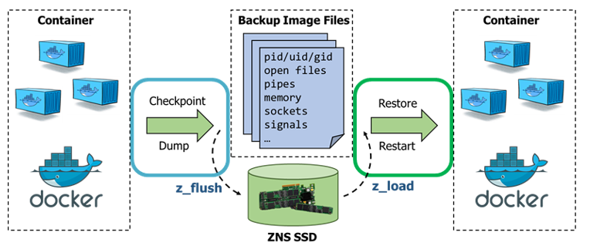
Docker Checkpoint
Performance measurment of C/R
  Application image size
…
Checkpoint/Restore Time 측정…

