Slide 1
Weekly Report
한예진
hbb97225@naver.com

Slide 2
Weekly Report
Last Week
Libfuse two API: high-level, low-level API
Passthrough example (mirrors the existing file system hierarchy)
fuse use case
This Week
FUSE use case
LinnOS

Slide 3
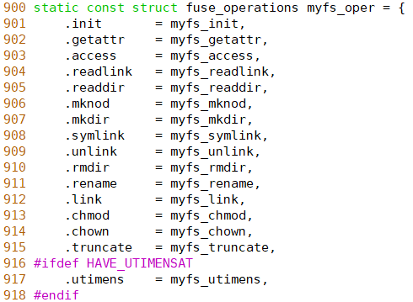
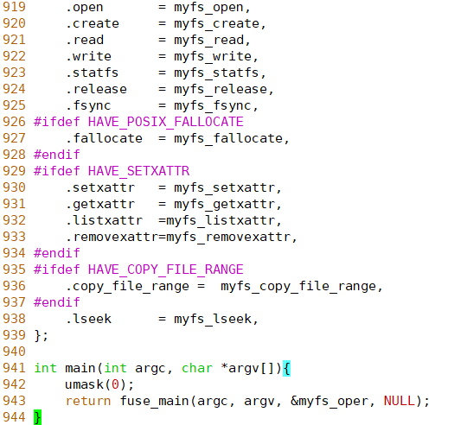
FUSE
passthrough

Slide 4
FUSE
passthrough
Fuse_application service
myfs_oper
User
ls /study/mnt
libfuse
Userspace
syscalls
/dev/fuse
Kernel
File system
fuse_dev
VFS
fuse_fs_type

Slide 5
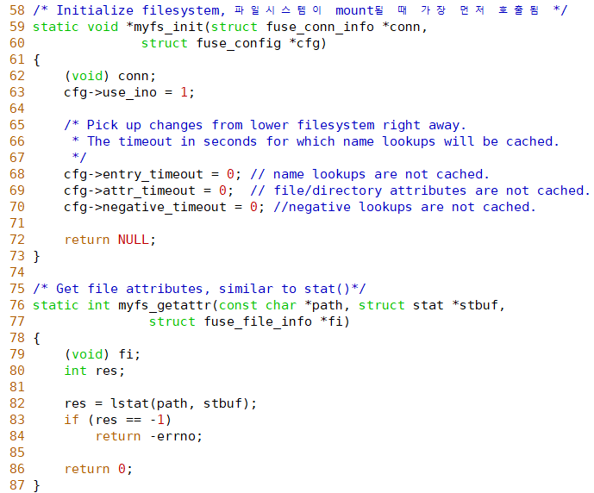
FUSE
Passthrough
Init, getattr

Slide 6
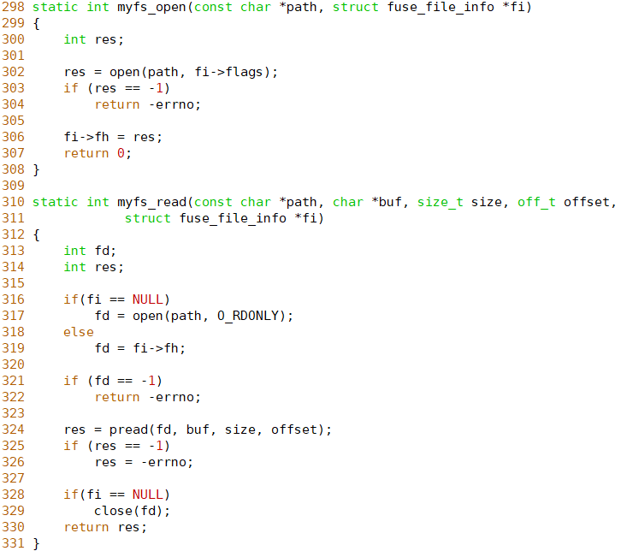
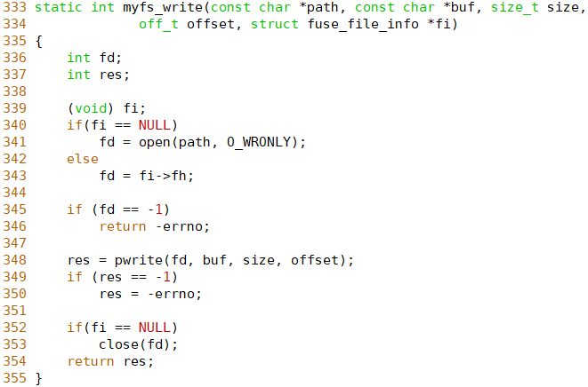
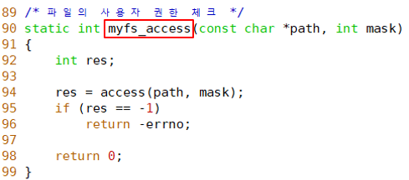
FUSE
Passthrough
File – open, read, write, access

Slide 7
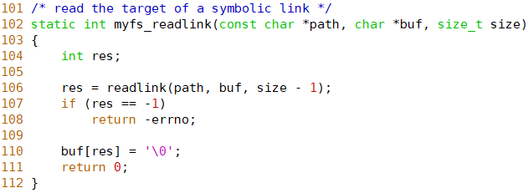
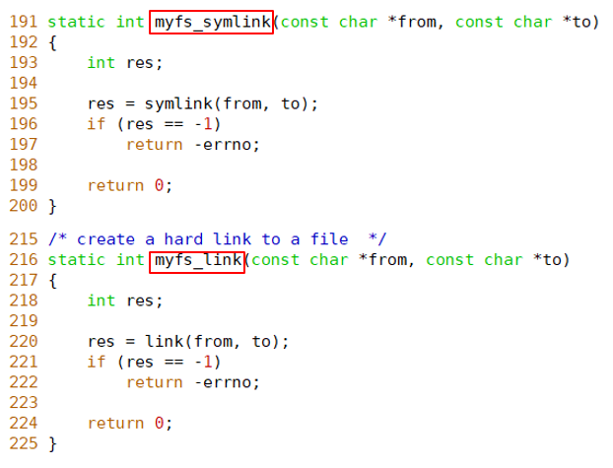
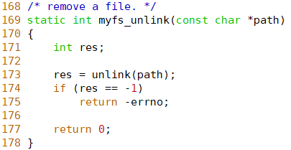
FUSE
Passthrough
File – readlink, unlink, symlink, link

Slide 8
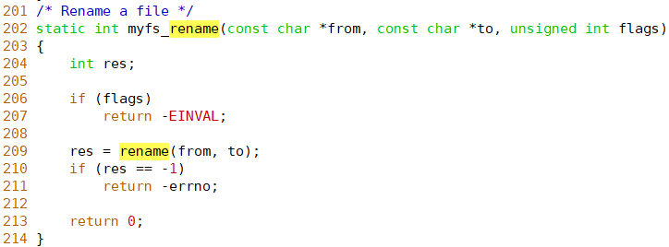
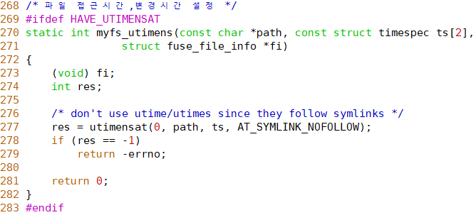
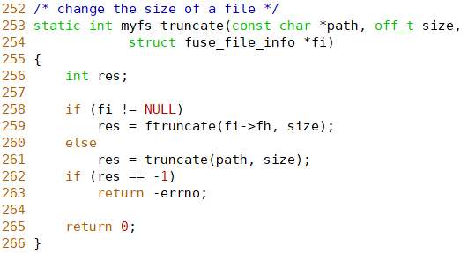
FUSE
Passthrough
File – rename, truncate, utimens

Slide 9
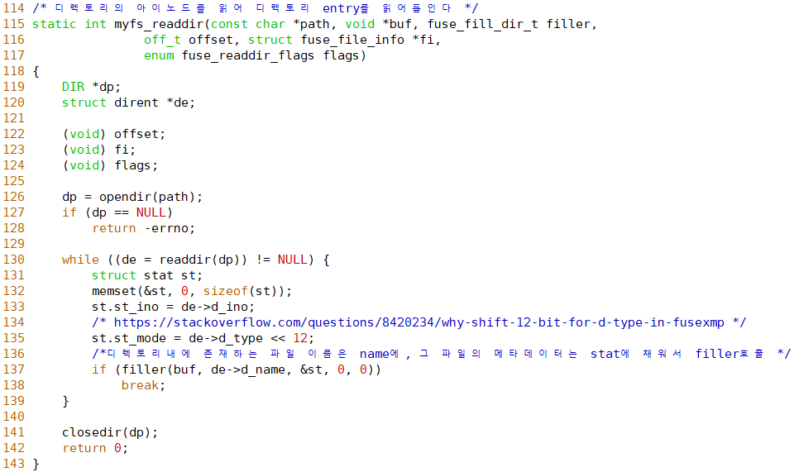
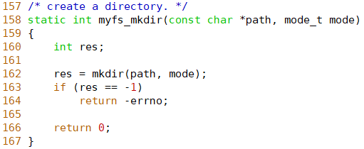
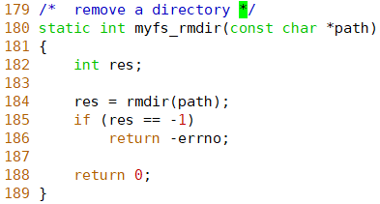
FUSE
Passthrough
Directory – readdir

Slide 10
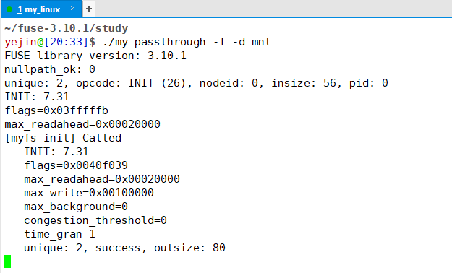
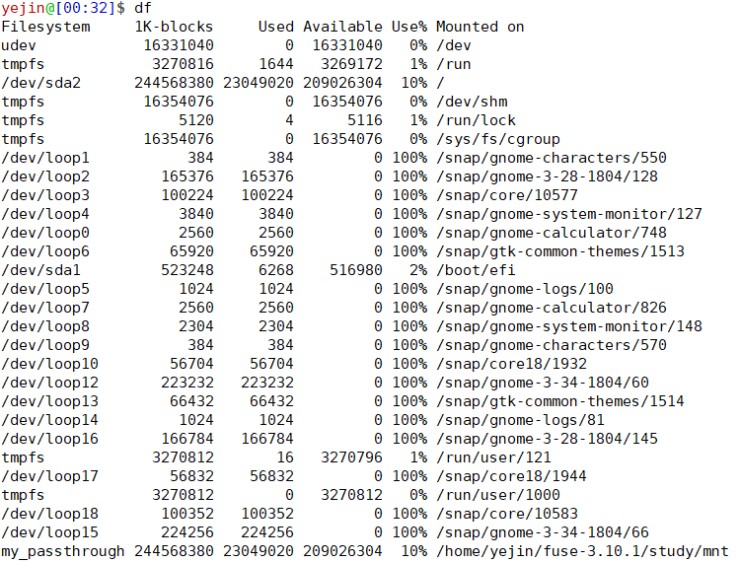
FUSE
passthrough
mount

Slide 11
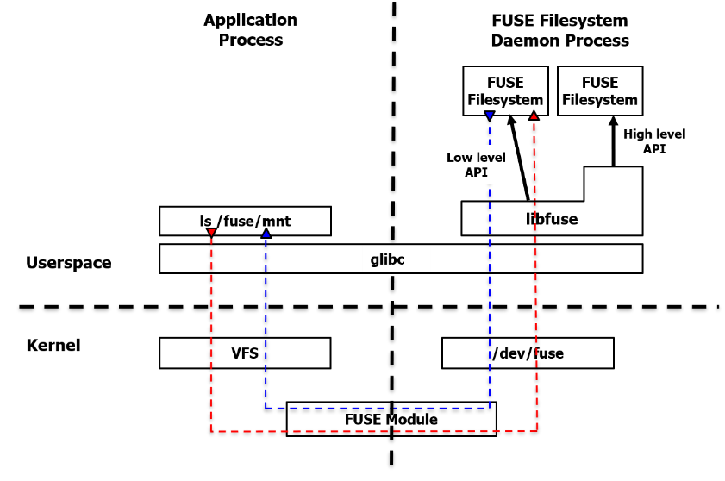

FUSE
FUSE API levels
My File System
myfs_open()
myfs_read()
myfs_write()
fuse_lowelevel_ops { }
High Level
operations
fuse_lib_open()
fuse_lib_read()
fuse_lib_write()
fuse_lowelevel_ops { }
Low Level
FUSE Request
FUSE Reply
Userspace
/dev/fuse driver
Kernel

Slide 12
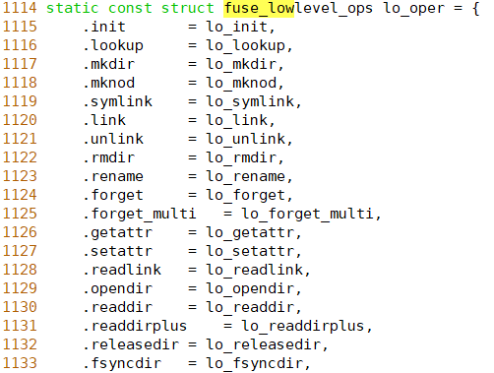


FUSE
passthrough
API performance
High-level api
low-level api

Slide 13

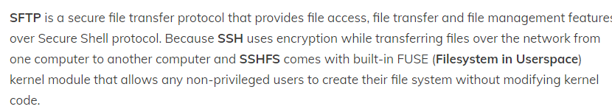
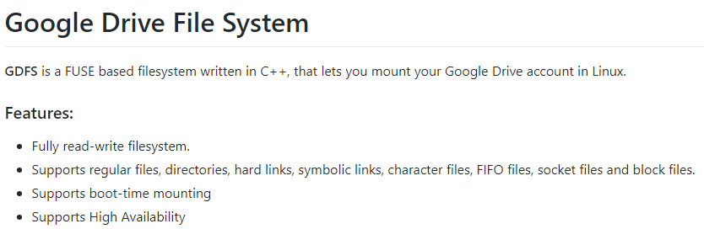
FUSE
Mounting remote file system

