Slide 1
2801ICT Computing Algorithms – Assignment 1 (Change making problems)
S5084207
Yoon Jin Park
Bachelor of Computer Science
Griffith University (Gold Coast Campus)

Slide 2
Overview of Change making problems
Counting the number of solutions to make up a target value with or without restricted number of coins.
Examples:
6 -> How many solutions available for the target value 6
6 3 -> How many solutions available for the target value 6 where the number of coins used is 3 coins
6 2 5 -> How many solutions available for the target value 6 for the number of coins used between 2 and 5
6 1 6 -> How many solutions available for the target value 6 for the number of coins used between 1 and 6 (equivalent to the first example)

Slide 3
Categorisation of problems – Two algorithms
Total number of solutions:
Problems with one number (i.e. target value)
Problems with three numbers where the second number (Minimum coin) = 1 and the third number (Maximum coin) = the first number
Dynamic programming approach
Possible number of solutions for the range between Minimum and Maximum coins:
All other problems requiring the number of solutions by the number of coins used
Backtracking and pruning approach

Slide 4
First algorithm – dynamic programming
Constructing a table with all possible values and coin denominations – the number of solutions is counted by using the previous number of solutions saved in the table.
Dynamic programming table with the reduced memory use (only two rows), the example of Value 5:
 | 0 | 1 | 2 | 3 | 4 | 5
1 | 1 | 1 | 1 | 1 | 1 | 1
2 | 1 | 1 | 2 | 2 | 3 | 3
 | 0 | 1 | 2 | 3 | 4 | 5
3 | 1 | 1 | 2 | 3 | 4 | 5
2 | 1 | 1 | 2 | 2 | 3 | 3

Slide 5
Dynamic programming pseudo code
Algorithm cal_combination_all()
Initialise a 2-D matrix with 1s for two rows and 0 to Value columns
row = 1, column = 1, row_index = 1
For row <- 1 to the size of coin_denomination list
For column <- 1 to Value
If column minus coin_denomination[row] >= 0 then x = the matrix[row_index][column - coin_denomination[row]]
Else x = 0
If row_index=0 then
If column >= 1 then y = the matrix[row_index+1][column] Else 0
Else
If column >= 1 then y = the matrix[row_index-1][column] Else 0
row_index += 1, row += 1
If row_index=2 then row_index -=2
result_row = row_index+1 if row_index = 0 else row_index-1
return matrix[result_row][value]

Slide 6
Second algorithm – backtracking and pruning
An algorithm for identifying all possible solutions based on depth-first recursive search.
Backtracking and pruning algorithm, however, has a worse Time complexity than the dynamic programming algorithm due to its recursive nature.

Slide 7
Backtracking
The example of Value 8, Minimum/Maximum coin 3:
8
8
8
8
7
1
7
1
6
2
6
2
6
1
5
2
4
2
3
3
No further expansion because the number of coins are already 3
No further expansion after [4,3,1] because it will generate same combinations

Slide 8
What to prune – two pruning methods
Number of coins used:
If current coins are coin restriction -1 and the remaining value is not a prime number or 1, then no need to further expand.
Second half of combinations -> combination not permutation
If the remaining value and current coin denomination are same, then no need to further expand. [5,2,1] equivalent to [2,5,1]

Slide 9
Backtracking and pruning pseudo code
Algorithm cal_combination(integer remaining_value, integer current_coin_position, integer restricted_number_of_coins, integer current_number_of_coins)
boolean number_of_coins_check = current_number_of_coins == restricted _number_of_coins - 1
//two base cases and one utility condition
If (number_of_coins_check is true) and (remaining_value is not in coin_ denomination list) then return 0 //not a prime number or 1 - not a solution
If (number_of_coins_check is true) and (remaining_value is in coin_denomination list) then (add 1 to the dictionary containing the number of solution by the number of coins used) and (return 1) //one of the solutions
If (number_of_coins_check is false) and (remaining_value is not in coin_denomination list) then (add 1 to the dictionary containing the number of solution by the number of coins used) //utility condition to keep a track of the solutions for the different number of coins
integer number_of_combinations
For index <- current_coin_position to the size of coin_denomination list
difference = remaining_value – coin_denomination list[index]
If difference >= coin_denomination list[index] then
current_number_of_coins++
cal_combination(difference, index, restricted_number_of_coins, current_number_of_coins) and add the result to number_of_combinations
Else return 0
current_number_of_coins--
return number_of_combinations
First pruning
Second pruning

Slide 10
Analysis of the results
Total number of solutions -> the dynamic programming algorithm
Number of solutions by the coins used -> the backtracking and pruning algorithm
Input | Output | Ave. CPU Time (Secs) | Input | Output | Ave. CPU Time (Secs)
5 | 6 | 0.000000 | 20 10 15 | 57 | 0.000000
6 2 5 | 7 | 0.000000 | 100 5 10 | 14839 | 0.088542
6 1 6 | 9 | 0.000000 | 100 8 25 | 278083 | 1.869792
8 3 | 2 | 0.000000 | 300 12 | 4307252 | 72.968750
8 2 5 | 10 | 0.000000 | 300 10 15 | 32100326 | 443.703125

Slide 11
Dynamic programming results
The example of Value 5:
5 + 1 (account for the gold coin solution)
The example of Value 6, Minimum coin 1, Maximum coin 6:
8 + 1 (account for the gold coin solution)
 | 0 | 1 | 2 | 3 | 4 | 5
3 | 1 | 1 | 2 | 3 | 4 | 5
2 | 1 | 1 | 2 | 2 | 3 | 3
 | 0 | 1 | 2 | 3 | 4 | 5 | 6
3 | 1 | 1 | 2 | 3 | 4 | 5 | 7
5 | 1 | 1 | 2 | 3 | 4 | 6 | 8

Slide 12
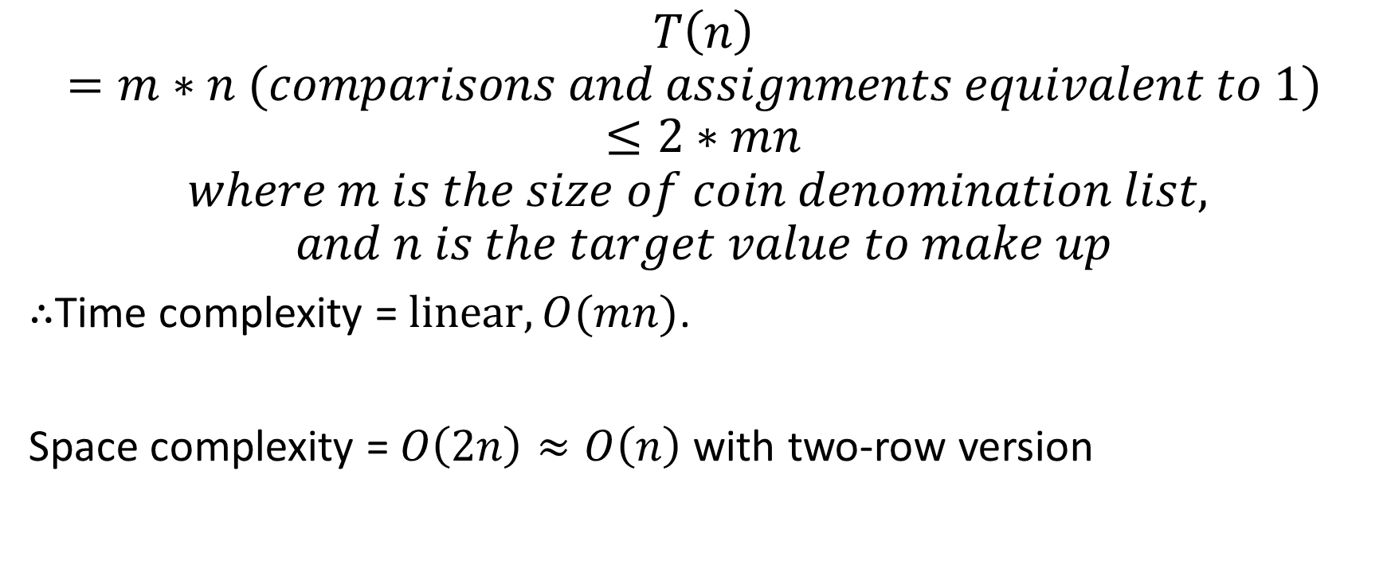
Dynamic programming time & space efficiency
$$T\left(n\right)=m∗n (comparisons and assignments equivalent to 1) ≤2∗mn$$
$$where m is the size of coin denomination list,$$
$$and n is the target value to make up$$
$∴$Time complexity = $linear, O(mn)$.
Space complexity =$O\left(2n\right)≈O\left(n\right)$ with two-row version

Slide 13
Backtracking and pruning results
The example of Value 6, Minimum coin 2, Maximum coin 5:
Dictionary {(2,2), (3,2), (4,2), (5,1)} -> sum up for the range 2 to 5: 2+2+2+1=7
The number of coins used | The number of solutions | The solutions meeting constraints
2 | 2 | [5,1], [3,3]
3 | 2 | [2,2,2], [3,2,1]
4 | 2 | [2,2,1,1], [3,1,1,1]
5 | 1 | [2,1,1,1,1]
Total | 7

Slide 14
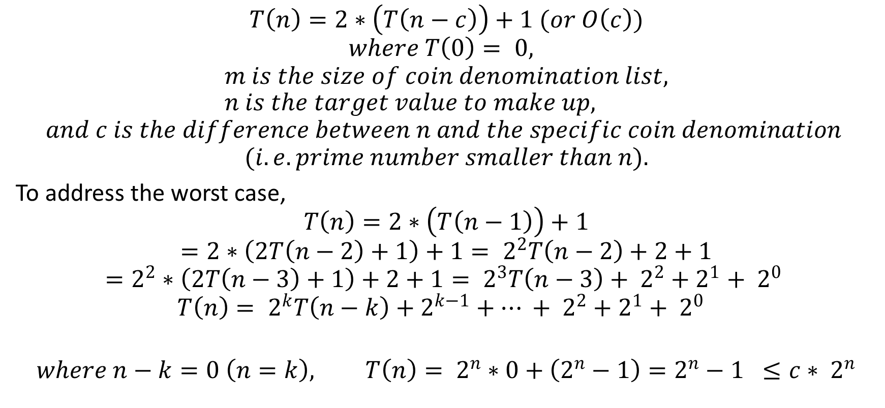
Backtracking and pruning time & space efficiency
$$T\left(n\right)=2∗\left(T\left(n−c\right)\right)+1 (or O\left(c\right))$$
$$where T\left(0\right)= 0,$$
$$m is the size of coin denomination list, n is the target value to make up,$$
$$and c is the difference between n and the specific coin denomination$$
$$(i.e. prime number smaller than n).$$
To address the worst case,
$$T\left(n\right)=2∗\left(T\left(n−1\right)\right)+1$$
$$=2∗\left(2T\left(n−2\right)+1\right)+1= 2^{2}T\left(n−2\right)+2+1$$
$$=2^{2}∗\left(2T\left(n−3\right)+1\right)+2+1= 2^{3}T\left(n−3\right)+ 2^{2}+2^{1}+ 2^{0}$$
$$T\left(n\right)= 2^{k}T\left(n−k\right)+2^{k−1}+… + 2^{2}+2^{1}+ 2^{0}$$
$$where n−k=0 \left(n=k\right), T\left(n\right)= 2^{n}∗0+\left(2^{n}−1\right)=2^{n}−1 ≤c∗ 2^{n}$$

Slide 15
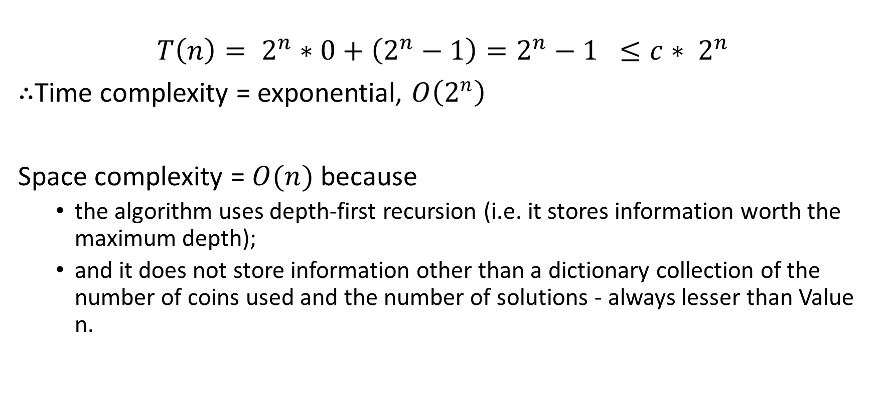
Backtracking and pruning time & space efficiency (cont.)
$$T\left(n\right)= 2^{n}∗0+\left(2^{n}−1\right)=2^{n}−1 ≤c∗ 2^{n}$$
$∴$Time complexity = exponential, $O\left(2^{n}\right)$
Space complexity = $O(n)$ because
the algorithm uses depth-first recursion (i.e. it stores information worth the maximum depth);
and it does not store information other than a dictionary collection of the number of coins used and the number of solutions - always lesser than Value n.

Slide 16
Dynamic programming vs backtracking and pruning
Value 300, Minimum coin 1, Maximum coin 300 implemented by Python:
Overall, the backtracking algorithm can deal with cases for the specific constraints, but less efficient even with the pruning methods.
 | Dynamic programming algorithm | Backtracking and pruning algorithm
CPU Time (Secs) | 0.000000 | Not finished within 21 hours

