Slide 1
2801ICT Assignment 2 Maximise The Score
S5084207
Yoon Jin Park
Bachelor of Computer Science
Griffith University

Slide 2
Introduction
Objective –
To outline the design and pseudo codes of the algorithm to solve “Maximise The Score” games;
To provide results of the algorithm
To analyse the algorithm’s correctness and performance.
“Maximise The Score” game - the objective of the game is to maximise the sum of the chosen balls for each player.
Scott selects the maximum value based on the value written on a ball while Rusty choose the maximum value based on the sum of digits of the values on a ball Each player’s priority is different.

Slide 3
Overview of the algorithm
Three main parts of the algorithm interpreted into the three classes:
Game Ball class – storing the value written on a ball, calculating the sum of digits and storing this value, and setting and storing the state of the ball as to whether it is taken or not.
Priority queue class - performing functions of a priority queue based on a heap and providing the max value based on a different priority criterion set for each player. Usual methods for a priority queue (front, insert, delete, is_empty).
Score Maximiser class - building two different priority queues and dealing with turns for each player.

Slide 4
Description of Algorithm
Main inputs:
the number of balls on a table;
the maximum number of turns per round;
balls with the value; and
the result of the toss determining which player starts first.
Output: the maximised score for each player in addition to generating the output file in a text format.

Slide 5
Score Maximiser
1) build queues and 2) extract a ball and delete
Score Maximiser class builds two priority queues: one for Scott, the other for Rusty.
For Scott, the priority is the value itself
For Rusty, the priority is the sum of digit values.
The priority queue is implemented through a max heap – maximum value at the front of the queue.
Since the queue is based on the heap, the queue is not sorted perfectly. Only parent node is larger than child nodes

Slide 6
Step 1. Build queues summary
Append the ball at the end and heapify up.
This is to ensure the queue does not violate the heap property where a parent node is expected to have a larger value than child nodes.
For Rusty, if multiple balls have same priority, then the ball with a higher value must be having a higher priority than the other balls.

Slide 7
Step 1. Build queues – Insert
Example of the initialised priority queue construction process with the balls [1000, 99, 98] for Rusty
a. Initialise a root and insert the second ball
b. Heapify up because the priority of the second ball has a higher priority (i.e. Digit value 18 > Digit value 1)
Value: 1000
Digit value: 1
State: 0
Value: 99
Digit value: 18
State: 0
Value: 99
Digit value: 18
State: 0
Value: 1000
Digit value: 1
State: 0

Slide 8
Step 1. Build queues – Insert (cont.)
c. Insert the third ball and check the priority – no violation of the heap properties
Value: 99
Digit value: 18
State: 0
Value: 1000
Digit value: 1
State: 0
Value: 97
Digit value: 17
State: 0

Slide 9
Step 1. Pseudo code – Build queue and Insert
To build the queue, Insert method is important – append the ball at the end of the queue and heapify the queue based on each player’s priority
class ScoreMaximiser:
//build a priority queue for each player based on one’s priority
Algorithm build_pq(ball_list):
for i <- 0 to ball_list.length do
insert balls to scott_pq based on value priority
insert balls to rusty_pq based on sum of digit priority
class PriorityQueue:
Algorithm insert(ball_picked, priority):
ball_heap.append(ball_picked)
size += 1
heapify_up(size, priority)

Slide 10
Step 1. Pseudo code – Heapify up
class PriorityQueue:
//heapify up makes the ball goes up to meet the max heap property where a parent node must be larger than child nodes.
Algorithm heapify_up(size, priority)
while floor value of size of the queue/2 > 0 do
if priority="HEADS" //Scott’s priority
//parent node < child node then swap based on the value
if ball_heap[size//2].get_value()<ball_heap[size].get_value()
swap(size//2, size)
if priority="TAILS" //Rusty’s priority
//parent node < child node then swap based on the sum of digits
if ball_heap[size//2].get_digit()<ball_heap[size].get_digit()
swap(size//2, size)
//parent node = child node then look at the value and swap based on the value
if ball_heap[size//2].get_digit()=ball_heap[size].get_digit()
if ball_heap[size//2].get_value()<ball_heap[size].get_value()
swap(size//2, size)
//reduce index size to half to do the same process until the max heap property is met
size = size//2

Slide 11
Step 2. Play Rounds summary
Play round in the Score Maximiser class calls the “delete” method from the queue.
This initiates the delete method where it deals with extracting the maximum value of the ball (depending on priority) and delete the ball from the player’s queue, followed by heapify down to ensure the max heap property.
If the ball is already taken (i.e. ball has the state 1) then this ball is deleted and heapify down is performed.
The maximum turns finish when the current player extracts the number of balls equivalent to the maximum turns.

Slide 12
Step 2. Pseudo code – Play rounds
class ScoreMaximiser:
//start to play rounds
Algorithm play_round(maximum_turns, player_turn):
rounds <- take ceiling of number of balls/maximum_turns
toggled <- initialise the turn of this round for a player (e.g. “HEADS” then Scott plays first)
track the number of balls taken from 0
if the whole number of balls are not taken:
for game_round <- 0 to rounds do
if toggled="HEADS":
max_taken <- call delete(toggled, maximum_turns) on scott_pq
if max_taken has some value:
add max_taken to “scott”’s result
if toggled="TAILS":
max_taken = <- call delete(toggled, maximum_turns) on rusty_pq
if max_taken has some value:
add max_taken to “rusty”’s result
toggled <- toggle the turn so that the next player can play a round
add maximum_turns to the tracked number of balls to count the balls taken
return the final score for each player

Slide 13
Step 2. Pseudo code - Delete
Algorithm delete(priority, turns)
//initialise the sum of the max balls for each player in this round
max_addition = 0
//track the number of turns taken by each player
player_turn = 0
//if the player did not exhaust his turn, keep extracting the max ball
while player_turn != turns
//find the max and change deleted state to 1
if front_index().get_state() is not taken
max_deleted = front() //get the max ball
self.ball_heap[1].set_state_deleted() //change the state
//remove the element by assigning the least value and reduce the size of the heap
ball_heap[1] = ball_heap[self.size]
size -= 1
Algorithm delete(priority, turns) continued…
//heapify down to ensure the heap property is still met
heapify_down(1, priority)
//add the extracted ball to the result of this round
max_addition += max_deleted
//the player used one turn
player_turn += 1
else
//remove the element by swapping and reduce the size of the heap
ball_heap[1] = ball_heap[self.size]
size -= 1
//heapify down to ensure the heap property is met
heapify_down(1, priority)
//but do not add any value to the result or player’s turn as nothing happened
return max_addition

Slide 14
Step 2. Pseudo code – Heapify down
//heapify down method makes a parent node that is smaller than child nodes to be placed at the right position in the queue
Algorithm heapify_down(self, c_index, priority)
//while current index is smaller than the size of the queue
while (c_index * 2) <= size of the queue do
//get the child node with a larger value based on the priority
max_child_index = self.get_max_child(c_index, priority)
if priority="HEADS" //Scott’s turn
//if the value of the current index < the value of the max_child_index then swap
if ball_heap[c_index].get_value() < ball_heap[max_child_index].get_value()
swap(c_index, max_child_index)
if priority="TAILS" //Rusty’s turn
//if the sum of digits of the current index < the sum_of digits of the max_child_index then //swap
if ball_heap[c_index].get_digit() < ball_heap[max_child_index].get_digit()
swap(c_index, max_child_index)
//if the sum of digits of the current index = the value of the max_child_index
if ball_heap[c_index].get_digit() == ball_heap[max_child_index].get_digit()
//consider the value of the current index compared to the value of the max_child_index
if ball_heap[c_index].get_value() < ball_heap[max_child_index].get_value()
swap(c_index, max_child_index)
//current index goes down to the max_child_index to meet max heap property
c_index = max_child_index

Slide 15
Result
The output of the algorithm for total score consistent with the desired output.
CPU time taken is presented as the time taken output subtracting the time taken for running a basic program (i.e. printing out “Hello World”).
Input | Output | CPU Time (Secs) | Input | Output | CPU Time (Secs)
1 | 1000 197 | 0.000000 | 6 | 4726793900 3941702128 | 0.000000
2 | 240 150 | 0.000000 | 7 | 13793 12543 | 0.000000
3 | 2100000000 98888899 | 0.000000 | 8 | 2173 1665 | 0.000000
4 | 9538 2256 | 0.000000 | 9 | 3923529875 3049188235 | 0.000000
5 | 30031 17796 | 0.000000 | 10 | 0 284401 | 0.000000

Slide 16
The example ball list of [88888888 10000011 999999999 100000001 1000000000]
Value: 1000000000
Digit value: 1
State: 0
Value: 999999999
Digit value: 81
State: 0
a. Initialised Scott’s queue
b. Initialised Rusty’s queue
Value: 999999999
Digit value: 81
State: 0
Value: 88888888
Digit value: 64
State: 0
Value: 10000011
Digit value: 3
State: 0
Value: 88888888
Digit value: 64
State: 0
Value: 10000011
Digit value: 3
State: 0
Value: 100000001
Digit value: 2
State: 0
Value: 100000001
Digit value: 2
State: 0
Value: 1000000000
Digit value: 1
State: 0

Slide 17
Scott has a maximum two turns, two maximum values are taken from the queue. Heapify down is performed at the same time.
a. Result from Scott’s round
b. Two balls taken for Scott: max_addition = 1,999,999,999
Value: 100000001
Digit value: 2
State: 0
Value: 1000000000
Digit value: 1
State: 1
Value: 999999999
Digit value: 81
State: 1
Value: 10000011
Digit value: 3
State: 0
Value: 88888888
Digit value: 64
State: 0

Slide 18
For Rusty’s turn, the ball with the max sum of digits is taken. This ball with the sum of digits, 81, is removed from Rusty’s queue without being taken, because it has been picked up by Scott previously.
a. Result from Rusty’s round
b. Removed from the Rusty’s queue
because it is taken
Value: 100000001
Digit value: 2
State: 0
c. Two balls taken for Rusty: max_addition = 98,888,899
Value: 999999999
Digit value: 81
State: 1
Value: 88888888
Digit value: 64
State: 1
Value: 10000011
Digit value: 3
State: 1
Value: 1000000000
Digit value: 1
State: 1

Slide 19
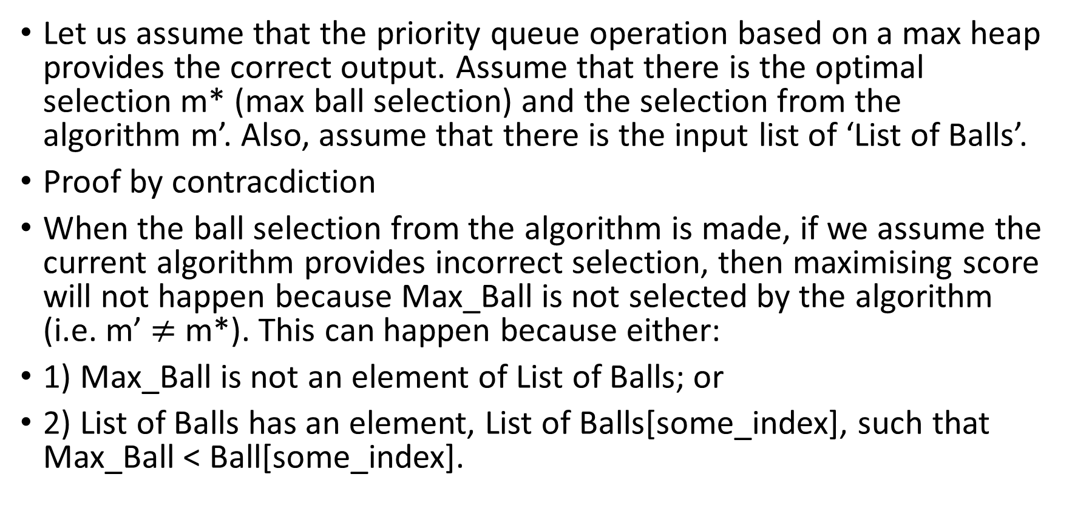
Correctness of the algorithm
Let us assume that the priority queue operation based on a max heap provides the correct output. Assume that there is the optimal selection m* (max ball selection) and the selection from the algorithm m’. Also, assume that there is the input list of ‘List of Balls’.
Proof by contracdiction
When the ball selection from the algorithm is made, if we assume the current algorithm provides incorrect selection, then maximising score will not happen because Max_Ball is not selected by the algorithm (i.e. m’ $≠$ m*). This can happen because either:
1) Max_Ball is not an element of List of Balls; or
2) List of Balls has an element, List of Balls[some_index], such that Max_Ball < Ball[some_index].

Slide 20
Correctness of the algorithm (cont.)
To prove correctness of the algorithm by contradiction, it is required to prove that these cases are not possible/available, indicating that providing incorrect selection by this algorithm cannot happen.
First, given the priority queue operation is perfectly implemented, Max_Ball is initialised to and assigned to elements of List of Balls and inserted into both queues, so the first case is not possible. Max_Ball must be in List of Balls.
for each_ball in range(games[each_game]['n_balls']):
ball = GameBall(games[each_game]['ball_list'][each_ball])
balls.append(ball)
Algorithm build_pq(ball_list):
for i <- 0 to ball_list.length do
insert balls to scott_pq based on value priority
insert balls to rusty_pq based on sum of digit priority

Slide 21
Correctness of the algorithm (cont.)
Secondly, given the assumption that the heapify up and down and other heap operations are implemented perfectly, after some_index iterations of the loop, Max_Ball >= A[some_index] otherwise it would have been swapped in the code lines highlighted in yellow below. Upon termination of the codes below, hence, Max_Ball is at least as large as every other element in List of Balls or the largest. This is in contrast with the second case listed above.
if priority="HEADS" //Scott’s turn
if ball_heap[c_index].get_value() < ball_heap[max_child_index].get_value()
swap(c_index, max_child_index)
if priority="TAILS" //Rusty’s turn
if ball_heap[c_index].get_digit() < ball_heap[max_child_index].get_digit()
swap(c_index, max_child_index)

Slide 22
Correctness of the algorithm (cont.)
In conclusion, both first and second case are not possible.
It is proved that the algorithm cannot provide incorrect selection from these both cases.
Hence, the optimal selection m* and the selection from the algorithm m’ must equal (m’=m*) where the algorithm must give the max value based on the priority and maximising score occurs because m’=m*.

Slide 23
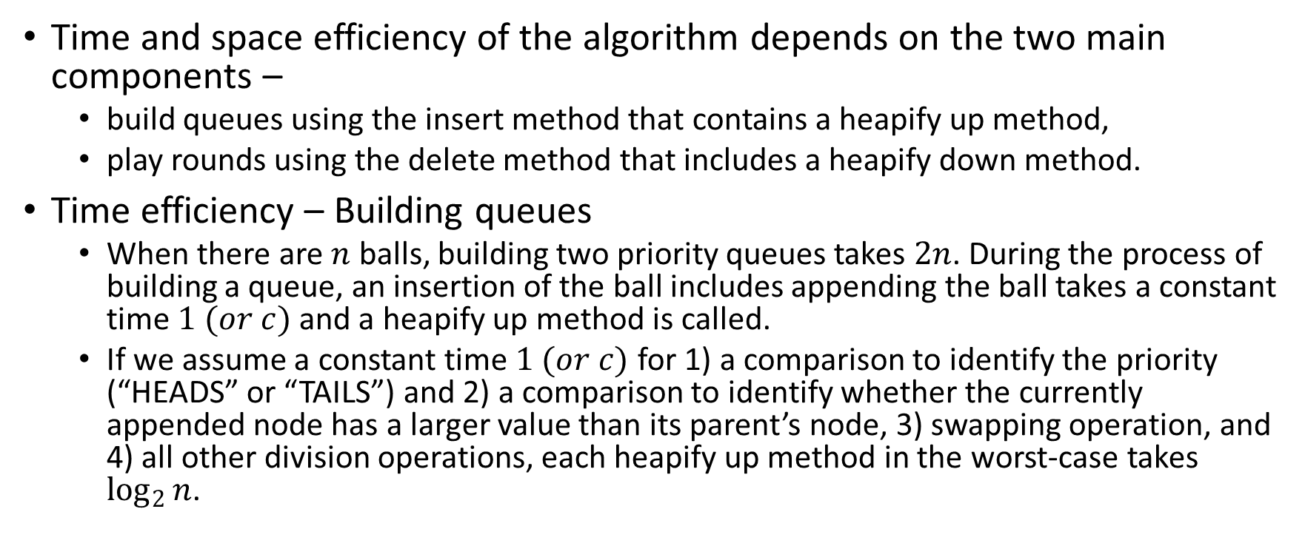
Performance analysis
Time and space efficiency of the algorithm depends on the two main components –
build queues using the insert method that contains a heapify up method,
play rounds using the delete method that includes a heapify down method.
Time efficiency – Building queues
When there are $n$ balls, building two priority queues takes $2n$. During the process of building a queue, an insertion of the ball includes appending the ball takes a constant time $1 (or c)$ and a heapify up method is called.
If we assume a constant time $1 (or c)$ for 1) a comparison to identify the priority (“HEADS” or “TAILS”) and 2) a comparison to identify whether the currently appended node has a larger value than its parent’s node, 3) swapping operation, and 4) all other division operations, each heapify up method in the worst-case takes $\log_{2}{n}$.

Slide 24
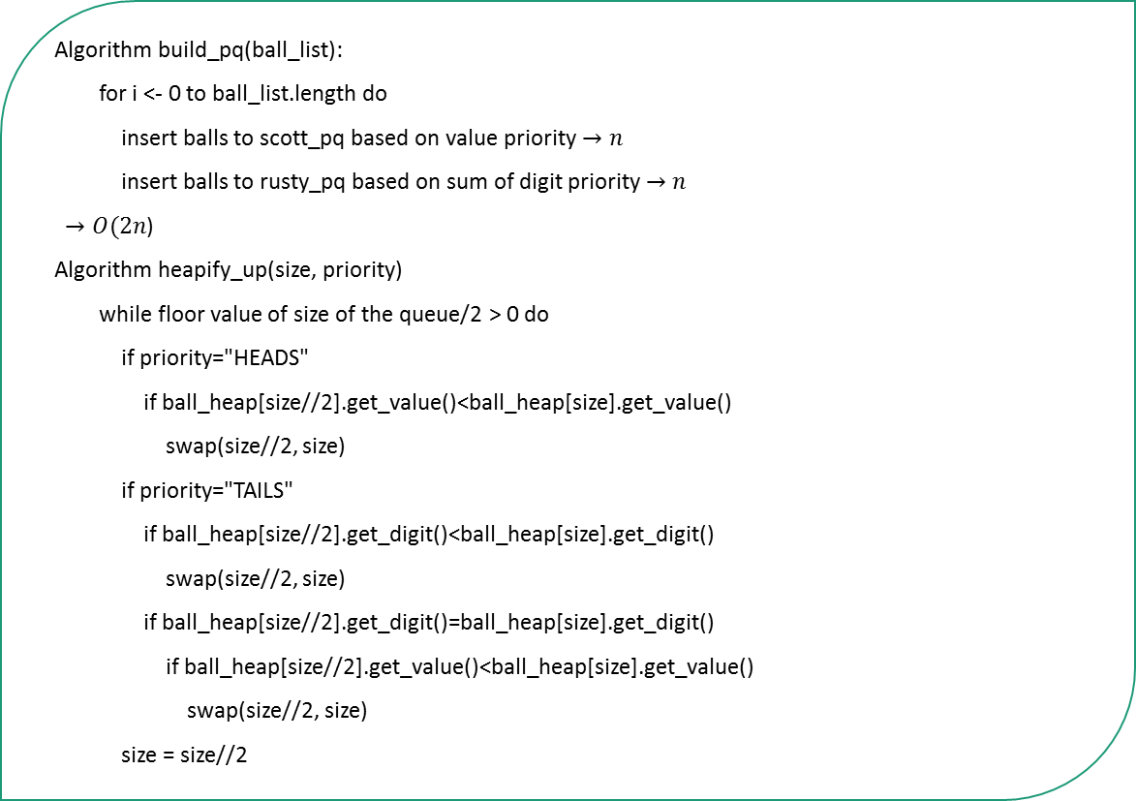


Performance analysis - Building queues
Algorithm build_pq(ball_list):
for i <- 0 to ball_list.length do
insert balls to scott_pq based on value priority$→n$
insert balls to rusty_pq based on sum of digit priority $→n$
$→O(2n$)
Algorithm heapify_up(size, priority)
while floor value of size of the queue/2 > 0 do
if priority="HEADS"
if ball_heap[size//2].get_value()<ball_heap[size].get_value()
swap(size//2, size)
if priority="TAILS"
if ball_heap[size//2].get_digit()<ball_heap[size].get_digit()
swap(size//2, size)
if ball_heap[size//2].get_digit()=ball_heap[size].get_digit()
if ball_heap[size//2].get_value()<ball_heap[size].get_value()
swap(size//2, size)
size = size//2
$$O({2nlog}_{2}{n})$$
$$O(1)$$
The worst-case scenario for building two queues takes $2∗n∗\log_{2}{n}$ where there are two queues ($2$) with $n$ balls ($n$) that need to be a heapify up ($\log_{2}{n)}$ each time

Slide 25
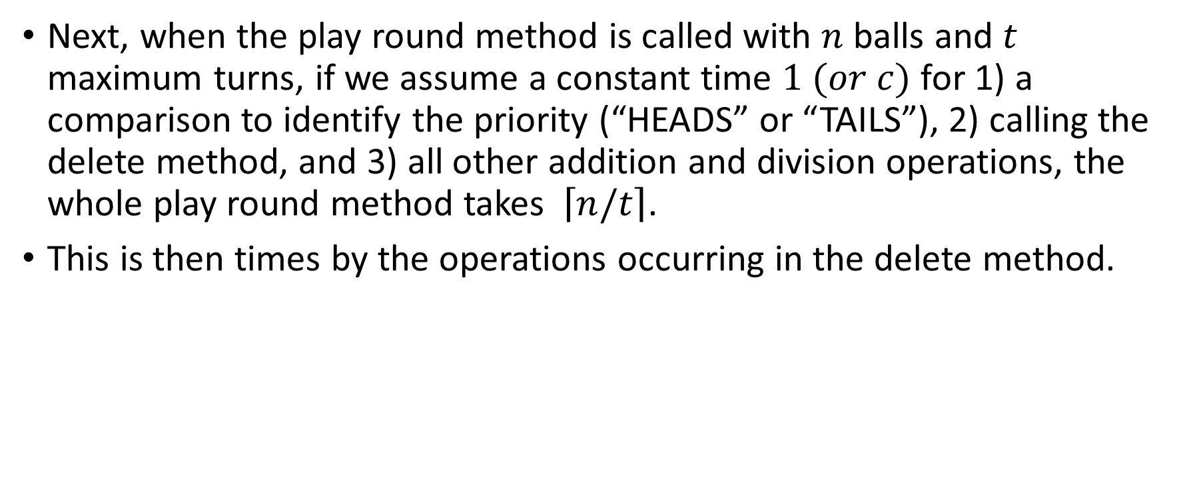
Performance analysis – Play round
Next, when the play round method is called with $n$ balls and $t$ maximum turns, if we assume a constant time $1 (or c)$ for 1) a comparison to identify the priority (“HEADS” or “TAILS”), 2) calling the delete method, and 3) all other addition and division operations, the whole play round method takes $\left\lceil n/t\right\rceil$.
This is then times by the operations occurring in the delete method.

Slide 26




Performance analysis – Play round
Algorithm play_round(maximum_turns, player_turn):
rounds <- take ceiling of number of balls/maximum_turns
toggled <- initialise the turn of this round for a player (e.g. “HEADS” then Scott plays first)
track the number of balls taken from 0
if the whole number of balls are not taken:
for game_round <- 0 to rounds do
if toggled="HEADS":
max_taken <- call delete(toggled, maximum_turns) on scott_pq
if max_taken has some value:
add max_taken to “scott”’s result
if toggled="TAILS":
max_taken = <- call delete(toggled, maximum_turns) on rusty_pq
if max_taken has some value:
add max_taken to “rusty”’s result
toggled <- toggle the turn so that the next player can play a round
add maximum_turns to the tracked number of balls to count the balls taken
return the final score for each player
$$all minor operations →O(1)$$
$$→O(n/t)$$
$$→O(?)$$
$$→O(?)$$

Slide 27
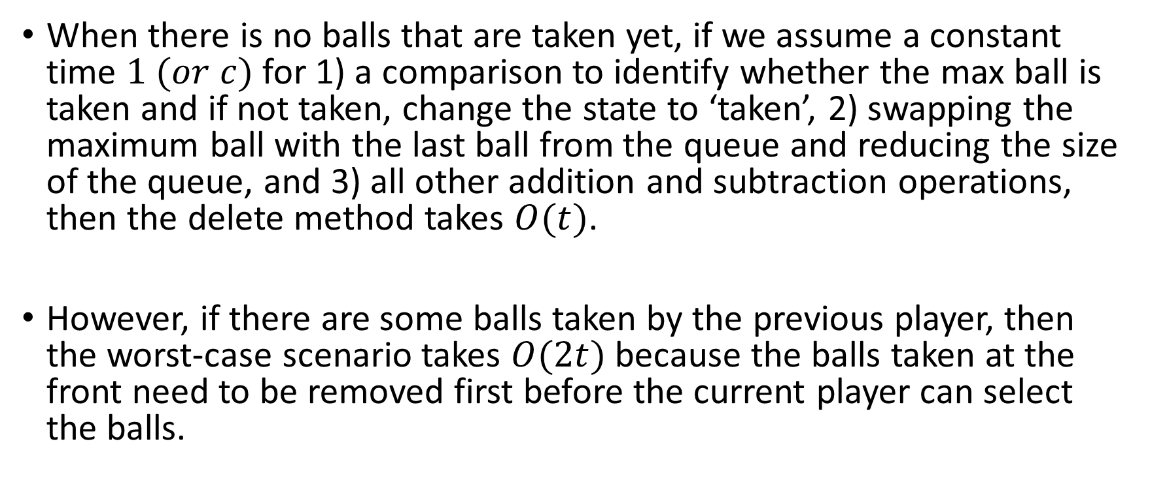
Performance analysis – Delete
When there is no balls that are taken yet, if we assume a constant time $1 (or c)$ for 1) a comparison to identify whether the max ball is taken and if not taken, change the state to ‘taken’, 2) swapping the maximum ball with the last ball from the queue and reducing the size of the queue, and 3) all other addition and subtraction operations, then the delete method takes $O(t)$.
However, if there are some balls taken by the previous player, then the worst-case scenario takes $O(2t)$ because the balls taken at the front need to be removed first before the current player can select the balls.

Slide 28



Performance analysis – Delete
Algorithm delete(priority, turns)
max_addition = 0
player_turn = 0
while player_turn != turns
if front_index().get_state() is not taken
max_deleted = front() //get the max ball
self.ball_heap[1].set_state_deleted() //change the state
ball_heap[1] = ball_heap[self.size]
size -= 1
heapify_down(1, priority)
max_addition += max_deleted
player_turn += 1
else
ball_heap[1] = ball_heap[self.size]
size -= 1
heapify_down(1, priority)
return max_addition
$$→O\left(t\right) or O\left(2t\right)$$
$$all minor operations →O(1)$$
$$→O(?)$$
$$→O(?)$$

Slide 29
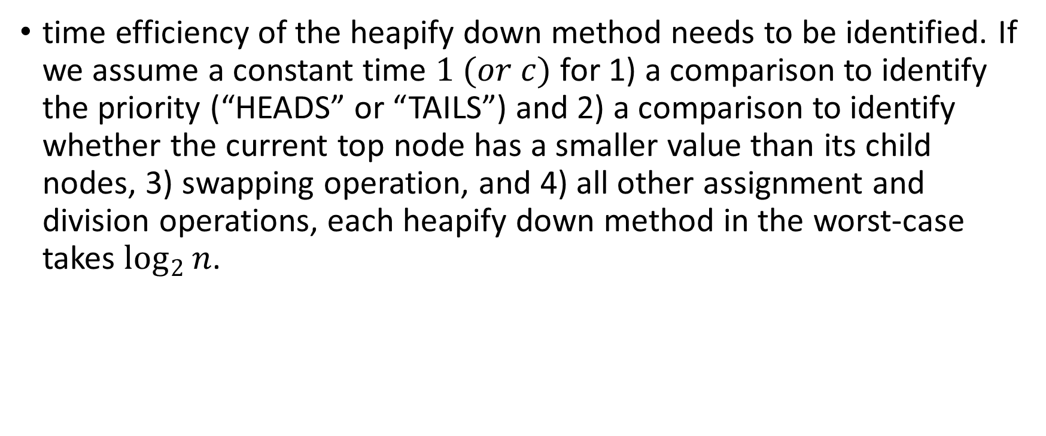
Performance analysis – Heapify down
time efficiency of the heapify down method needs to be identified. If we assume a constant time $1 (or c)$ for 1) a comparison to identify the priority (“HEADS” or “TAILS”) and 2) a comparison to identify whether the current top node has a smaller value than its child nodes, 3) swapping operation, and 4) all other assignment and division operations, each heapify down method in the worst-case takes $\log_{2}{n}$.

Slide 30


Performance analysis – Heapify down
Algorithm heapify_down(self, c_index, priority)
while (c_index * 2) <= size of the queue do
max_child_index = self.get_max_child(c_index, priority)
if priority="HEADS" //Scott’s turn
if ball_heap[c_index].get_value() < ball_heap[max_child_index].get_value()
swap(c_index, max_child_index)
if priority="TAILS" //Rusty’s turn
if ball_heap[c_index].get_digit() < ball_heap[max_child_index].get_digit()
swap(c_index, max_child_index)
if ball_heap[c_index].get_digit() == ball_heap[max_child_index].get_digit()
if ball_heap[c_index].get_value() < ball_heap[max_child_index].get_value()
c_index = max_child_index
$$→O(\log_{2}{n})$$
$$O(1)$$

Slide 31
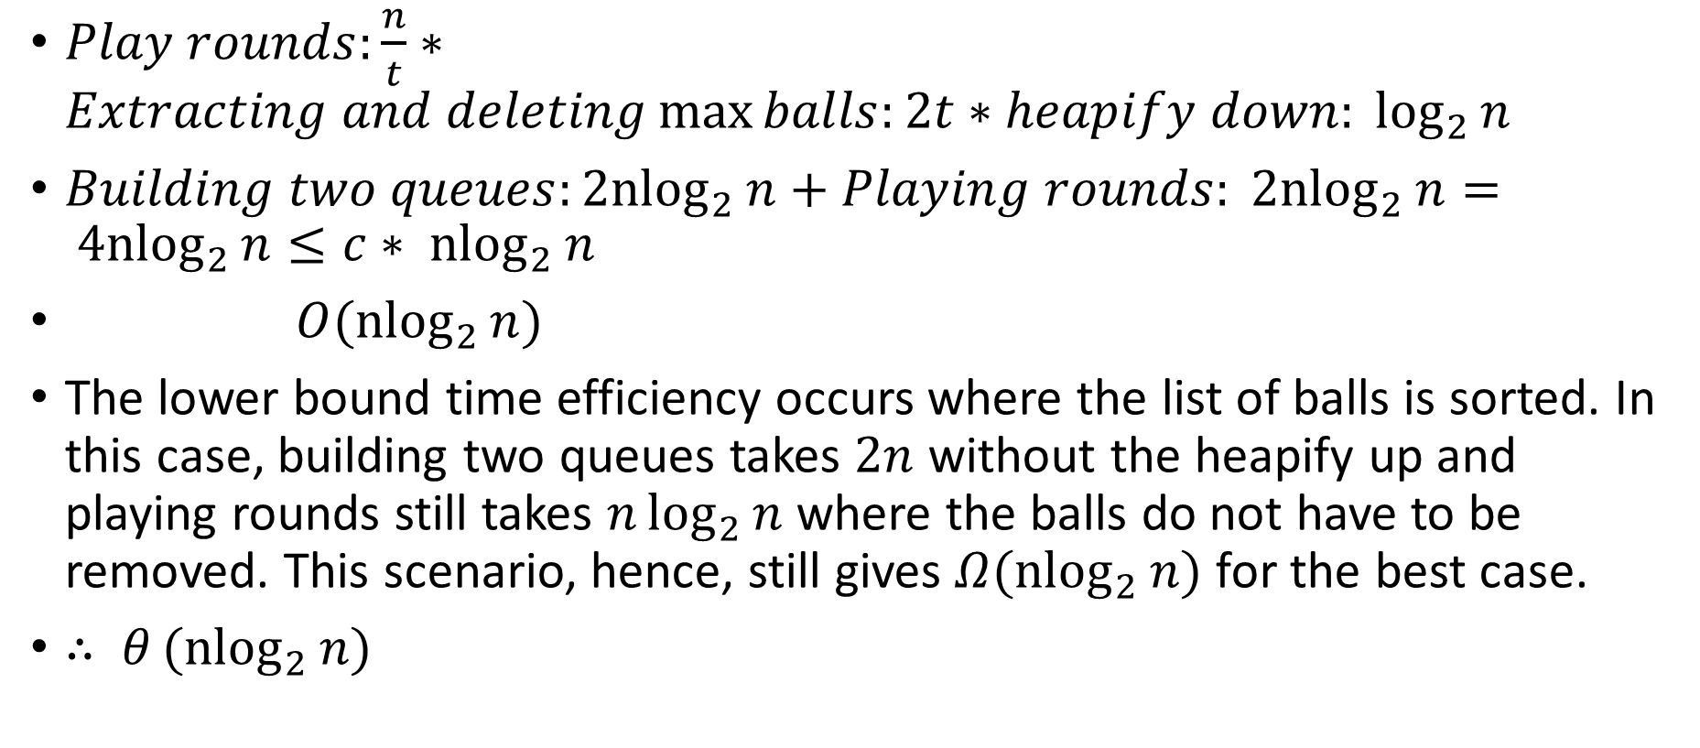
Putting it all together
$Play rounds:\frac{n}{t}∗Extracting and deleting\max{balls:2t∗heapify down: \log_{2}{n}}$
$Building two queues:{2nlog}_{2}{n}+Playing rounds: {2nlog}_{2}{n}= {4nlog}_{2}{n}≤c∗ {nlog}_{2}{n}$
$O({nlog}_{2}{n})$
The lower bound time efficiency occurs where the list of balls is sorted. In this case, building two queues takes $2n$ without the heapify up and playing rounds still takes $n\log_{2}{n}$ where the balls do not have to be removed. This scenario, hence, still gives $Ω({nlog}_{2}{n})$ for the best case.
$∴ θ({nlog}_{2}{n})$

Slide 32
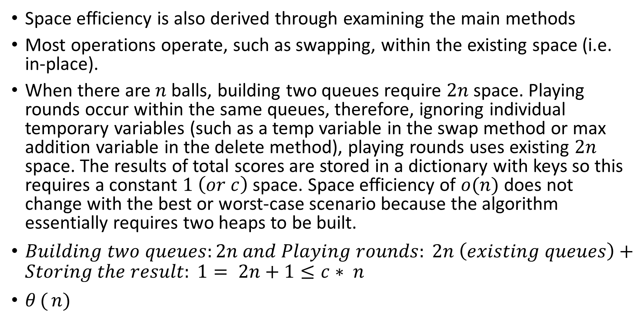
Space efficiency
Space efficiency is also derived through examining the main methods
Most operations operate, such as swapping, within the existing space (i.e. in-place).
When there are $n$ balls, building two queues require $2n$ space. Playing rounds occur within the same queues, therefore, ignoring individual temporary variables (such as a temp variable in the swap method or max addition variable in the delete method), playing rounds uses existing $2n$ space. The results of total scores are stored in a dictionary with keys so this requires a constant $1 \left(or c\right)$ space. Space efficiency of $o(n)$ does not change with the best or worst-case scenario because the algorithm essentially requires two heaps to be built.
$Building two queues:2n and Playing rounds: 2n \left(existing queues\right)+Storing the result: 1= 2n+1≤c∗ n$
$θ({n})$

