Slide 1
Compiler Principle Presentation
Group 2
Presenter 尤锦江

Slide 2
Preface: what we have implemented
C-Compiler
Detect comments: //, /**/
Detect escape characters: “\””, ‘\n’, “123\t\n\0abc”

Slide 3
Preface: what we have implemented
Supported statements:
if, for, while, do-while, switch-case,
break, continue, return, statement-block
variable declaration (with optional initializer);
function declaration/definition;
type definition (typedef).

Slide 4
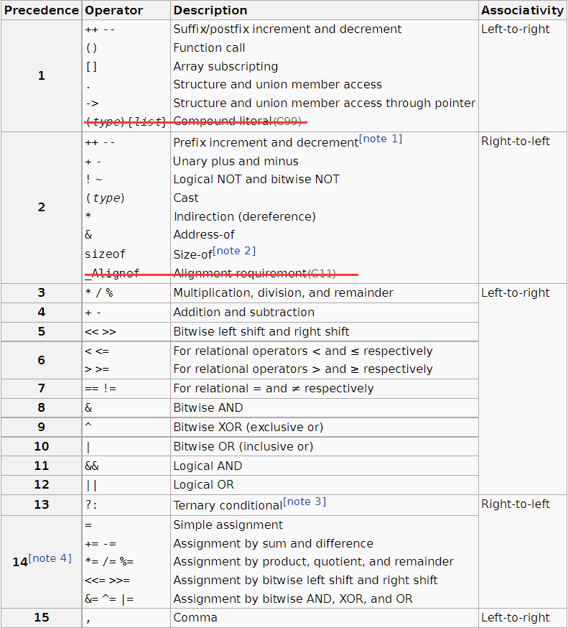
Preface: what we have implemented
Supported expressions:
All expressions in C, except for
Compound literal (C99),
Alignment requirement (C11).

Slide 5
Preface: what we have implemented
Supported types:
void, bool, char, short, char, int, long, float, double
struct, enum, union, array
user-defined type
Recursive struct / union
typedef struct {
union{
struct {double x, y, z;} Point;
struct {char r, g, b, a;} Color;
};
Node ptr Next;
} Node;

Slide 6
Preface: what we have implemented
Type cast and type upgrade:
int / float
float + double
pointer + int
int = double
(void*)&a
etc.
Left-values and right-values
*p <<= (c ? a : b)[3] = st->x += sizeof(double array(5));

Slide 7
Preface: what we have implemented
Variable Arguments
Link to C standard library
As long as you declare them before using them:
double sum(int n, ...);
double avg(int n, ...);
int printf(char ptr, ...);
int scanf(char ptr, ...);
void ptr malloc(long);
void free(void ptr);

Slide 8
Preface: what we have implemented
Multi-level symbol table
Compiler optimization
-O0, -O1, -O2, -O3, -Os, -Oz
int i;
typedef int MyType;
int main(int argc, char array() argv){
int i;
typedef double MyType;
for (int i = 0; i < 10; i++){
int i;
while (true)
int i;
}
}

Slide 9
Grammar specification
We modify the syntax of C language a little bit:
1、Pointer types should be declared using "ptr" instead of "*":
Why？
//C
int * p, * q;
//Our language
int ptr p, q;
a * b;
typedef int a;
a * b;

Slide 10
Grammar specification
We modify the syntax of C language a little bit:
2、Array types should be declared using “array()” instead of “[]”:
Why？
//C
int* a[20];
int (*a)[20];
//Our language
int ptr array(20) a;
int array(20) ptr a;

Slide 11
Key Designing Issues: implement struct types
Struct types in LLVM-IR don’t have field names:
To access elements inside a struct, indices instead of names be provided:
//C
typedef struct {int x; double y; bool z;} MyType;
//LLVM-IR
%struct.MyType = type { i32, double, i8 }
//C
a.y = 2.0
//LLVM-IR
store double 2.0, double* getelementptr (%struct.MyType, %struct.MyType* @a, i32 0, i32 1)

Slide 12
Key Designing Issues: implement struct types
Solution 1: Create a mapping from variable names to their struct field names:
Problem: "a" is an entry in the map. However, "a.x" is not in the map
using FieldNames = std::vector<std::string>;
std::map<std::string, FieldNames> Map;
struct{
struct{
int x, y;
} x, y;
} a;
a.x.y;

Slide 13
Key Designing Issues: implement struct types
Solution 2: create a mapping from “llvm::StructType*” to their struct field names:
Potential Problem: What will happen if one "llvm::StructType* " instance maps to several "FieldNames"?
using FieldNames = std::vector<std::string>;
std::map<llvm::StructType*, FieldNames> Map;

Slide 14
Key Designing Issues: implement struct types
Solution: Name-Equivalence
Use identified structure (instead of literal structure) in LLVM-IR
Every "llvm::StructType* " is unique.
So given a "llvm::StructType* " instance, we can always find a unique "FieldNames" instance.
struct {int x; int y;} a, b;
struct {int m; int n;} c;
struct {int x; int y;} d;
a=b; //OK
a=c; //Error!
a=d; //Error!

Slide 15
Key Designing Issues: implement union types
the IR generated by Clang:
So, union types can be implemented by struct types
When referred / dereferred, do pointer bitcast instead of getelementptr
//C
typedef union {int x; double y; char z;} MyType;
//LLVM-IR
%union.MyType = type { double }

Slide 16
Key Designing Issues: implement union types
Union members should be accessed by their names. To address this problem, we can adopt the same method:
using FieldNames = std::vector<std::string>;
std::map<llvm::StructType*, FieldNames> StructMap;
std::map<llvm::StructType*, FieldNames> UnionMap;

Slide 17
Key Designing Issues: Array Arguments
the IR generated by Clang:
when defining a function with array arguments, array types should be converted to element pointers.
//C
int quicksort(int arr[]);
//LLVM-IR
declare void @quicksort(i32* %0)
//C
void ReadMatrix(int Mat[4][4]);
//LLVM-IR
declare void @ReadMatrix([4 x i32]* %0)

Slide 18
Key Designing Issues: Left Values vs Right Values
LLVM-IR doesn't have concepts of "left-value" or "right-value“.
Defining a global variable: use "new llvm::GlobalVariable", you will get a "llvm::GlobalVariable* " instance.
Defining a local variable: call "IRBuilder::CreateAlloca", you will get a "llvm::AllocaInst* " instance.
In both case, they are pointers pointing to memory locations.

Slide 19
Key Designing Issues: Left Values vs Right Values
So, we can use pointers to implement "right-value" in C language.
For example:
As right values, "a" is an integer, "b" is a float pointer.
As left values, "a" is an integer pointer, "b" is a float-pointer pointer.
int a;
float ptr b;

Slide 20
Key Designing Issues: Left Values vs Right Values
Problem:
What's the return value of "llvm::Value* CodeGen(CodeGenerator&)"?
A left value? A right value?
Solution:
llvm::Value* CodeGen(CodeGenerator&); //return a right-value
llvm::Value* CodeGenPtr(CodeGenerator&); //return a left-value

Slide 21
Key Designing Issues: Right Value Expression
Most expressions only return right values,
e.g. "+", "-", "*", "/", "%", "<<", ">>", "sizeof", typecast, function call.
llvm::Value* CodeGen(CodeGenerator&){ //return a right-value
...//Calculate the right value
return Val;
}
llvm::Value* CodeGenPtr(CodeGenerator&){//return a left-value
throw std::exception;
}

Slide 22
Key Designing Issues: Left Value Expression
E.g. Indirection operator "*p". Array subscription "a[2]".
Reference operator "a.x". Dereference operator "a->x".
llvm::Value* CodeGen(CodeGenerator& Gen){ //return a right-value
return CreateLoad(this->CodeGenPtr(Gen));
}
llvm::Value* CodeGenPtr(CodeGenerator& Gen){//return a left-value
...//Calculate the left value;
return Ptr;
}

Slide 23
Key Designing Issues: Special Expression
Ternary condition expression " ? : " can return a left value,
if and only if the later two operands have the same type, and can both be left values:
int a, b; float c, d; bool t;
(t ? a : 1); //Right value
(t ? a : b); //Left value
(t ? b : c); //Right value
(t ? a : (float)b); //Right value

Slide 24
Key Designing Issues: Special Expression
Comma expression can return a left value, if and only if the last operand can return a left value.
int a, b; float c, d;
1, 2, d, 4, a; //Left value
1, 2, a, c, 5; //Right value
a, b, c, a, (double)d; //Right value

Slide 25
Key Designing Issues: Sizeof() Operator
"sizeof()" can cause reduction-reduction conflict.
For example:
{
typedef int a;
sizeof(a); //"sizeof" "(" Type ")"
}
{
int a;
sizeof(a); //"sizeof" "(" Expr ")"
}

Slide 26
Key Designing Issues: Sizeof() Operator
So, we modify our CFG:
The parser cannot determine whether "IDENTIFIER" is a type name or a variable name.
The code generator will deal with it.
Expr: //Deprecated: "sizeof" "(" Type ")"
"sizeof" "(" IDENTIFIER ")" %prec HIGH
"sizeof" "(" Expr ")" %prec LOW
...//Other
;

Slide 27
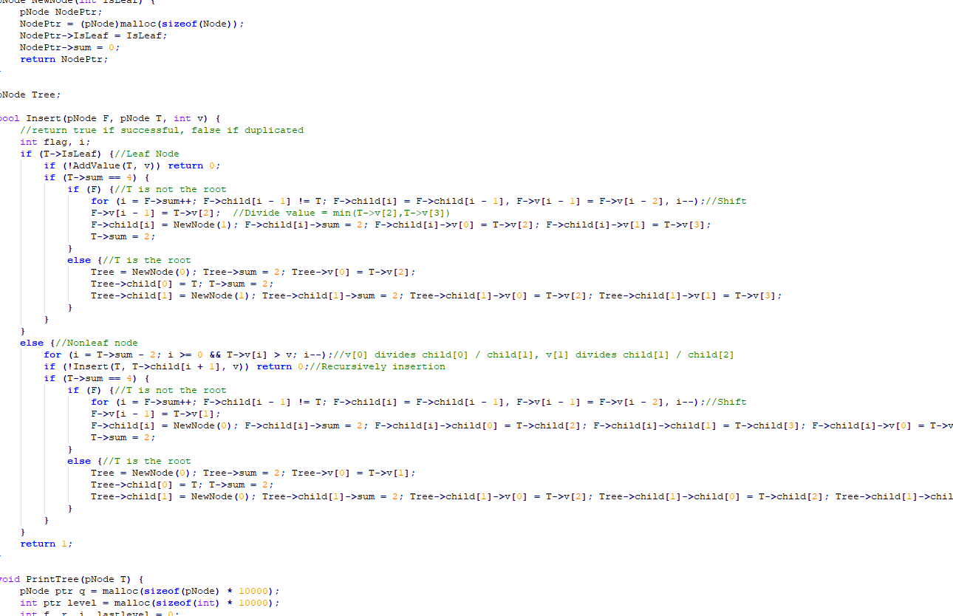
Test Case
B+ tree

Slide 28
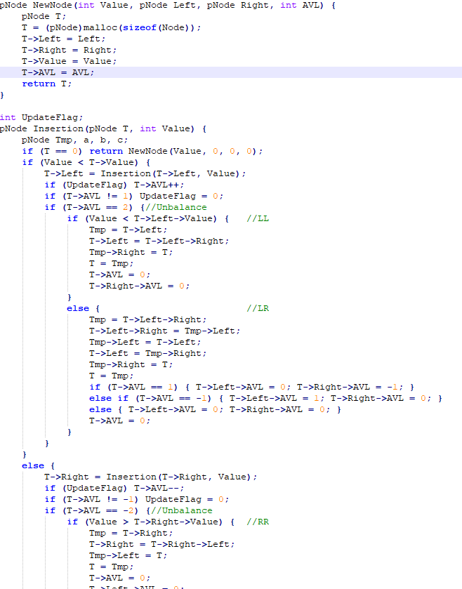
Test Case
AVL tree

