Slide 1
Introduction to Spark and Pyspark
Elika Bozorgi, Aida Farhadi, Alireza Vaezi

Slide 2
Intro
Most of the times, the amount of the data we’re working with is too big; that needs to be implemented and processed on different machines. So, we need Functional code that can be distributed across entire cluster of computers.
Before development of Spark, this job was done by Hadoop.

Slide 3

Why do we need to learn about Spark and Pyspark?

Slide 4
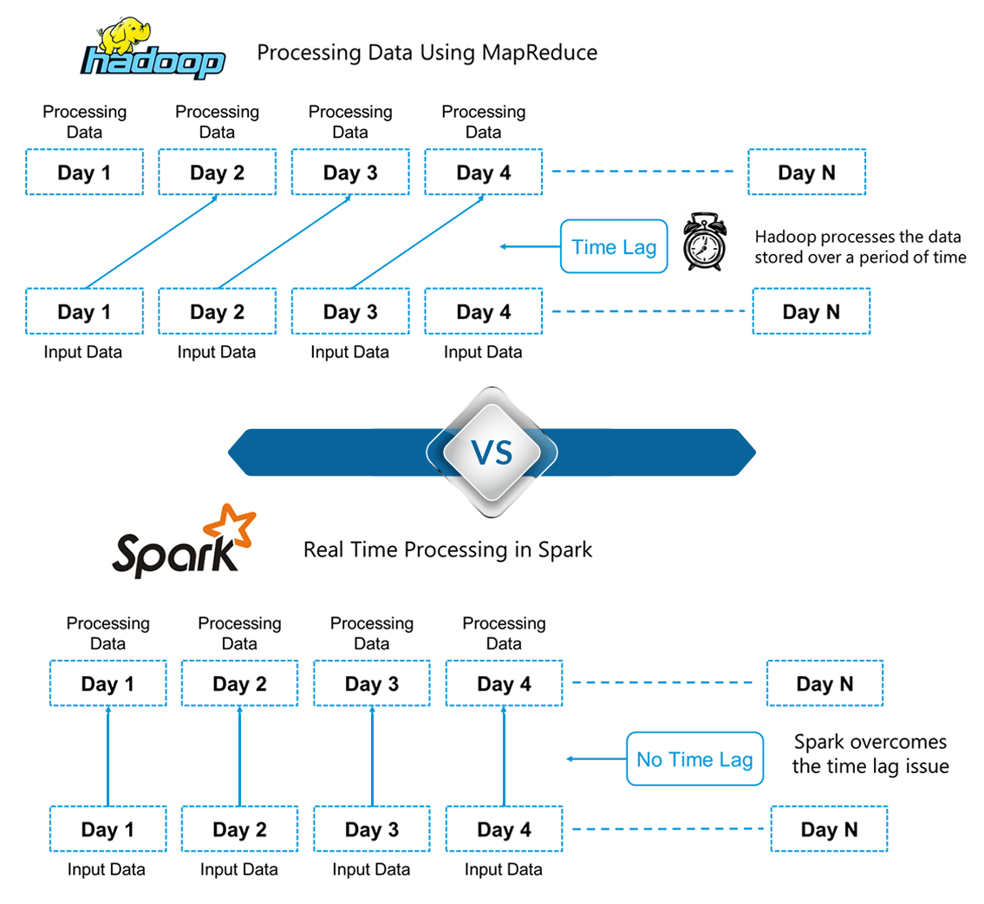
Shortcomings of Hadoop:

Slide 5
What is functional programming?
A paradigm that lets you take your code and have it run on several CPUs or even entirely different machines.
The core idea of functional programming is that data should be manipulated by functions without maintaining any external state.
Another common idea in functional programming is anonymous functions.

Slide 6
Features:
First class functions: Functions can be assigned to variables or be passed into other functions
Statelessness: A stateless function has no knowledge of the past
Laziness: Work is only done on demand
Immutable: Data should never change

Slide 7
Why Spark?
Spark
Pandas: Not quick enough, not distributed
Hadoop: Not fast (Read/write on disk, spark does it on RAM)
DasK: No library for graph processing
Pandas
Hadoop
Dask
Notes:
Pandas: perfect for tabular data. Can handle thousands of data? Pandas can not process data quickly enough. Pandas is not a distributed system.
Hadoop: is a distributed cluster. And runs on disk. Until couple of years ago, hadoop was the big data platform. Has a computes system called mapreduce and storage system called hdfs.line azure, google cloud storage or aws that have these integrated systems.HDFS splits data in blocks and replicated in several machines. So when one machine crash, others are helpful. Spark may be up to 100 times faster(because it runs on memory and the number of reading and writing on memory is reduced) Hadoop need more disk, spark need more ram.
Dask: spark has its own API to do sql. Dask has pandas API and does not support sql. Spark has graphx library for graph processing but dask does not have it.

Slide 8
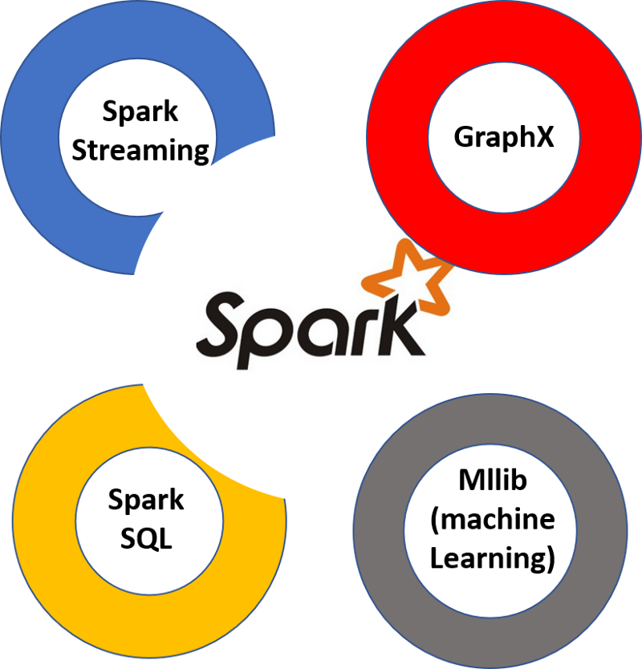
Spark: Unified analytics engine for large scale data processing
Developed by UC Barkely’s AMPLab, later donated to Apache Software Foundation
Spark is written in Scala and runs on Java Virtual Machine
Spark has built-in components for processing streaming data, machine learning, graph processing, and even interacting with data via SQL.
Spark can be accessed using Scala, Java, Python, R or SQL
Spark can be used on large clusters or a single machine

Slide 9
How to access all that functionality with Python?
With PySpark!
You can think of PySpark as a Python-based wrapper on top of the Scala API
Another way to think of PySpark is a library that allows processing large amounts of data on a single machine or a cluster of machines.
PySpark communicates with the Spark Scala-based API via the Py4J library.

Slide 10
Environments:
Self Hosted: You can set up a cluster yourself using bare metal machines or virtual machines.
Cloud Providers: Most cloud providers offer Spark clusters: AWS has EMR and GCP has DataProc
Vendor Solutions: Companies including Databricks and Cloudera provide Spark solutions, making it easy to get up and running with Spark.

Slide 11
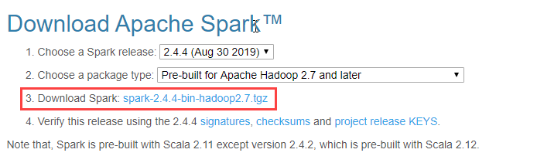
Spark Installation and Configuration:
Prerequisites: Anaconda, Java 7+, GOW (optional for windows)
Download spark: “https://www.apache.org/dyn/closer.lua/spark/spark-2.4.4/spark-2.4.4-bin-hadoop2.7.tgz” And unzip the file to a desired destination

Slide 12
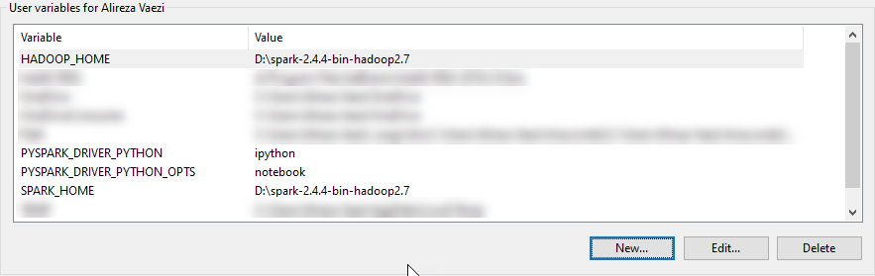
Spark Installation and Configuration:
**For Windows users**
Add entries to Environment Variables: $ setx SPARK_HOME C:\location\on\disk\spark-2.1.0-bin-hadoop2.7 $ setx HADOOP_HOME C:\location\on\disk\spark-2.1.0-bin-hadoop2.7 $ setx PYSPARK_DRIVER_PYTHON ipython $ setx PYSPARK_DRIVER_PYTHON_OPTS notebook
Add C:\location\on\disk\spark-2.1.0-bin-hadoop2.7\bin to PATH.

Slide 13
Spark Installation and Configuration:
**For Linux users**
Tell your bash where to find Spark by adding these to ~/.bashrc export SPARK_HOME=/opt/spark export PATH=$SPARK_HOME/bin:$PATH
Install Jupyter: $ pip install jupyter
Configure PySpark driver export PYSPARK_DRIVER_PYTHON=jupyter export PYSPARK_DRIVER_PYTHON_OPTS='notebook'
FindSpark package $ pip install findspark $ jupyter notebook

Slide 14
Spark Installation and Configuration:
**For Mac users**
Edit .bash_profile and add the following: export SPARK_PATH=~/spark-1.6.0-bin-hadoop2.6 export PYSPARK_DRIVER_PYTHON="jupyter" export PYSPARK_DRIVER_PYTHON_OPTS="notebook" #For python 3, You have to add the line below or you will get an error # export PYSPARK_PYTHON=python3 alias snotebook='$SPARK_PATH/bin/pyspark --master local[2]’
Run: $ source .bash_profile

Slide 15
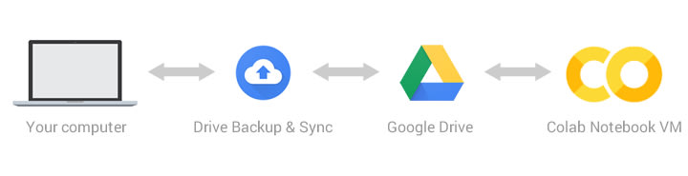
PySpark on Google Colab:
Why Google Colab?
Based on Jupyter notebook
No need to install anything locally
Powerful resources (e.g. GPU)
Notes:
Google has done the coolest thing ever by providing a free cloud service based on Jupyter Notebooks that supports free 12GB-RAM GPU!

Slide 16
Setup and configuration on Google Colab
Open a new python 3 notebook in Colab and run:
!apt-get update
!apt-get install openjdk-8-jdk-headless -qq > /dev/null
!wget -q http://us.mirrors.quenda.co/apache/spark/spark-2.4.4/spark-2.4.4-bin-hadoop2.7.tgz
!tar xf spark-2.3.1-bin-hadoop2.7.tgz
!pip install -q findspark

Slide 17
Big Data analytics
Hadoop is the standard tool for distributed computing across really large data sets
Two ideas from Google in 2003 and 2004 made Hadoop possible:
A framework for distributed storage (The Google File System), which is implemented as HDFS in Hadoop
A framework for distributed computing (MapReduce)
MapReduce requires data to be serialized to disk between each step, which means that the I/O cost of a MapReduce job is high, making interactive analysis and iterative algorithms very expensive.
Spark uses in-memory caching to improve performance and, therefore, is fast enough to allow for interactive analysis. Most machine learning and optimization algorithms are iterative, making Spark an extremely effective tool for data science.
Notes:
Notably, programming MapReduce is difficult. You have to chain Map and Reduce tasks together in multiple steps for most analytics. This has resulted in specialized systems for performing SQL-like computations or machine learning. Worse, MapReduce requires data to be serialized to disk between each step, which means that the I/O cost of a MapReduce job is high, making interactive analysis and iterative algorithms very expensive.
Caching also improves the performance of iterative algorithms, which makes it great for data theoretic tasks, especially machine learning.

Slide 18
PySpark implementation
SparkSession
import pyspark
from pyspark.sql import SparkSession
spark = SparkSession.builder.getOrCreate()
SparkContext
import findspark
findspark.init()
from pyspark import SparkContext
sc = SparkContext.getOrCreate()
Notes:
Spark session provides a way to interact with various spark's functionality with a lesser number of constructs. Instead of having a spark context, hive context, SQL context, now all of it is encapsulated in a Spark session.
In order to use APIs of SQL, HIVE, and Streaming, no need to create separate contexts as sparkSession includes all the APIs.

Slide 19
APIs
DataFrame
Easy to work with!
High level API
DataFrame:Distributed collections of
objects type row ,structured data
Think of dataframe as an excel that can sit across multiple machines
RDD
All the codes running using dataframes compiles down to RDD
Low level API
Immutable partition of record that can be worked on parallel
Records are java, python , scala objects
Spark does not understand inner structure of records!!
Notes:
Head and take function return list
Limit returns dataframe
Show function prints data in nice format
resilient distributed datasets.transformations and actions on your unstructured data

Slide 20
Programming Spark
Define RDDs either through accessing data on disk (HDFS, Cassandra, HBase, Local Disk), parallelizing some collection in memory, transforming an existing RDD, or by caching or saving.
Invoke operations on the RDD by passing functions to each element of the RDD. Spark offers over 80 high level operators beyond Map and Reduce.
Use the resulting RDDs with actions (e.g. count, collect, save, etc.). Actions kick off the computing on the cluster.
The driver program creates one or more RDDs, applies operations to transform the RDD, then invokes some action on the transformed RDD.
Notes:
Code is written in a driver program which is lazily evaluated
Upon an action, the driver code is distributed across the cluster to be executed by workers on their partitions of the RDD
Results are then sent back to the driver for aggregation or compilation.
Broadcast variables are distributed to all workers, but are read-only. Broadcast variables can be used as lookup tables or stopword lists. Accumulators are variables that workers can “add” to using associative operations and are typically used as counters.

Slide 21
Transformation Actions
Return RDD
Such as:
Map: define a function and apply record by record
FlatMap:applies function to all elements RDDs and the flatten the result
Filter:returns new RDD. only elements that satisfy a condition
Returns another data type
Such as:
Reduce: we take neighbouring elements and produce a single combined result
Count: like dataframe allows to count number of rows in an RDD
Notes:
an RDD is simply a set of Java or Scala objects representing data.
When you’re working with Python, also make sure not to pass your data between DataFrame and RDD unnecessarily, as the serialization and deserialization of the data transfer is particularly expensive.
pretty much all the higher level APIs decompose to RDDs.

Slide 22
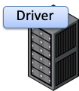


Spark Execution
The Spark context connects to cluster manager (e.g. YARN) to allocate system resources.
Each worker(driver) in the cluster is managed by an executor
The executor manages computation as well as storage and caching on each machine. It is in turn managed by the SparkContext
Each worker(driver) in the cluster is managed by an executor
Drivers are key participants in Spark jobs!
Notes:
Driver should be on the same network as the cluster. This is different from Hadoop code, where you might submit a job from anywhere to the JobTracker, which then handles the execution on the cluster.
Spark’s Standalone, Apache Mesos, and Hadoop YARN

Slide 23


Slide 24
References and helpful resources
Install Spark on Windows (PySpark) https://t.ly/9Z7n7 & https://t.ly/zP3VX & https://t.ly/knWe9
Install Spark on Mac (PySpark) https://t.ly/KJN9R
Get Started with PySpark and Jupyter Notebook in 3 Minutes (Linux) https://t.ly/3VzMb
PySpark in Google Colab https://t.ly/jnNGD
PySpark Tutorial-Learn to use Apache Spark with Python https://t.ly/AKydk
First Steps With PySpark and Big Data Processing https://t.ly/XN7V1
DataCamp – Introduction to PySpark https://t.ly/GOepB

