Slide 1
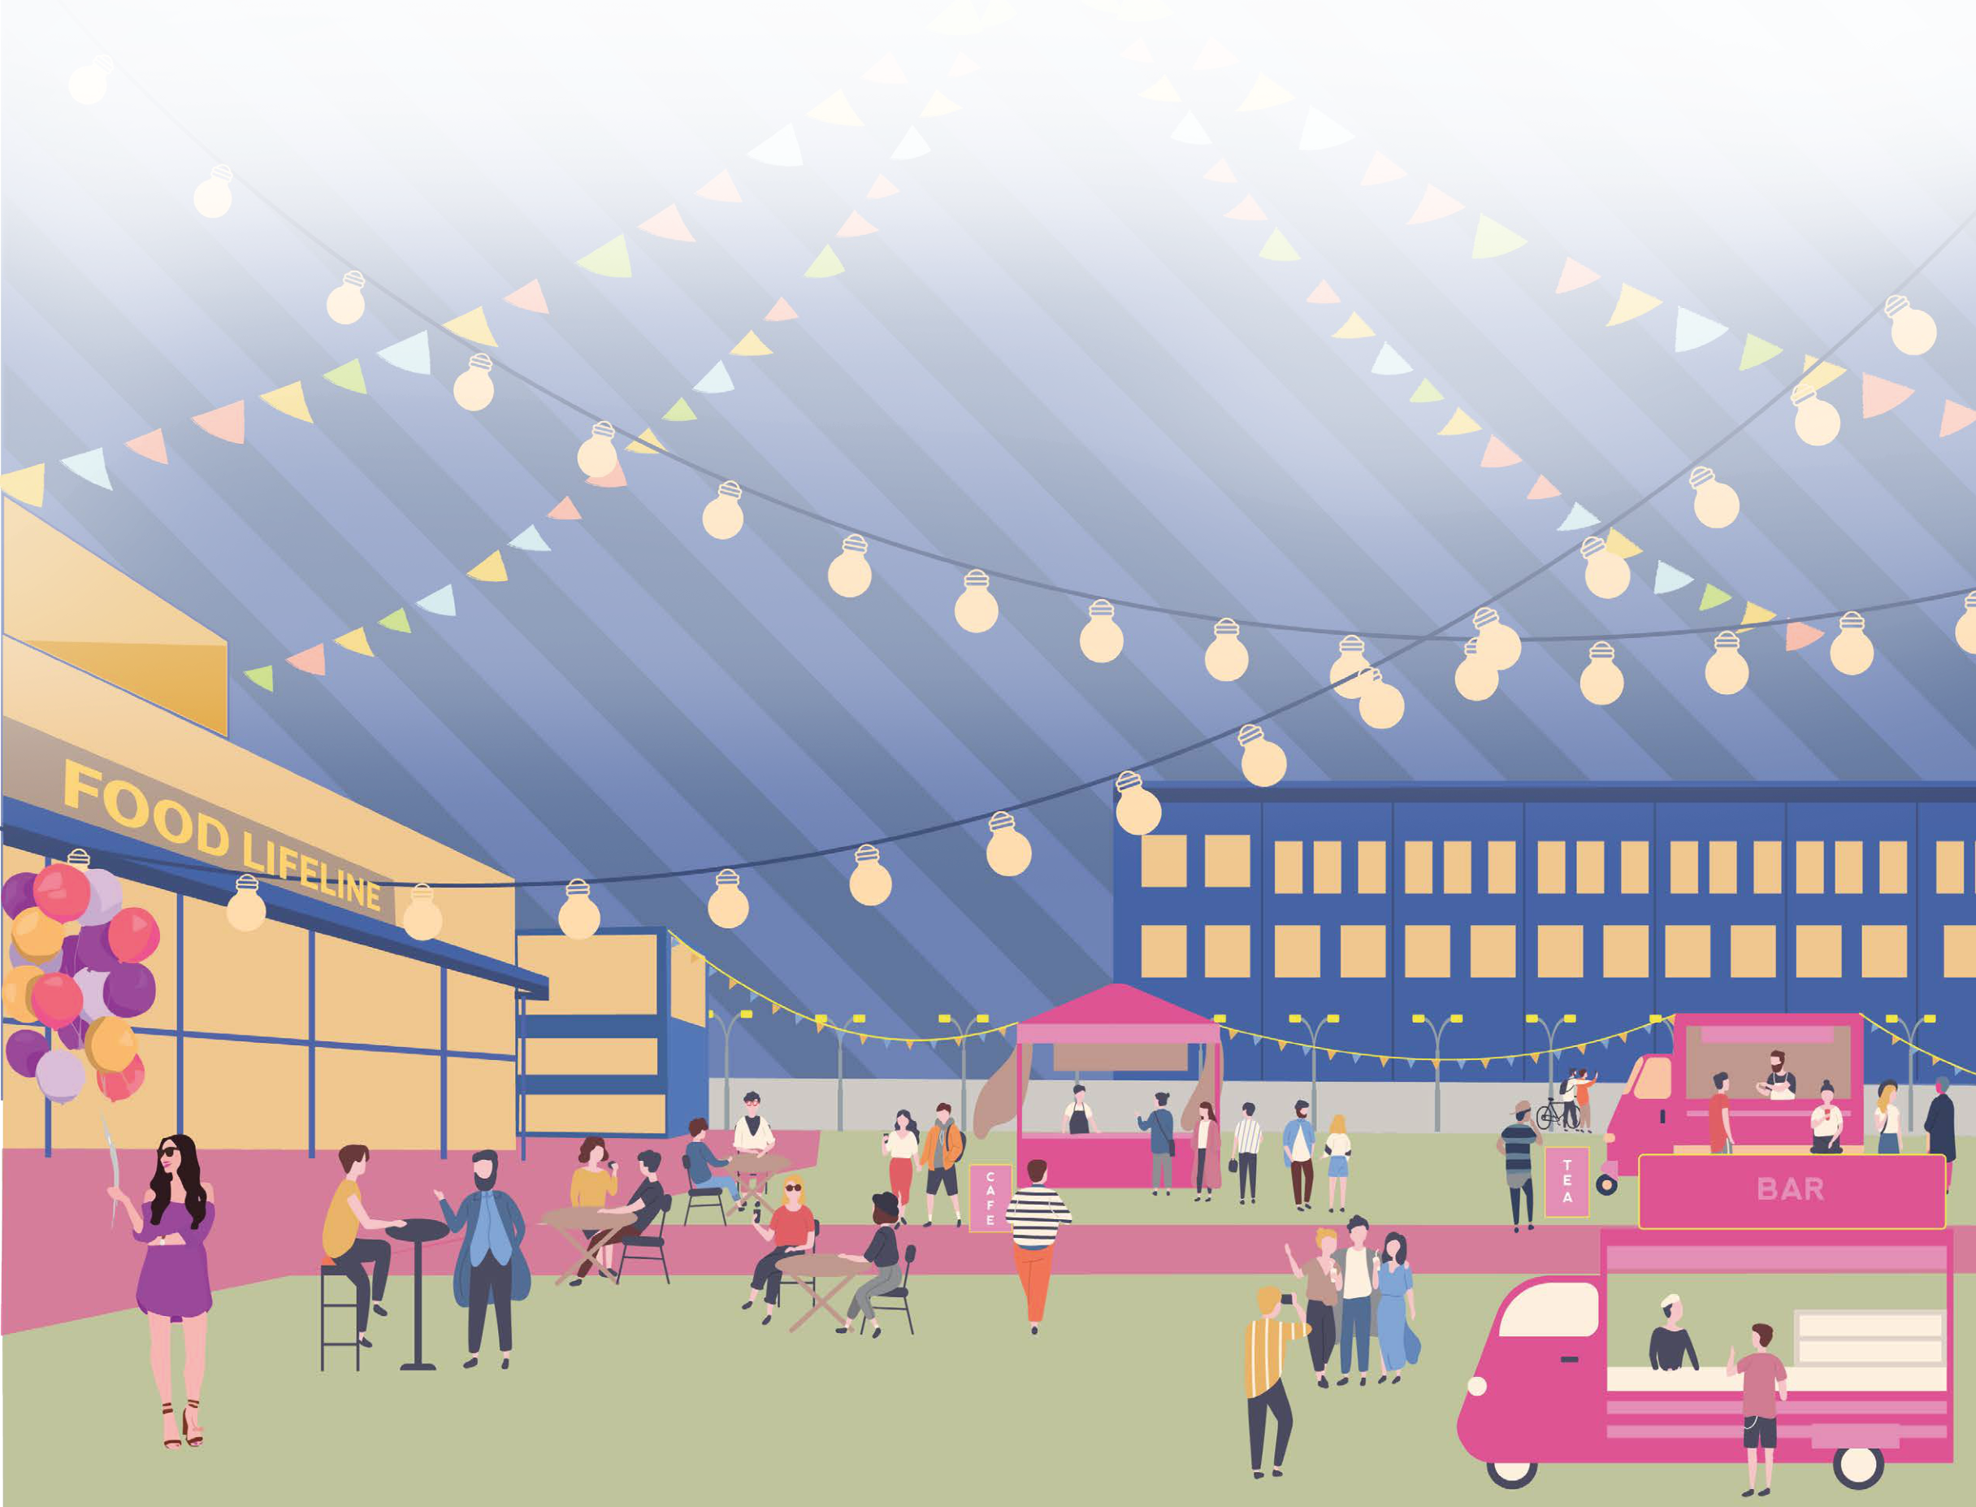
ACSP · CONFERENCE PRESENTATION
Unequal access
by design
Industrial zoning and spatial justice in
Seattle’s Lower Duwamish corridor
Yijun Zhang
MKSK
FOOD. CO. · Studio design scenario
Research diagnosis + FOOD. CO. studio proposal
Research: supplied ACSP abstract · Visual: studio PDF p. 1, design proposal
01
Notes:
I’m Yijun Zhang from MKSK. This presentation examines how industrial land use shapes access to urban and environmental resources in Seattle’s Lower Duwamish corridor. The research focuses on Georgetown and South Park, where residential life and industrial activity occupy the same landscape. The study period is approximately 2023 to 2025, based on presenter clarification. Its central argument is that land use decisions help organize residents’ everyday opportunities and constraints. I will explain the study’s approach and reported findings on zoning, mobility, public space, and income. I will introduce FOOD. CO., a separate studio proposal, as a possible design response, keeping research findings distinct from proposed interventions.

Slide 2
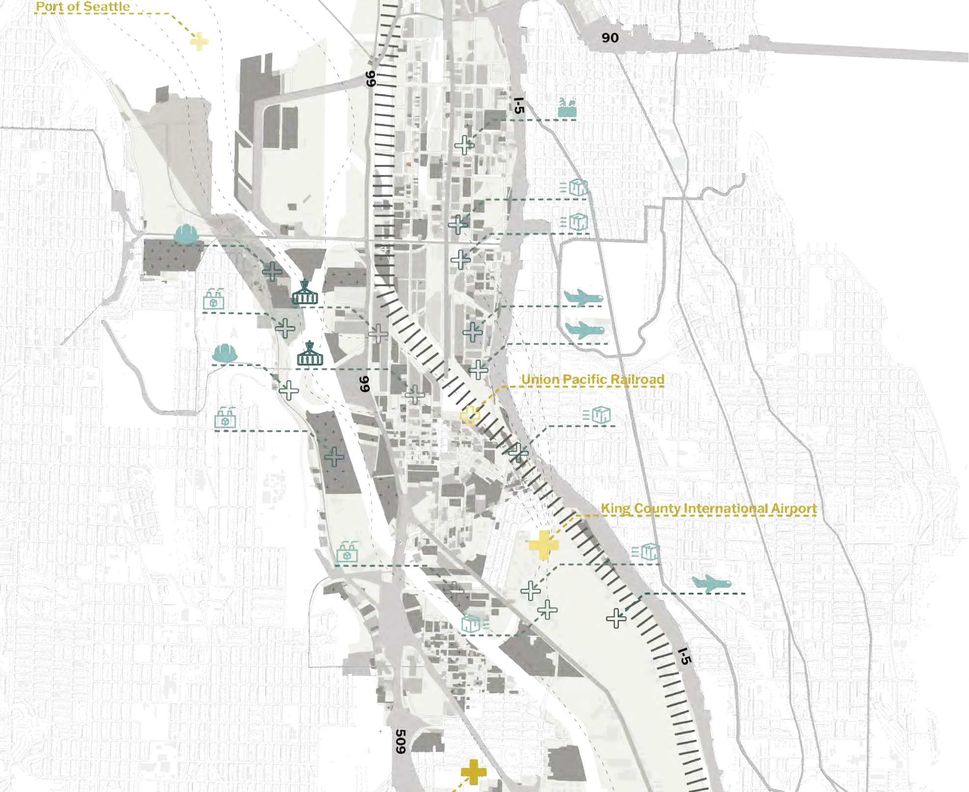
RESEARCH CONTEXT
Industry and everyday life share a corridor
Georgetown + South Park
Residential life alongside
manufacturing, maritime activity
and logistics
How do land-use decisions
shape everyday access?
Context: supplied ACSP abstract · Cropped logistics map: studio PDF p. 5
02
Notes:
Georgetown and South Park are long established neighborhoods within a corridor organized around manufacturing, maritime activity, and logistics. These functions connect Seattle to global systems, while residents depend on the same landscape for everyday movement, public space, and services. The abstract describes disproportionate environmental burdens and limited access to urban amenities in these communities. This creates an important planning question: how do land use arrangements distribute the benefits and costs of urban infrastructure? The setting brings environmental quality into the discussion of accessibility. Access includes the conditions under which people reach and use resources, alongside the presence of those resources on a map.

Slide 3
RESEARCH APPROACH
Read access through patterns and experience
Connect mapped patterns with community perspectives
01
02
03
Spatial patterns
Social conditions
Community input
GIS + municipal data
American Community Survey
Team–community workshop
Zoning
Public + environmental access
Household income
Socioeconomic context
Everyday mobility
Public space + participation
Approximate study period: 2023–2025
Exact dataset vintages, access measures and workshop details are not supplied.
Approach: ACSP abstract · Workshop and approximate period: presenter clarification
03
Notes:
The study connects spatial patterns with community perspectives. GIS analysis examines zoning, access to public and environmental resources, and socioeconomic conditions, drawing on municipal data and the American Community Survey. Community input came through a workshop between the project team and community. This adds a perspective on how mapped constraints relate to everyday mobility, environmental exposure, public space, and planning participation. The supplied abstract provides the research framework, while the presenter’s clarification identifies the workshop setting. It does not provide analytical measures, precise dataset vintages, or participant details. I therefore present this approach without adding methods or testimony that the materials do not document.

Slide 4
ABSTRACT · REPORTED FINDING
Industrial land dominates both neighborhoods
Land designated for maritime manufacturing and logistics
Georgetown
≈87%
South Park
≈61%
0%
50%
100%
A strong spatial concentration; the bars do not establish causation.
Approximate period: 2023–2025. Exact zoning vintage, boundaries and calculation are not supplied.
Source: supplied ACSP abstract · Percentages reproduced as approximate reported estimates
04
Notes:
The numerical finding is the concentration of land designated for maritime manufacturing and logistics. The abstract reports approximately eighty seven percent in Georgetown and approximately sixty one percent in South Park. These figures suggest that industrial designation occupies a substantial share of each neighborhood, with a higher reported concentration in Georgetown. They establish the spatial context for the study’s discussion of access. The abstract does not provide the data year, neighborhood boundaries, or denominator definitions, so these are reported estimates. The comparison identifies a pattern that merits examination alongside mobility, environmental resources, and community perspectives. It does not establish a causal relationship on its own.

Slide 5
ABSTRACT · REPORTED FINDINGS
Access constraints extend beyond zoning
Spatial concentration corresponds with several access constraints
PUBLIC SPACE
Limited public green space and environmental amenities
MOBILITY
Fragmented mobility networks
HOUSEHOLD RESOURCES
Median incomes below the King County average
Community perspectives describe persistent, structural constraints.
Source: supplied ACSP abstract · Community perspectives are paraphrased, not quoted
05
Notes:
The findings extend from industrial concentration to dimensions of everyday access. The abstract identifies limited public green space, fragmented mobility networks, and reduced environmental amenities. It also reports median household incomes below the King County average in both neighborhoods, without supplying the income amounts. The abstract summarizes community perspectives as describing persistent and structural conditions. The combined account places spatial constraints within a social context: resources, connections, and household circumstances influence opportunities together. For planning, this means that examining zoning alone offers an incomplete picture. The study’s contribution is to connect the organization of land with the experience of moving through and living within it.

Slide 6
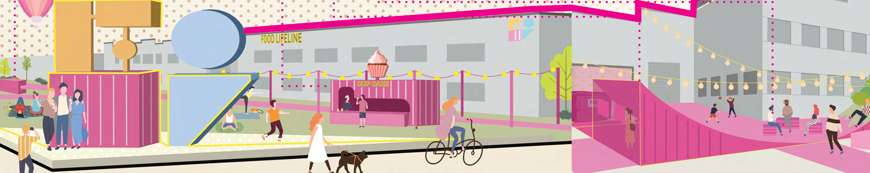
FOOD. CO. · DESIGN PROPOSAL
FOOD. CO.: a studio response to access
Community
Containers
Collaboration
Spaces for everyday use
Adapt existing logistics assets
Link organizations and services
Proposed public-space functions; no measured implementation outcomes.
Studio PDF pp. 1, 7, 11 · Su Li, Yijun Zhang, Yanrong Zheng · LARCH 507, Catherine de Almeida
06
Notes:
FOOD. CO. introduces a different kind of material: a landscape architecture studio proposal by Su Li, Yijun Zhang, and Yanrong Zheng, developed in LARCH 507 under Catherine de Almeida. Its organizing ideas are community, container reuse, and collaboration. The proposal adapts idle shipping containers into spaces and services associated with food distribution, food waste, mobility, and community activities. Food Lifeline provides a central site within this network. Here, the project illustrates how a design response can translate access concerns into specific spatial arrangements. Its drawings show proposed possibilities; the supplied material does not establish that these interventions were constructed or that their effects were evaluated.

Slide 7
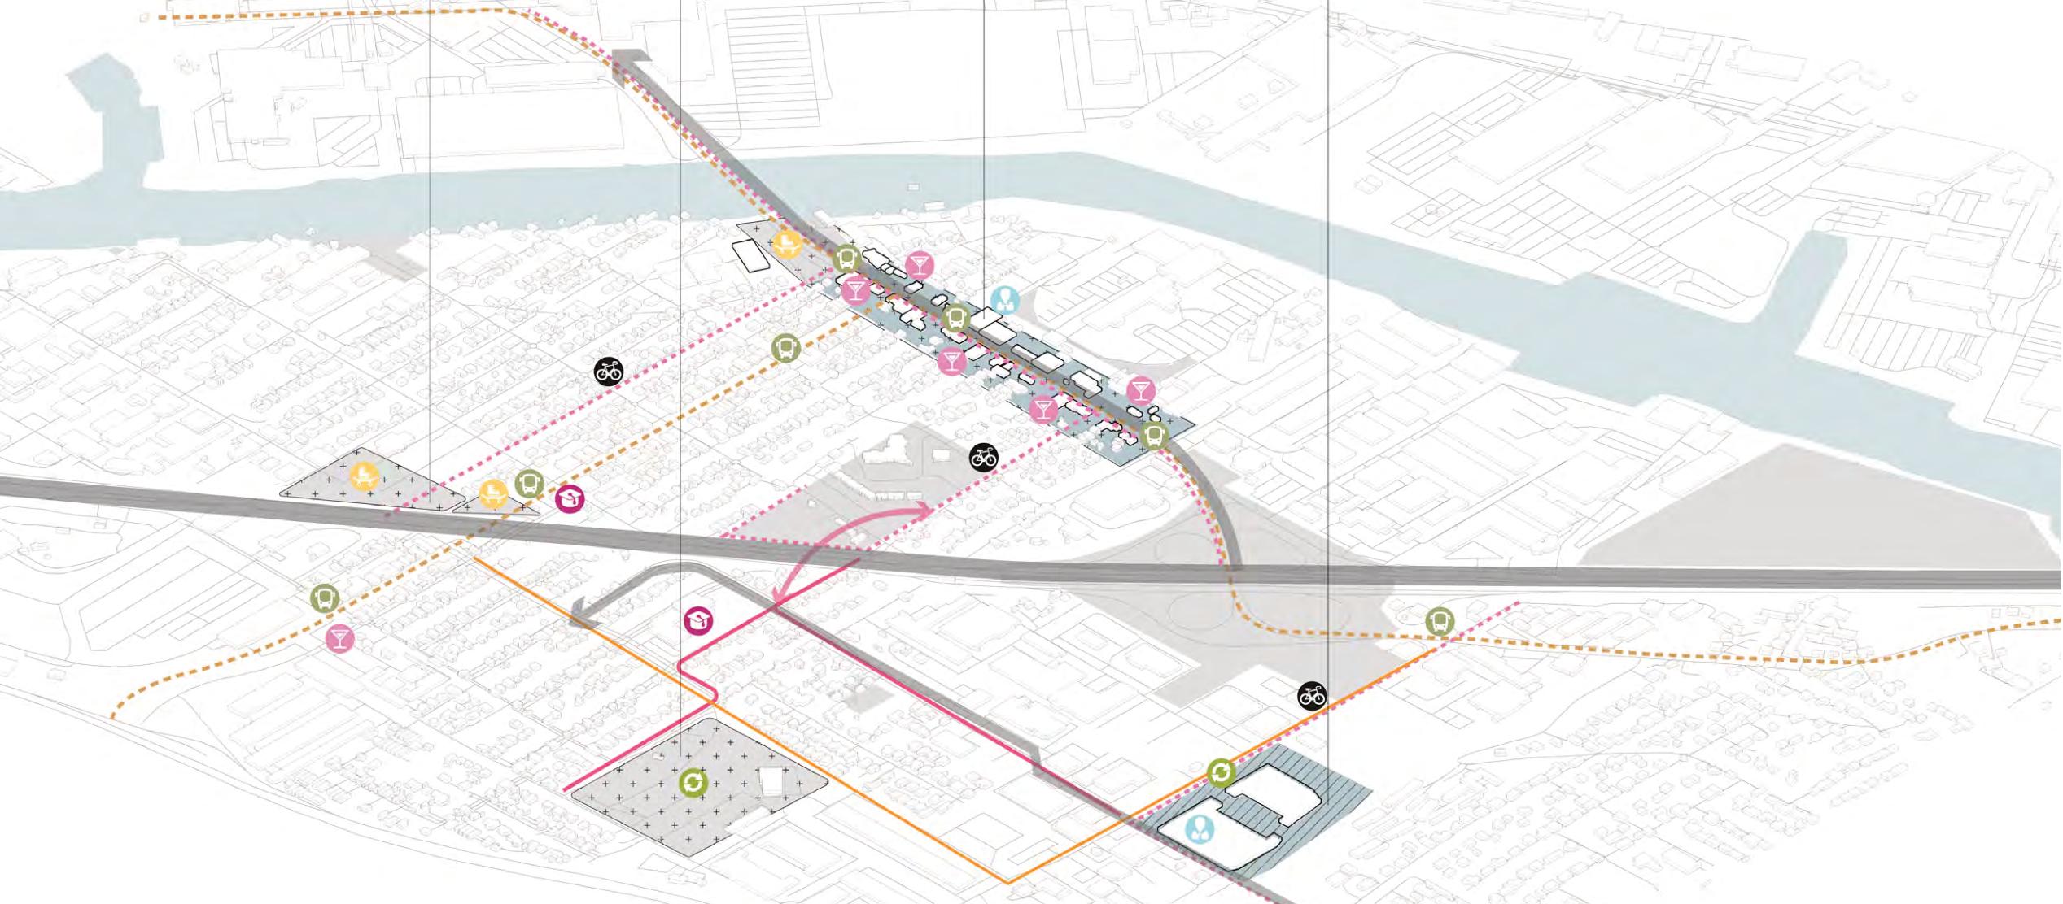
FOOD. CO. · DESIGN PROPOSAL
Connect four sites through shared services
South Park
Marra Farm
Duwamish River
Community Hub
Food Lifeline
Proposed community network: cropped studio PDF p. 9 · Routes shown are design scenarios
07
Notes:
The proposed network connects four sites: South Park, Marra Farm, the Duwamish River Community Hub, and Food Lifeline. Each contributes a different setting for community activity, food services, learning, or movement. The studio’s network drawing distributes container modules and proposed connections across these locations. The planning idea is to organize services across community places, allowing interventions to support a wider system. This shifts attention from one redesigned site to the relationships among sites. For the access argument, those relationships matter because useful destinations require workable connections. The diagram illustrates that intention, while the feasibility and everyday usefulness of the proposed routes remain questions for further testing.

Slide 8
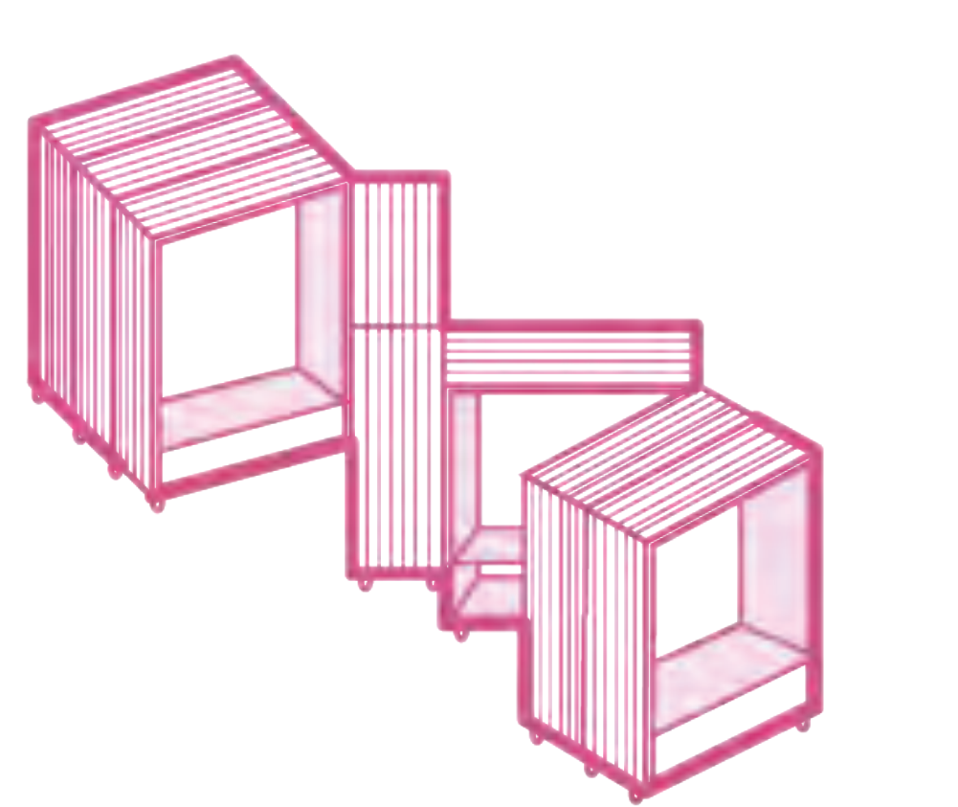
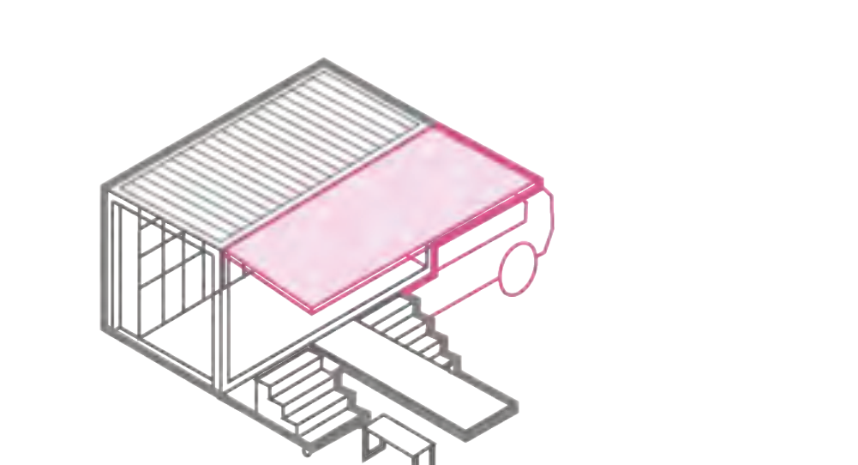

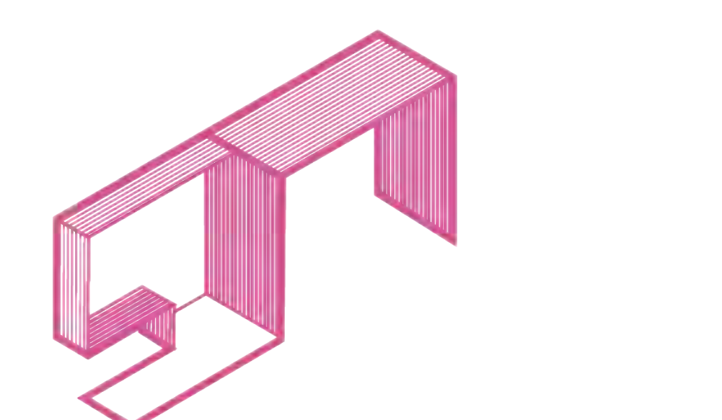
FOOD. CO. · DESIGN PROPOSAL
Adapt containers to different access needs
One design vocabulary, several community functions
Café bus
Collection module
Bus stop
Seating
Food service
Food-waste collection
Transit waiting
Shared space
Selected container modules: cropped studio PDF p. 8 · Functional intentions, not performance claims
08
Notes:
The studio develops a vocabulary of container adaptations rather than a single repeated building. Its module taxonomy includes a cafe bus, food collection facilities, bus stops, seating, and pavilions, among other functions. Containers can be opened, divided, combined, or given components to support different uses. This range allows the proposal to address several access needs through a shared design approach. In the proposal, collection points support food waste handling, bus stops support waiting and movement, and seating supports staying in public space. The drawings communicate functional possibilities. Choosing modules would require attention to the needs of each site, the people using it, and the organizations responsible for its operation.

Slide 9
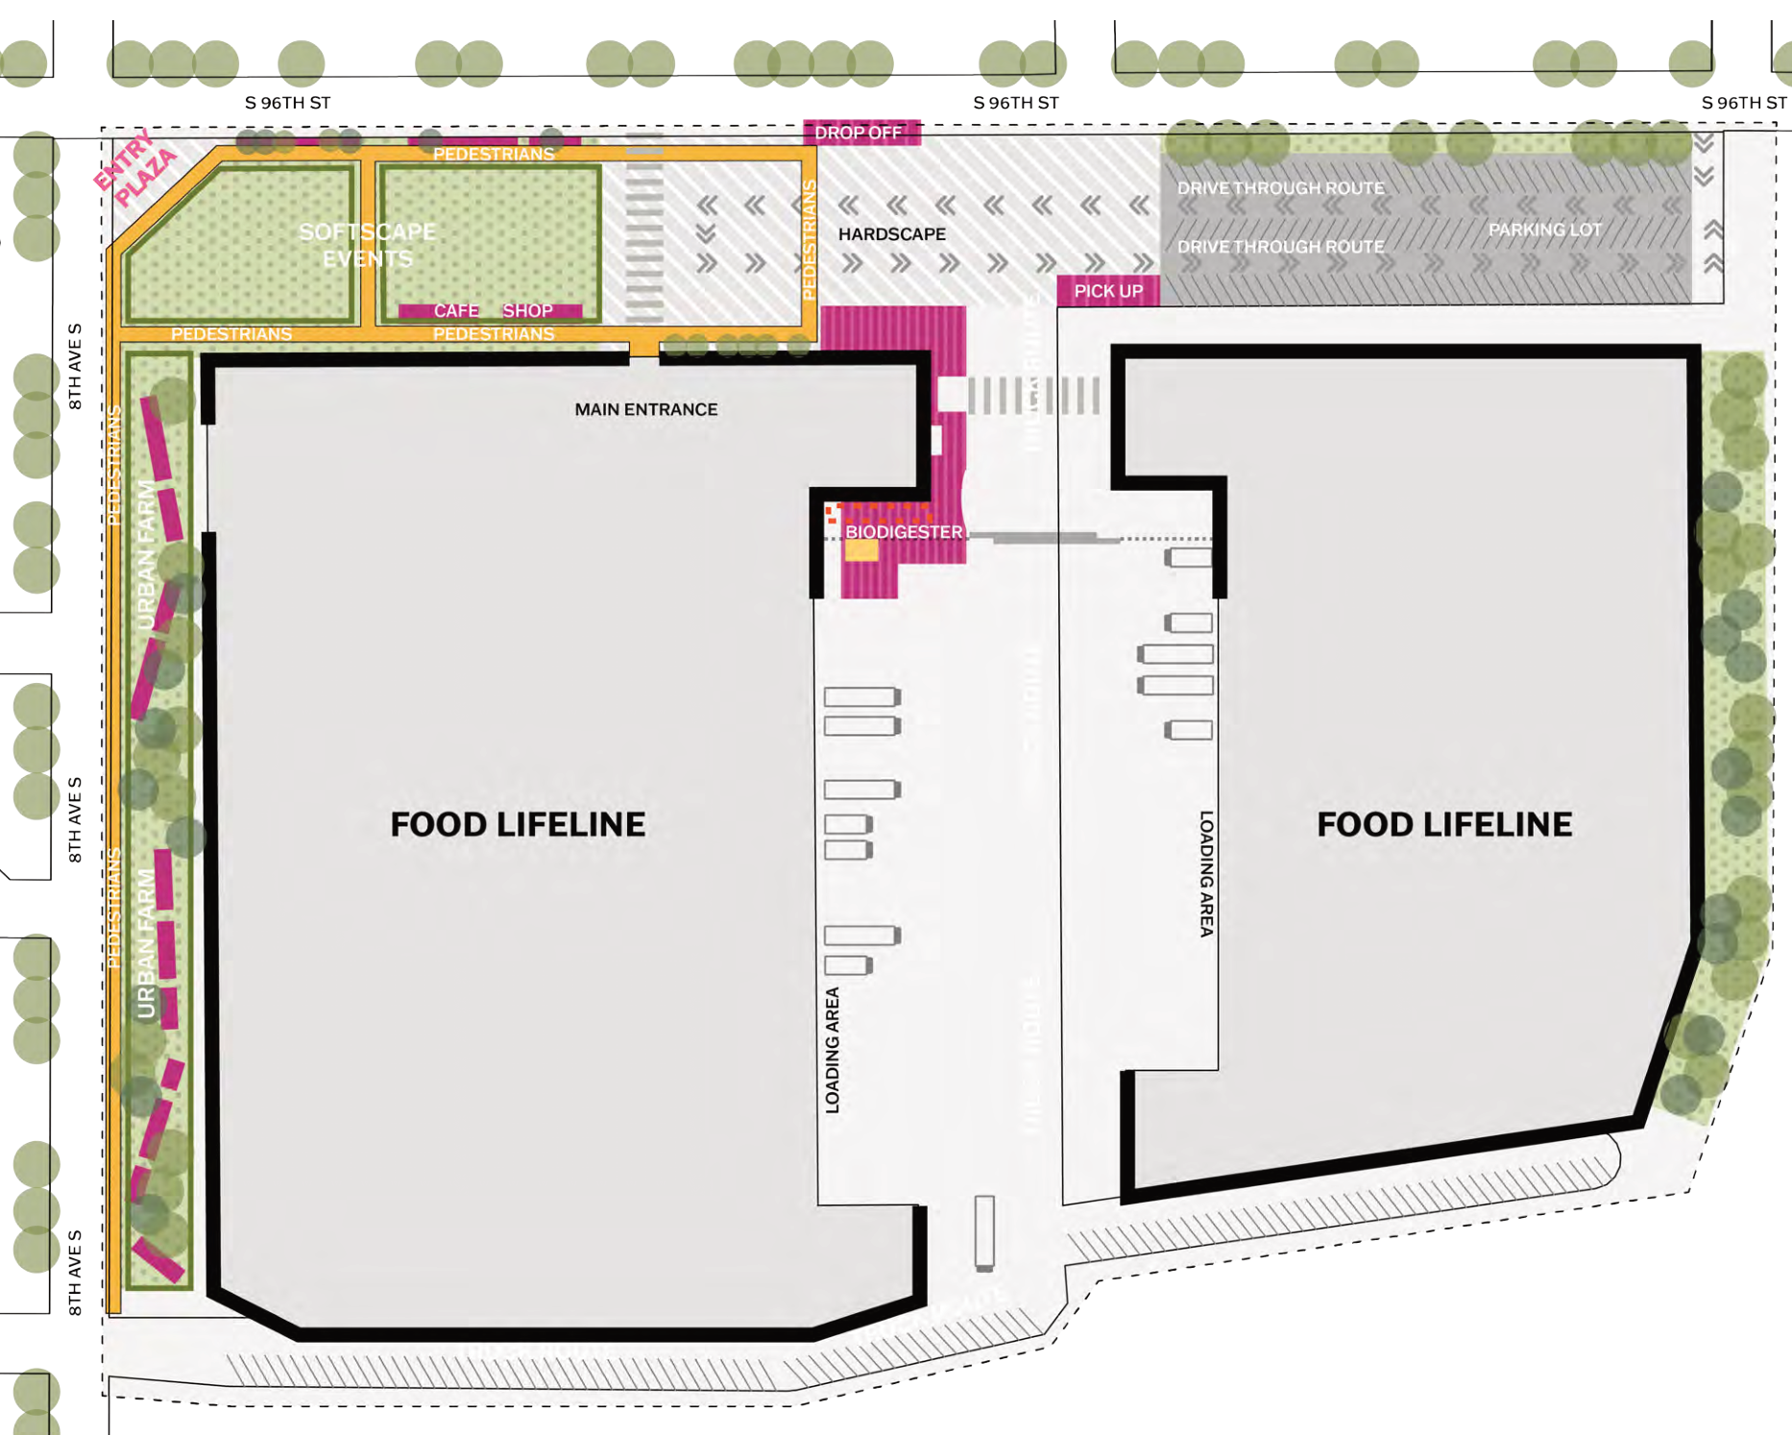
FOOD. CO. · DESIGN PROPOSAL
Make Food Lifeline’s edge a public interface
1
Entry plaza
1
Events + café
2
Pedestrian edge
Movement + urban farm
2
3
3
Loading areas
Retain operational functions
Operational compatibility and safe circulation need testing.
Proposed Food Lifeline plan: cropped studio PDF p. 10 · Callouts are presentation annotations
09
Notes:
At Food Lifeline, the proposal gives attention to the space around the buildings. The site plan introduces an entry plaza, pedestrian circulation, a cafe, and urban farm areas alongside loading and vehicle functions. Different drawings show arrangements for circulation, events, and a night market. The design intention is to create opportunities for public activity around a facility associated with food distribution. This makes the site edge an important interface between organizational operations and community use. The plan allows us to discuss how those functions might coexist spatially. It does not demonstrate operational compatibility, so access, loading, maintenance, and safe circulation would need assessment before implementation.

Slide 10
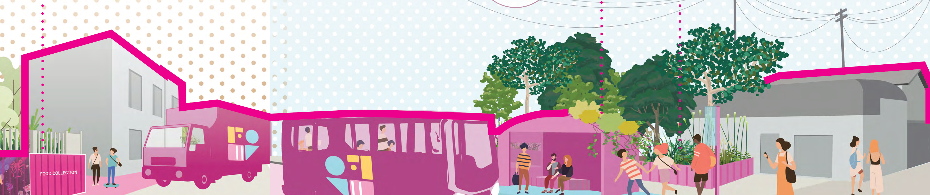
FOOD. CO. · DESIGN PROPOSAL
Bring mobility and food-waste collection together
Coordinate movement, collection and places to wait
Collection
Transit
Cycling
Food-waste collection points
Bio-bus concept + stops
Bike racks + pavilions
Proposed mobility and collection system: studio PDF p. 12 · No route, fuel or emissions performance is established
10
Notes:
The studio renderings combine proposed mobility services with food waste collection. They show collection containers, a bio bus concept, redesigned bus stops, and a bicycle system with racks and sheltered spaces. These elements suggest that community movement and resource collection could share a coordinated network. They also make the proposal’s experience visible: residents might encounter the system through a stop, a bicycle facility, or a collection point. The material supplies a design scenario rather than evidence about routes, fuel, energy production, or emissions. Its contribution here is to identify possible connections between services that planners and operators could investigate through more detailed technical and community assessment.

Slide 11
CONCLUSIONS · PLANNING IMPLICATIONS
Plan for access, then test the proposal
Make everyday access an explicit concern
in industrial land-use decisions.
NEXT VALIDATION
Verify baselines
Zoning, access measures and dataset vintages
Develop together
Residents, site organizations and transport operators
Test operation
Usefulness, safety, costs, maintenance and governance
Argument: supplied ACSP abstract · Design implications: studio PDF · Next steps are recommendations
11
Notes:
Taken together, the materials connect a diagnosis of uneven access with a proposal for reorganizing community services and spaces. The research argues that land use decisions shape access across industrial corridors. The studio translates related concerns into a network of specific interventions. A next step would be to verify the access baselines and develop the proposal with residents, site organizations, and transport operators. Testing should examine everyday usefulness, safe circulation, costs, maintenance, and governance. These are recommendations for advancing the proposal, rather than findings from an evaluation. The broader planning lesson is to make access an explicit concern when organizing industrial land, environmental resources, and public services.

Slide 12
SOURCES · EVIDENCE PROVENANCE
References
RESEARCH ABSTRACT
Author and date not stated. Unequal Access by Design: Industrial Zoning and Spatial Justice in Seattle’s Lower Duwamish Corridor.
Presenter-supplied conference abstract · ACSP.pdf, p. 1
STUDIO PROJECT + VISUALS
Li, Su; Zhang, Yijun; Zheng, Yanrong. n.d. FOOD. CO. LARCH 507 studio project, led by Catherine de Almeida.
Presenter-supplied portfolio · LARC507_SL_YZ_YZ.PDF.pdf, PDF pp. 1–12
Presenter clarification: Yijun Zhang, MKSK; approximate 2023–2025 period; team–community workshop.
Primary documents supplied by the presenter · No supplementary external data added
12
Notes:
The presentation draws on two supplied primary documents: the ACSP abstract, Unequal Access by Design, and the FOOD. CO. studio portfolio. The abstract supplies the research topic, stated analytical approach, zoning percentages, and qualitative findings. The portfolio supplies the community mapping, container modules, site plan, and proposed service network. Presenter clarification identifies approximate study dates of 2023 to 2025 and a workshop between the project team and community. These sources make different contributions, which have been kept distinct. The presentation connects the access argument with a design response, while preserving the limits of the supplied evidence and the work needed to test the proposal.

