Slide 1

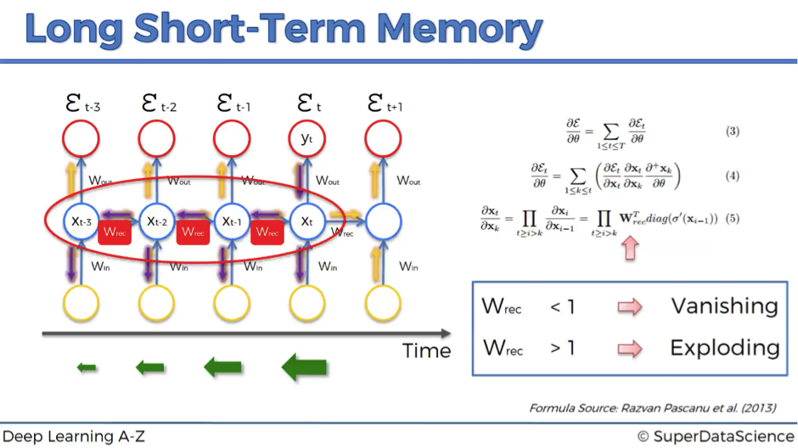
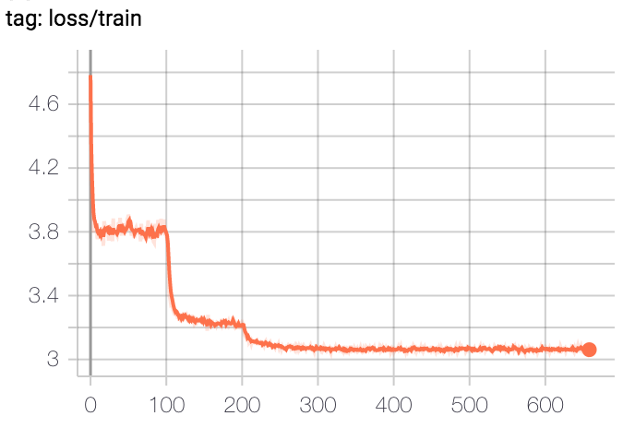
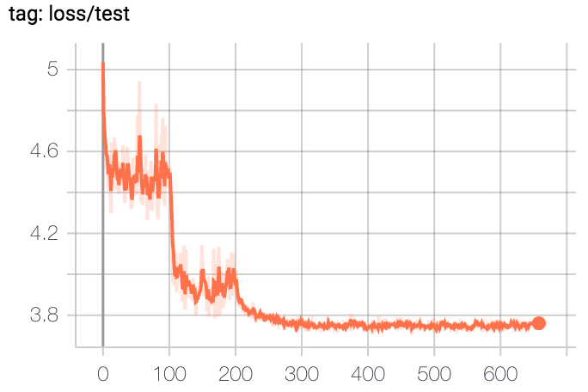
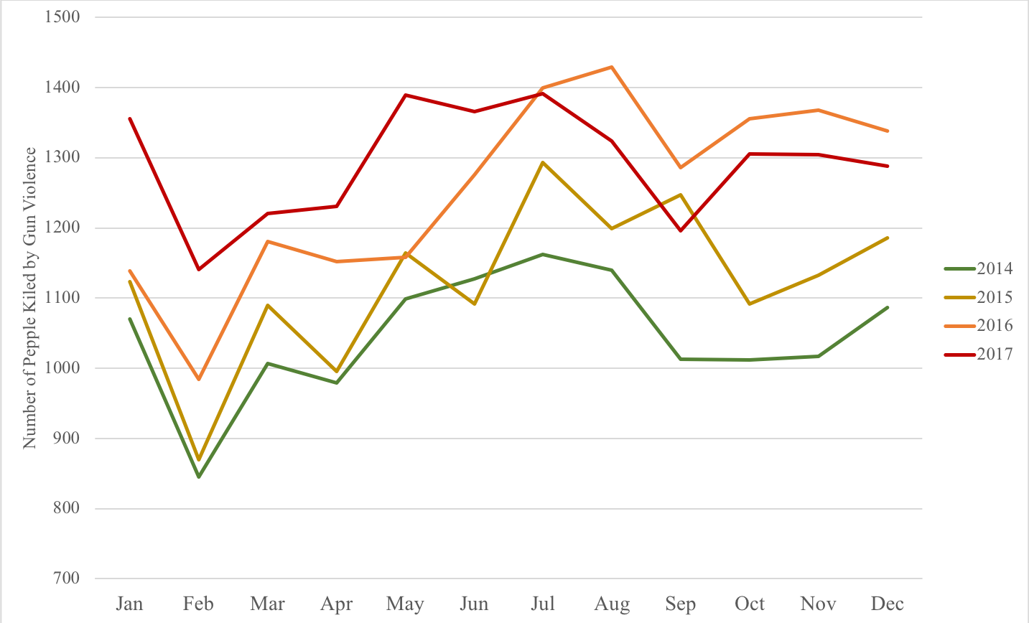
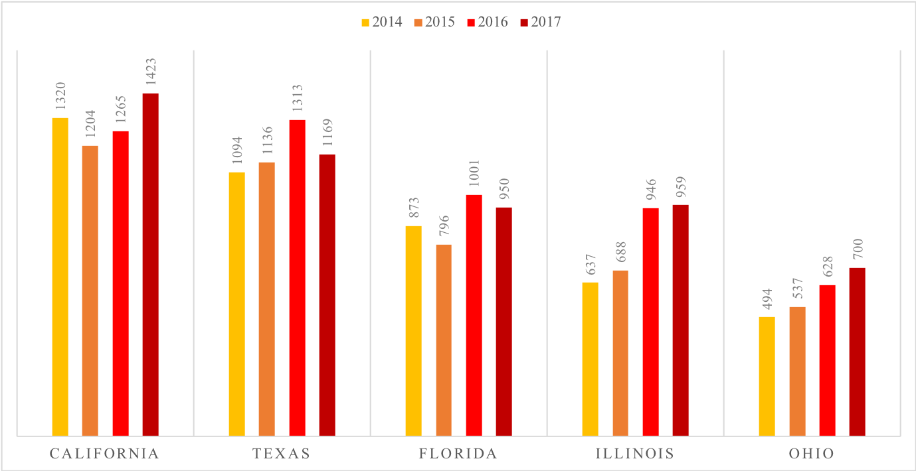
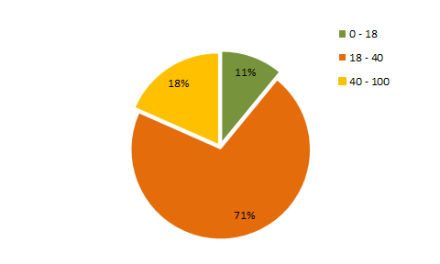
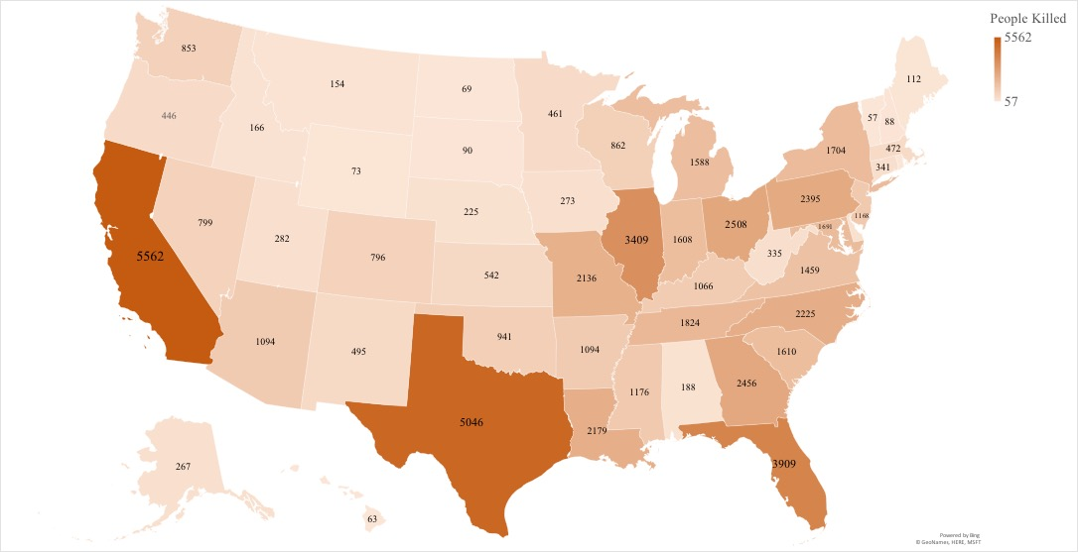
Gun Violence Prediction by Long Short-Term Memory and Beyond
Yifan Jiang, Yiwen Tang, Yijun Zhang, Weicheng Gan
Motivation:
Introduction:
United States has the 28th highest rank of deaths from gun violence in the world
A total of 15,511 deaths are caused by gun violence in 2017
People are concerned about their safety, especially around their neighborhood
With data from previous years, we hope to predict amount of gun-violence in various locations in 2019
Visualization of gun-related violence recorded in previous years, categorized by fatality, year, location(state), time(month)
We train a Long Short-Term Memory model based on records from previous years and such model is able to make prediction.
Methodologies:
LSTM: A common LSTM unit is composed of a cell, an input gate, an output gate and a forget gate. The cell remembers values over arbitrary time intervals and the three gates regulate the flow of information into and out of the cell.
Dataset: We find that each state and each month have some internal tendency by visualization results. Therefore, we collect the killed number sequence by the order of year and then split the data to per state and per month, thus we got 50 states with each has 12 months data, 600 sequences. Each data contains the killed number from 2013-2018 years. We further split the whole dataset into training and testing set to evaluate our method.
Experiment Setting: We use Stochastic Gradient Descent (SGD) as the optimization method, with momenta = 0.9 and weight decay = 5e-03. We use 0.1 learning rate and decay it by 1/10 on 100 and 200 training epochs. Since the dataset is small, we conduct data augmentation by randomly plus or minus 0~3 for each killed number sequence.
Results
As shown on the loss curve figure, the model successfully learns the variation tendency on training set. And there is an obvious downtrend when applied it on testing set. This demonstrates the effectiveness of our long short-term memory model. Thus, by further applying data in 2018, we can use the model to predict the killed number on each state on 2019.
Visualization:
The amount of fatal shooting incidents dropped in February and generally peak during Summer, especially in July. In addition, we observed an increasing trend of fata incidents from 2014 to 2017
This chart listed the top five states with the most fata shooting incidents from 2014 to 2017. California had the highest amount of such incidents in all four years, followed by Texas as the second rank, and Florida as the third.
We calculated the number of incidents according to age groups through 2013 - 2018. The number of participants in gun violence is 23899, 154342, 40132 in age range 0 - 18, 18 - 40, 40 - 100 respectively.
Conclusion:
In this project, we analyze the deaths caused by gun from 2013 to 2018. Specifically, we give a detailed discussion on the deaths number on different states and also visualize the tendency for each month. We find that more people are killed on summer and less people are killed on February. Furthermore, we count the killed number on each state and find that California, Texas, Florida are the Top. 3 state that gun violence occurs. Moreover, we analyze the age distribution and found juvenile criminals are surprisingly accounts for 11%, which should taken seriously. We also proposed a Long Short-Term Memory (LSTM) model to predict the gun violence. As shown on the figure, our proposed model can successfully fit the training set and achieve a good results on testing set. By applying the 2015-2018 data on this model, we can predict the gun violence tendency on 2019.

