Slide 1
Wastewater and Covid Cases Project

Slide 2
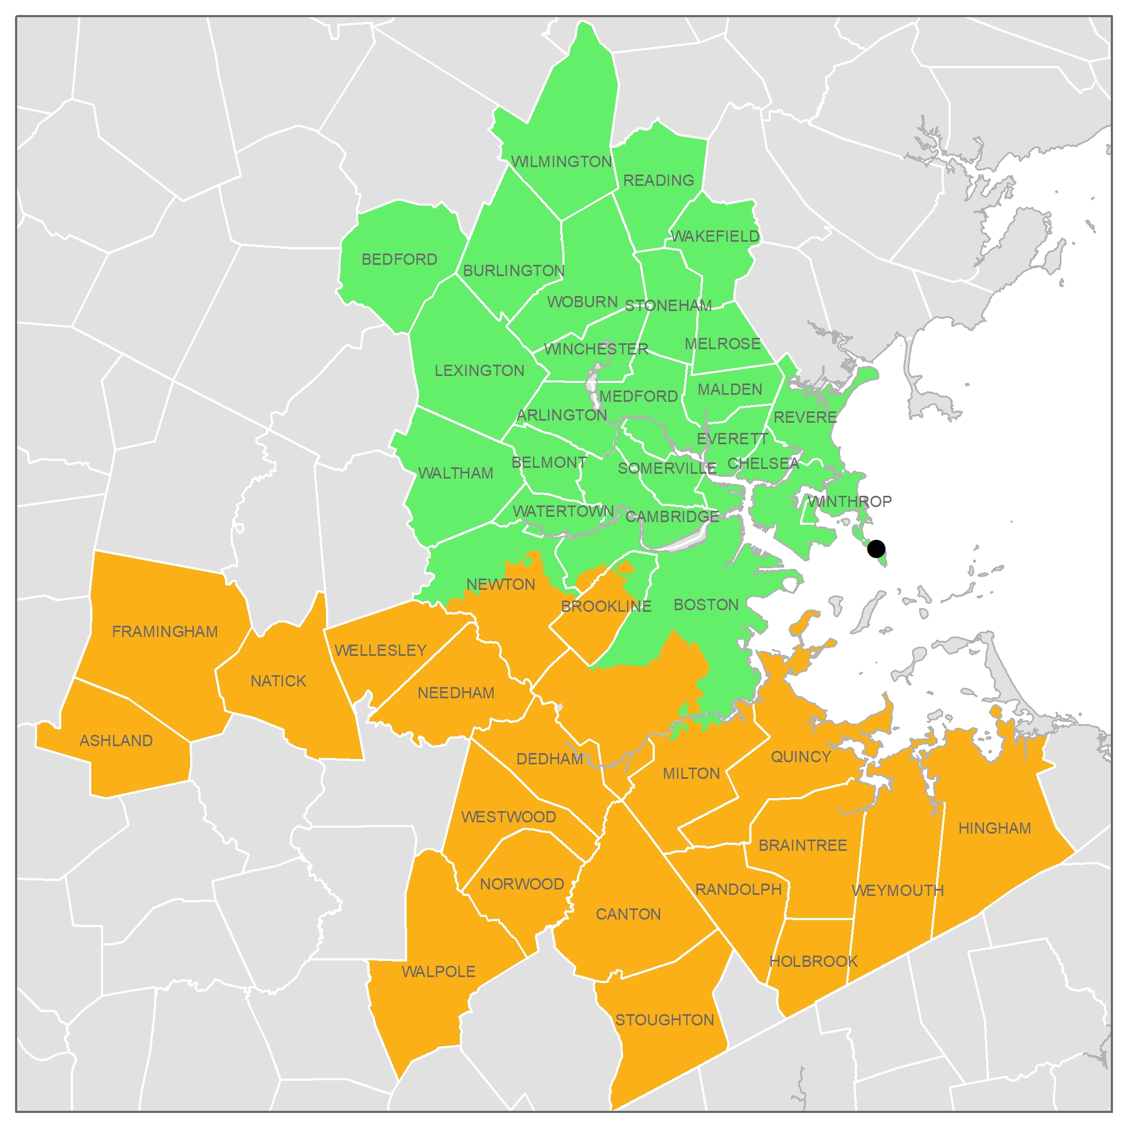
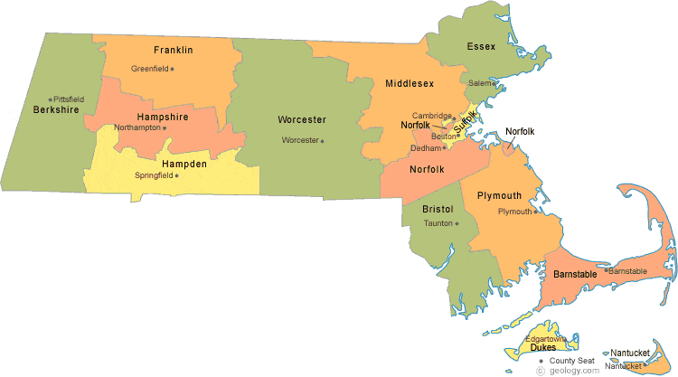
Wastewater Coverage and Covid Cases Area

Slide 3
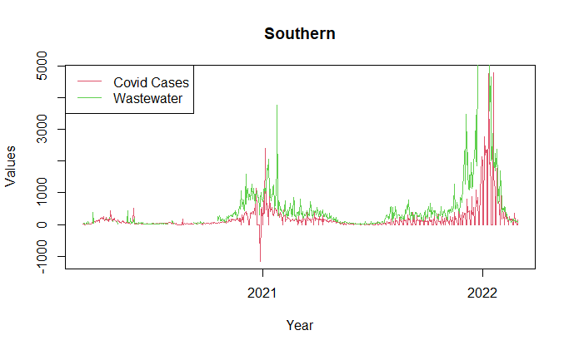
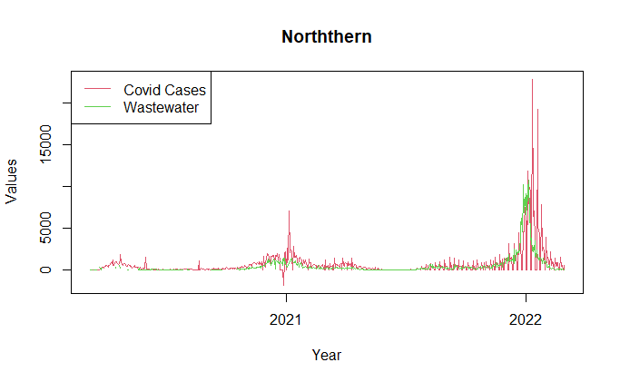
Wastewater and Covid Cases

Slide 4
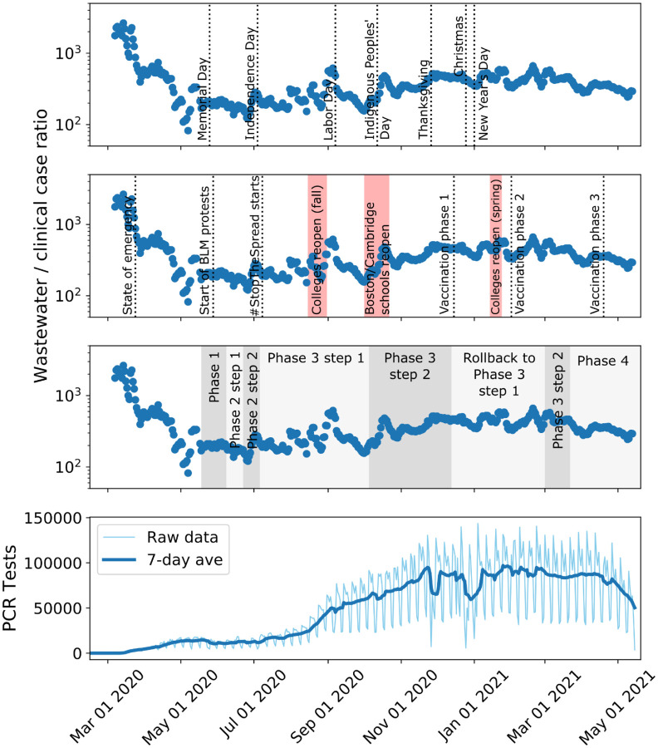
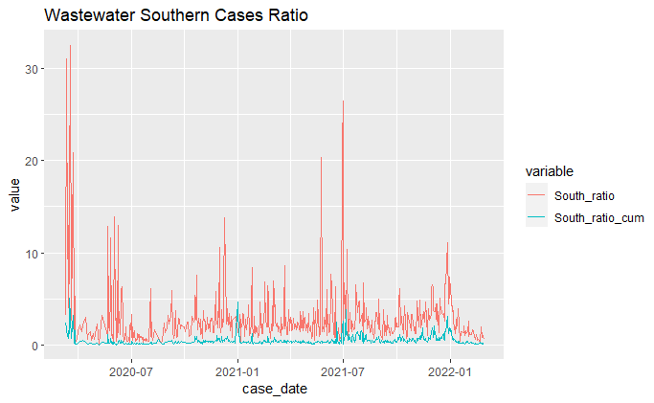
Wastewater/Covid Cases Ratio

Slide 5
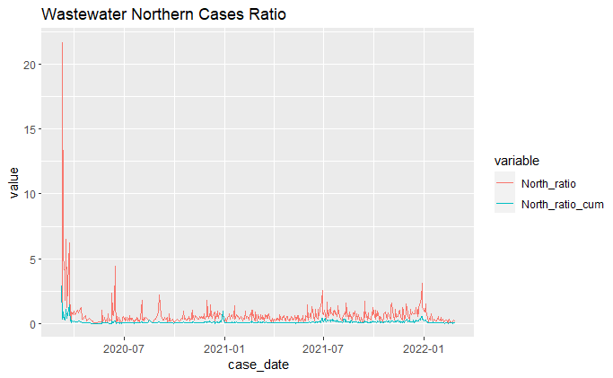
Wastewater/Covid Cases Ratio

Slide 6
Southern and Northern

