Slide 1
Wastewater and Covid Cases Project

Slide 2
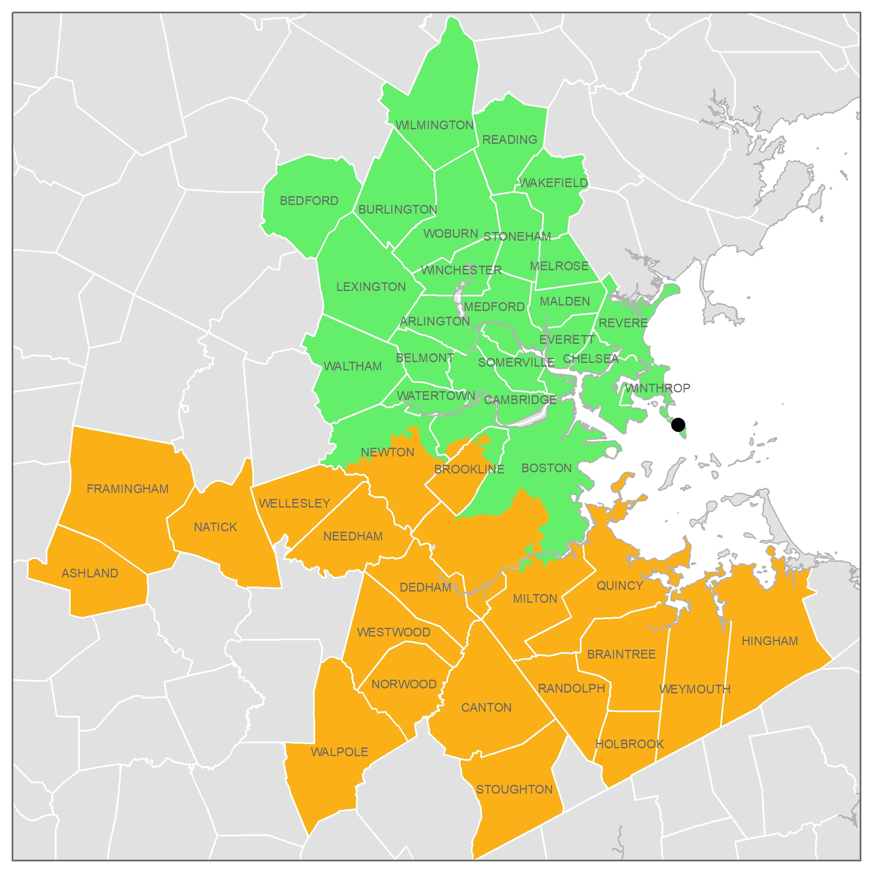
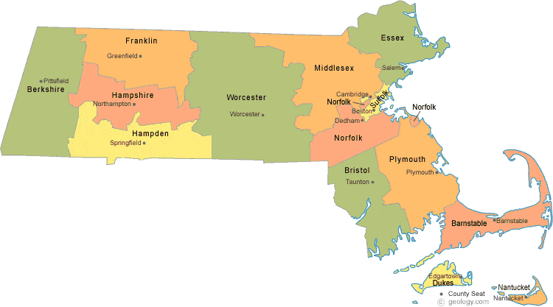
Wastewater Coverage and Covid Cases Area

Slide 3
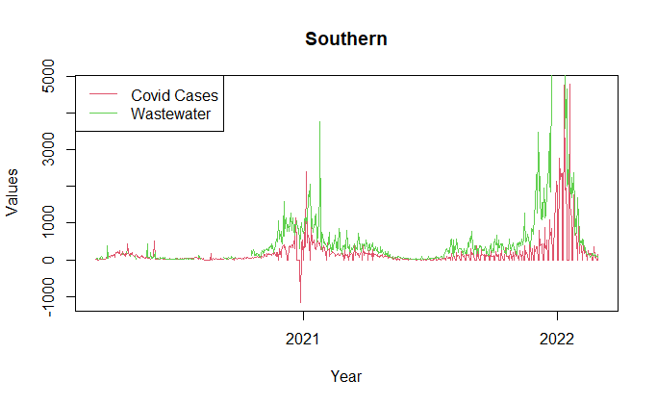
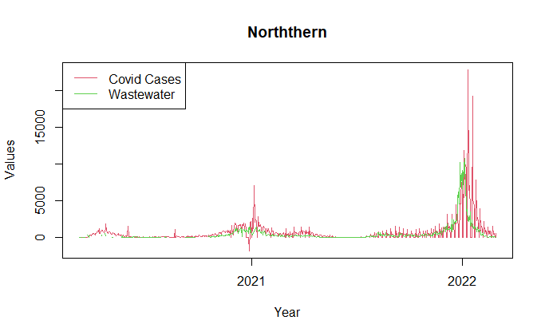
Wastewater and Covid Cases

Slide 4
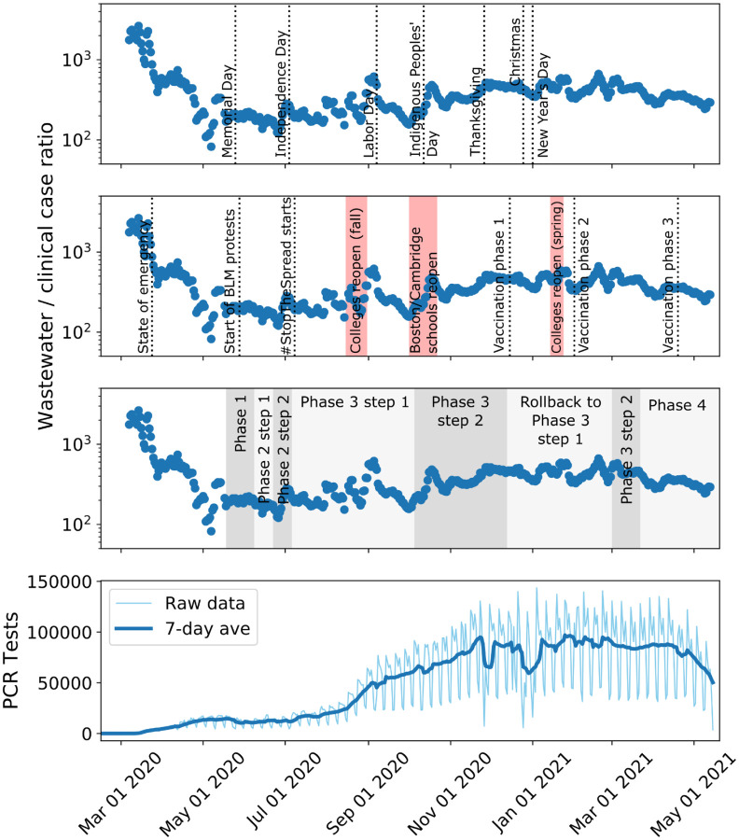
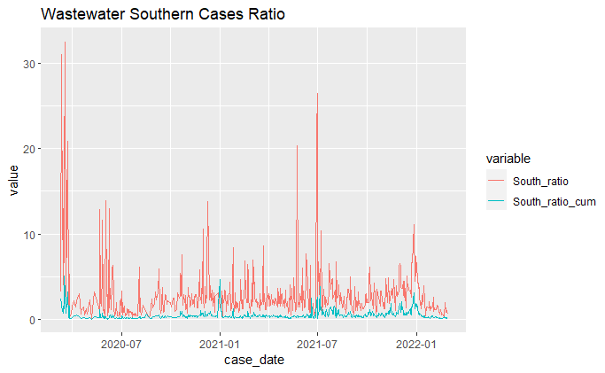
Wastewater/Covid Cases Ratio

Slide 5
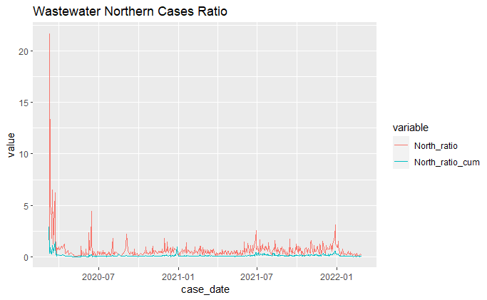
Wastewater/Covid Cases Ratio

Slide 6
Southern and Northern

Slide 7
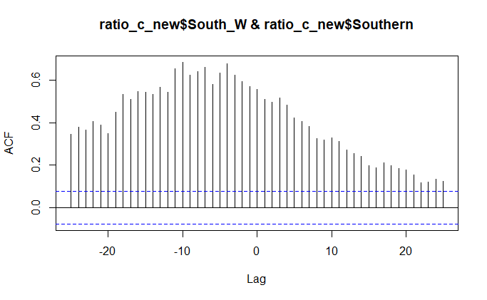
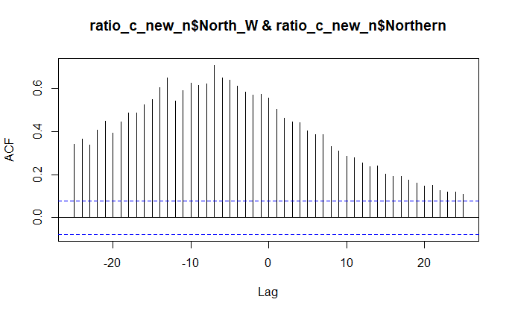
Daily New Cases Lag
-10: 0.685
-4: 0.678
-7: 0.708

Slide 8
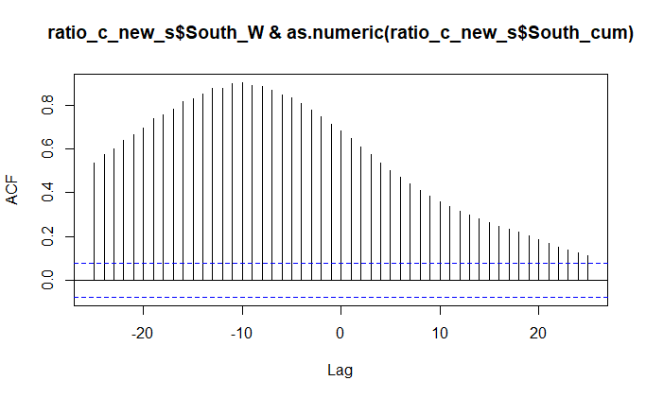

7 Day Cumulative Lag
-10: 0.903
-10: 0.915

Slide 9
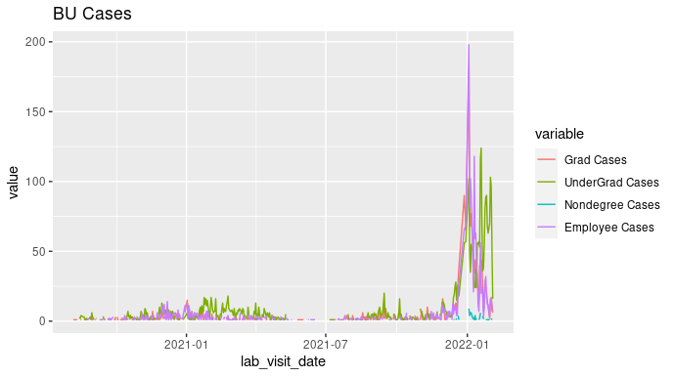
BU Covid Cases

Slide 10
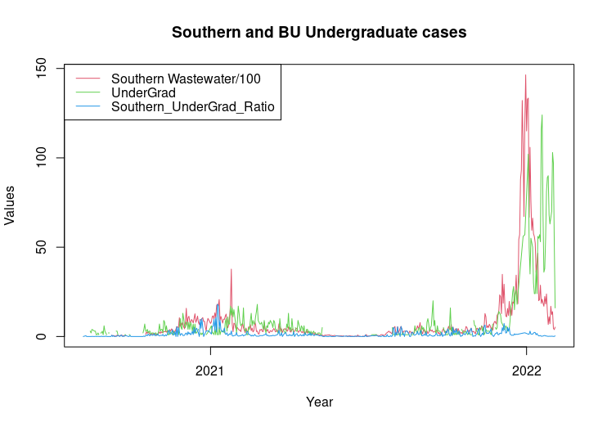
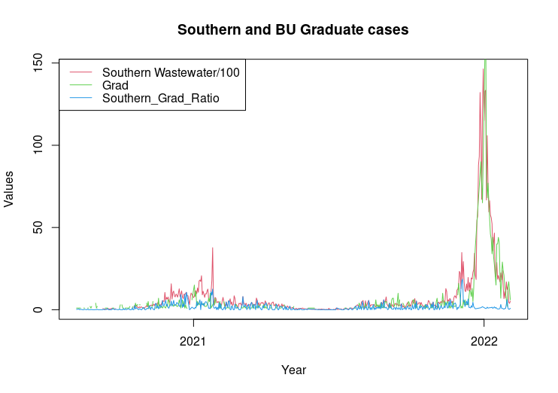
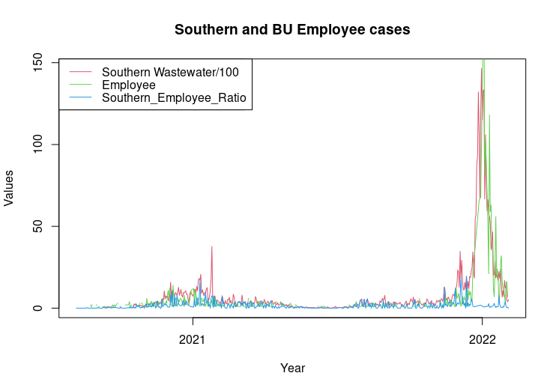
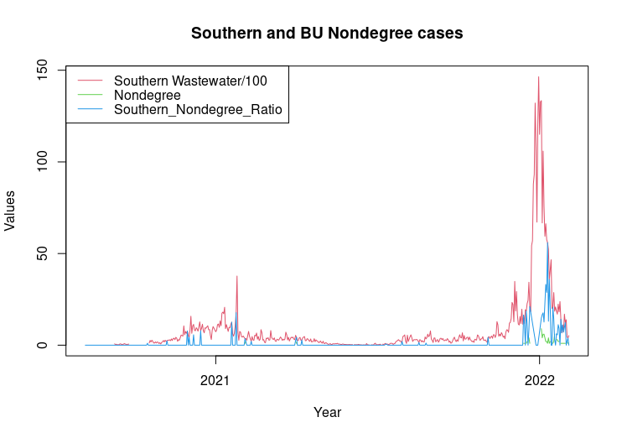
Wastewater/BU Cases Ratios

Slide 11
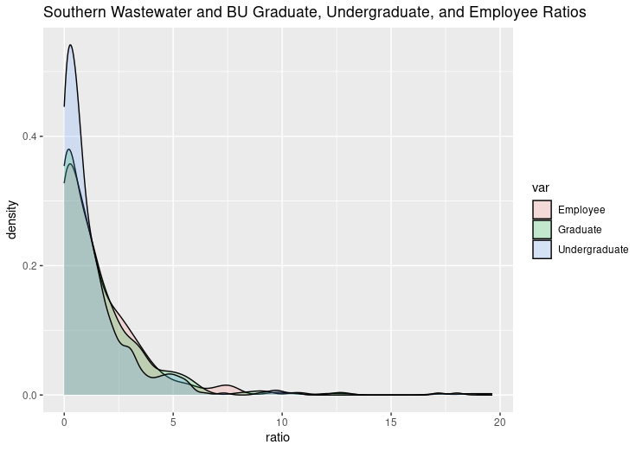
Ratio Densities

Slide 12
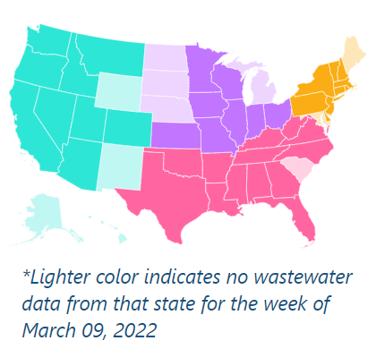

Interesting Things

