Slide 1

SUMMER INTERNSHIP PROJECT
Student Performance Prediction System
A Hybrid Stacking Regression Approach Using Linear Regression,
XGBoost & Linear Regression
TEAM MEMBERS
Tanishq Soni
Ritika Sonkar
Yash Raj Jaiswal
Internship Organization: Innovation & Incubation Hub, MNNIT Foundation Academic Year: 2026
Notes:
Welcome the panel. Introduce the project title: predicting a student's exam score from measurable academic and lifestyle factors using a hybrid stacking regression model that combines Linear Regression, Random Forest, and XGBoost. Introduce yourself and your teammates, department, college, and academic year. Keep this to 30 seconds -- it is just an orientation slide.

Slide 2




01 · PROBLEM STATEMENT
Why Predicting Exam Performance Matters
Academic performance depends on many interacting factors, but institutions rarely quantify how much each one contributes -- or catch at-risk students early enough to help.
Reactive, not predictive
Multi-factor complexity
Single models fall short
Poor results are noticed only after final exams, when it is too late to intervene.
Attendance, study hours, sleep, tutoring, and prior scores interact non-linearly.
A single linear or tree model captures only part of the pattern -- not all of it.
Our approach: combine complementary models so their strengths cover each other's weaknesses -- and quantify each factor's real impact on Exam Score.
02
Notes:
Explain the real-world problem: predicting exam performance helps students and teachers intervene before results are final. Traditional approaches are reactive -- they only look at outcomes after the fact. The relationship between attendance, study hours, sleep, tutoring, and prior scores is complex and interacting, so a single simple model (like plain linear regression) tends to underfit these interactions, while a single complex model can overfit. That's why our project combines multiple models together instead of relying on just one.

Slide 3




02 · OBJECTIVES
Project Objectives
01
02
Analyze influencing factors
Engineer a clean pipeline
Explore how attendance, study hours, sleep, tutoring, and prior scores relate to exam outcomes.
Handle missing values, duplicates, and scaling so the model trains on reliable data.
03
04
Build a hybrid stacked model
Evaluate rigorously
Combine Linear Regression and XGBoost as base learners with a Linear Regression meta-model.
Measure MAE, MSE, RMSE, and R² to judge real predictive accuracy, not just training fit.
03
Notes:
Walk through the four objectives in order: first, understand which factors actually influence exam scores; second, build a clean and reliable data pipeline; third, combine multiple algorithms into one hybrid stacked model instead of relying on a single learner; fourth, evaluate the model properly using standard regression metrics so the results can be trusted, not just visually inspected.

Slide 4



03 · DATASET
Dataset Overview
Student Performance Factors Dataset
PREPROCESSING
Loaded from Google Drive as a CSV file into a pandas DataFrame for analysis and modeling.
Mean / Mode Imputation
Feature | Role | Type
Attendance | Input | Numeric
Hours_Studied | Input | Numeric
Previous_Academic_Scores_Avg | Input | Numeric
Sleep_Hours | Input | Numeric
Tutoring_Sessions | Input | Numeric
Exam_Score | Target | Numeric
DUPLICATES
Removed via drop_duplicates()
SCALING
StandardScaler (zero mean, unit variance)
MISSING VALUES
Numeric columns filled with the column mean; categorical columns filled with the column mode -- ensuring no rows are dropped due to missing entries.
df.shape → (rows, 6 columns) after cleaning & duplicate removal
04
Notes:
Introduce the dataset: it contains five input features -- Attendance, Hours Studied, Previous Academic Scores, Sleep Hours, and Tutoring Sessions -- and one target variable, Exam Score. The code loads it from Google Drive as a CSV. Explain the cleaning: missing numeric values are filled with the column mean, missing categorical values with the column mode, and duplicate rows are dropped. Mention that all features are scaled using StandardScaler before training so no single feature dominates due to its scale.

Slide 5




04 · WORKFLOW
End-to-End Execution Pipeline
1
2
3
4
5
6
Load Data
Clean Data
EDA
Scale & Split
Stack Models
Evaluate
CSV from Drive
Impute & dedupe
Plots & heatmap
Standardize, 80/20
LR + XGB → LR
MAE · RMSE · R²
Input → Output
Input: Attendance, Hours Studied, Previous Scores, Sleep Hours, Tutoring Sessions Output: Predicted Exam Score (continuous value) Constraint: All features must be numeric and scaled the same way as during training before inference.
05
Notes:
Walk through the pipeline left to right: data is loaded from Google Drive, cleaned (missing values and duplicates handled), explored visually through EDA, then scaled and split into train and test sets. The core of the pipeline is the stacking model -- Linear Regression and Random Forest as base learners feeding into an XGBoost meta-model -- and finally the model is evaluated with regression metrics. Emphasize that the same scaling used in training must be applied to any new input before prediction.

Slide 6

05 · METHODOLOGY
Preprocessing Pipeline
STEP 1
Numeric columns imputed with the mean; categorical columns imputed with the mode -- df.isnull().sum() confirms zero nulls afterward.
Missing Value Handling
STEP 2
df.drop_duplicates() removes repeated rows so the model isn't biased by redundant records.
Duplicate Removal
STEP 3
Histograms, scatter plots, a pairplot, and a correlation heatmap reveal feature distributions and relationships with Exam Score.
Exploratory Analysis
STEP 4
StandardScaler transforms all 5 input features to zero mean & unit variance -- essential since Linear Regression is scale-sensitive.
Feature Scaling
STEP 5
train_test_split() reserves 20% of data for testing (random_state=42) so evaluation reflects unseen data.
Train-Test Split
06
Notes:
Walk through each preprocessing step in the order it appears in the code: first, missing values are handled with mean for numeric and mode for categorical columns. Second, duplicate rows are dropped. Third, exploratory data analysis using histograms, scatter plots, a pairplot, and a correlation heatmap to understand feature relationships. Fourth, StandardScaler is applied because Linear Regression is sensitive to feature scale. Finally, the data is split 80/20 into training and test sets with a fixed random_state for reproducibility.

Slide 7
06 · ALGORITHM
Hybrid Stacking Regression
Two diverse base learners feed their predictions -- plus the original features -- into a gradient-boosted meta-model that learns the optimal way to combine them.
BASE LEARNERS
Linear Regression
Meta-Features
( ŷ_LR , ŷ_XGB , X )
passthrough = True
Linear Regression
Meta-Model
Predicted
Exam Score
Input
Features (X)
XGBoost
PSEUDOCODE
COMPLEXITY
for model in [LinReg, XGBoost]:
fit model on X_train (5-fold CV)
oof_preds = out-of-fold predictions
meta_X = concat(oof_preds, X_train) # passthrough
fit LinReg on meta_X, y_train
predict(X_test) → combine base preds
→ feed into LinReg
Model | Time | Space
Linear Regression | O(n·f) | O(f)
XGBoost (meta) | O(t·n·f) | O(t·nodes)
n = samples, f = features, t = trees/estimators
07
Notes:
Explain stacking conceptually: Linear Regression captures the straightforward linear relationships, while Random Forest captures non-linear interactions between features. Both base models are trained with cross-validation to produce out-of-fold predictions, avoiding leakage. Because passthrough=True, the original scaled features are combined with these two predictions to form meta-features. An XGBoost meta-model, a gradient-boosted ensemble of decision trees, then learns how to best weigh and combine these signals into a final prediction. Briefly mention the time and space complexity so the panel sees you understand the computational cost, not just the API calls.

Slide 8


07 · CODE ARCHITECTURE
Module-by-Module Breakdown
1. Setup & Ingestion
2. Data Cleaning
3. EDA
4. Feature Prep
Mount Drive, import pandas/numpy/sklearn/xgboost, read CSV into df.
fillna(mean/mode) per dtype, drop_duplicates(), shape verification.
seaborn histplot, scatterplot, pairplot, and heatmap for correlation.
Select 5 features, StandardScaler.fit_transform, train_test_split.
5. Model Building
6. Evaluation
7. Feature Importance
8. Persistence
StackingRegressor(estimators=[LR, RF], final_estimator=XGB, cv=5).
model.fit / predict, MAE, MSE, RMSE, R², actual-vs-predicted plot.
Separate RandomForestRegressor, feature_importances_, bar chart.
pickle.dump model/scaler/features, files.download() for deployment.
08
Notes:
Walk the panel through the notebook module by module in execution order, from data ingestion through cleaning, EDA, feature preparation, model building with StackingRegressor, evaluation, a separate feature-importance analysis using RandomForest, and finally persisting the trained model, scaler, and feature list with pickle so the model can be reused for inference without retraining. If asked, be ready to point to the exact lines in the notebook for any module.

Slide 9
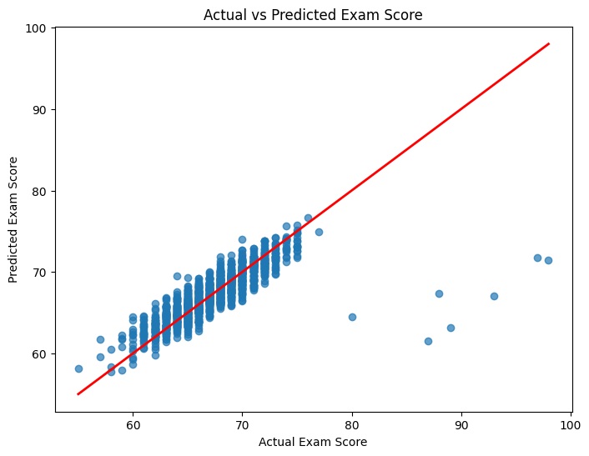
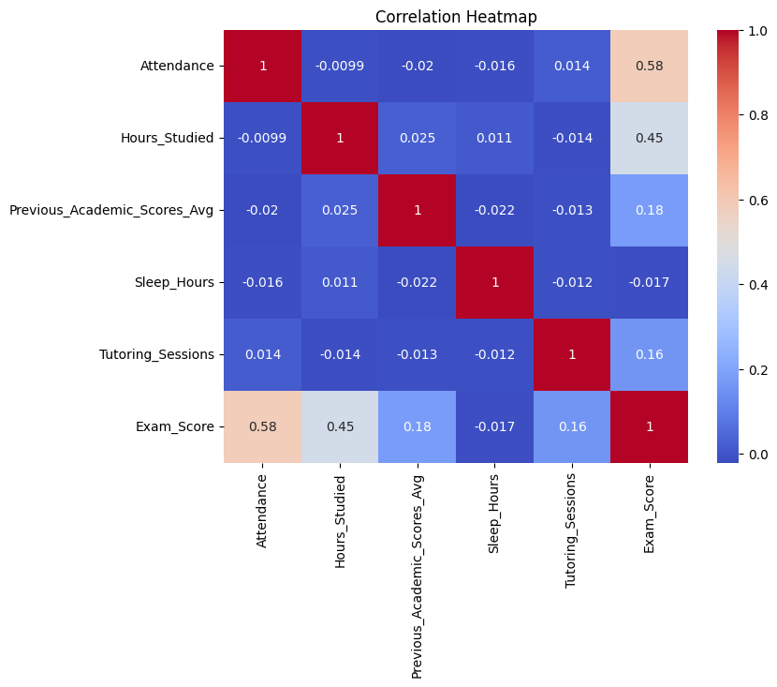
08 · RESULTS
Model Performance & Outputs
1.2761
5.0817
2.2543
0.6405
MAE
MSE
RMSE
R²
Mean Absolute Error
Mean Squared Error
Root Mean Squared Error
Variance Explained
Actual vs. Predicted Exam Score
Feature Correlation Heatmap
09
Notes:
Before presenting this slide, run the notebook end-to-end and drop your actual MAE, RMSE, and R squared values into the metric cards -- these are intentionally left as placeholders since they depend on your exact run. Explain that the actual-vs-predicted plot should show points clustered tightly around the diagonal red line, meaning predictions closely match reality; the further a point strays from that line, the larger the error for that student. For feature importance, explain that RandomForest's feature_importances_ ranks which inputs the model relies on most -- update the bars with your real printed ranking before presenting.

Slide 10

09 · DEMONSTRATION
Project Demonstration
STAGE 1
STAGE 2
STAGE 3
STAGE 4
Input
Processing
Intermediate
Output
Enter a student's Attendance, Hours Studied, Previous Score, Sleep Hours, Tutoring Sessions.
scaler.transform() standardizes the input, then the saved stacking model runs inference.
Linear Regression & each produce a base prediction, passed to XGBoost.
The model returns a single predicted Exam Score for the student.
SAMPLE DEMO SCENARIO
Attendance: 85% · Hours Studied: 6 · Previous Score: 78 · Sleep Hours: 7 · Tutoring Sessions: 3 → Predicted Exam Score: [live demo output]
10
Notes:
This is the live-demo slide. Load the saved student_model.pkl, scaler.pkl, and features.pkl using pickle.load(). Walk through an example: take a sample student's five feature values, apply scaler.transform on them, run model.predict, and read out the predicted exam score live in front of the panel. The example numbers shown here are placeholders -- substitute real values you use during your demo, and run it live if possible rather than only showing a static slide.

Slide 11

10 · CONCLUSION
Conclusion
What We Achieved
Key Learnings
Cleaned & explored the Student Performance dataset
Ensembling diverse models improves robustness
Built a hybrid Stacking Regressor (LR + XGBoost → LR)
Feature scaling is critical for linear learners
Evaluated with MAE, MSE, RMSE, and R²
Cross-validated stacking avoids information leakage
Persisted the model for reuse via pickle
Feature importance builds model interpretability
Advantages
Limitations
Combines linear & non-linear pattern capture
Performance depends on dataset size & quality
More stable predictions than any single model
Stacking adds training time & complexity
Passthrough retains original feature signal
Assumes input features stay in a similar range
Reusable, deployable saved artifacts
Limited to the 5 features currently used
11
Notes:
Summarize the project in four parts: what was achieved technically, the key conceptual lessons learned about ensembling and preprocessing, the practical advantages of the stacked approach over a single model, and an honest look at its limitations -- particularly that results depend heavily on data quality and the model currently only uses five features. Being upfront about limitations shows maturity and often earns credit in a viva.

Slide 12





11 · FUTURE SCOPE
Future Enhancements
Expand the feature set
Try deeper architectures
Automate hyperparameter tuning
Incorporate more factors -- parental involvement, extracurriculars, socio-economic context -- for richer predictions.
Experiment with neural networks or LightGBM/CatBoost as additional base or meta-learners.
Use GridSearchCV / Optuna instead of manually chosen estimator counts and depths.
Deploy as a web app
Add explainability
Continuous retraining
Wrap the saved model in a Flask/Streamlit app for teachers to get live predictions.
Integrate SHAP or LIME for per-student, per-feature prediction explanations.
Build a pipeline to retrain the model as new student data becomes available each term.
12
Notes:
Present these as realistic next steps rather than vague ambitions: expanding the feature set with more real-world factors, trying additional model types as base or meta-learners, automating hyperparameter search instead of manual tuning, deploying the model behind a simple web interface for teachers, adding explainability tools like SHAP so predictions are interpretable per student, and setting up periodic retraining as new data arrives.

Slide 13

Thank You
Questions & Discussion
Student Performance Prediction System -- Tanishq Soni · Ritika Sonkar · Yash Raj Jaiswal
Innovation & Incubation Hub, MNNIT Foundation | 2026
Notes:
Thank the panel for their time and open the floor for questions. Be ready to justify model choices (why stacking, why these specific base learners), discuss the preprocessing decisions, and speak to the limitations and future scope confidently -- these are the most commonly asked viva questions for a project like this.

