Slide 1
A Factor Decomposition Method for Separating
Store Substitution and Embedding Placement Effects
in Vector Database Migration
Junha Yoon · Ohhyeon Gwon · Junhaeng Lee · Hyeji Roh · Soowan Cho · Suhee Kim · SangSoon Lim
Sungkyul University · Chung-Ang University · Deep Insight Lab
2026 International Conference on PyGeek
Hongik University

Slide 2
Contents
1
Introduction
2
Proposed Method
3
Performance Evaluation
4
Experiment Result
5
Conclusion
1

Slide 3
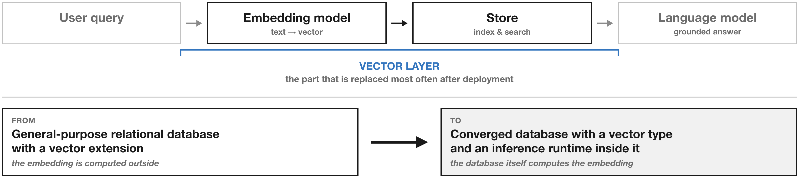
Introduction
The vector layer is the part that gets replaced after deployment
· A RAG system combines an embedding model, a store, and a language model
· A common migration moves it to a converged database that embeds internally
2

Slide 4
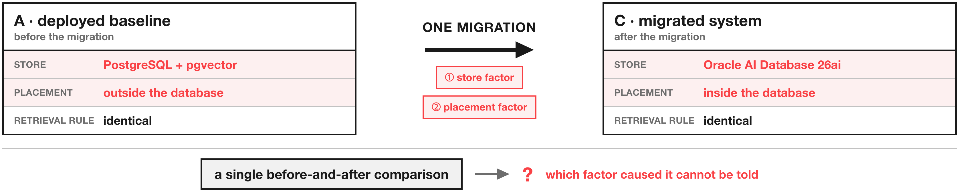
Introduction
One migration changes two things at the same time
· The store and the embedding placement move together, not one at a time
· A governance-driven migration pulls the model inside, and the model size limit follows
· A single before-and-after comparison cannot attribute the change to either factor
3

Slide 5
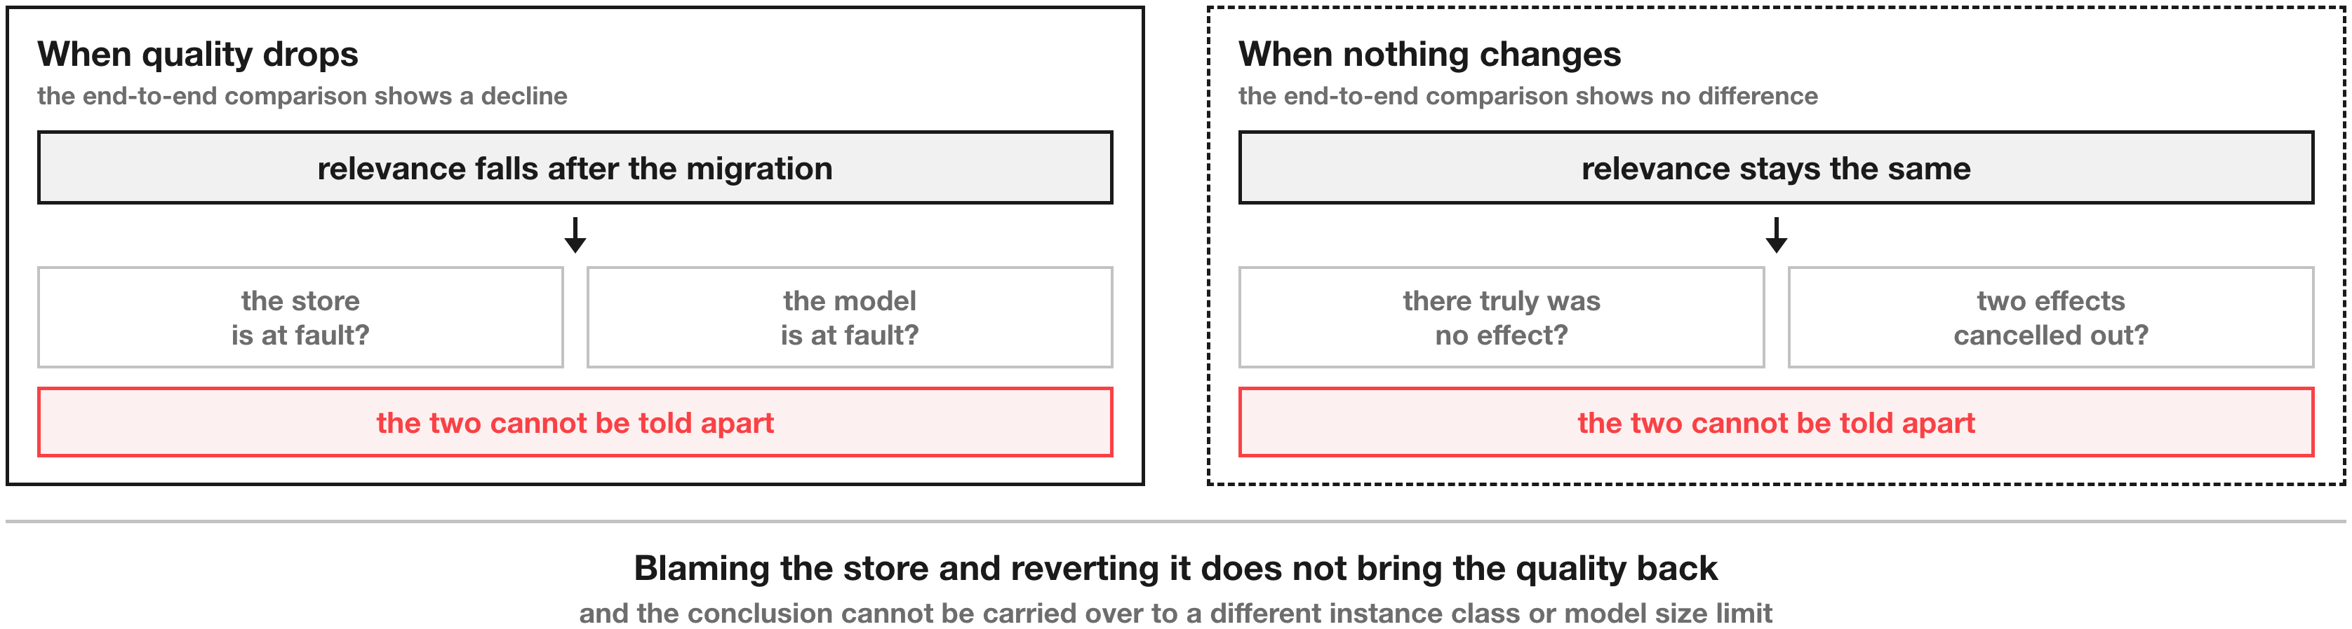
Introduction
Misattributing the cause leads to the wrong remedy
· A decline cannot be assigned to the store or to the model
· No observed change may mean no effect, or two effects cancelling each other out
4

Slide 6
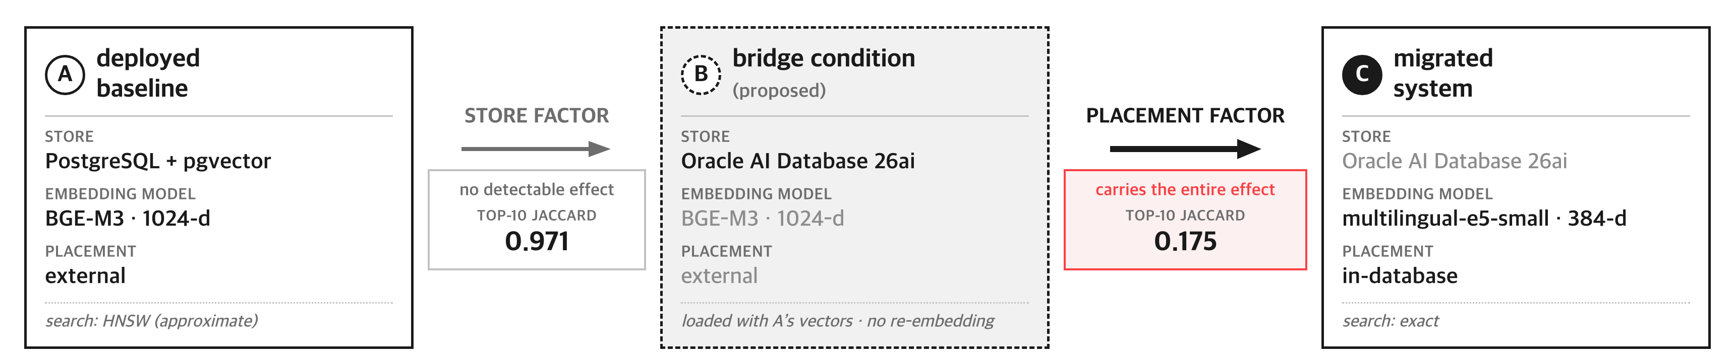
Proposed Method
A bridge condition splits one comparison into two
· Load the target store with the vectors the source system has already produced
· A to B differs only in the store, B to C only in the placement
· No re-embedding is required, so the running service is left untouched
5

Slide 7
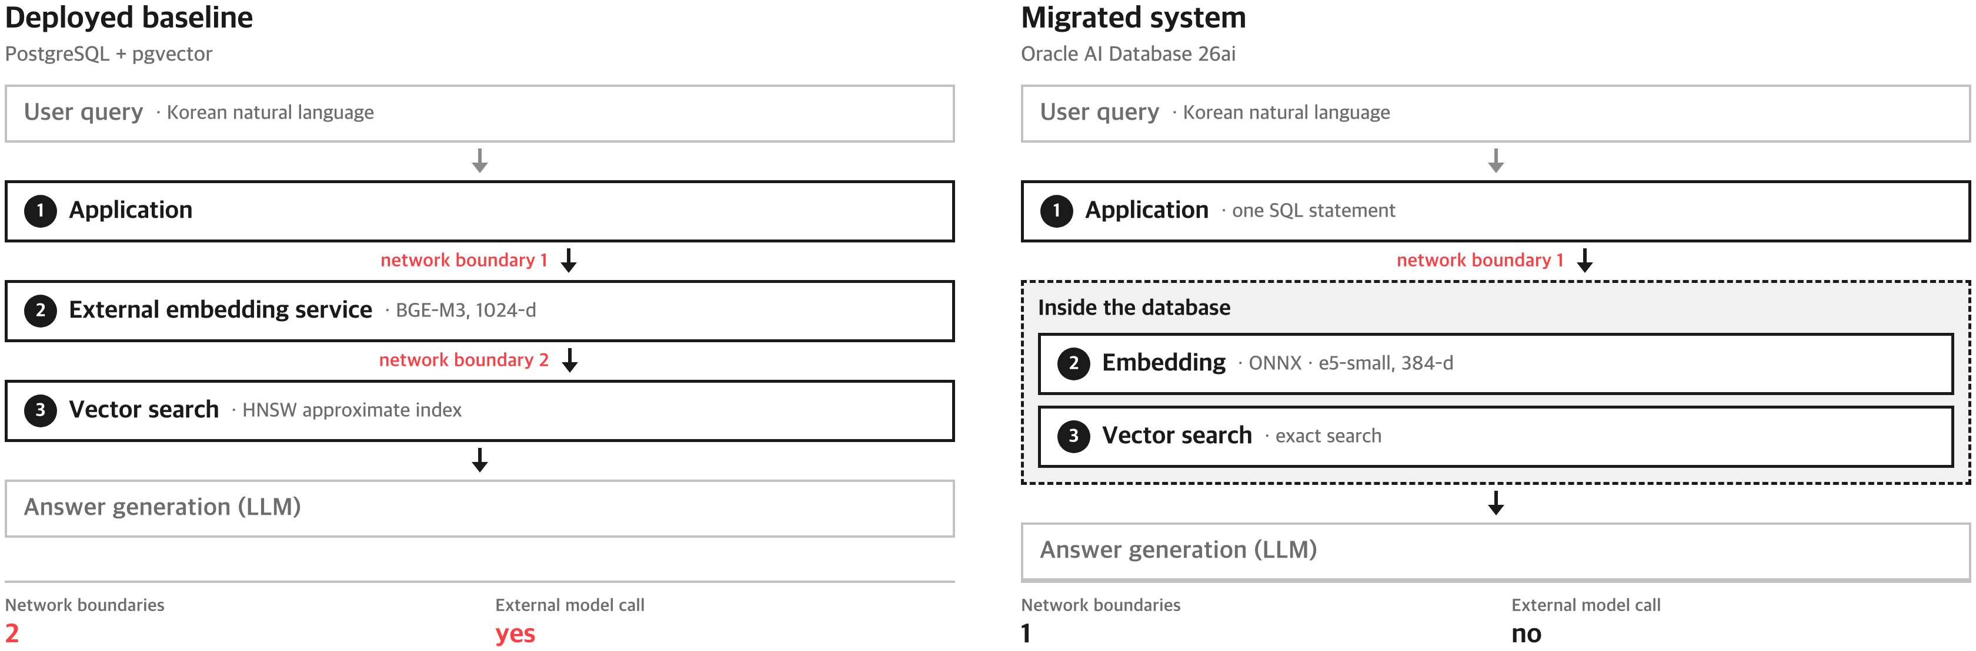
Proposed Method
Network boundaries drop from two to one and the external model call disappears
· The baseline crosses two network boundaries to reach an external embedding service
· After migration, embedding and search both run inside the database boundary
· The retrieval rule and its parameters were held identical across the three conditions
6

Slide 8
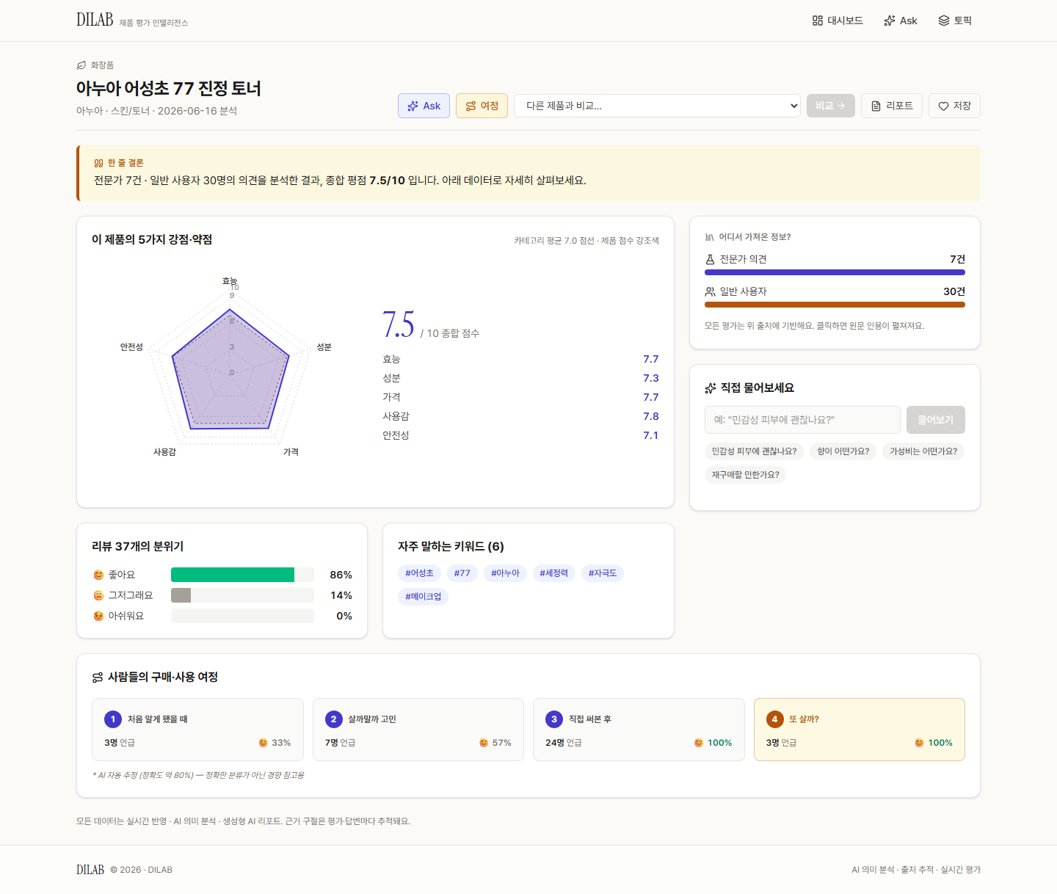
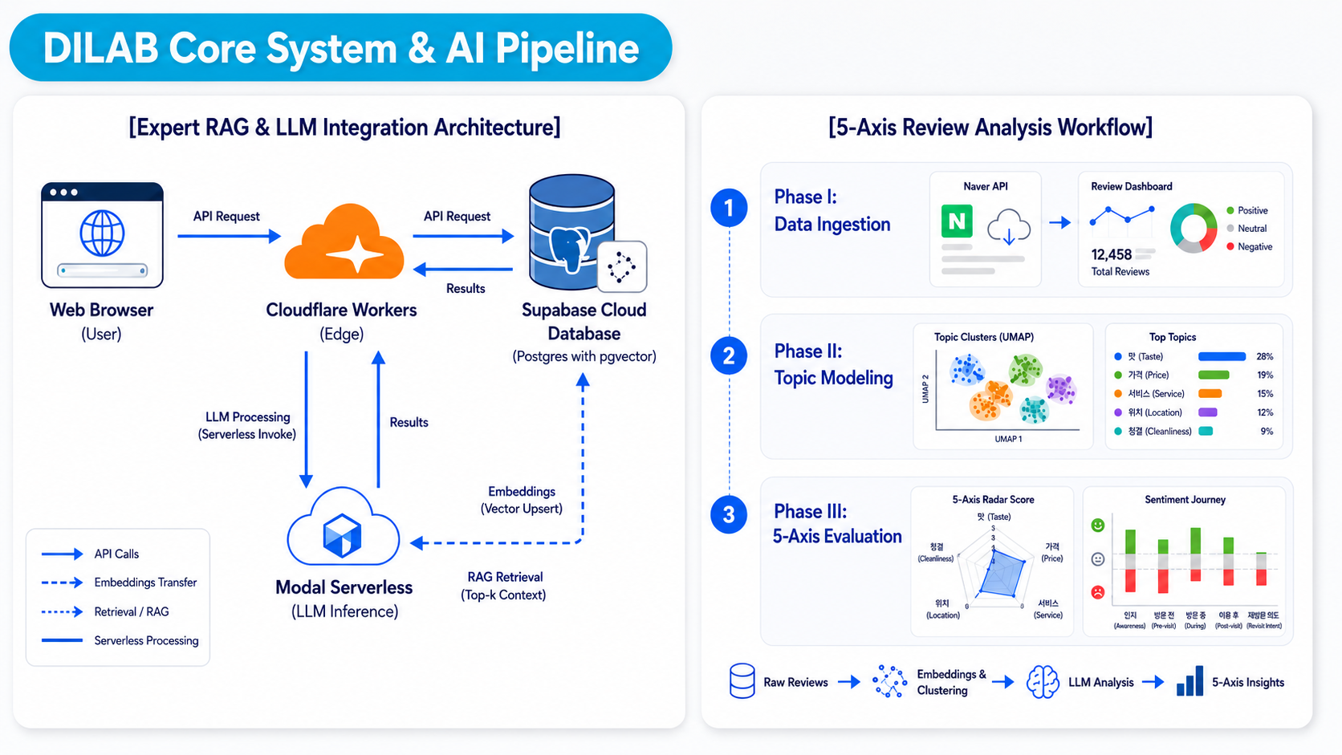
Performance Evaluation
Testbed — DILAB, a product-review analysis service in production
· Consumer and expert reviews are embedded into a vector store and served as evidence-cited reports
· The 1,347-chunk corpus and 43 queries in our experiments come from this service
System architecture & analysis pipeline
Product report dashboard
7

Slide 9
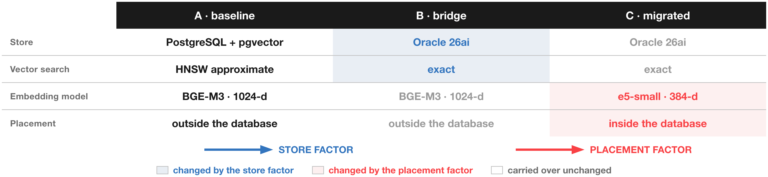
Performance Evaluation
Three conditions measured over 1,347 chunks and 43 fixed queries
· Retrieval agreement, evidence relevance on a 0 to 2 scale, and search latency
· Confidence intervals from 10,000 bootstrap resamples on an entry-level instance
8

Slide 10
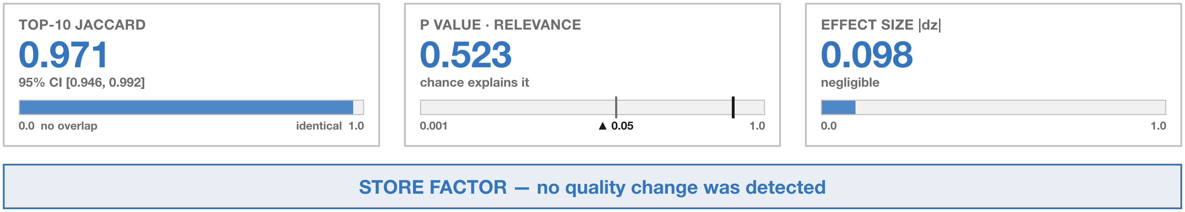
Experiment Result
Store factor — no quality change was detected
· An identical top-10 set was returned for 37 of the 43 queries
· What the approximate index missed amounts to about 1.6 percent
· A Wilcoxon test on the queries remaining after ties agrees (p = 0.908)
9

Slide 11
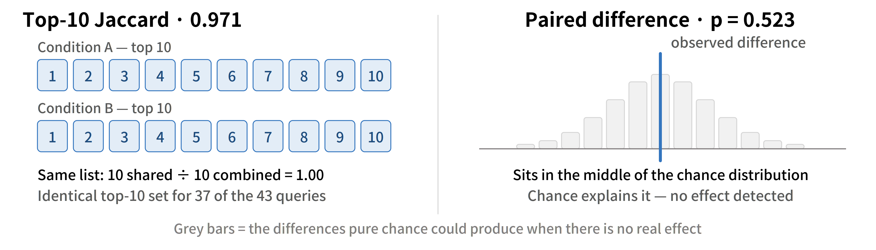
Experiment Result
How the two metrics are read
· Jaccard measures how much the two top-10 sets overlap, on a 0 to 1 scale
· The p value is how well chance alone explains the observed difference
· Here both conditions returned the same list and the difference sits mid-distribution
10

Slide 12
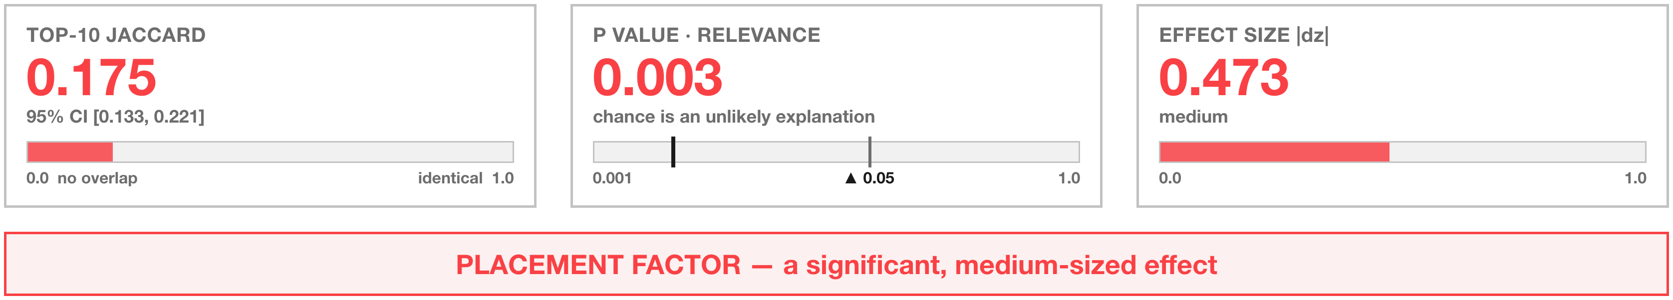
Experiment Result
Placement factor — a significant, medium-sized effect
· The same store and the same search method returned mostly different evidence
· Since no store effect was detected, the change is attributable to the placement factor
· An end-to-end comparison alone would have blamed the store instead
11

Slide 13
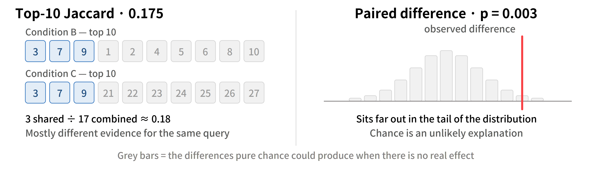
Experiment Result
The same two metrics applied to the placement factor
· Jaccard falls from 0.971 to 0.175 and the p value from 0.523 to 0.003
· Only 3 items are shared between the two top-10 lists
· The observed difference now sits far out in the tail of the chance distribution
12

Slide 14
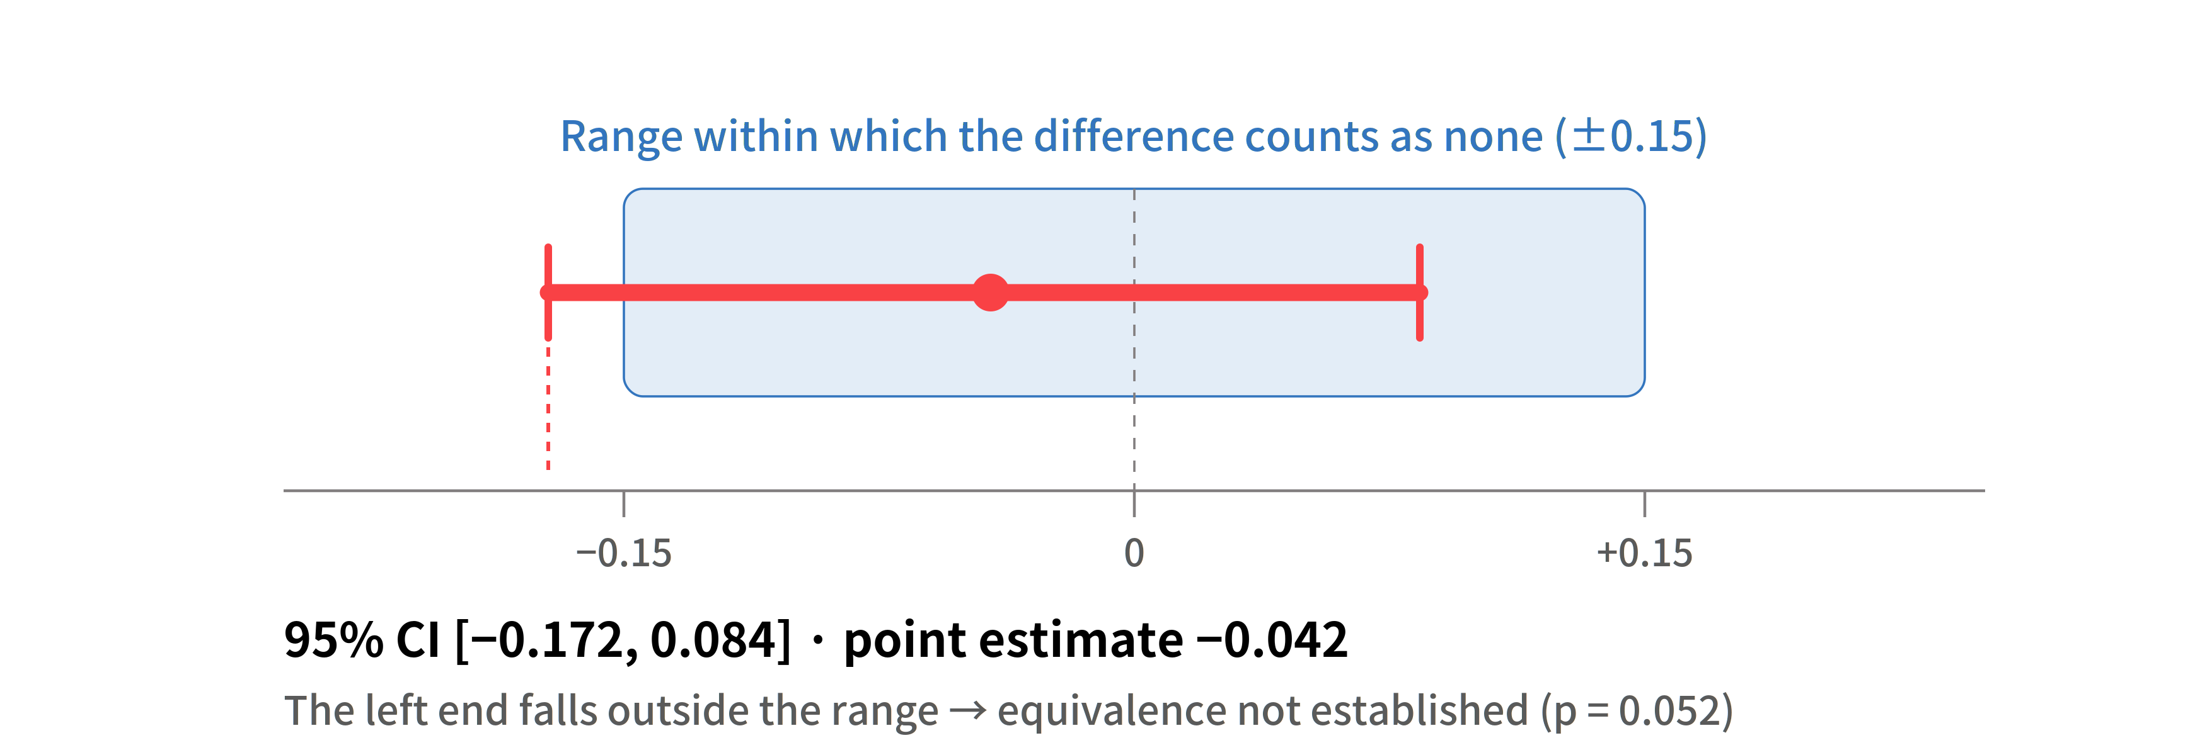
Experiment Result
Claiming no difference requires an equivalence test of its own
· A non-significant p value is not evidence of equivalence
· TOST over a plus or minus 0.15 range gave p = 0.052, so the level was not met
· We report no effect detected with a bounded magnitude, not equivalence established
13

Slide 15
Conclusion
Moving the placement is a trade in governance rather than in performance
· A single bridge condition splits an end-to-end comparison into two single-factor comparisons
· No store effect was detected; the entire observed change came from the placement
A practical decision rule
· If governance of the stored data is the only goal, replacing the store alone is enough
· If the query path must stay inside, confirm the model size limit before migrating
14

Slide 16
References
[1] P. Lewis et al., “Retrieval-augmented generation for knowledge-intensive NLP tasks,” Advances in Neural Information Processing Systems, vol. 33, pp. 9459–9474, 2020.
[2] Y. Gao et al., “Retrieval-augmented generation for large language models: A survey,” arXiv preprint arXiv:2312.10997, 2023.
[3] Oracle, “Oracle AI Vector Search User’s Guide,” Oracle AI Database 26ai documentation, 2026.
[4] L. Wang, N. Yang, X. Huang, L. Yang, R. Majumder, and F. Wei, “Multilingual E5 text embeddings: A technical report,” arXiv preprint arXiv:2402.05672, 2024.
[5] pgvector, “pgvector: Open-source vector similarity search for Postgres,” GitHub repository, 2026.
[6] J. Chen, S. Xiao, P. Zhang, K. Luo, D. Lian, and Z. Liu, “M3-Embedding: Multi-linguality, multi-functionality, multi-granularity text embeddings through self-knowledge distillation,” Findings of the Association for Computational Linguistics: ACL 2024, pp. 2318–2335, 2024.
[7] Y. A. Malkov and D. A. Yashunin, “Efficient and robust approximate nearest neighbor search using hierarchical navigable small world graphs,” IEEE Transactions on Pattern Analysis and Machine Intelligence, vol. 42, no. 4, pp. 824–836, 2020.
[8] L. Zheng et al., “Judging LLM-as-a-judge with MT-Bench and Chatbot Arena,” Advances in Neural Information Processing Systems, vol. 36, Datasets and Benchmarks Track, 2023.
[9] D. Lakens, “Equivalence tests: A practical primer for t tests, correlations, and meta-analyses,” Social Psychological and Personality Science, vol. 8, no. 4, pp. 355–362, 2017.
15

Slide 17
Thank You
Contact to me: wnsgk111400@sungkyul.ac.kr
16

