Slide 1
A Factor Decomposition Method for Separating
Store Substitution and Embedding Placement Effects
in Vector Database Migration
벡터 데이터베이스 이전에서 저장소 교체와 임베딩 위치 효과의 분리
2026 International Conference on PyGeek
August 20, 2026 · Hongik University, Seoul
Junha Yoon · Ohhyeon Gwon · Junhaeng Lee · Hyeji Roh · Soowan Cho · Suhee Kim · SangSoon Lim
Sungkyul University · Chung-Ang University · Deep Insight Lab

Slide 2
At a Glance
DB를 바꿨더니 품질이 변했다 — 저장소 탓인가, 임베딩 위치 탓인가
Quality changed after the migration. Which change caused it?
Problem · 문제
· Migrating the vector layer changes the store and the embedding placement at the same time
· A single before-and-after comparison cannot tell which factor is responsible
Proposal · 제안
· Insert one intermediate condition — a bridge condition — so that one comparison splits into two
· It needs no re-embedding, so it is inexpensive and leaves the running service untouched
Result · 결과
· No quality change was detected for the store substitution; virtually all of the observed change came from the embedding placement
2

Slide 3
Background · The Vector Layer Changes Most Often
RAG에서 배포 후 가장 자주 바뀌는 것이 벡터 레이어다
Three components of a RAG system · RAG의 세 요소
· Embedding model — turns queries and documents into vectors
· Store — indexes and searches those vectors
· Language model — generates an answer grounded in the retrieved evidence
A representative migration path · 대표적인 이전 경로
· General-purpose relational database with a vector extension → converged database with a vector type and an inference runtime inside it
· That is, the database itself performs the embedding computation
The effect of such a migration is usually assessed by an end-to-end comparison before and after the change.
3

Slide 4
Problem · Two Things Change at Once
이전하면 저장소와 임베딩 위치가 동시에 바뀌어 원인을 가릴 수 없다
Two factors folded into a single migration · 한 번에 섞이는 두 요인
· Store — the engine that holds the vectors and its indexing method (approximate or exact search)
· Placement — whether the embedding is computed outside or inside the database
They change together for a reason · 함께 바뀌는 데는 이유가 있다
· A migration motivated by governance prefers to move the embedding inside as well
· A database that hosts a model imposes a model size limit, so moving the placement drags the model capacity along with it
The end-to-end difference alone cannot point to the factor that caused the change
4

Slide 5
Why It Matters · The Cause Gets Misdiagnosed
원인을 잘못 짚으면 처방도 어긋난다 — 저장소를 되돌려도 품질은 안 돌아온다
When quality drops · 품질이 떨어졌을 때
· It cannot be told apart whether the store or the model is at fault
When nothing changes · 변화가 없을 때
· It cannot be known whether there was truly no effect, or the two factors cancelled each other out
So the remedy misses · 그래서 처방이 어긋난다
· Blaming the store and reverting it does not bring the quality back
· The conclusion cannot be carried over to an environment with a different instance class or model size limit
5

Slide 6
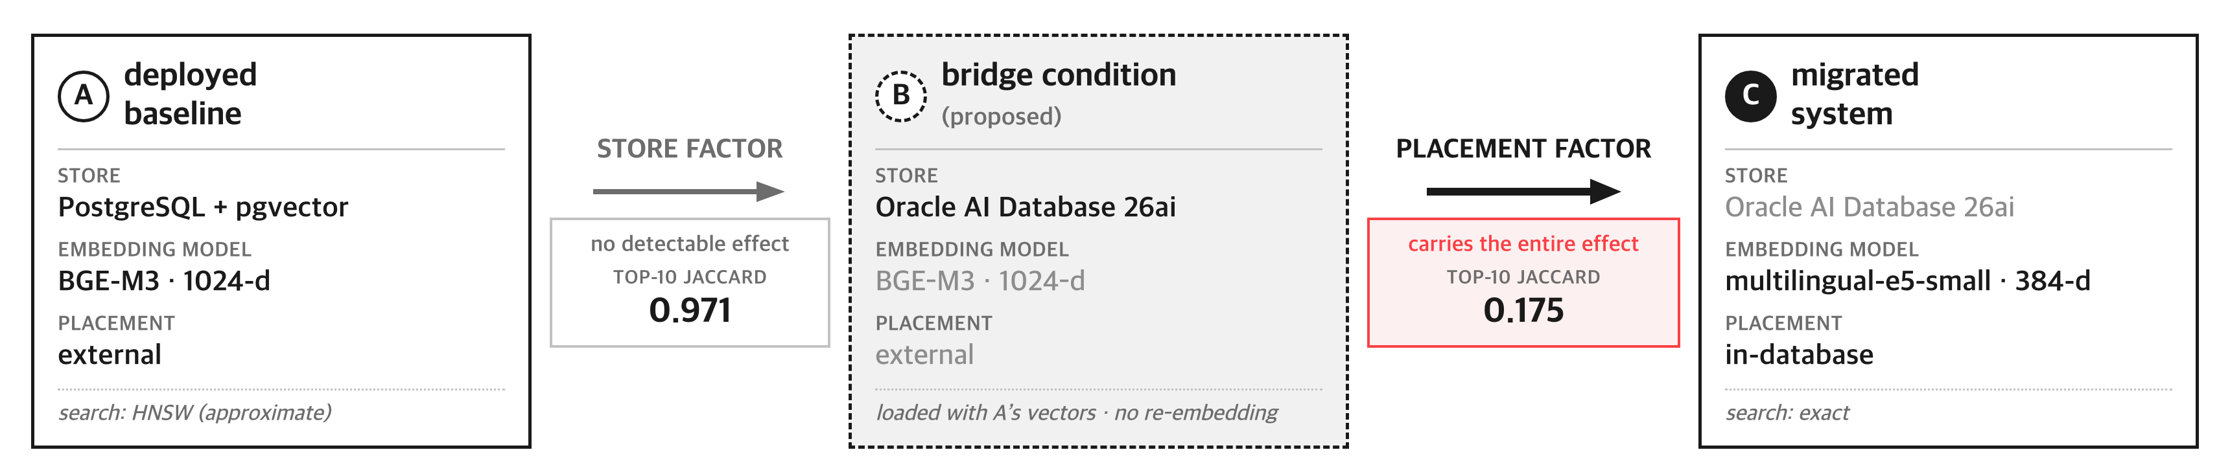
Proposal · A Bridge Condition Separates the Factors
원본이 만든 벡터를 목표 저장소에 그대로 실어 중간 조건 B를 만든다
· Load the target store with the vectors the source system has already produced — that is condition B
· A→B differs only in the store, B→C only in the placement — one factor at a time
6

Slide 7
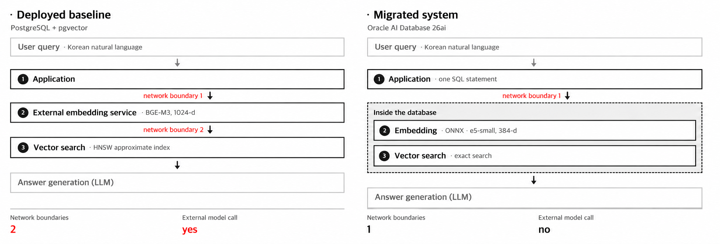
System Architecture · What Actually Changes
네트워크 경계가 2개에서 1개로 줄고, 외부 모델 호출이 사라진다
The retrieval rule (vector similarity + metadata filters + source-based prioritization) and its parameters were kept identical across the three conditions.
7

Slide 8
Experimental Setup
세 조건 A·B·C를 두고 청크 1,347개·질의 43개로 측정했다
 | A · baseline | B · bridge | C · migrated
Store | PostgreSQL + pgvector | Oracle 26ai | Oracle 26ai
Embedding model | BGE-M3 (1024) | BGE-M3 (1024) | e5-small (384)
Placement | external | external | in-database
Vector search | HNSW approx. | exact | exact
Corpus and metrics · 대상과 지표
· 1,347 review chunks from a Korean product-review service in production · 43 fixed queries
· Retrieval agreement (Jaccard · Spearman · Recall@10) / evidence relevance (0–2 scale) / search latency
Confidence intervals from 10,000 bootstrap resamples. The target database ran on the lowest-tier free instance.
8

Slide 9
Result ① Store Factor · No Effect Detected
저장소만 바꿨을 때는 품질 변화가 검출되지 않았다
Top-10 Jaccard
0.971
[0.946, 0.992]
Relevance difference
−0.042
p = 0.523
Effect size dz
−0.098
negligible
· Loaded with identical vectors, the two stores returned exactly the same top-10 set for 37 of the 43 queries
· What the baseline missed because of its approximate index amounts to about 1.6%
· A Wilcoxon test on the queries that remain after excluding ties leads to the same conclusion (p = 0.908)
9

Slide 10
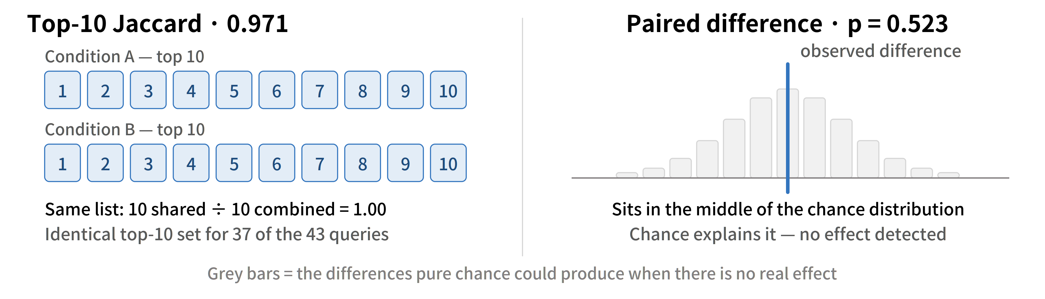
Reading the Numbers ① Store Factor
자카드는 겹치는 정도, p값은 우연일 확률을 뜻한다
10

Slide 11
Result ② Placement Factor · Significant, Medium-Sized
임베딩 위치를 옮기자 유의미한 중간 크기의 효과가 나타났다
Top-10 Jaccard
0.175
[0.133, 0.221]
Relevance score
1.270 → 1.014
p = 0.003
Effect size dz
0.473
medium
· Same store and same search method, yet mostly different evidence is retrieved for the same query
· Since no store effect was detected from A to B, virtually all of the quality change is due to the placement factor and the model size limit that comes with it
· Had only an end-to-end comparison been performed, the 20% drop in relevance would have been blamed on the store — and reverting the store would not bring the quality back
11

Slide 12
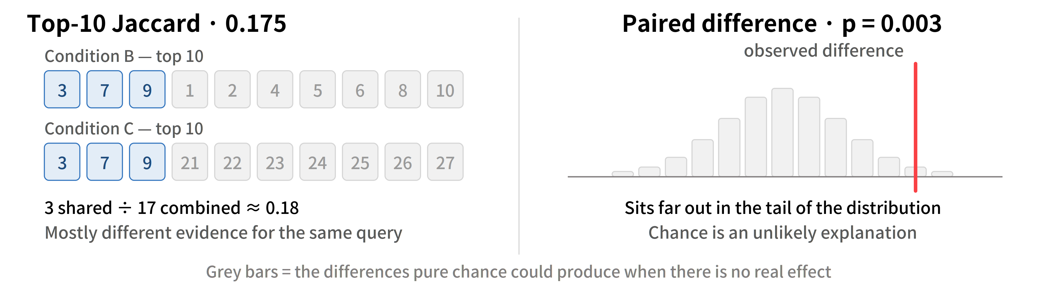
Reading the Numbers ② Placement Factor
같은 두 지표를 위치 요인에 그대로 적용해 본다
12

Slide 13
But · Claiming “No Difference” Needs Its Own Test
“차이 없음”을 주장하려면 등가성 검정을 따로 해야 한다
A non-significant p value is not evidence of equivalence · 유의하지 않은 p값은 동등함의 증거가 아니다
· We ran equivalence tests (TOST) separately over a ±0.15 point range
· The result was p = 0.052 — the lower bound of the confidence interval, −0.172, falls outside the range, so the significance level was not met
So we report it this way · 그래서 이렇게 보고한다
· Not “equivalence has been established”, but “no effect was detected and its magnitude is bounded to a small range”
· The direction in which the interval extends is the one where the target store scores higher, so there is no basis for concluding that substituting the store degraded quality
13

Slide 14
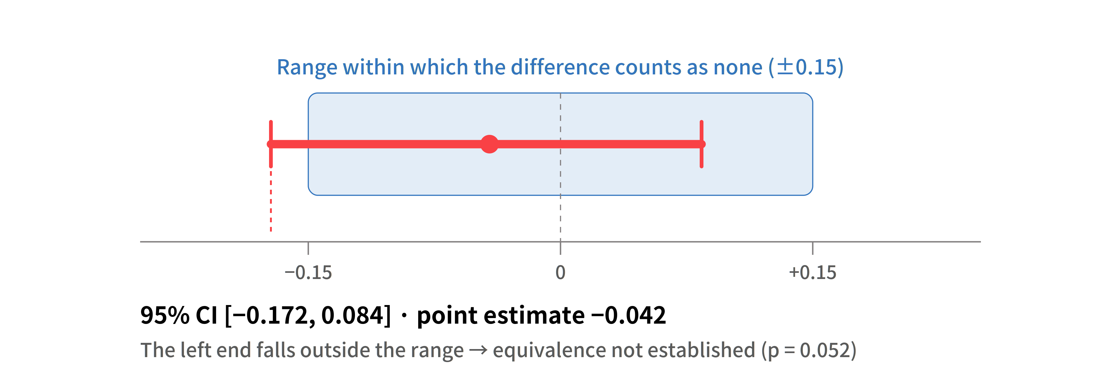
Reading the Numbers ③ Equivalence Test
신뢰구간이 범위를 벗어나 등가성은 성립하지 못했다
14

Slide 15
Conclusion
위치 변경은 성능의 교환이 아니라 거버넌스의 교환이다
Method · 방법
· Adding a single bridge condition splits an end-to-end comparison into two single-factor comparisons
What we observed in this service · 이 서비스에서 관측한 것
· No effect of the store factor was detected; the entire observed change originated from the placement factor
· Changing the placement is a trade in governance rather than in performance
A practical decision rule · 실무 판단 기준
· If governance of the stored data is the only goal → replacing the store alone is enough
· If the query path must also stay inside the boundary → first confirm that the largest model that can be hosted is sufficient for that domain
The bridge condition makes that confirmation possible before the migration
15

Slide 16
Limitations and Future Work
단일 코퍼스·LLM 채점·엔트리급 인스턴스라는 한계가 있다
Limitations · 한계
· A single Korean corpus of 1,347 chunks from one product domain
· Human assessors were not involved in the relevance scoring
· Measurements were taken on an entry-level instance — the latency figures cannot be generalized to higher-tier hardware
· Placement and model size are coupled by construction, and the store result does not establish equivalence
Future work · 향후 과제
· A fourth condition that runs the smaller model outside the database would separate placement from model size
16

Slide 17
Q&A
Thank you for listening to the presentation.
16

