Slide 1
A Factor Decomposition Method for Separating
Store Substitution and Embedding Placement Effects
in Vector Database Migration
2026 International Conference on PyGeek
August 20, 2026 · Hongik University, Seoul
Junha Yoon · Ohhyeon Gwon · Junhaeng Lee · Hyeji Roh · Soowan Cho · Suhee Kim · SangSoon Lim
Sungkyul University · Chung-Ang University · Deep Insight Lab

Slide 2
Contents
1
Introduction
2
Proposed Method
3
Performance Evaluation
4
Experiment Result
5
Conclusion
1

Slide 3
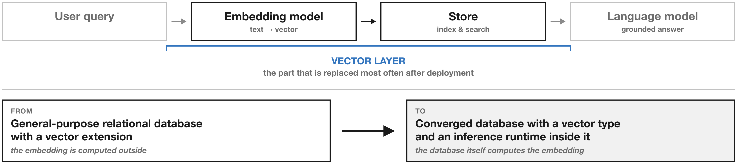
1. Introduction
The vector layer is the part that gets replaced after deployment
· A RAG system combines an embedding model, a store, and a language model
· A common migration moves it to a converged database that embeds internally
2

Slide 4
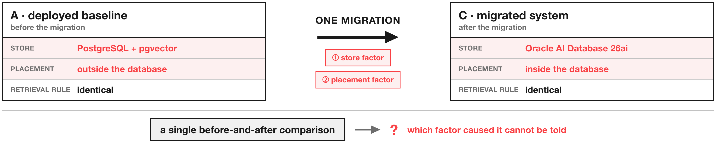
1. Introduction
One migration changes two things at the same time
· The store and the embedding placement move together, not one at a time
· A governance-driven migration pulls the model inside, and the model size limit follows
· A single before-and-after comparison cannot attribute the change to either factor
3

Slide 5
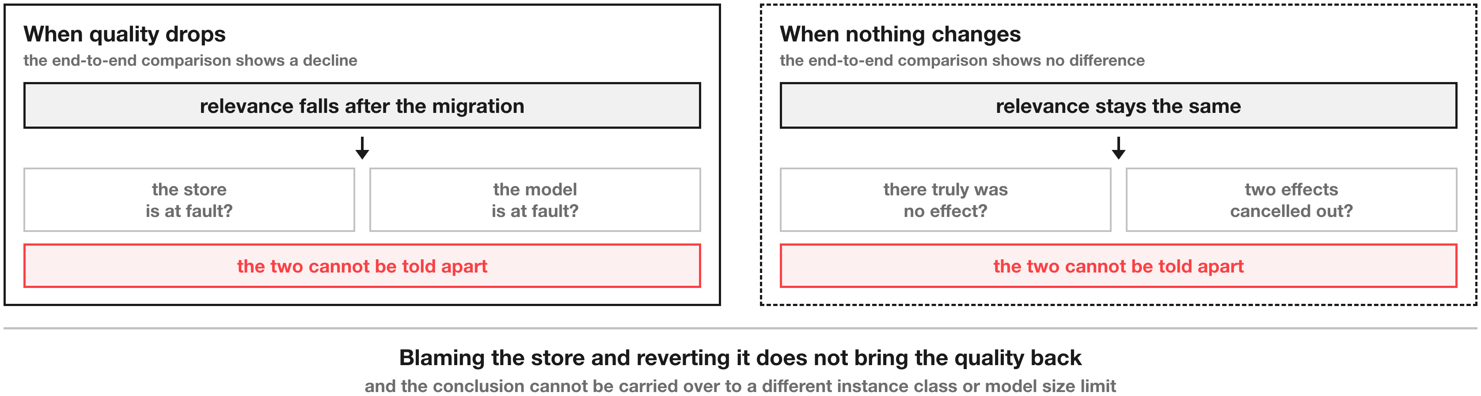
1. Introduction
Misattributing the cause leads to the wrong remedy
· A decline cannot be assigned to the store or to the model
· No observed change may mean no effect, or two effects cancelling each other out
4

Slide 6
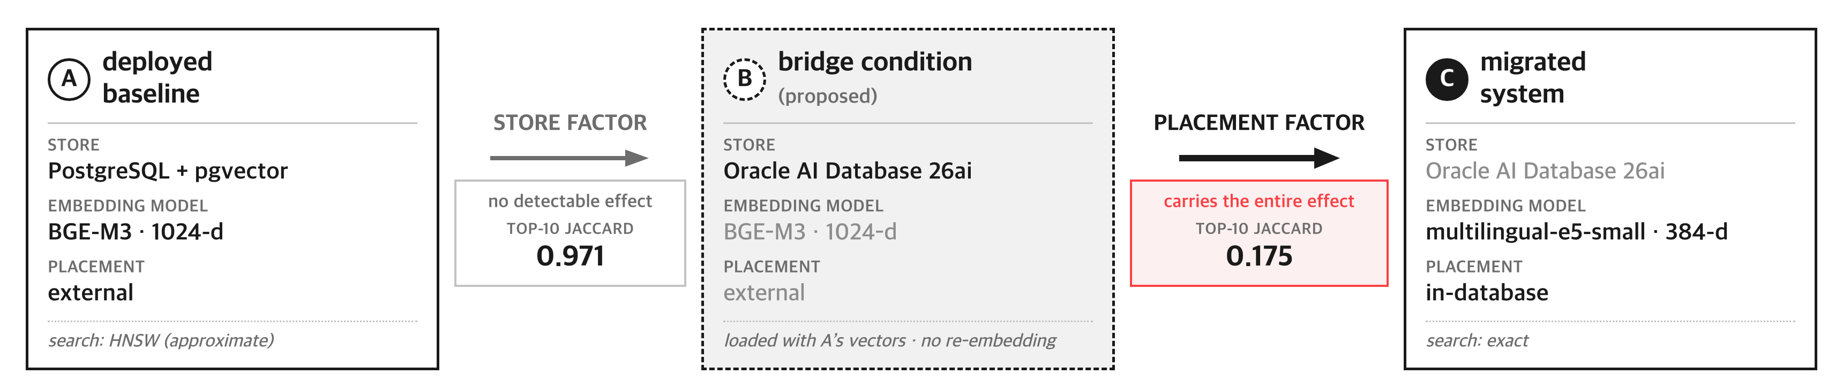
2. Proposed Method
A bridge condition splits one comparison into two
· Load the target store with the vectors the source system has already produced
· A to B differs only in the store, B to C only in the placement
· No re-embedding is required, so the running service is left untouched
5

Slide 7
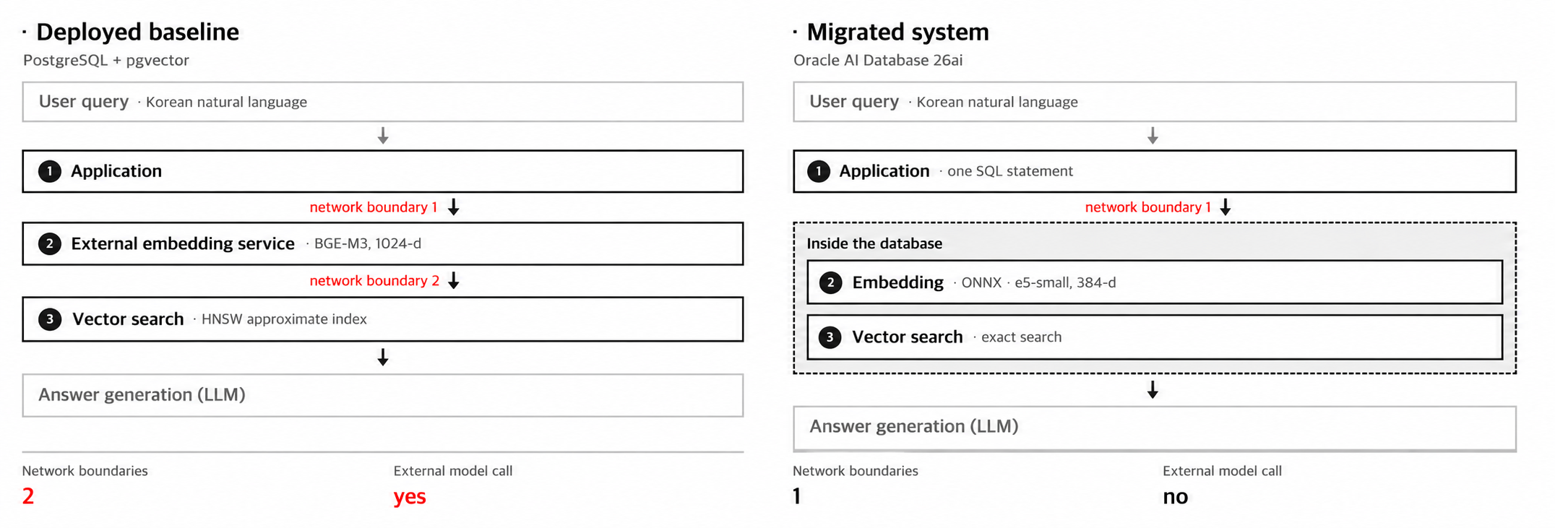
2. Proposed Method
Network boundaries drop from two to one and the external model call disappears
· The retrieval rule and its parameters were held identical across the three conditions
6

Slide 8
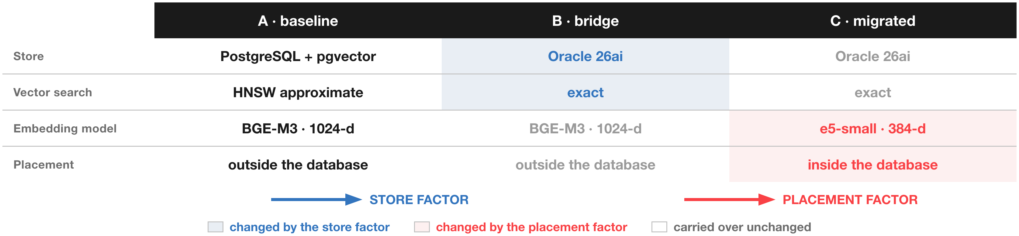
3. Performance Evaluation
Three conditions measured over 1,347 chunks and 43 fixed queries
· Retrieval agreement, evidence relevance on a 0 to 2 scale, and search latency
· Confidence intervals from 10,000 bootstrap resamples on an entry-level instance
7

Slide 9
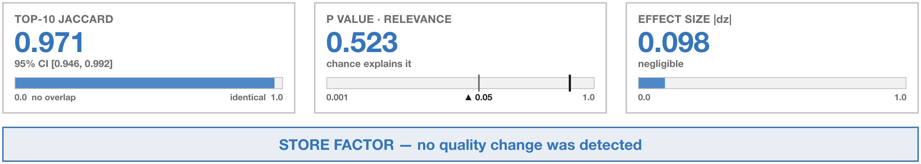
4. Experiment Result
Store factor — no quality change was detected
· An identical top-10 set was returned for 37 of the 43 queries
· What the approximate index missed amounts to about 1.6 percent
· A Wilcoxon test on the queries remaining after ties agrees (p = 0.908)
8

Slide 10
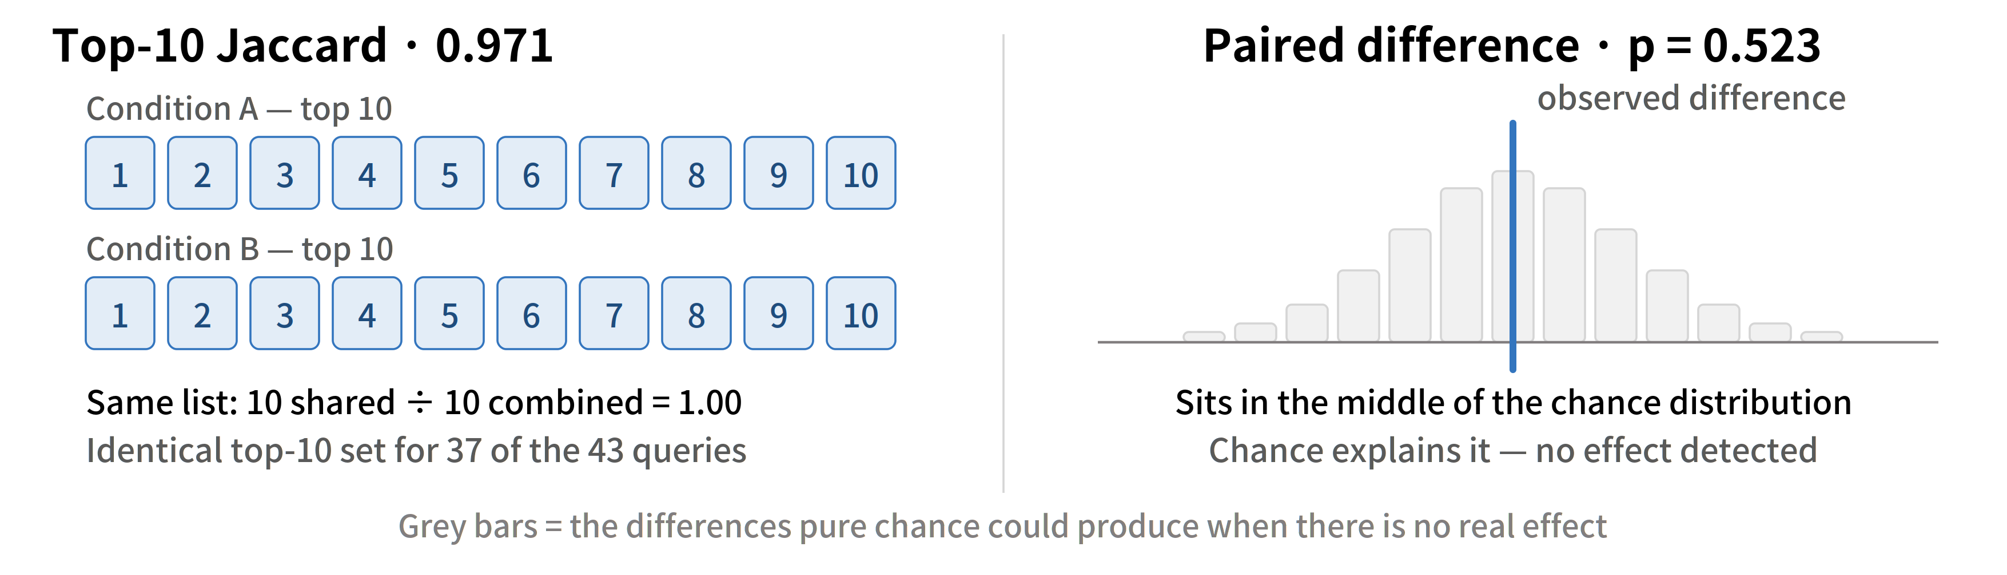
4. Experiment Result
How the two metrics are read
· Jaccard is how much the two result sets overlap; the p value is how well chance explains it
9

Slide 11
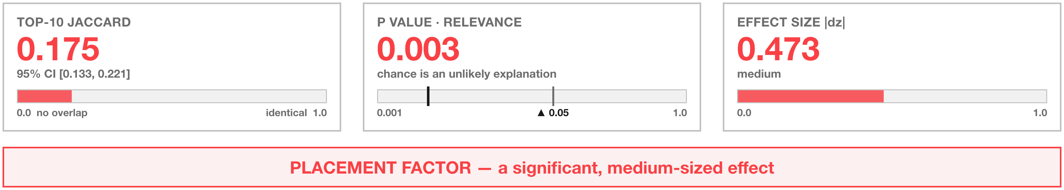
4. Experiment Result
Placement factor — a significant, medium-sized effect
· The same store and the same search method returned mostly different evidence
· Since no store effect was detected, the change is attributable to the placement factor
· An end-to-end comparison alone would have blamed the store instead
10

Slide 12
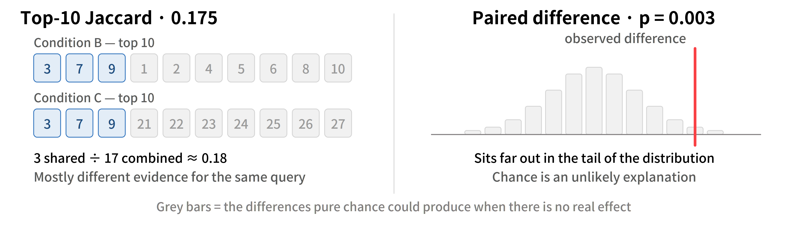
4. Experiment Result
The same two metrics applied to the placement factor
· Jaccard falls from 0.971 to 0.175 and the p value from 0.523 to 0.003
11

Slide 13
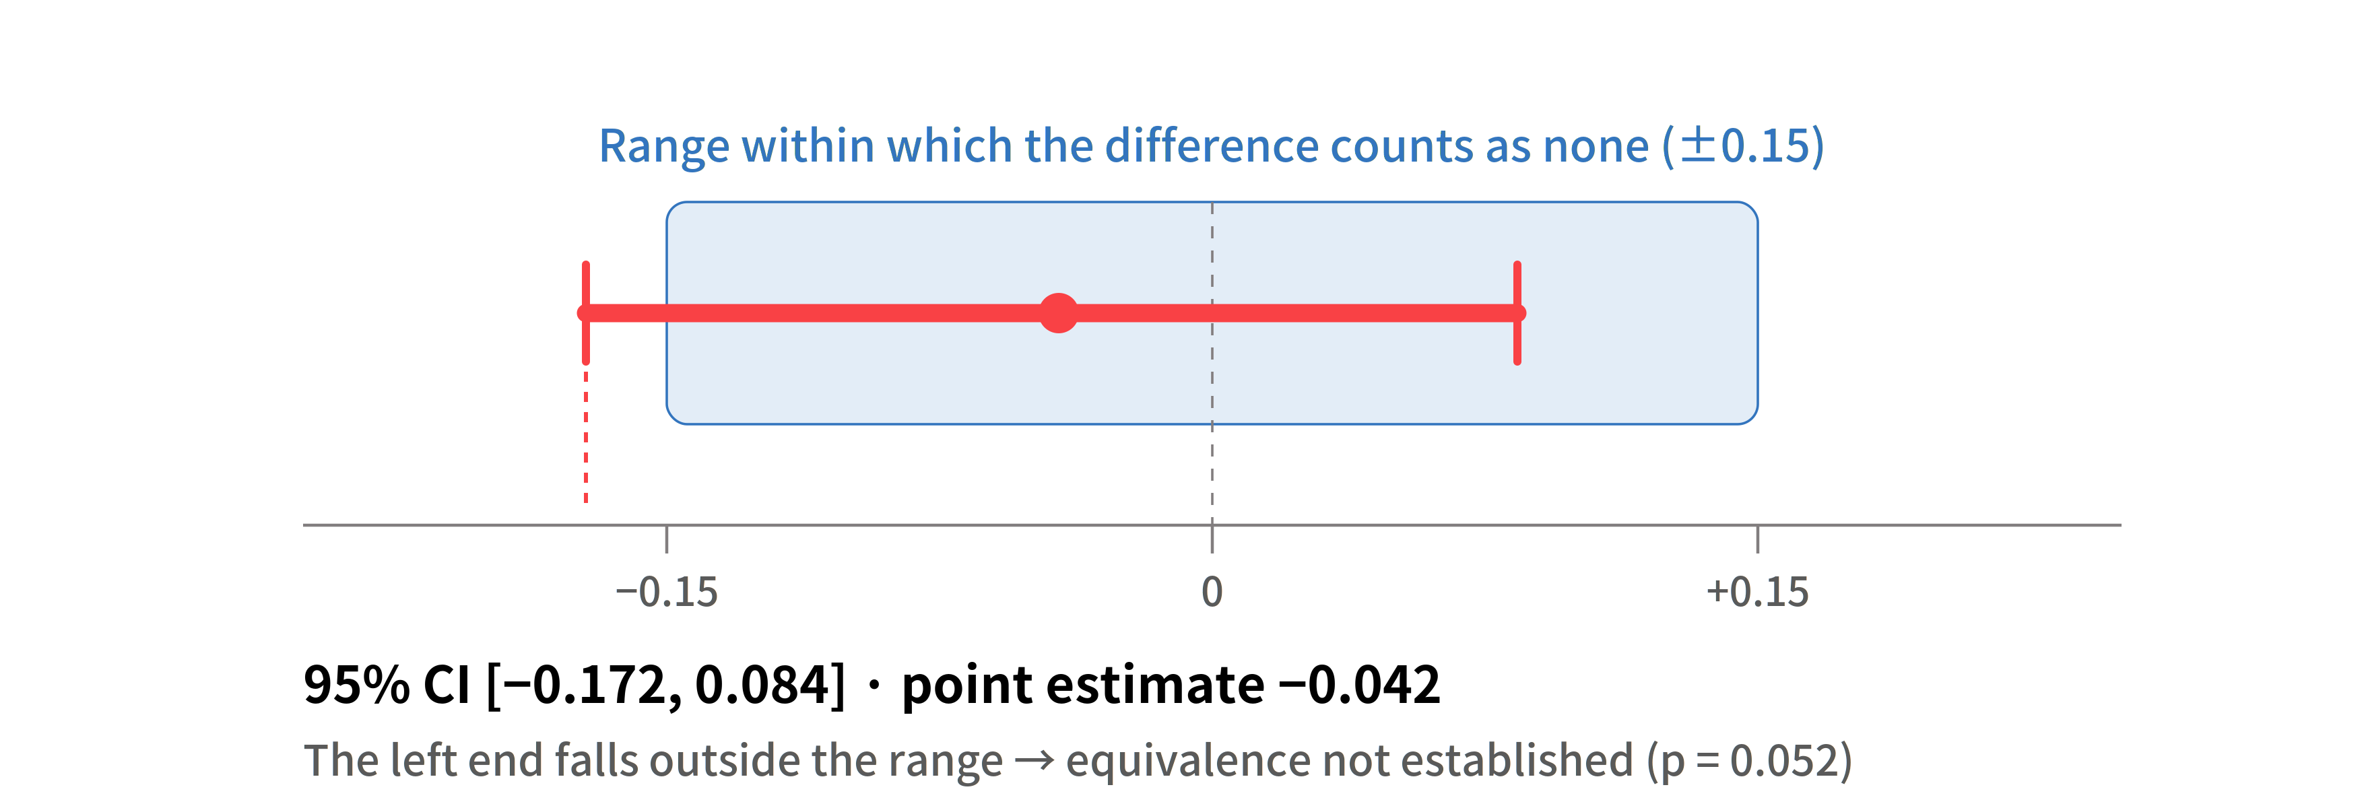
4. Experiment Result
Claiming no difference requires an equivalence test of its own
· A non-significant p value is not evidence of equivalence
· TOST over a plus or minus 0.15 range gave p = 0.052, so the level was not met
· We report no effect detected with a bounded magnitude, not equivalence established
12

Slide 14
5. Conclusion
Moving the placement is a trade in governance rather than in performance
· A single bridge condition splits an end-to-end comparison into two single-factor comparisons
· No store effect was detected; the entire observed change originated from the placement
A practical decision rule
· If governance of the stored data is the only goal, replacing the store alone is enough
· If the query path must stay inside the boundary, confirm the model size limit first
· The bridge condition makes that confirmation possible before the migration
13

Slide 15
5. Conclusion
Limitations and future work
· A single Korean corpus of 1,347 chunks drawn from one product domain
· Human assessors were not involved in the relevance scoring
· Measurements were taken on an entry-level instance, so latency does not generalize
· Placement and model size are coupled by construction
· The store result does not establish equivalence
Future work
· Running the smaller model outside the database would separate the two factors
14

Slide 16
Thank You
15

