Slide 1

Supply Chain Management
Group – 5

Slide 2



Kpi’s
* Total Sales (YTD,MTD,QTD) *Store Wise Sales *Sales Growth *Daily Sales Trend *Brand Wise Sales *Gross Profit *Product in Inventory *Over stock ,out of stock, Understock *Inventory Value *Region Wise Sales *Total Profits, Profit Margin and Unique Orders by Region *Total Profits by Region

Slide 3




Introduction
The project may focus on different aspects of the supply chain, such as procurement, production, logistics, and distribution. The ultimate goal of the project is to identify areas for improvement and develop strategies for enhancing the overall performance of the supply chain.

Slide 4
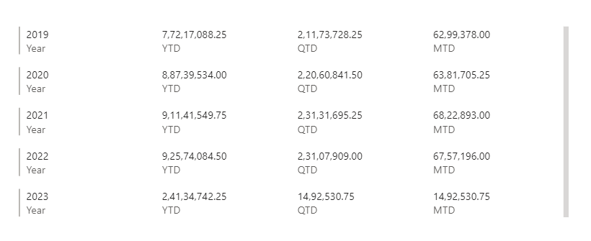
Total Sales (YTD,MTD,QTD)

Slide 5
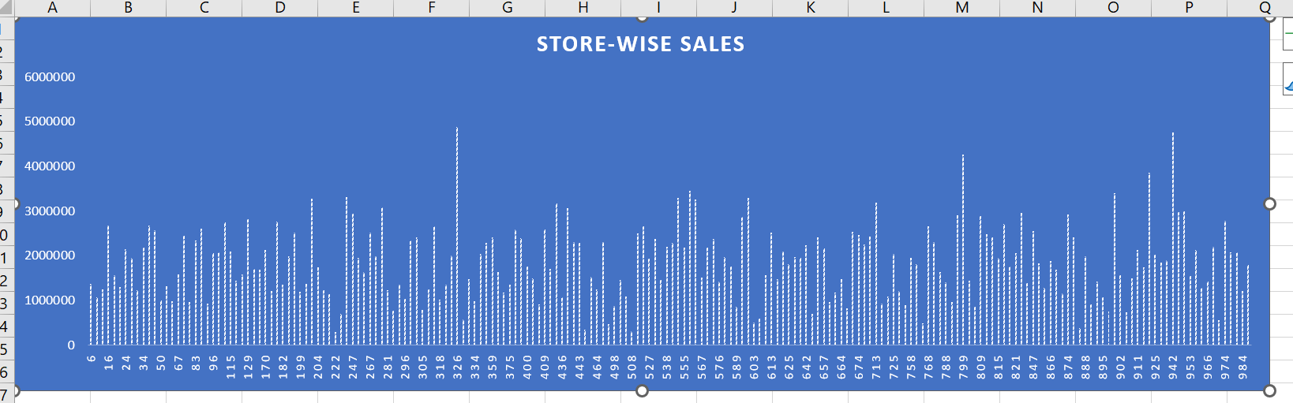
Store Wise Sales *store key 326 i.e Argyle Store has max sales i.e 48,82,155

Slide 6
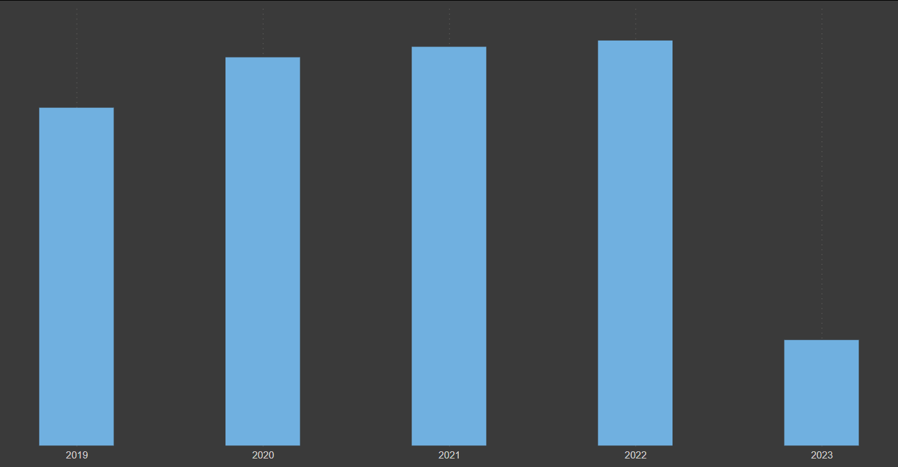
Sales Growth per year * we have highest sales in the year 2022 * Immense decrease of sales in 2023

Slide 7
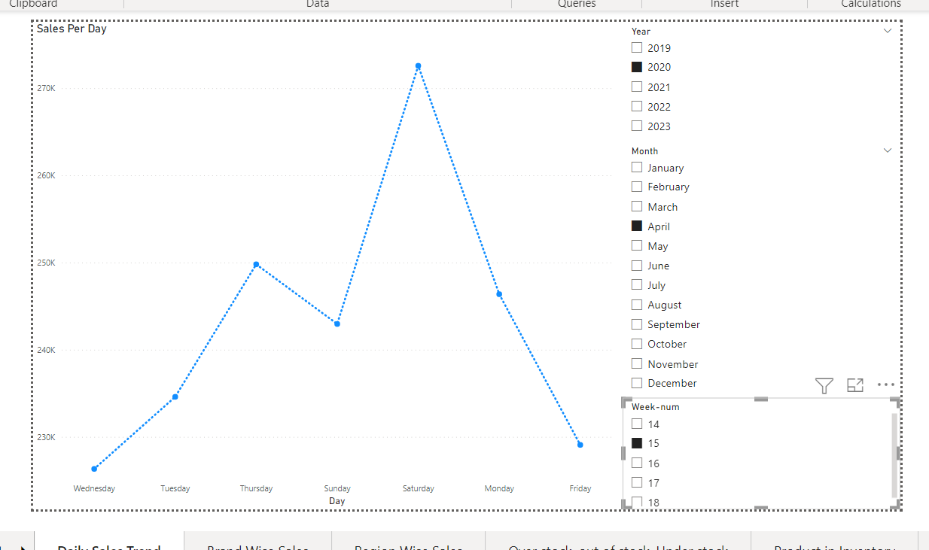
Daily Sales Trend *Used slicers for Year, Month and Week so that we can select the required one and check daily sales in a week

Slide 8
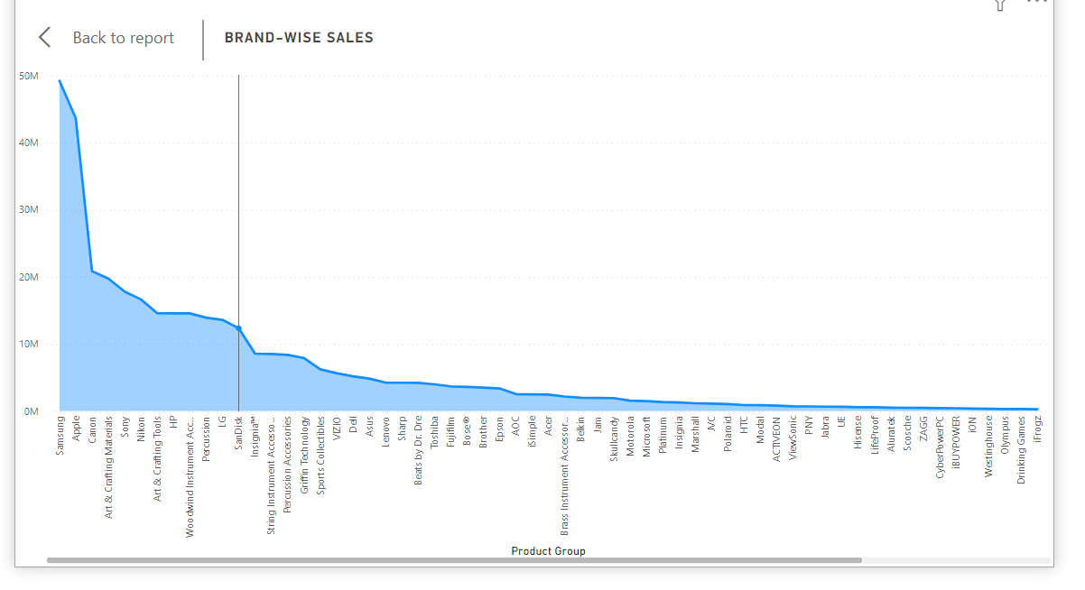
Brand Wise Sales *Samsung brand has higher sales and apple brand stands next.

Slide 9
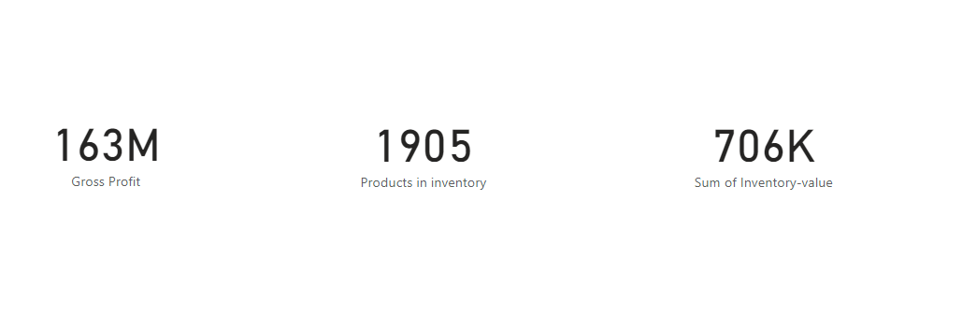
Gross Profit, Product in Inventory , Inventory Value

Slide 10
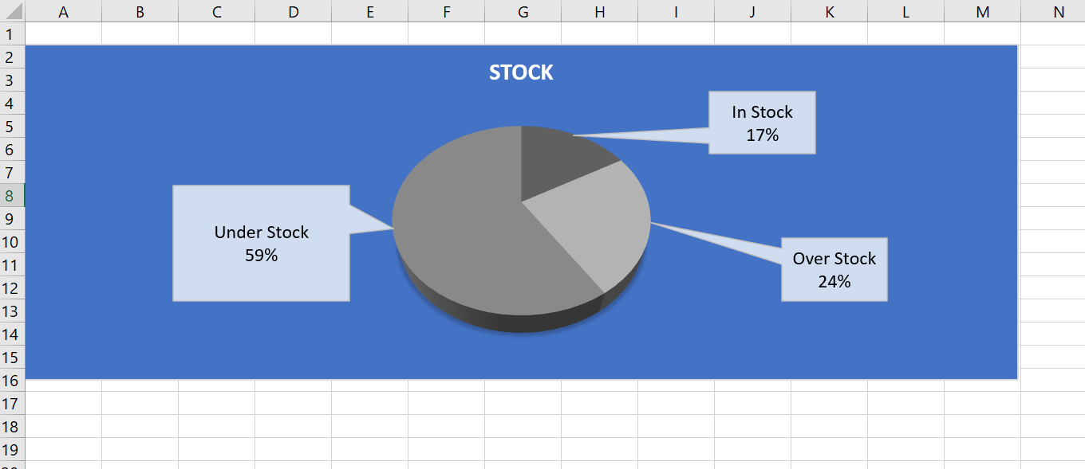
*Over stock ,out of stock, Understock

Slide 11
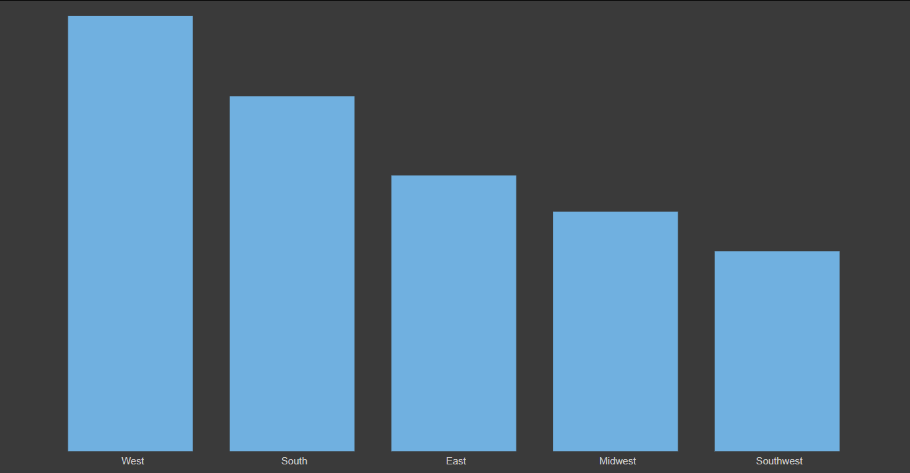
Region Wise Sales *West region has most of the sales and Southwest has least sales.

Slide 12
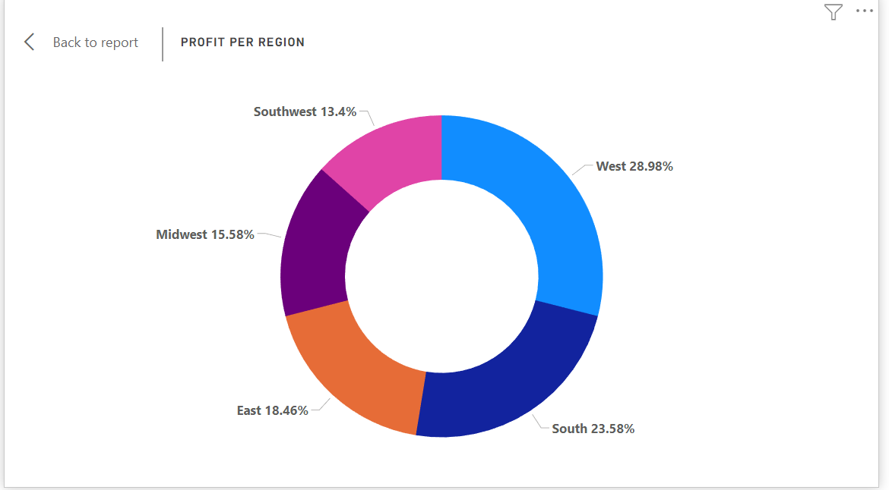
Total Profits by Region *West region has most of the profit.

Slide 13
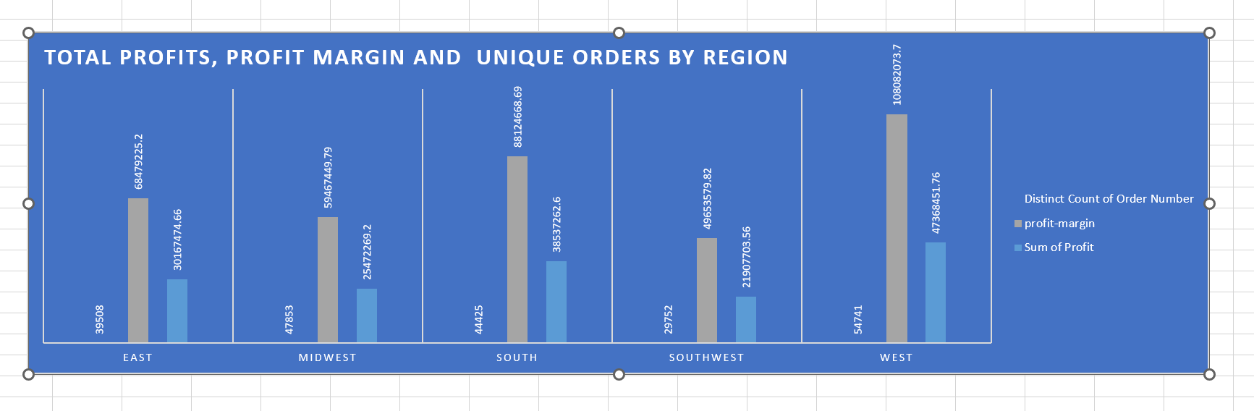
Total Profits, Profit Margin and Unique Orders by Region

Slide 14
Team
Pagilla Sai Preethi
Anjaly Thandel
Navya Juvaladine
Aarthi babu
Jones Edwin
Chinta Srinivas
Muhammad Shifas

Slide 15

Summary
*West region has more profit as sales are also high. *Most of the products are under stock. *Most of the customers are willing to get products from Samsung brand i.e there is a huge demand for those products . * The sales in 2023 are less because we have data only upto april *Got more orders in the year 2022.

Slide 16


Thank You

