Slide 1


SMART INDIA HACKATHON 2024
TITLE PAGE
Problem Statement ID –1607
Problem Statement Title- A smart AI based solution for traffic management.
Theme- Smart Automation
PS Category- Software
Team ID-
Team Name - Nebula

Slide 2
IDEA TITLE
Team Nebula
How It Addresses the Problem:-
The solution tackles traffic congestion by minimizing idle times at traffic signals, improving road safety, and ensuring better traffic flow, especially during peak hours.
The AI system responds to sudden events such as accidents or road closures, adapting in real-time to prevent bottlenecks.
Detailed Explanation of the Proposed Solution:-
Our AI-based traffic management system uses real-time data from sensors, cameras, and IoT devices to optimize traffic flow.
The system leverages machine learning algorithms to predict and adjust traffic light signals dynamically based on real-time conditions like traffic volume, time of day, and road incidents.
Innovation and Uniqueness of the Solution:-
Unlike traditional traffic systems, this solution uses predictive modeling and real-time data analytics, offering scalability and adaptability across various environments (urban, suburban, highways).

Slide 3






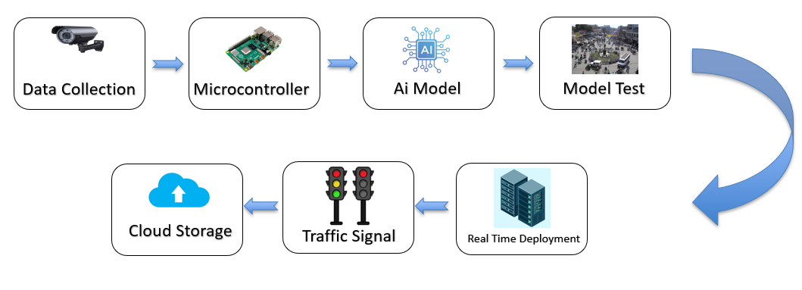
TECHNICAL APPROACH
Team Nebula
Technologies used
Methodology and Process for Implementation :-
Data Collection: Collect real-time data from traffic sensors, cameras, and vehicle GPS.
Machine Learning Model: Develop a predictive AI model trained on historical and real-time traffic data.
Traffic Signal Control: Use AI outputs to dynamically control traffic signal.

Slide 4
FEASIBILITY AND VIABILITY
Team Nebula
Analysis of the feasibility of the idea :
Technological Feasibility: The required technologies (AI, IoT, sensors) are mature and proven to be reliable in real-world applications.
Financial Feasibility: While the initial investment may be high, long-term savings in terms of reduced congestion, fuel consumption, and time wastage make the system financially viable.
Potential Challenges and Risks :
Data privacy and cybersecurity risks.
High initial cost for infrastructure setup and maintenance.
System adaptability to unpredictable events like accidents, weather changes, or road closures.
Strategies for Overcoming These Challenges:
Implement strong data anonymization and encryption practices.
Conduct a phased rollout to manage costs and demonstrate effectiveness.
Train AI models on diverse datasets to handle various edge cases, and continuously improve with real-time feedback.

Slide 5
IMPACT AND BENEFITS
Team Nebula
Potential Impact on the Target Audience:
Commuters: Reduced travel times and less frustration due to congestion.
City Authorities: Improved traffic law enforcement and road safety.
Emergency Services: Faster emergency response times due to optimized traffic flow.
Benefits of the Solution:
Social: Enhanced quality of life through reduced traffic stress, fewer accidents, and quicker emergency response.
Economic: Decreased fuel consumption, reduced wear and tear on vehicles, and overall cost savings for individuals and government.
Environmental: Lower carbon emissions due to smoother traffic flow and reduced idle times at traffic lights, contributing to urban sustainability efforts.

Slide 6
RESEARCH AND REFERENCES
Team Nebula
https://rno-its.piarc.org/en/network-control/traffic-management#:~:text=Traffic%20Management%20refers%20to%20the,impact%20on%20road%20network%20performance
https://hyscaler.com/insights/ai-in-traffic-management-5-effective-ways/
https://www.clickworker.com/customer-blog/artificial-intelligence-road-traffic/

