Slide 1
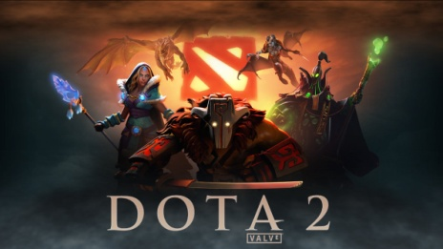
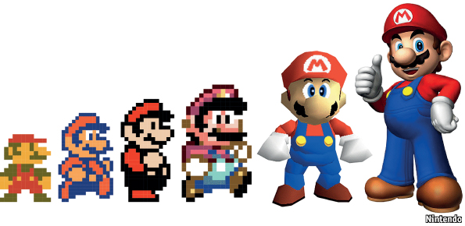


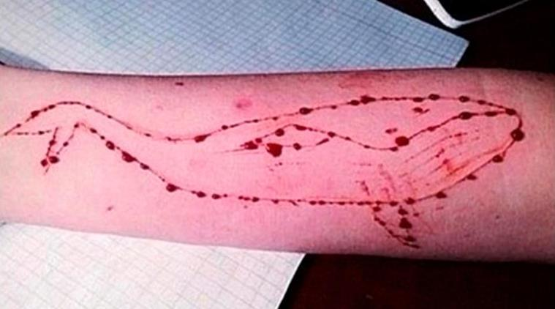
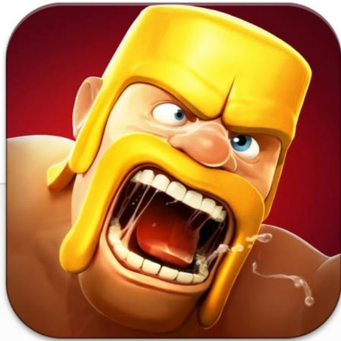

Communication- How gaming affected the society

Slide 2
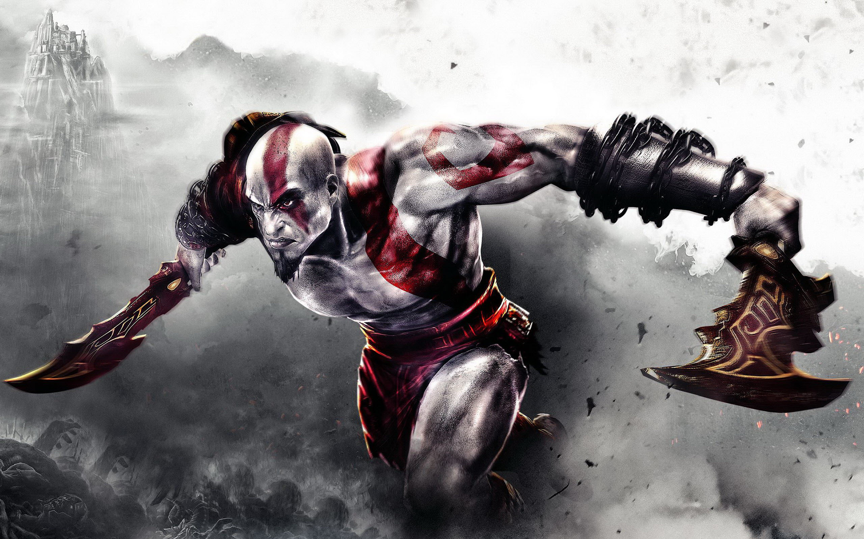
Introduction
So, what’s GAMING?
BIRTH of Gaming…
Types of Gaming.
Effects of gaming.

Slide 3
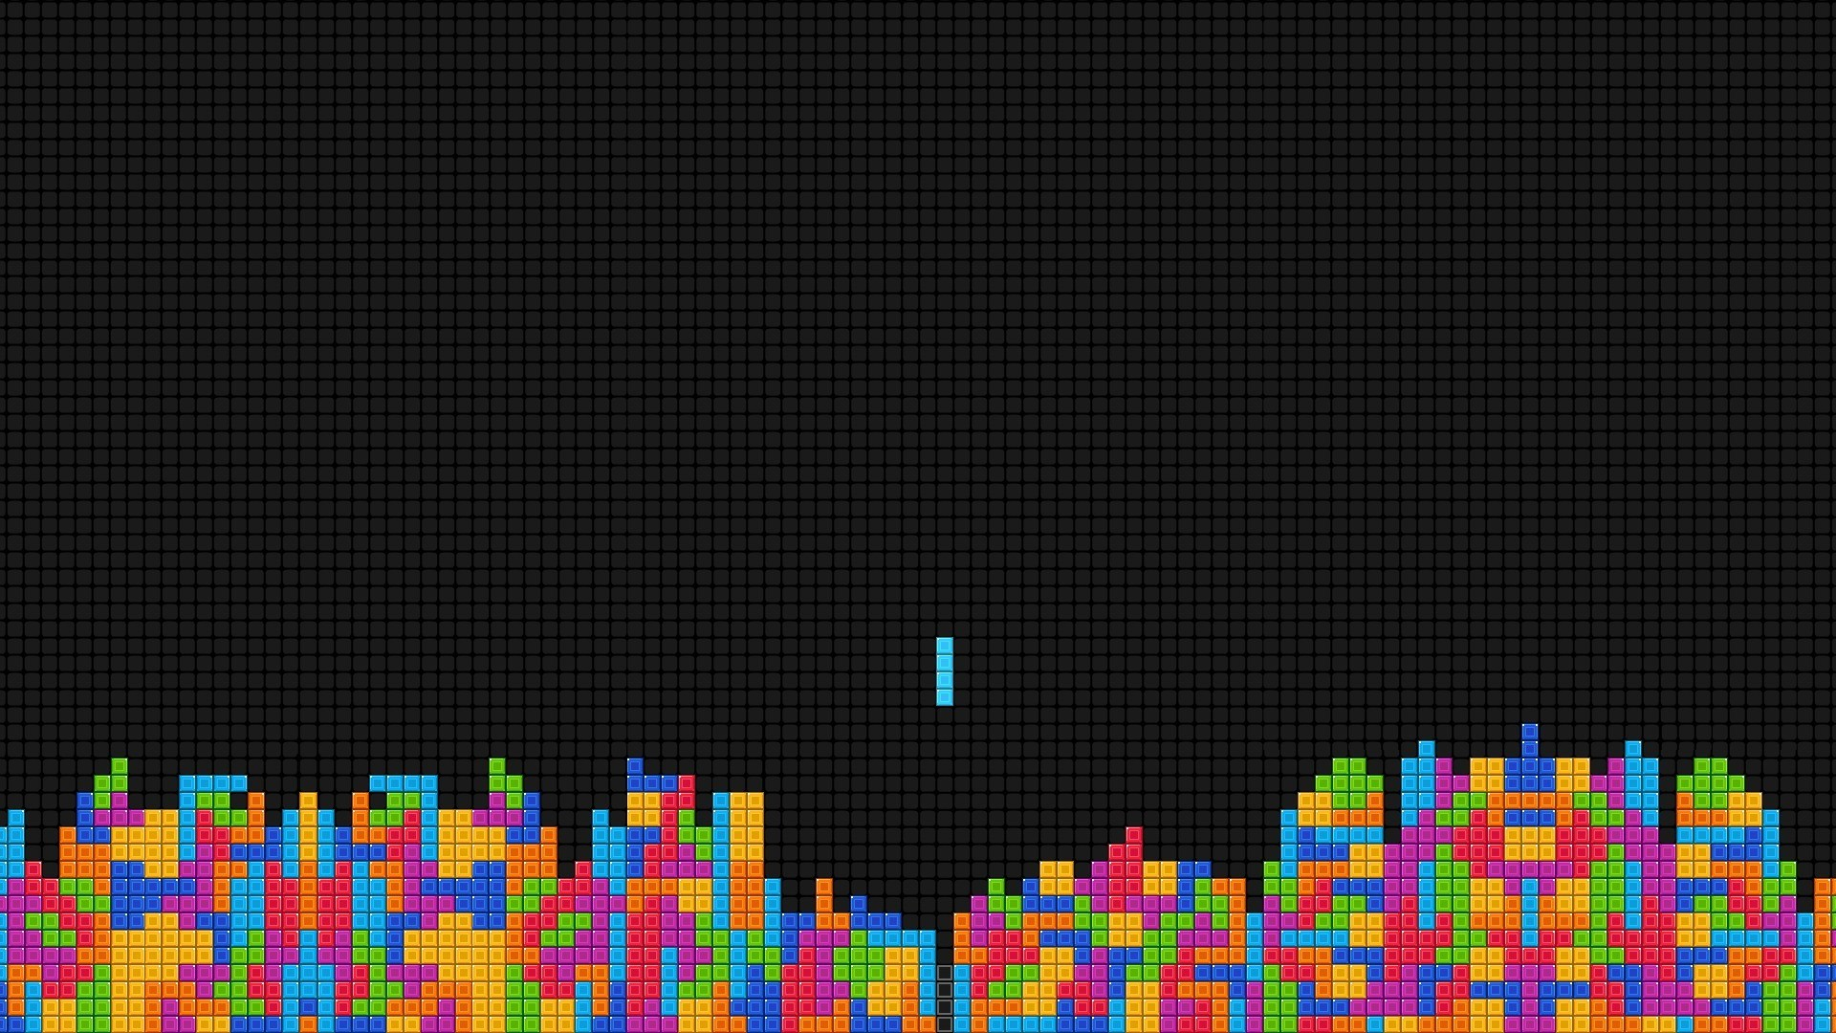
Objectives
Our research is on how gaming affected the society over the years.
Research will focus on few aspects like how gaming evolve since it’s birth.
How people reacted to the evolution and how it affected their lifestyle.
How it affects behavior.

Slide 4
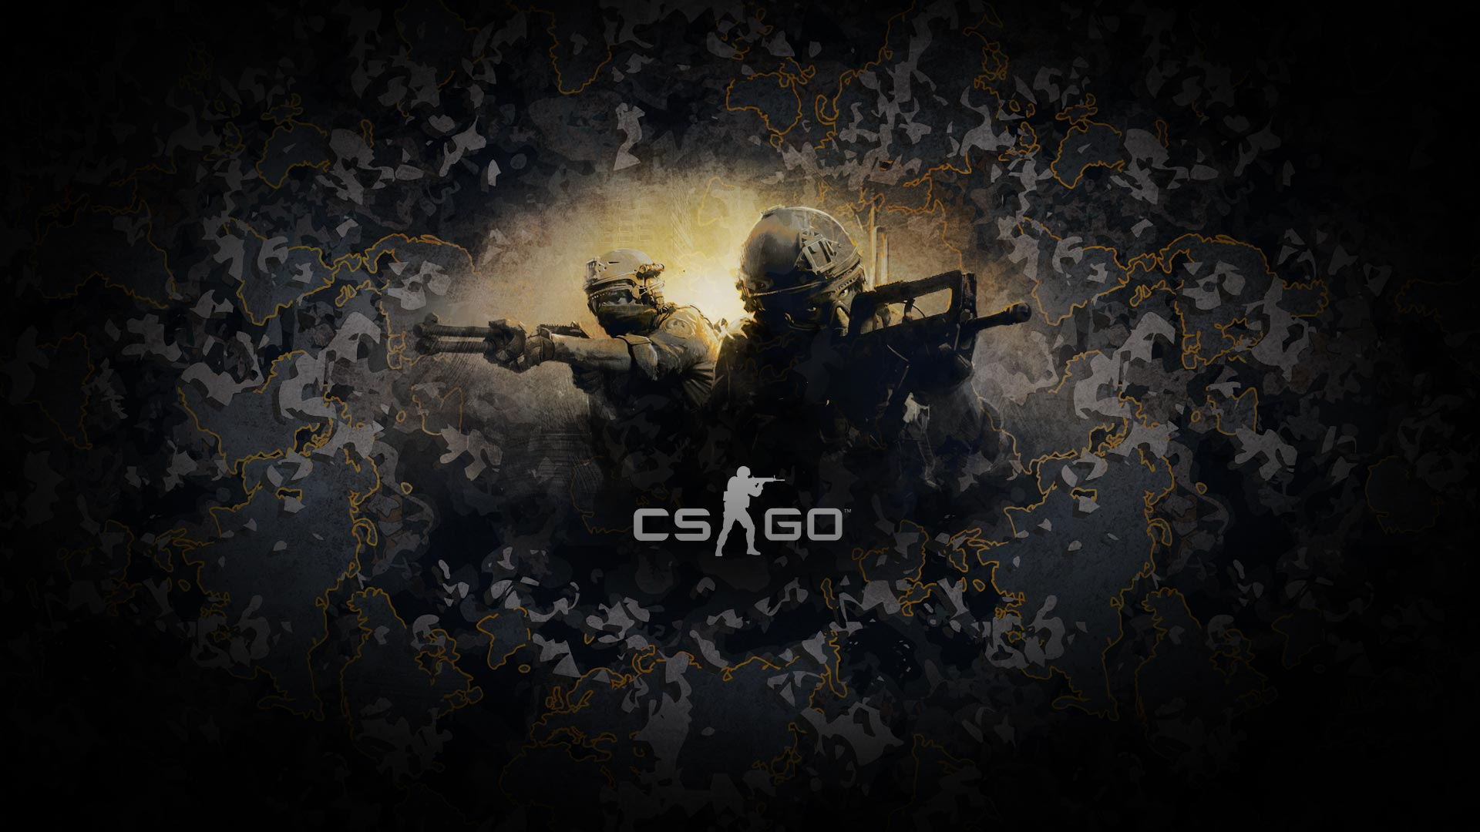
Methodology
Conducting Surveys
#Google forms
Sample space
Target group

Slide 5
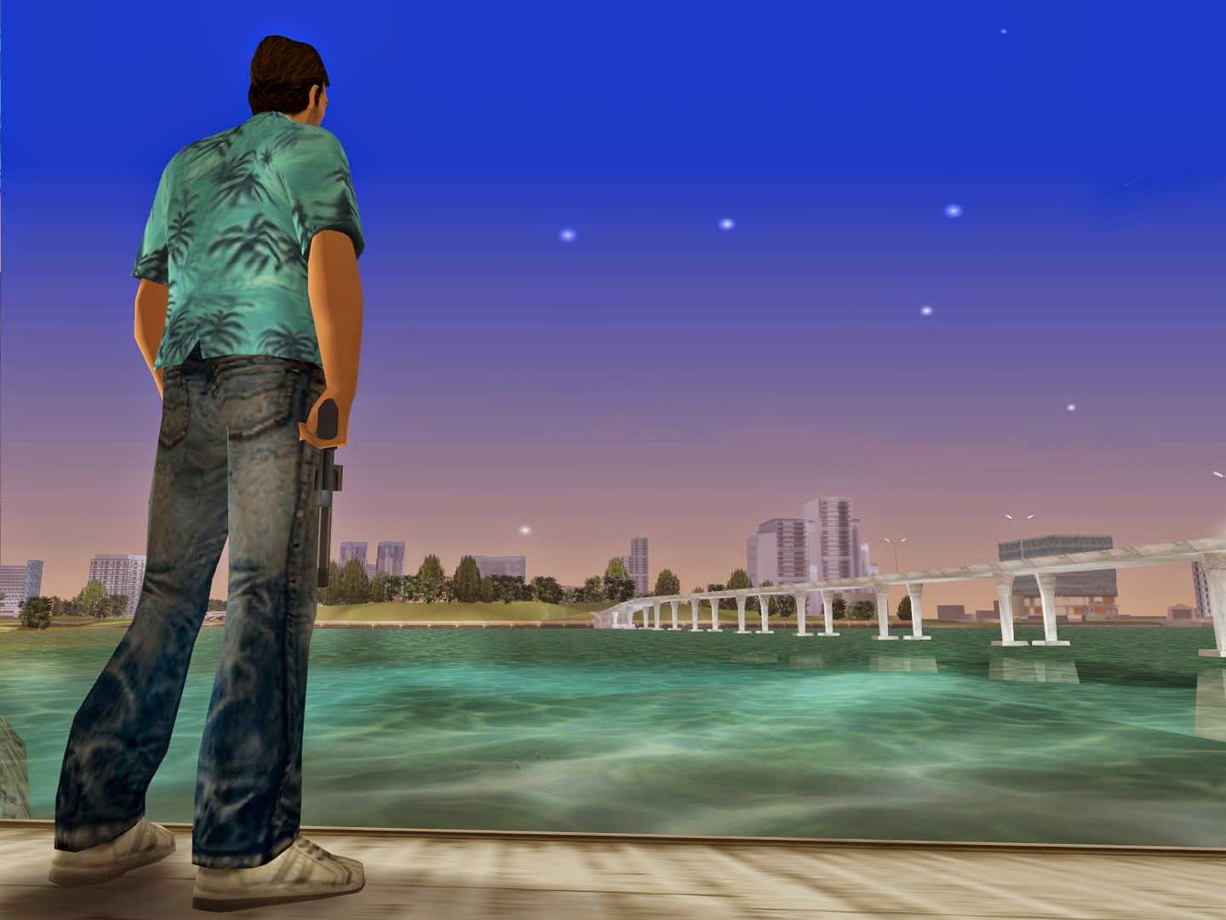
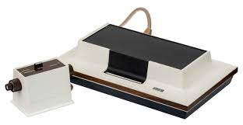
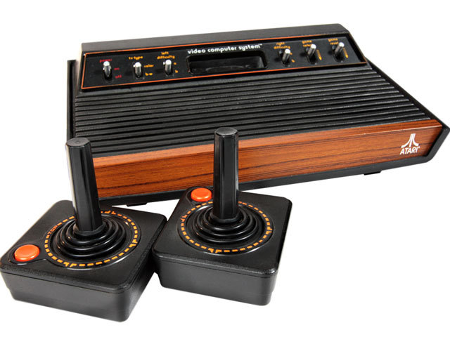
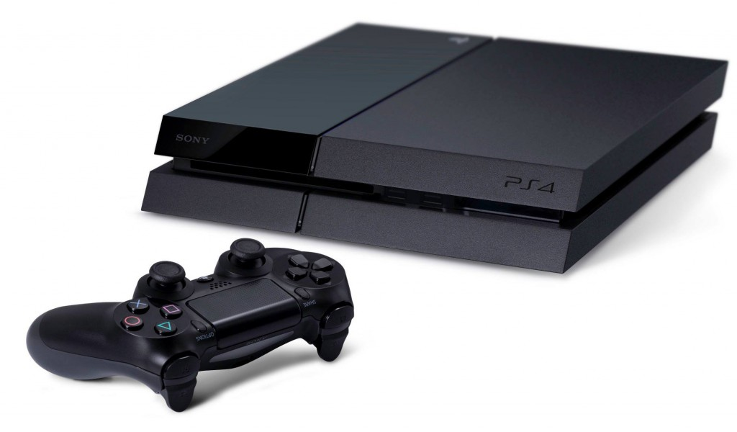
Evolution
First Console :
Better Versions :
Consoles Nowadays :

Slide 6

Hypothesis
Gaming affects Brain.
Gaming affects Behaviour.
Gaming affects Lifestyle.
Gaming is Useful.

Slide 7

Thank You
Group-5
Enrolment ID NAME
16103452 Maharshee Swain 16103463 Jaydeep Nakrani
16103464 Yaksh Patel
16103475 Raj Patel
16103489 Rutvij Panot

