Slide 1
Application of Data Mining In Weather Data
Xavier Tay Yi Han WQD180109

Slide 2
01
OBJECTIVE
02
PROCESS WORKFLOW
03
RECOMMENDATION
04
CONCLUSION

Slide 3
OBJECTIVES
01

Slide 4
OBJECTIVES
1
To identify correlation of weather features with weather conditions
2
To develop machine learning models for prediction of future weather condition
3
To develop machine learning models for prediction of severity of weather news

Slide 5
SEMMA
SEMMA refers to process of Sampling, Exploring, Modifying, Modelling and Assessing.
Sample the data by creation of multiple data tables.
Explore the data by investigating anticipated relationships to gain understanding and ideas.
Modify the data by select and transform features before constructing a model.
Model the data with analytical tools to predict outcome of result.
Assess the data by extracting insights from data mining process

Slide 6
PROCESS WORKFLOW
02

Slide 7
Process Workflow
Step 6
Step 5
Predictive Analytic
Step 4
Sentiment Analysis
Descriptive Analytic
Step 3
Step 2
Correlation Analysis
Step 1
Data Pre-Processing
Data Extraction

Slide 8
OVERVIEW DIAGRAM
Weather Data Source
Unstructured Data
Structured Data
Weather News
Weather Forecast Data
Source: https://www.theguardian.com/us-news/us-weather
Source:
http://www.myweather2.com/City-Town/United-States-Of-America/Washington/Seattle/14-Day-Forecast.aspx

Slide 9
STRUCTURED DATA PRE-PROCESSING
Data Pre-Processing
STEP 1
Append Weekly Weather Datasets
STEP 3
Impute
Missing
Values
STEP 5
Renaming Target
Attribute
UNSTRUCTURED DATA PRE-PROCESSING
STEP 1
Append Weekly
Weather
News
STEP 3
Remove
Unwanted
Symbols
STEP 2
Remove
Unnecessary symbols &
characters
STEP 4
Detect
Outlier &
Anomalies
STEP 2
Remove
Duplicated
Records

Slide 10
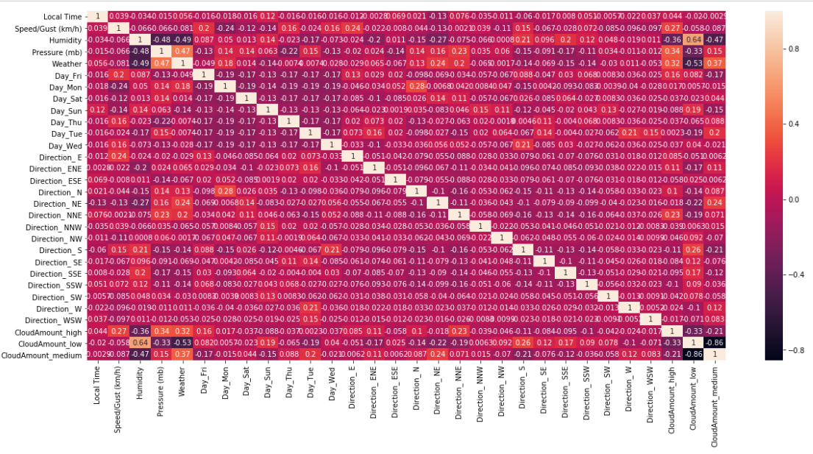
Correlation Analysis

Slide 11
Correlation Summary
The variables that has highest correlation with weather target variable are:
What does it tell us?
On sunny day, the pressure will be higher.
On rainy day , the humidity and cloud amount will be higher.
Features | Correlation Coefficient | Correlation
Pressure | Positive | 0.47
Humidity | Negative | -0.49
CloudAmount_low | Negative | -0.53

Slide 12
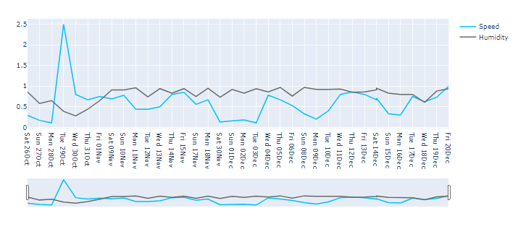
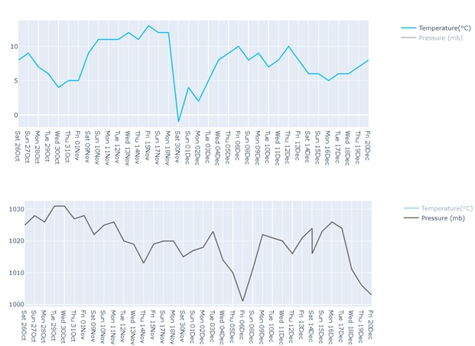
Descriptive Analysis
Value
Value
Temperature vs Date
Speed & Humidity vs Date
Date
Date
Value
Pressure vs Date
Sharp increase of wind speed in October and decrease gradually to 0.2-0.8
Humidity slightly decrease in October and fluctuate over the chart between 0.7-0.95
Date
First chart illustrated temperature remained low from October to December.
Second chart displayed decreasing trend of pressure when approaching to December

Slide 13
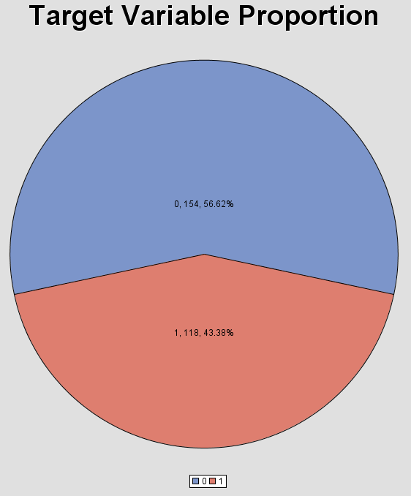
Descriptive Analysis
Balanced Target Class

Slide 14
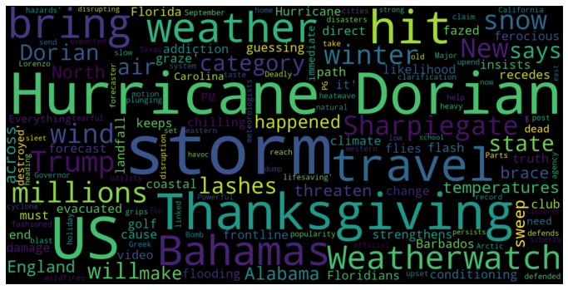
Sentiment Analysis
Word Cloud
WHAT CAN WE KNOW FROM THIS?
There are high occurrence of storm and hurricane from October to December
Alabama, Bahamas and Florida (seacoast states) are more likely to experience these disasters
It is a danger season for fishing activities on sea
WHAT USERS CAN DO?
Citizens in these seacoast states should reduce outdoor activities
It is advised to bring raincoat and umbrella if travelling and outdoor activities are unavoidable
Fisherman should stop fishing activities on sea due to high storm and hurricane occurrence.

Slide 15
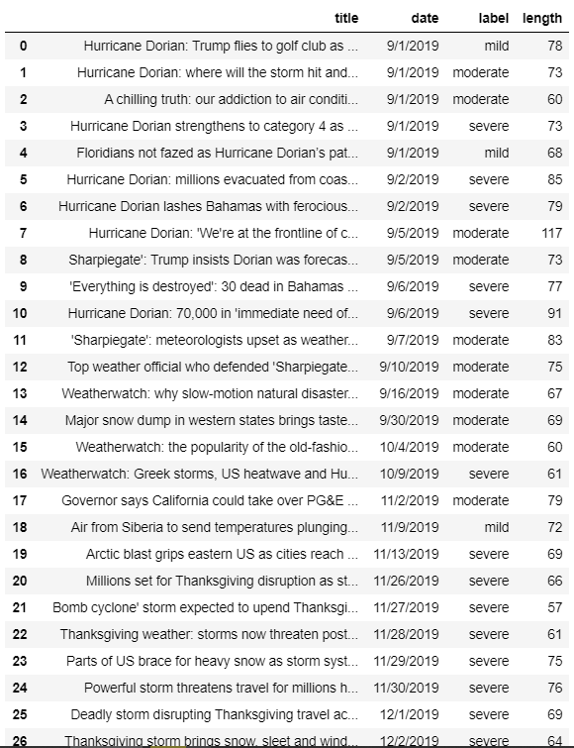
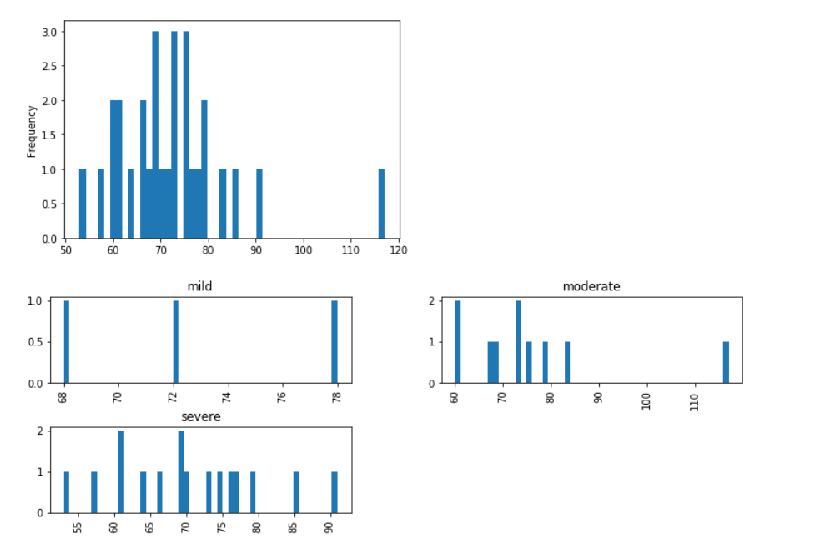
Sentiment Analysis

Slide 16
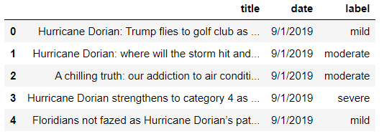
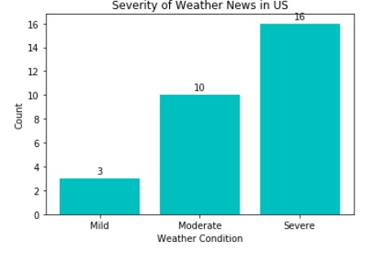
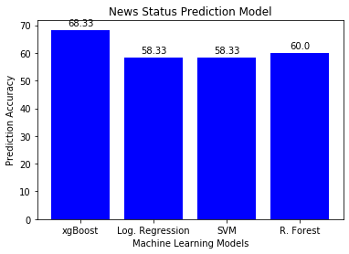
Sentiment Analysis
NEWS IMPACT CLASSIFICATION
WHAT CAN WE KNOW FROM THIS?
NEWS IMPACT CLASSIFICATION
The seriousness of a news can be identified
Helps news company to classify the news, and publish headlines based on the impact level of the news
Automatic news impact classification by labelling using prediction model
WHAT USERS CAN DO?
Citizens are alerted if there is a breaking news that is labelled as severe
Increase the visibility of critical news on the web page or mobile application of a news company
Readers can filter news based on the impact level of the news, which improve their reading experience

Slide 17
Predictive Analysis
Data
Target Variable
Input Variable
3 Month of US Weather Data
Weather Forecasting of Next Day
( Rainy / Sunny)
Humidity, Pressure, Cloud Amount and etc.

Slide 18
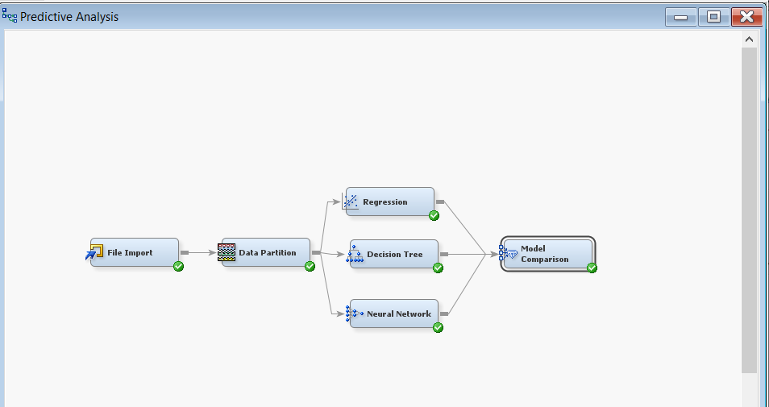
Predictive Analysis
Target Variable: Weather (Rainy/Sunny)
Input Variables: Wind speed & direction, temperature, humidity, pressure, cloud amount, precipitation amount
Dataset is partitioned into: 40% training set, 30% validate set, 30% test set
3 Classification models are employed: Logistic Regression, Decision Tree, Artificial Neural Network

Slide 19
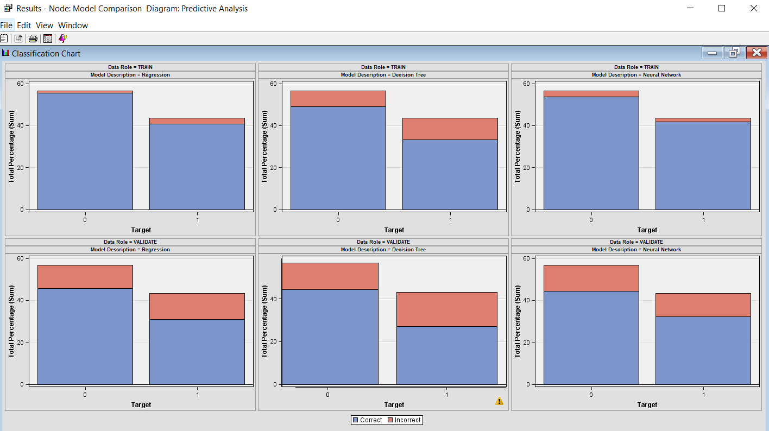
Predictive Analysis Chart

Slide 20
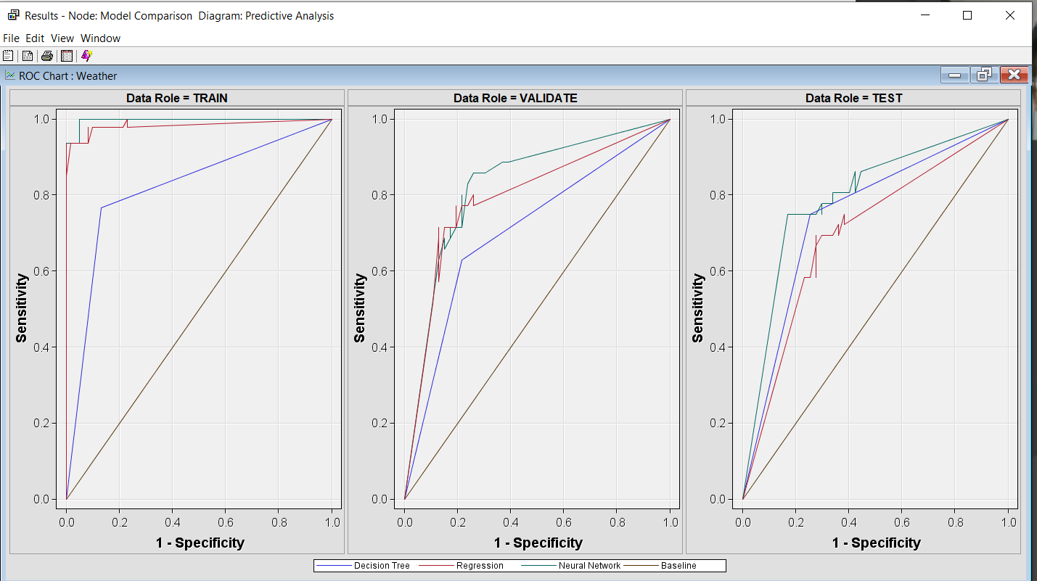
Predictive Analysis ROC Chart
ANN
LR
DT
Baseline
The ROC chart indicates how the classification model perform in each train, validate and test stages.
Overfitting issue is indicated in Logistic Regression and Decision Tree as they perform very well in training set, but poorly in unseen data (testing set).
Artificial Neural Network performs the best with higher area under the curve, and no indication of overfitting

Slide 21
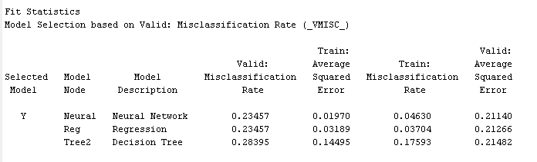
Predictive Analysis Result
Artificial Neural Network is the best performing model with lowest misclassification rate without overfitting issue
Decision Tree is the worst performing model with highest misclassification rate with overfitting issue.

Slide 22
RECOMMENDATION
03

Slide 23
Recommendation
News company could adopt the application of news impact classification to increase visibility of critical news on web page. The severity of weather news may create travel upheaval. Extreme weather has the ability to wreak havoc on tourism industry.
Weather forecasting model is beneficial for people because the model could helps to predict weather condition for next day so that any planning for next day could be made beforehand.
Model constructed could be improved by collecting more weather data because the larger the volume of data used for analysis, the more reliable the model constructed.

Slide 24
CONCLUSION
04

Slide 25
Conclusion
Correlation Analysis
On sunny day, the pressure will be higher.
On rainy day , the humidity and cloud amount will higher.
Sentiment Analysis
Frequent occurrence of storm and hurricane from October to December in America
Seacoast states such as: Alabama, Bahamas and Florida are more likely to experience these disasters
Predictive Analysis
Artificial Neural Network is the best performing predictive model for weather forecast.
Extreme Gradient Boosting (xgBoost) is the best prediction model for news impact classification.

Slide 26
Thank you

