Slide 1
Team - VitalCode
Skin Lesion Analysis Toward Melanoma Classification
Members - Koustubh Rao, Neeshi S Merchant, Onkar Borade, Akshay Padakanti

Slide 2
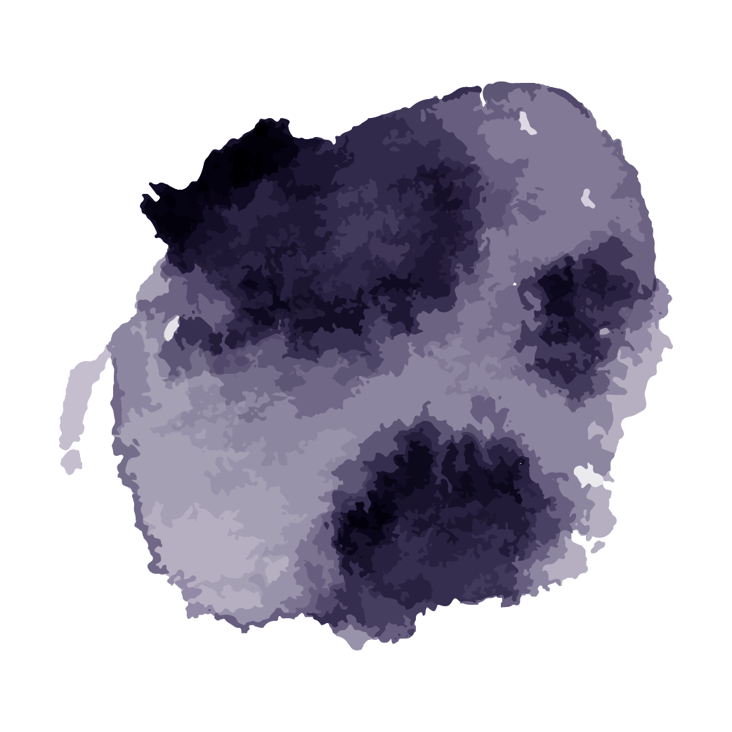
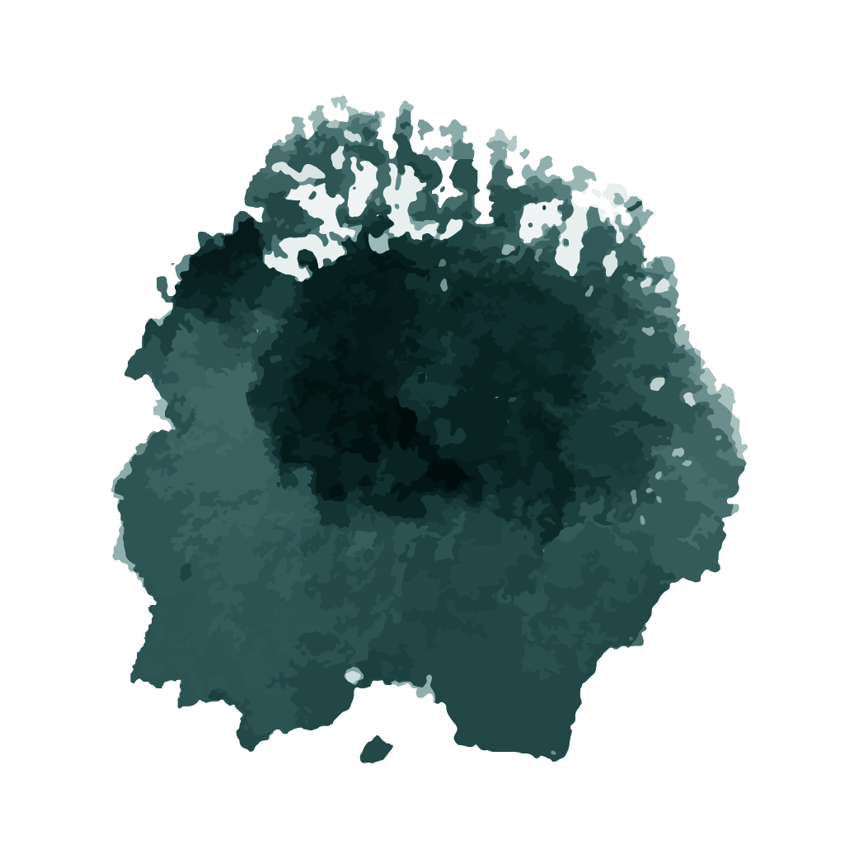
Table of Contents
01
03
02
04
What is Melanoma
Swin Transformer
Current Work
Results

Slide 3
What is Melanoma?
Melanoma is a type of skin cancer that develops from the pigment-producing cells known as melanocytes.
It is one of the deadliest forms of skin cancer due to its ability to metastasize, spreading to other parts of the body if not detected and treated early.
With early detection, the 5 year survival rate can be up to 99%; however, delayed diagnosis causes the survival rate to dramatically decrease to 23%
Melanoma can mimic benign moles, complicating visual diagnosis.

Slide 4
Problem Statement - Lesion Disease Classification
Classify dermoscopic skin images into 7 different skin cancers (Melanoma,Nevus,BCC,Pigmented Bowen’s,BKL,Dermatofibroma,Vascular)
Training data consists of 10015 images and test data consisted of 1512 images sized 600*450
Test data was further split into two partitions:
“internal” partition, consisting of 1,196 images selected from data sources that were consistent with the training dataset (two institutions in Austria and Australia)
“external” partition, consisting of 316 images additionally selected from data sources not reflected in the training dataset
Evaluation was carried out using balanced accuracy (BACC) , Area Under Curve(ROC- AUC)
BACC is mean recall across classes, where Recall = TP / (TP + FN)

Slide 5
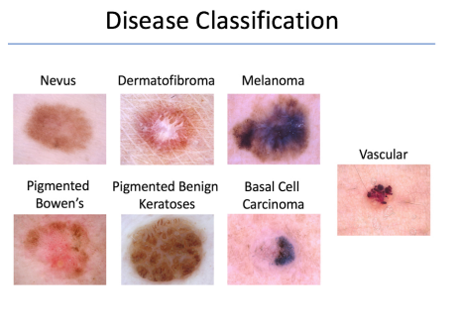

Slide 6
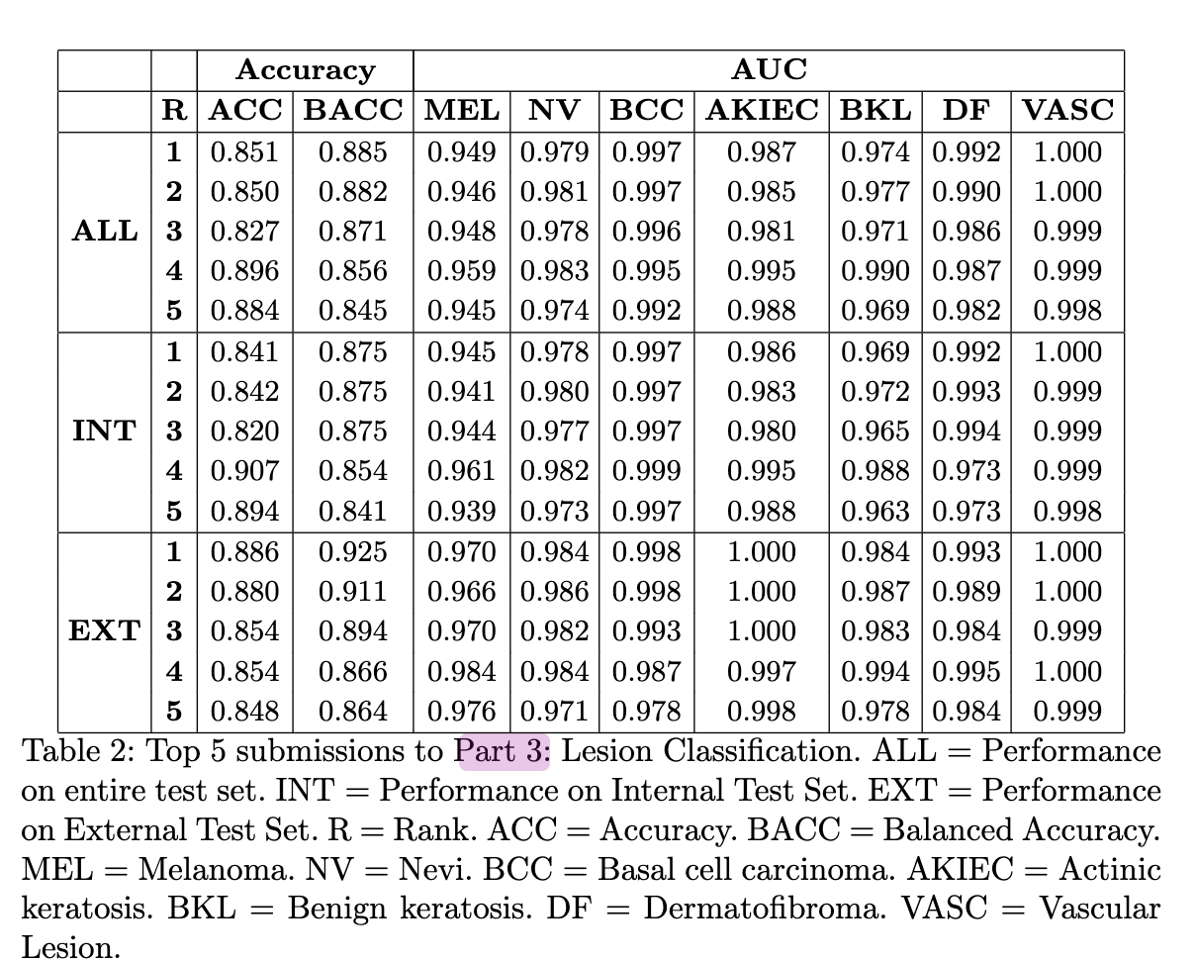
Previous Results
The Results of the top 5 submissions to Lesion Disease Classification of the Skin Lesion Analysis Toward Melanoma Detection challenge.

Slide 7
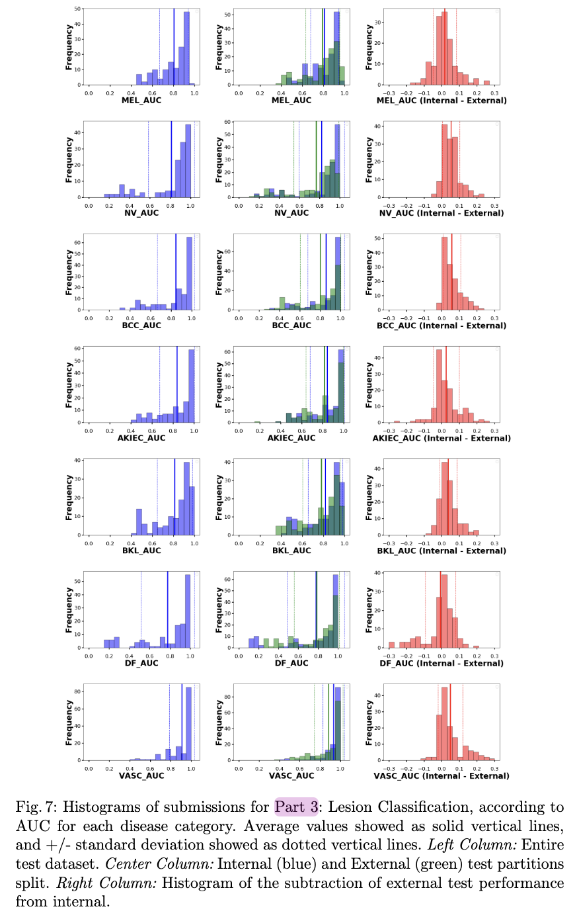
Comparisions
Histograms of submissions for Lesion Disease Classification, according to the Area Under the Curve (AUC) for each disease category.

Slide 8
Our Approach - Swin Transformer
Swin Transformer utilizes a hierarchical architecture, efficiently processing input data in stages to capture both local and global information.
It outperforms previous models in image classification tasks, such as ImageNet, thanks to its ability to efficiently capture long-range dependencies.
Swin Transformer is adaptable to various computer vision tasks, including object detection, semantic segmentation, and image generation.
With strong scalability and generalization properties, it handles inputs of varying resolutions and domains effectively, making it suitable for real-world applications.

Slide 9
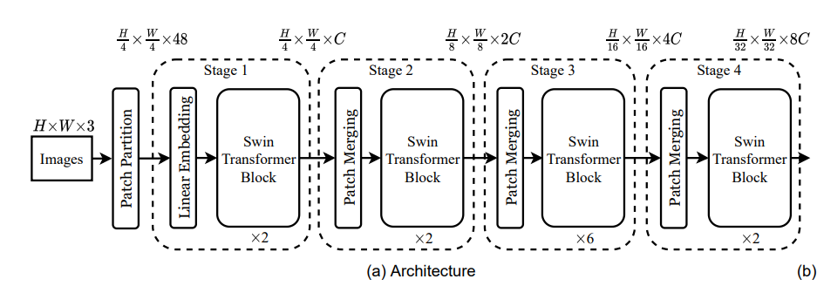

Slide 10
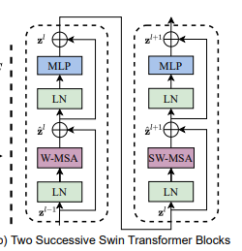
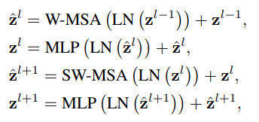
Notes:
Multi-head self attention modules

Slide 11
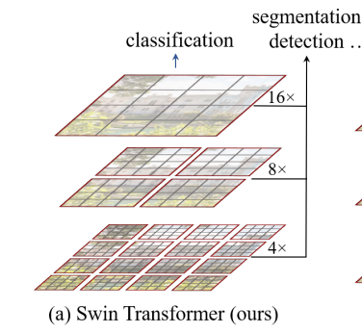
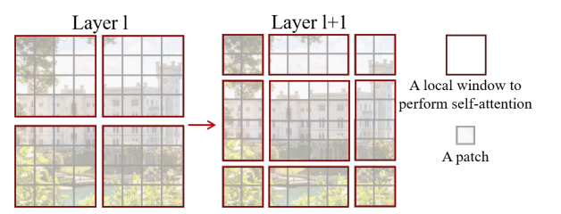
Shifted Window Approach

Slide 12
Results
BACC after fine-tuning (swin-tiny version): 0.453 (ALL), 0.482 (INT), 0.467 (EXT)
BACC after re-training the model: yet to be done

Slide 13
Thank You

