Slide 1
Simple and Unsupervised
Chinese Word Segmentation
Director: Jungyeul Park
Members: Yilei Zhao
Xingyu YAN

Slide 2
Chinese Word Segmentation
Example:
（C Language is a general computer
programming language.）
C语言是一种通用的计算机程序语言。

Slide 3
Chinese Word Segmentation
Example:
（C Language is a general computer
programming language.）
C语言是一种通用的计算机程序语言。

Slide 4
Chinese Word Segmentation
Example:
（C Language is a general computer
programming language.）
C语言是一种通用的计算机程序语言。
{C}{语言}{是}{一种}{通用的}
{计算机}{程序}{语言}{。}

Slide 5
Chinese Word Segmentation
Example:
{C}{语言}{是}{一种}{通用的}
{计算机}{程序}{语言}{。}
Good Segmentation
benefits
latter advanced data processing.

Slide 6
Chinese Word Segmentation
Supervised HMM:
Tags: {Single,Begin,Middle,End}
{是/S}
is
{计/B}{算/M}{机/E}
computer

Slide 7
Chinese Word Segmentation
Supervised HMM:
Tags: {Single,Begin,Middle,End}
{C/S}{语/B}{言/E}{是/S}
{一/B}{种/E}{通/B}{用/M}{的/E}
{计/B}{算/M}{机/E}{程/B}{序/E}
{语/B}{言/E}{。/S}

Slide 8
Chinese Word Segmentation
Supervised HMM:
Tags: {Single,Begin,Middle,End}
Easy to achieve 85% accuracy.
Requires tagged training data.

Slide 9
Proposed Solution

Slide 10
Combination of Two Models
HMM
optimize segmentation
result iteratively
Cost Function
(Morfessor)

Slide 11
Unsupervised HMM
Character Based Model:
{计/B} {算/M} {机/E}
E
E
E
M
M
M
B
B
B
S
S
S

Slide 12
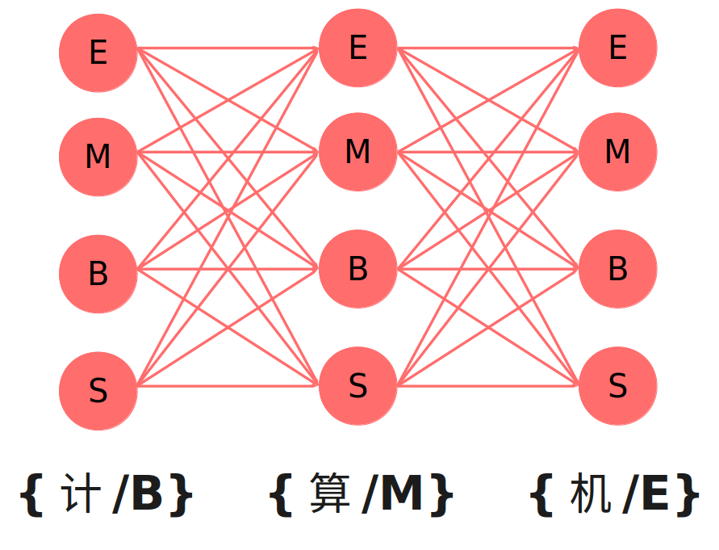
Unsupervised HMM
Issue:
without tagged training data, the result is
just like guessing (accuracy 50%)
Advantage:
inner transition and emission relations

Slide 13
Cost Function (Morfessor)
Word Based Model:
{计/B}{算/M}{机/E}{程/B}{序/E}{语/B}{言/E}
Cost 4
Cost 1
Cost 2
Cost 3
Cost 5
Cost 6

Slide 14
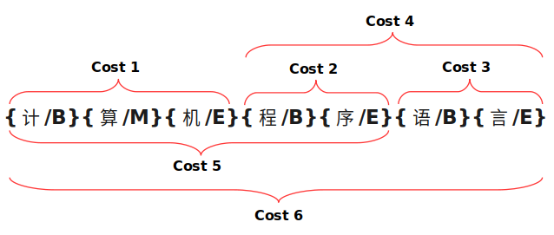
Cost Function (Morfessor)
Issue:
need an initial cookbook (dictionary)
Advantage:
describes the relation between words

Slide 15
Process
Given un-tagged corpus:
1. segment the corpus by HMM.
2. get the cookbook from HMM result.
3. use Cost Function based method
to optimize segmentation result.
4. use result from step 3, get new
transition and emission probability.
segment the corpus again.
5. repeat step 2–4, until converge.

Slide 16
Process
corpus
optimization
by Cost Function
initial seg
by HMM
seg
result
seg
result
converged
optimization
by HMM
final HMM model
and seg result

Slide 17
Current Works

Slide 18
Current Works
1. HMM: use NLTK
2. Cost Function: not finished
3. Combination: not finished

Slide 19
Thank you !

